Slide 1
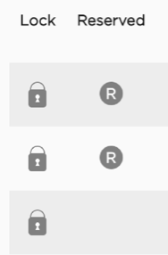
Proposed clearly defined icons for open/closed and reserved, in conjunction with state initials icons
Iconography and layout weren’t intuitive, nor were the color differentiators for different companies
Worked with POs to arrive at this design that more clearly calls out lock status. Result was improved layout, spacing and readability of the screen.

Slide 2
Needed alternate solution to the use of color, as the amount of companies in the list grew larger, thus nullifying the use of color as an effective differentiator.
Designed and proposed 3 versions of well-known initials for company states/names to provide text-based alternative that scales.
Worked with POs to arrive at this design, as it doesn’t rely on color at all, lessening the cognitive load on users. It also provides a meaningful, accessible secondary indicator.

Slide 3
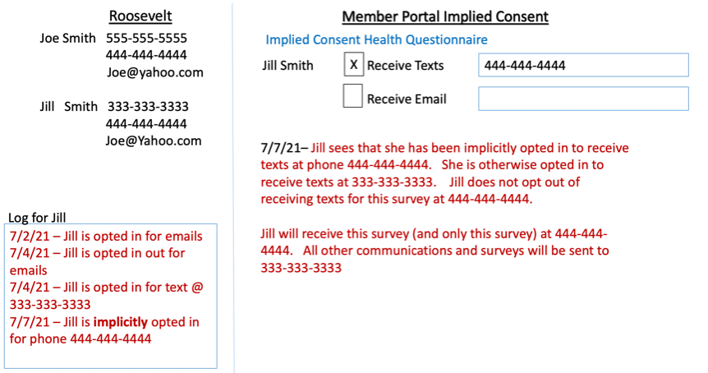
Survey communication options needs to be designed based on simple wireframe and domain knowledge collected from product owner. Screens must reflect screens according to the logic of survey opt-ins, opt-outs and communication option changes.

Slide 4
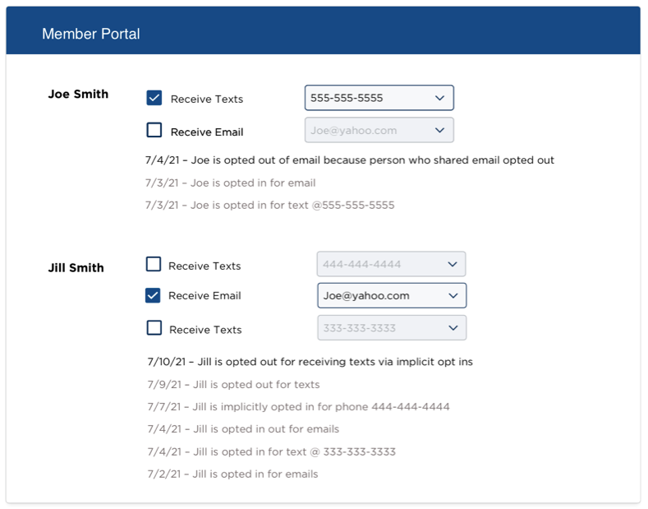
Option 1
Shows both subscriber and dependent in one view and allows for opt-in checkbox selections and the ability to toggle which phone number the customer would like to use for that specific item.

Slide 5
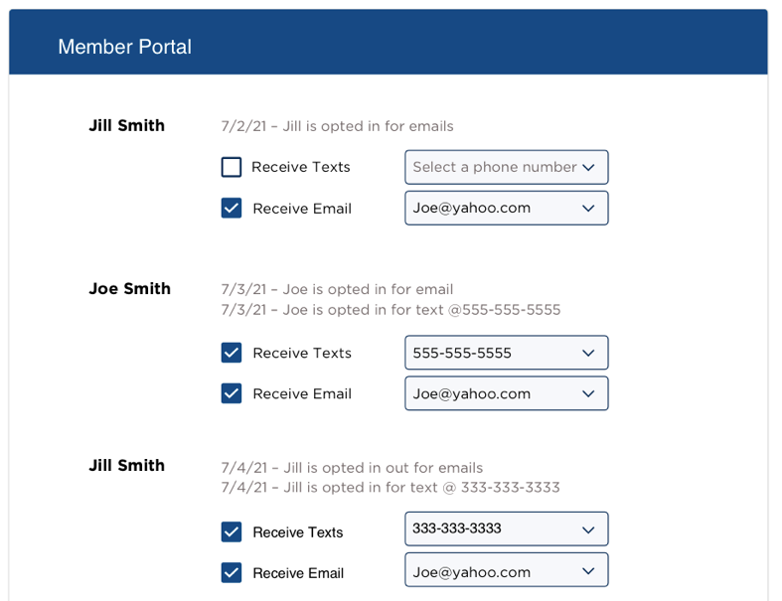
Option 2
Also shows both subscriber and dependent but presents the information in a timeline-style manner, which incorporates the activity log in a more chronological way. It also shows which status the communication options were in at the time of the action.

Slide 6
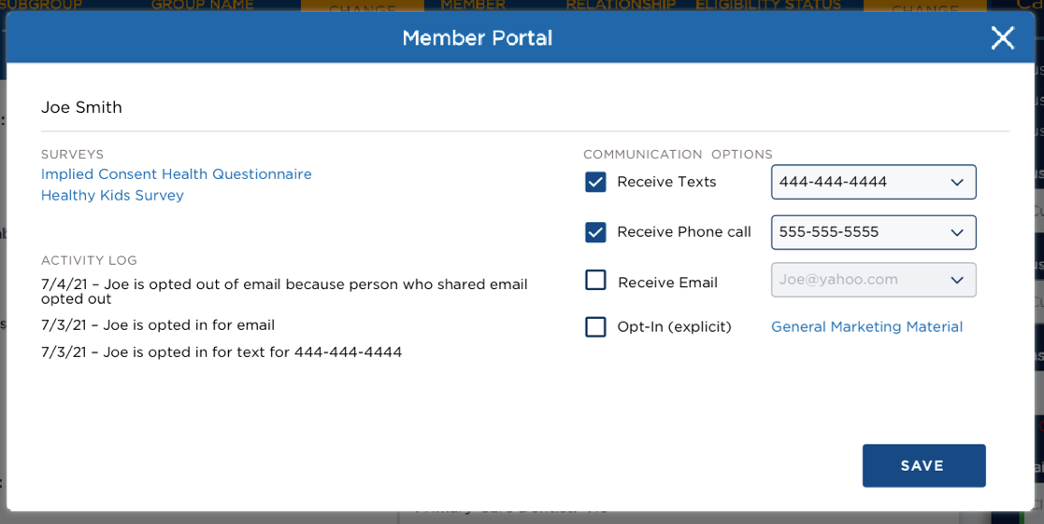
Option 3
This only shows one person at a time, yet includes a more comprehensive single view of the person’s status. Clear section delineation is achieved by subtle increases in spacing. Inline editing available for communication options.

Slide 7
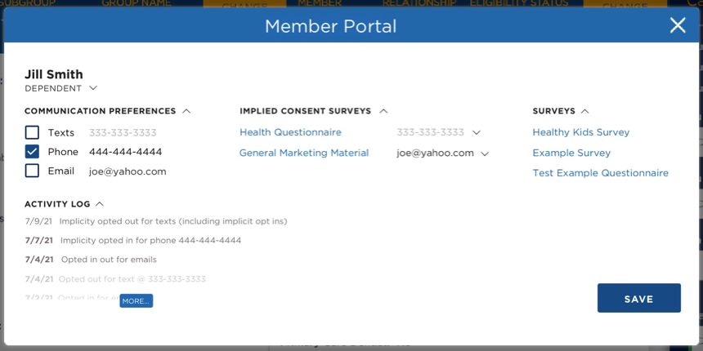
Worked with POs to arrive at this design which incorporates the ability to toggle between subscriber and dependent.
The survey types needed to be easily distinguishable from one another, hence their listing under separate headers.
Selections for new phone/text numbers positioned where the survey itself is visually linked next to the number.
Eliminated traditional select menu dropdown field treatment with a more concise link style text-based dropdown.
To address any real estate concerns, added toggle option to each section to show/hide the items.
Added a ‘more’ button instead of the requested frame-and-scrollbar treatment as a more elegant solution.

Slide 8
border: 5px solid #F3F3F3;
border-radius: 22px;

