Slide 1
COUGAAR Training
12-2004
Tools Demo Sessions
“All Lab, No Lecture”
Okay – a little bit of lecture

Slide 2


Control Surfaces
Two types offered, one for the dedicated command line scripter, one for the casual experimenter
Agent Workbench
  Visual Tools for the general COUGAAR experimenter
ACME
  General plugin extensible O-O scripting framework,
  Experimenter’s catalogue

Slide 3
Agent Workbench
AWB = A lightweight GUI + a little XML

Slide 4
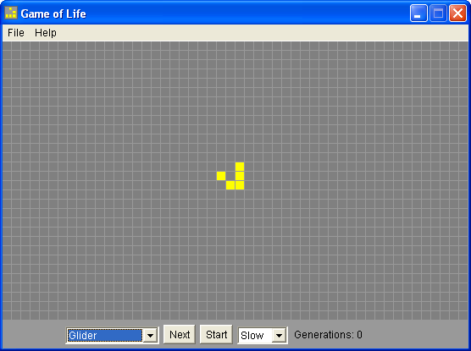
Tutorial Society
COUGAAR implementation of Conroy’s Game of Life (sans GUI)
Interesting example
  Simple to comprehend
  FSA
  Turn taking model w/ lots of inter-agent message passing

Slide 5
COUGAAR Implementation
public final class CellStatusPredicate implements UnaryPredicate;
public class GameMessage;
public class SimpleRelayExample extends ComponentPlugin;
public class GameManagerPlugin extends ComponentPlugin;
public class CellularAutomatonPlugin extends ComponentPlugin;
public class CellStatusServlet extends HttpServlet;
public class MessageCountServlet extends HttpServlet;

Slide 6
Society Model
Society
Host
Node
Agent
Component
Argument

Slide 7
XML Example
<?xml version='1.0'?>
<society name='TINY-1AD-TRANS-STUB'
xmlns,xsi='http,//www.w3.org/2001/XMLSchema-instance'
xsi,noNamespaceSchemaLocation='http,//www.cougaar.org/2003/society.xsd'>
<host name='localhost'>
<node name='1AD_TINY'>
<prog_parameter>
org.cougaar.core.node.Node
</prog_parameter>
<env_parameter>
DISPLAY=AD,0.0
</env_parameter>
<class>
org.cougaar.bootstrap.Bootstrapper
</class>
<vm_parameter>
-Dorg.cougaar.install.path=/usr/local/cougaar
</vm_parameter>
<agent name='1-35-ARBN' class='org.cougaar.core.agent.SimpleAgent'>
<component name='1-35-ARBN|org.cougaar.core.servlet.SimpleServletComponent'
class='org.cougaar.core.servlet.SimpleServletComponent'
priority='COMPONENT'
order='31.0'
insertionpoint='Node.AgentManager.Agent.PluginManager.Plugin'>
<argument order='1.0'>
org.cougaar.planning.servlet.PlanViewServlet
</argument>
<argument order='2.0'>
/tasks
</argument>
</component>
</agent>
</node>
</host>
</society>

Slide 8
GOL Example
<?xml version='1.0'?>
<society name='GameOfLife'
xmlns,xsi='http,//www.w3.org/2001/XMLSchema-instance'
xsi,noNamespaceSchemaLocation='http,//www.cougaar.org/2003/society.xsd'>
<host name='localhost'>
<node name=‘GameNode'>
<prog_parameter>
org.cougaar.core.node.Node
</prog_parameter>
<env_parameter>
DISPLAY=AD,0.0
</env_parameter>
<class>
org.cougaar.bootstrap.Bootstrapper
</class>
<vm_parameter>
-Dorg.cougaar.install.path=/usr/local/cougaar
</vm_parameter>
<agent name='Cell00'' class='org.cougaar.core.agent.SimpleAgent'>
<component name='org.cougaar.core.servlet.SimpleServletComponent'
class='org.cougaar.core.servlet.SimpleServletComponent'
priority='COMPONENT'
insertionpoint='Node.AgentManager.Agent.PluginManager.Plugin'>
<argument>
org.cougaar.planning.servlet.PlanViewServlet
</argument>
<argument>
/tasks
</argument>
</component>
</agent>
</node>
</host>
</society>

Slide 9
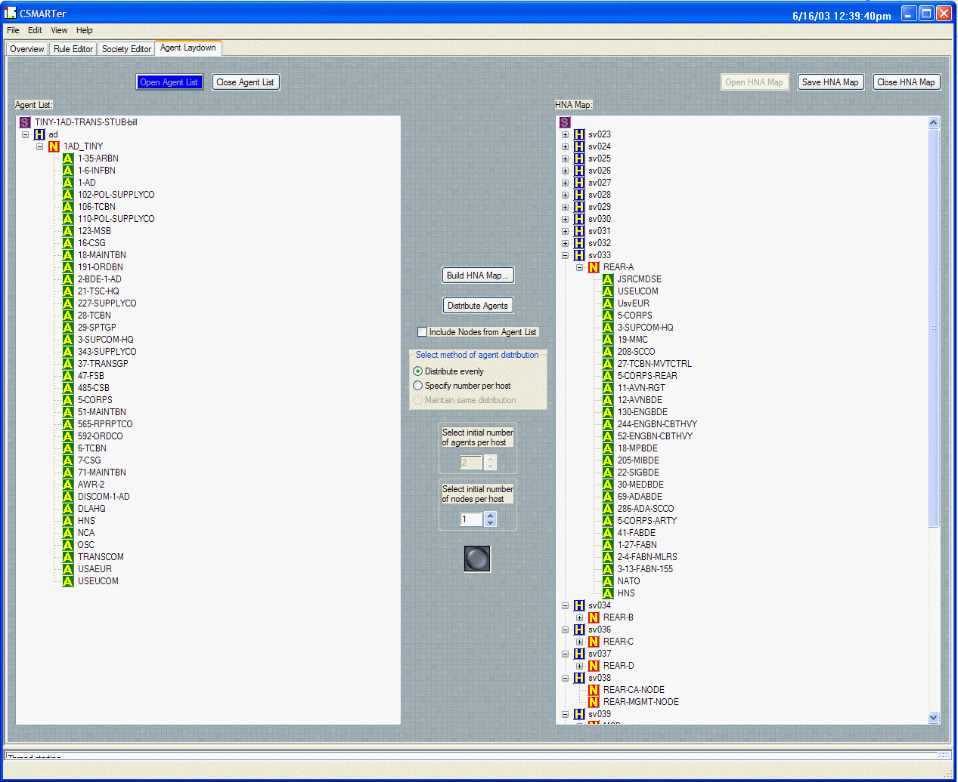
Agent WorkBench
Written in Python, Wx
Runs^{[1]} on Linux, OS/X
Rules are Ruby & Python statements.
  What, no Jscheme?^{[2]}
Generates complete runnable society.
Monitor & Control
Available from CVS
Installer → work in progress ^{[3]}
[1] Python is write-once, run anywhere. (However,) Wx GUI library is write-once, bugfix everywhere that’s not Windows
[2] Question asked at the Lightweight Languages 2003 Conference
[3] User and developer documentation still needed

Slide 10
Agent WorkBench Capabilities

Slide 11
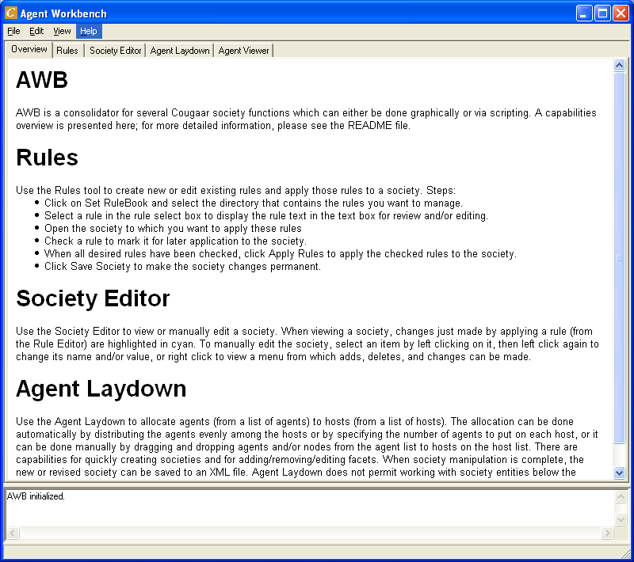
Agent WorkBench Capabilities
Society Editor
Rule Editor
Society Laydown Editor
Society Viewer (M&C)
AWB :== A linked set of tabbed panels for doing the most common/critical operations involved in creating and running COUGAAR societies.
Intended to be self documenting and easily extensible

Slide 12
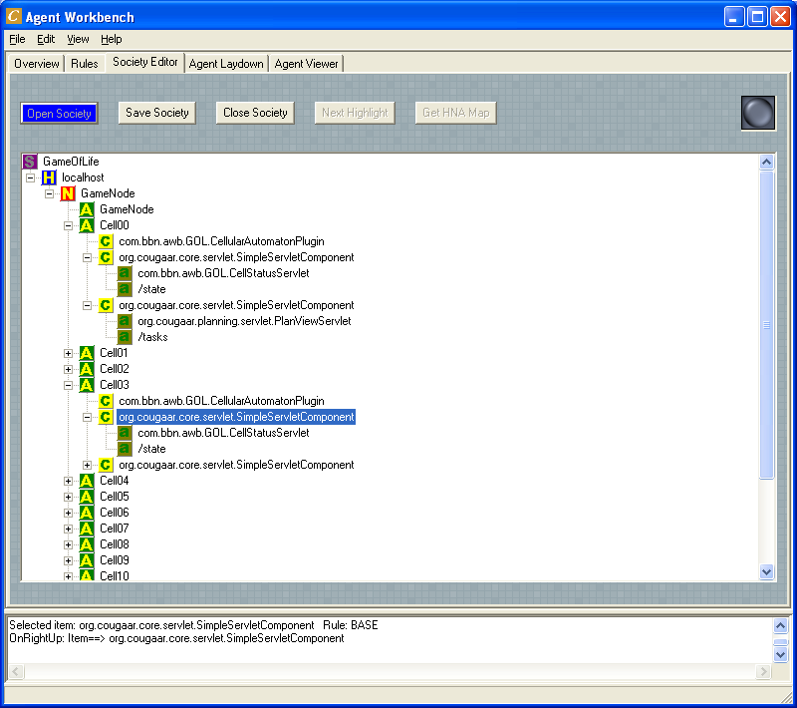
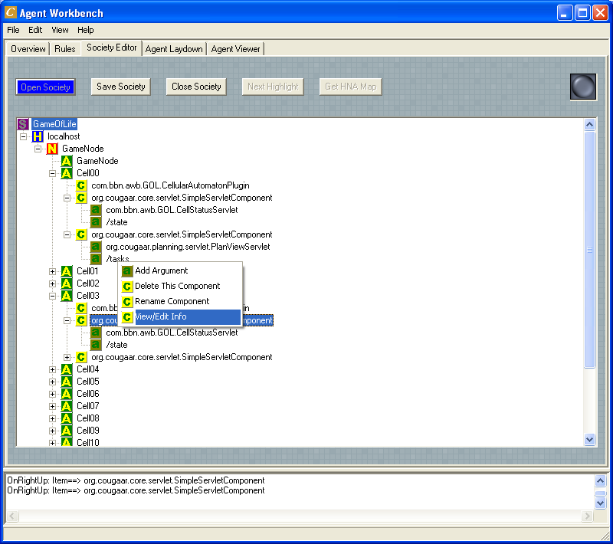
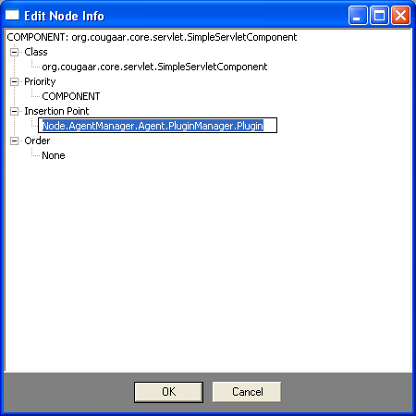
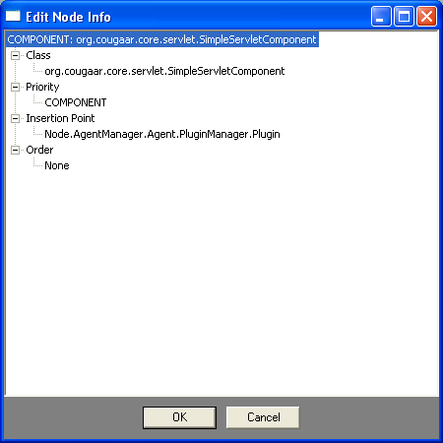
Society Editor

Slide 13
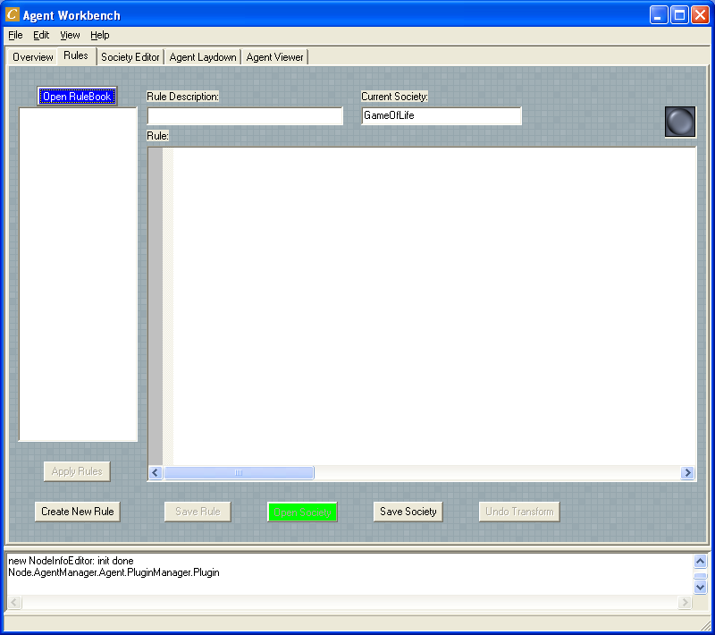
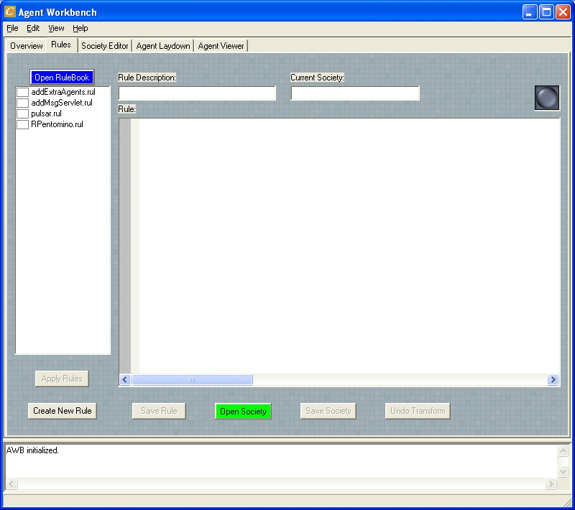
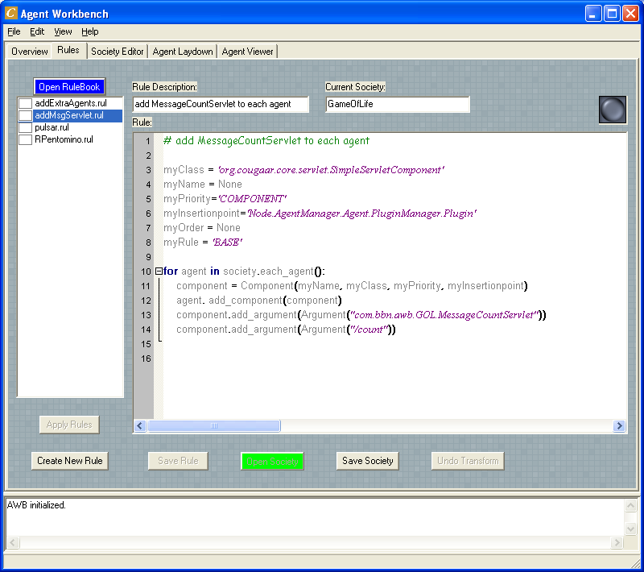

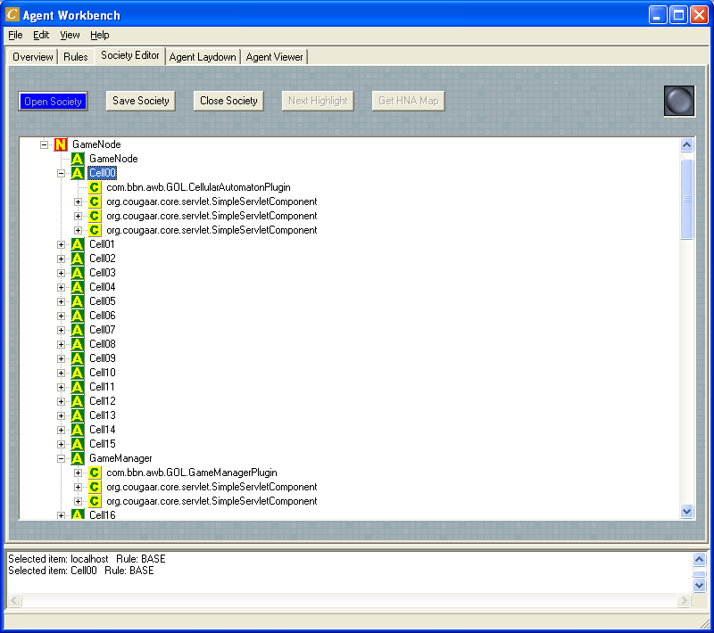
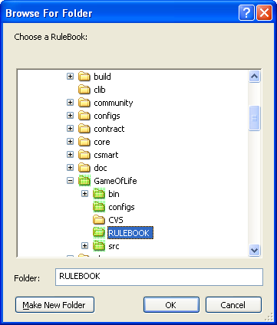
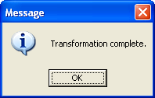
Rule-Based Society Editor

Slide 14
Society Laydown Editor

Slide 15
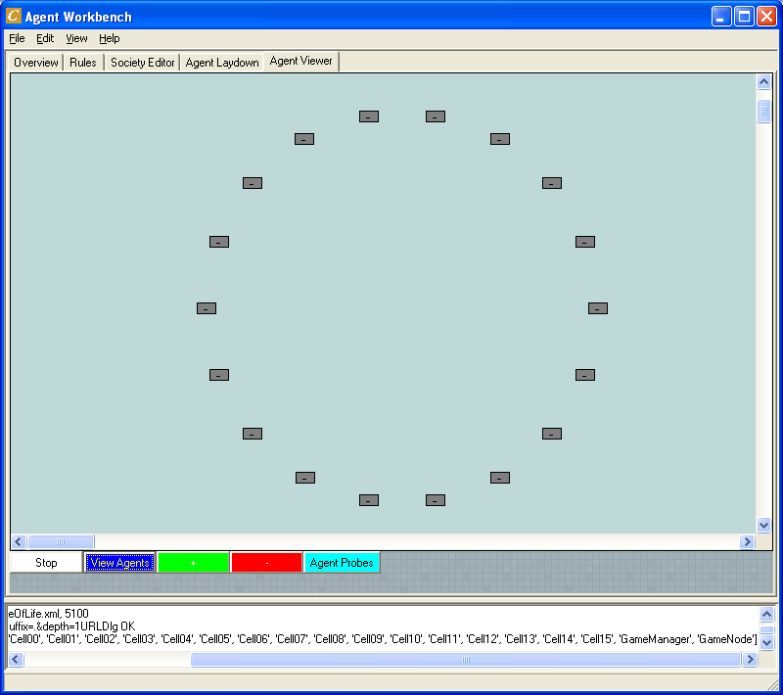
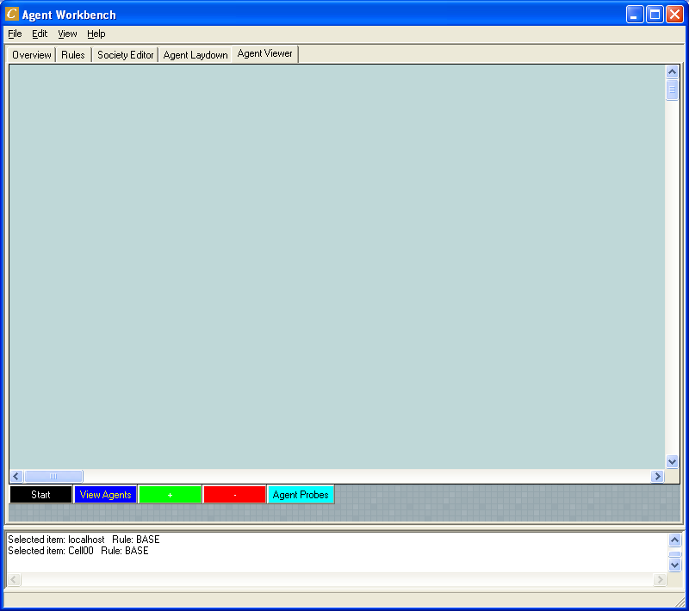
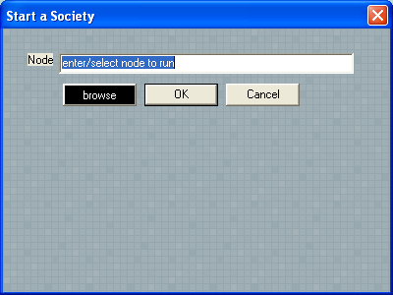
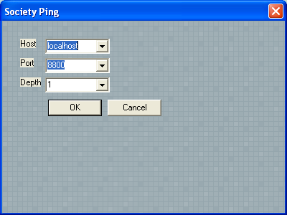
Agent Viewer

Slide 16
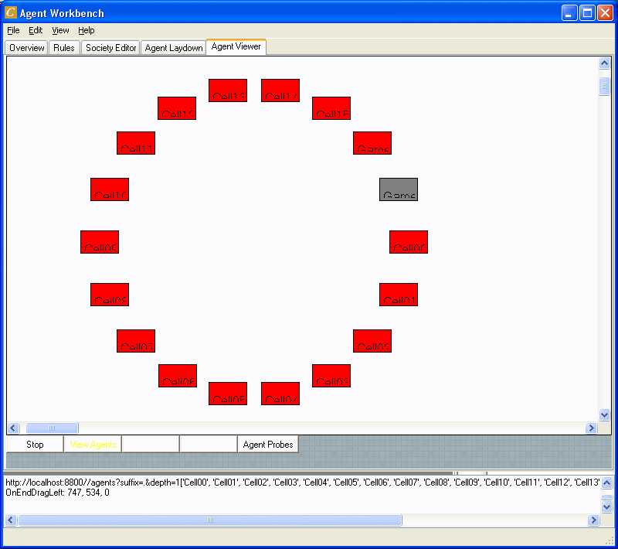
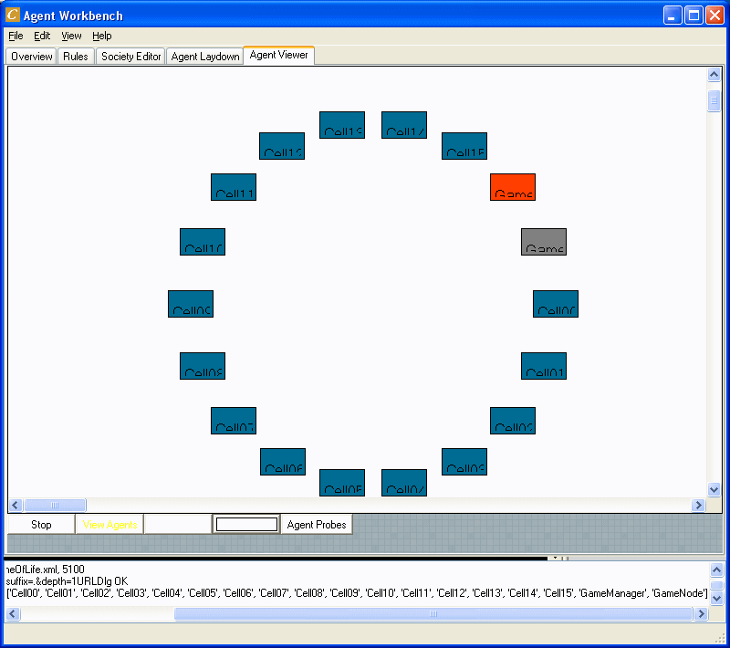
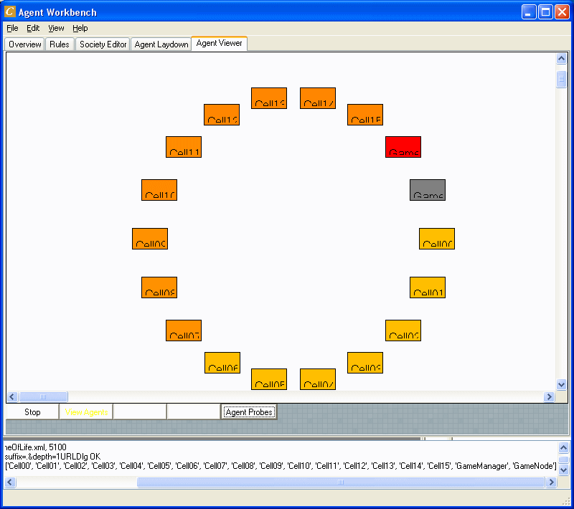
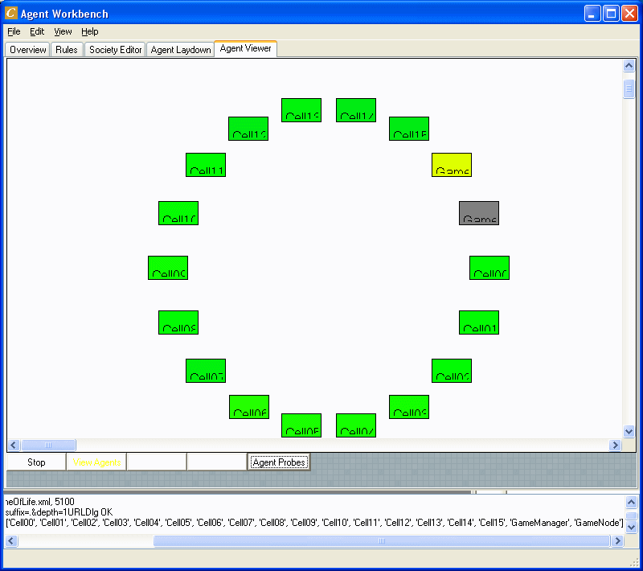
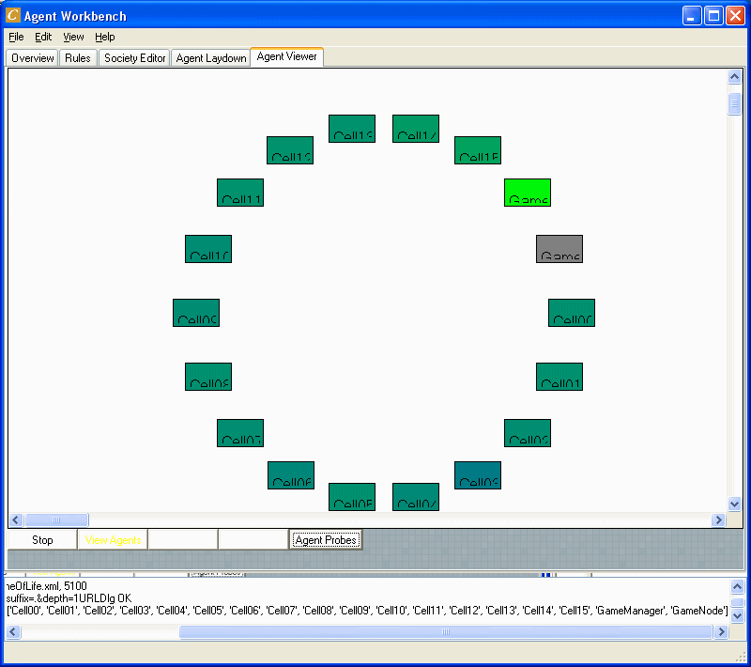
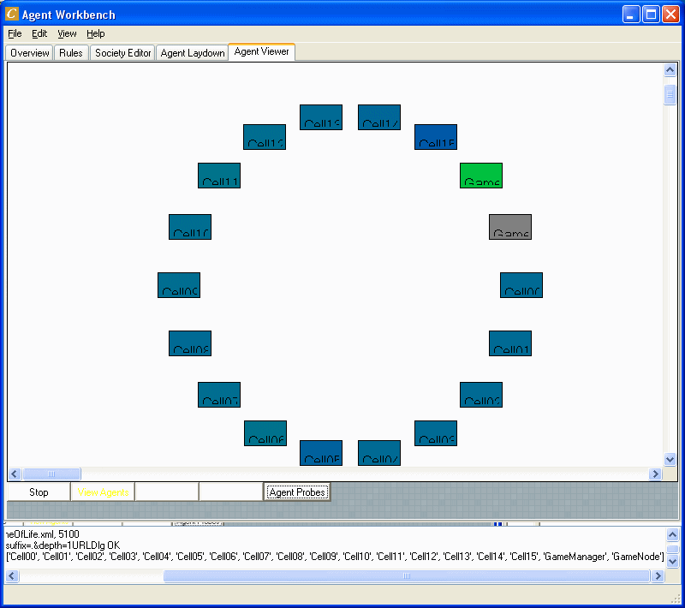
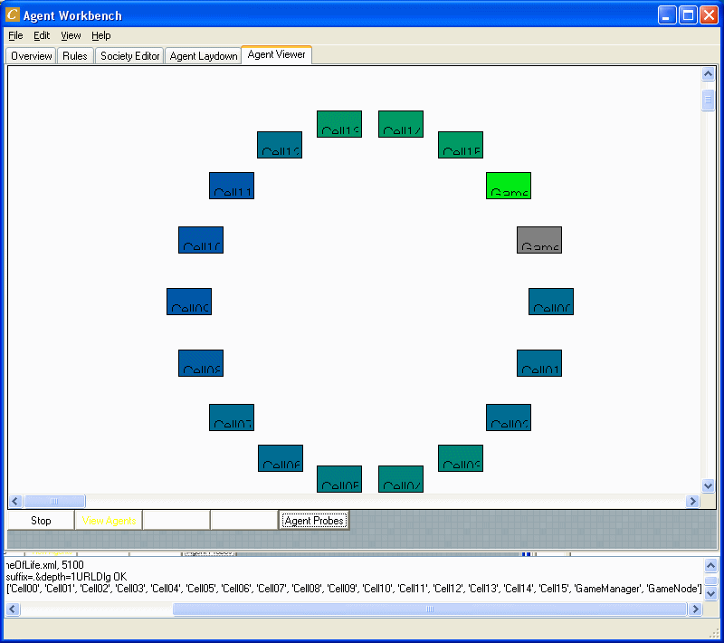
Agent Viewer (2)

Slide 17
DEMO
Agent WorkBench

Slide 18
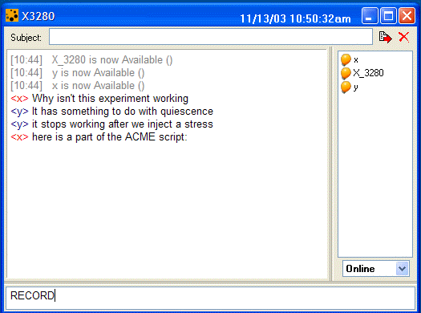
CHUCK (Collaborative Holographic Update Conference Koordinator):
Human
System Under Test
ACME Script
Better way to:
  Record observations
  Add generated test data to the experiment
  Hold real time conferences between developers/testers in the context of an ongoing experiment
  Document problems and fixes

Slide 19

Acknowledgement
This material is based upon work supported by the
Defense Advanced Research Projects Agency (DARPA)
Information Exploitation Office (IXO)
UltraLog ARPA order No. L120/Program Code 1G10
Issued by DARPA/CMO under Contract #MDA972-01-C-0025
Dana Moore
Division Scientist
BBN Technologies
Dana.Moore@bbn.com

