Slide 1
Introduction to Cougaar Programming
Mark Barger
mbarger@bbn.com
January 2004

Slide 2
Agenda
Tuesday
  Introduction
  Plugins
  Assets and Tasks
Wednesday
  Agents
  Task Preferences
  Cougaar User Interfaces
  Dynamic Planning
Thursday
  Expansions and Expander Plugins
  Constraining Tasks
  Execution Monitoring
  Cougaar Design Decisions
Notes:
The course covers the fundamentals of understanding and using the Cougaar architecture to develop agent-based software systems. There are many important topics that will not be covered in depth. Please consult the Cougaar Plugin Developers’ Guide, the Cougaar Architecture Document, and the Cougaar release notes for more information on other topics.

Slide 3
Outline
Tuesday
Introduction 9:00
Plugins 11:00
  Lab Exercise One
Lunch 12:30
Assets 1:30
  Lab Exercise Two
Tasks and Plan Elements 3:30
  Lab Exercise Three
Notes:
Most of the time over the next three days will be spent on the lab exercises. There are ten exercises in which we will apply the Cougaar concepts and software to a simple problem. Each exercise builds on the previous one. The final product is a simple but complete society that does dynamic planning, execution monitoring and replanning in a network of distributed agents.

Slide 4
Outline
Wednesday
Agents 9:00
  Lab Exercise Four
Cougaar User Interfaces 11:00
  Lab Exercise Five
Lunch
Task Preferences 1:00
  Lab Exercise Six
Dynamic Planning 3:00
  Lab Exercise Seven

Slide 5
Outline
Thursday
Expansion 9:00
  Lab Exercise Eight
Constraints 10:30
  Lab Exercise Nine
Execution Monitoring 12:00
  Lab Exercise Ten
Lunch
Cougaar Design Decisions 2:30
  Lab Exercise Eleven

Slide 6
Introduction
Goals of Training
What is Cougaar?
Cougaar Problem Domain

Slide 7
Goals of Training
Show how the Cougaar software can be applied to planning problems.
  To that end, we will cover:
    Cougaar operational concepts
    Cougaar software concepts, classes and patterns
Provide hands-on experience in Cougaar Plugin development
  Configuring the Cougaar software
  Building Cougaar classes (including Plugins)
  Debugging a Cougaar system
Notes:
Each concept will be introduced through this presentation and then reinforced through the lab exercise that follows.

Slide 8
Lab Exercises
Build a simple Cougaar society
  Starting with simple core concepts and adding functionality incrementally
  End product is a real Cougaar society
    It can be distributed across a network
    It does planning, execution monitoring, and dynamic replanning
    Illustrates the core Cougaar software concepts
Notes:
By the end of the class, you will have written several simple Plugins that demonstrate how to use the Cougaar architecture.

Slide 9
Prerequisites
Familiarity with the Windows 2000/NT operating system
  Navigating the filesystem
  Running batch files
  Using a text editor
Java programming
  Creating classes
  Using the standard Java packages
  Debugging
Notes:
The intended audience for this course is Java software developers. No familiarity with Cougaar is assumed, but reading the Cougaar Plugin Developers’ Guide before the course is recommended.

Slide 10
Other Training
Cougaar “fast-start” examples are available on-line
Advanced Cougaar training is available on-line
  “Books On-Line”
Comments and suggestions are welcome
Notes:
Please send comments to alpine-support@bbn.com

Slide 11
Cougaar Resources
www.cougaar.org
  Open-source web site
cougaar-developers@cougaar.org
  Design discussion list. Topics include future implementation approaches, bug fixes, and review of contributed code.
cougaar-information@cougaar.org
  General information concerning the Cougaar project. Announcements of software updates, workshops, and conferences are posted here.
cougaar-help@cougaar.org
  Licensing issues, requests for additional information, and comments about the web site should be directed here.
Notes:
These Internet resources are available for support and updates. Software releases are scheduled to occur quarterly.

Slide 12
What is Cougaar?
The Advanced Logistics Project was a 5-year DARPA program aimed at developing innovative approaches to the domain of military logistics.
The emerging result of that project was a powerful new agent architecture based on the human cognitive model of planning. We have taken this architecture Open Source in what we call Cougaar, the Cognitive Agent Architecture.
The DARPA Ultra*Log project is currently enhancing Cougaar to make it survivable.
  Scalability, Security, Robustness
Notes:
The Ultra*Log project stages annual assessments to measure its progress toward a survivable architecture.

Slide 13
What is Cougaar? [Take 2]
Cougaar is an innovative architecture for designing agent-based distributed computing
Cougaar is a software code base to allow implementing such designs
Cougaar is a methodology, a way of thinking about designing distributed applications
Notes:
This class looks at Cougaar as a software development approach and application development architecture.

Slide 14
Cougaar Problem Domain
What kind of problems are well-suited for Cougaar solutions?
  Hierarchical decomposition of complex tasks
  Integration of distributed separate applications and data sources
  Generation of dynamic plans in face of execution
  Highly parallel applications
  Domains too complex to model monolithically
    Best modeled by emergent behavior of components
Notes:
What are some examples of unsuitable applications?
Simple applications that do not need to communicate with other applications
Monolithic number-crunching applications (although they might be effectively used as part of a larger society)
Others?

Slide 15
Three Scalability Challenges
  As software development projects reach large scales, they confront some very challenging scalability issues:
    Scalability of Execution
      Monolithic solutions often encounter CPU bottlenecks
      Distributed solutions often encounter network bottlenecks
    Scalability of Model
      Monolithic solutions are too difficult or too low fidelity
      Complex object hierarchies are impossible to represent, use and maintain
    Scalability of Development
      Complexities of integration of multiple disparate components
      Development and maintenance of large numbers of components
Notes:
Cougaar addresses these challenges with these approaches:
Bottom-up analysis operating at site of best data ensures model fidelity while enabling model scalability
Development of Plugins allows efficient parallel development of large component-based software systems with low integration costs
Asset/Prototype/Property approach to objects is both globally scalable and locally manageable
We’ll look in more detail at how these approaches are realized later in the course.

Slide 16
Cougaar Overview
Cougaar Operation Concepts
Cougaar Design Concepts
Cougaar Software Configuration

Slide 17
What does Cougaar do?
The essential operation of Cougaar is the generation of plans that represent solutions to sets of requirements
Continually replanning and refining as a result of:
  Availability of resources (assets to handle job)
  Execution monitoring
  Changes to requirements
  Iteratively improving solution from ‘fast feasible’ towards ‘optimal’
Developing and maintaining distributed coordination between agents cooperatively accomplishing complex tasks
Notes:
It’s important to understand that the Cougaar “answer” is not in one place but distributed among all of the agents in the society. Each agent holds the part of the plan that it is responsible for. This is an important design factor in support of scalability.

Slide 18
Cougaar Structures
Java VM
Node
Agent
Agent
Plugin
Plugin
Plugin
Plugin
Plugin
Plugin
Agent
Plugin
Plugin
Plugin
Notes:
Cougaar builds a society of agents to generate its plan, based on a three-tier decomposition
Agents : Essential acting/reacting components within society
Nodes : Platform-level grouping of agents – corresponds to a Java virtual machine
Plugins : Functional modular components from which agents are composed
The layering of the decomposition is the node at the lowest level, with agents operating above that and a set of plugins operating within each agent.
The Cougaar blackboard is a shared distributed document, with each agent holding its piece.

Slide 19
Simple Agent View
Agent
Blackboard
(PLAN)
Publish
Subscribe
Plugins
Message Queue
Notes:
What’s an Agent?
Simply put, an agent is an element of software that can autonomously accomplish tasks for a person or other entity. A Cougaar Agent (previously called a “Cluster”) is an agent that has been given behaviors to model a particular organization, business process or algorithm.
Components of An Agent:
Plugins
Software components that provide behaviors and business logic to the Agent’s operations, and operate by publishing
and subscribing to objects on the blackboard.
Blackboard
The blackboard of a Cougaar Agent distributed by the whole Cougaar society. Each Agent owns its blackboard and its contents are visible only to that
Agent. All sharing of blackboard state is done by explicit push-and-pull of data through inter-Agent tasking
and querying.
Message Queue
Contains messages to and from other Agents.

Slide 20
NodeAgent
Exactly one NodeAgent per Node
  Provides Node-level services
  Created automatically
Acts like regular Agent
  Can add Plugins
    These typically provide Services for Node
  State may be persisted
Has full control over components within Node
  Does not actually contain them
Notes:
NodeAgents allow flexibility in providing Node-level Services by allowing Plugins to be added.

Slide 21
Determining Society Behavior
The behavior of a Cougaar society is the aggregate emergent behavior of all the agents in the society cooperatively working on a set of requirements.
  Plugins give agents their individual behaviors and characteristics
  Agents have roles and relationships with other agents
  Dynamic nature of asset state/availability drives continual execution monitoring and dynamic replanning
Notes:
A Cougaar Society is a collection of cooperating agents
The ‘product’ of a running Cougaar society is the distributed blackboard logically composed from the combination of all blackboards in all agents in all nodes across the society
An agent is the fundamental building block of Cougaar.
An agent represents a complete, discrete functionality with well-defined interfaces
Typically represents a physical entity, organization or algorithm
Agents interact with one another by tasking and responding to tasks
No direct query interface
A node is a collection of agents running in a single JVM
Typically, one node per H/W platform
Agents have no sense of their node, or other co-resident agents
A Plugin is a software module that operates in the context of an agent
Plugins implement a particular Java interface
So what is an Agent? It is a Cougaar agent that has been populated with a set of appropriate plugins such that it is capable of accomplishing some set of business processes (behaviors). Think of your plugins as the Lego building blocks from which you construct an agents behavior, and the behavior is the sum of the coordinated capabilities of the individual plugins.

Slide 22
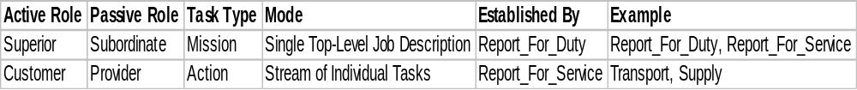
Agent Roles and Relationships
Two fundamental models for relationships between agents
Agents will be in each of these roles at different times
Plugins may be in any or several of these roles at one time
Notes:
Customer / Provider : Actions
Single tasks to be handled, reported on, refined
Thinking in terms of time, cost, quantity
Superior / Subordinate : Missions
Top-level description of your job and how you should do it
Thinking in terms of readiness, risk, danger, customer satisfaction

Slide 23
Agent In Multiple Roles
Superior
Provider Customer
Subordinate
Superior
Customer
Provider
Subordinate
Notes:
This diagram shows an agent (in the center) which is both a superior and a subordinate. It can also be a customer of one agent while also a provider to another agent. These relationships can also change over time – an agent might report to a new superior for example. It is important to always be conscious of the fluid nature of the business processes and especially their evolution over time. Never assume anything in the distributed society is static.

Slide 24
Static Planning
Task Allocations
Strict forward planning: No feedback
Notes:
This is the simplest form of planning and provides no way for the success or failure of the planning to be reported. It is a unidirectional broadcast of a task to the task recipient. What you lose here is the ability to understand failures and problems, as well as being able to negotiate mutually equitable solutions.

Slide 25
Dynamic Planning
Task Allocations
Allocation Results
Rescinds / Reallocations
Negotiate between agents to iteratively improve plan
Notes:
Dynamic planning is a dialog between two agents to arrive at an acceptable plan. Two agents take equal ownership of the solution. If something changes, either is equally vested in refining the solution based on the change – be it requirements from the task originator or constraint problems and execution issues with the task provider. This bi-directional flow of information is also far more supportive of iterative solution development working towards an optimal or near-optimal solution over time.

Slide 26
Dynamic Re-Planning
Self-Assessment
Task Allocations
Allocation Results
Rescinds / Reallocations
Negotiate between agents to iteratively improve plan
Continually recheck assumptions : Constraints, Data, Policies, Metrics
Notes:
An agent that continually rechecks its assumptions in order to improve the plan is carrying out Dynamic re-planning.

Slide 27
Dynamic Re-Planning and Execution Monitoring
Self-Assessment
Task Allocations
Allocation Results
Rescinds / Reallocations
Real-Time
Data Fusion
Data Source
Negotiate between agents to iteratively improve plan
Continually recheck assumptions : Constraints, Data, Policies, Metrics
Updates from data sources as time progresses
Notes:
Agents can also monitor the state of the real world to drive re-planning. We call this execution monitoring. Here you are attempting to map the expectations of the plan and its outcomes to the real world. During the evaluation, deviations beyond acceptable tolerances will trigger changes in either the expectations of future actions of the plan. In some cases, the deviation may be so large as to warrant completely rethinking the solution.

Slide 28
Plugin Functionality
Embody domain knowledge
Continuously executing
Responding to dynamic environment
No dependencies on other Plugins
Publish all relevant information to the blackboard
Expanders
Cougaar
Agent
Data
Allocators
User Interface
Assessors
Notes:
The Cougaar software architecture is a component-based framework for building agents. The components are the Plugins. Plugins do not interact directly with each other by calling each other’s methods or sending messages addressed to particular Plugins. They communicate only through a shared blackboard in each agent.

Slide 29
Plugin Structure
Plugins operate by:
  Publishing additions/changes/deletions to the Agent blackboard
  Defining subscriptions to elements in the Agent’s blackboard
  Being woken up by the Agent infrastructure to execute when one of its subscriptions is satisfied
Plugins should have no internal state : all state should be in the Agent blackboard
Plugins cannot communicate with one another other than through publish/subscribe with blackboard
Plugin operations are asynchronous : they operate only when the agent wakes them with work to do
Plugin operations are order independant
Notes:
Why should Plugins have no internal state? A feature of the Cougaar infrastructure is the ability to recover from a crash to a checkpoint. The infrastructure can save the state of the blackboard to a file or database for recovery but it can’t save Plugin state. In fact, many Plugins do have state, but only caching for efficiency. Don’t save anything in Plugin state that you can’t recreate from the blackboard.

Slide 30
Subscription
A subscription is a mechanism established by a Plugin to receive updates on publishes by other Plugins
  Created by specifying a Boolean UnaryPredicate (test). Examples:
    All tasks whose verb is ‘TRANSPORT’
    All organizations who provide transportation support
  Contains list of elements in Agent blackboard currently satisfying predicate
Notes:
Any object can be published to or subscribed from the blackboard. Some objects like tasks and organizations are recognized and handled by the infrastructure. We will see these objects later in the course.

Slide 31
Subscription (cont.)
With each Plugin invocation, ‘delta’ lists on subscription are filled in with changes relative to previous invocation
  AddedList : All objects satisfying predicate that have been published as Added (new)
  ChangedList : All objects satisfying predicate that have been published as Changed
  RemovedList : All objects satisfying predicate that have been published as Removed (deleted)
Notes:
Some people are confused by the delta lists. They assume that objects stay on the lists until they are read by the Plugin – that’s not how it works. These delta lists are reset at the end of the Plugin’s execution cycle. So an object that is added to the blackboard will appear on the AddedList exactly once and will not remain on the AddedList during future execution cycles.

Slide 32
Publish
Plugins have an interface to allow them to publish changes to the Agent blackboard
  publishAdd
  publishChange
  publishRemove
All changes are done within a transaction as Plugin execute method exits
  Then all Plugin subscriptions are recomputed and execute methods are invoked as appropriate
Notes:
publishAdd inserts a new object into the blackboard.
publishChange notifies other interested Plugins than an object in the blackboard has changed.
publishRemove requests that an object be removed from the blackboard.
Plugins that subscribe to removed object get a chance to see it before it’s removed. Unless objects are publishRemoved from the blackboard they cannot be garbage collected.

Slide 33
Cougaar Software Configuration
Cougaar Java API
Node/agent configuration
Manipulation of the blackboard
Notes:
In this section we will discuss some of the nuts and bolts of how Plugins affect the blackboard.
There are several Cougaar concepts that were inspired by other research. See for example the work on aspect-oriented programming at Xerox PARC. A distributed blackboard architecture is also employed. Cougaar also is very much influenced by component-based design concepts.

Slide 34
Cougaar Java Packages
Planning Classes
  org.cougaar.planning.ldm.asset
    Asset and property group classes
  org.cougaar.planning.ldm.plan
    Plan elements, Task, etc.
Generic Logistics Model (GLM) Classes
  org.cougaar.glm.ldm.asset
    Military logistics assets and property groups
Notes:
The Cougaar software is divided into separate bundles. The core classes contain the infrastructure and is domain-independent. The Planning bundle classes are specific to planning. These used to be contained within the core, but have been separated to allow the core to be more general. The GLM classes were developed to support logistics, including military logistics. We will use some of the GLM classes, but most of the classes we discuss will be core and planning classes.

Slide 35
Plugin Base Classes
Provide access to Cougaar services
  Blackboard, naming, etc….
Provide utility methods
  Publishing and subscribing
Handling transactions
  Handling delta lists, etc.
Notes:
There is an ever-evolving list of Plugin base classes that can be extended to make real Plugins. Consult the Plugin Developers’ guide and the code javadoc for the latest list.

Slide 36
ComponentPlugin
protected abstract void setupSubscriptions()
Called during initialization to set up subscriptions. More precisely, called in the plugin's Thread of execution inside of a transaction before execute will ever be called. A Plugin can have zero or more subscriptions.
protected abstract void execute()
Called inside of an open transaction whenever the plugin was explicitly told to run or when there are changes to any of our subscriptions.
Notes:
We will use ComponentPlugin as the base classes for the lab Plugins. ComponentPlugin only requires the Plugin developer to implement these two methods. It also ensures that transactions are handled appropriately.

Slide 37
The Blackboard Service
protected BlackboardService getBlackboardService()
Can be called by a Plugin to request access to the agent’s blackboard. The blackboard service is used to publish and subscribe to the blackboard.

Slide 38
BlackboardService
protected final boolean publishAdd(java.lang.Object o)
Add an object to the Blackboard.
protected final boolean publishChange(java.lang.Object o)
Mark an element of the Blackboard as changed
protected final boolean publishRemove(java.lang.Object o)
Remove an object from the Blackboard
protected final Subscription subscribe(UnaryPredicate isMember)
Specify objects of interest
Notes:
Subscribe requests a subscription to all objects for which isMember.execute(object) is true. The returned Collection is a transactionally-safe set of these objects which is guaranteed not to change out from under you during execution.
You can also use another version of subscribe() to give it the Collection to use to hold the subscription objects. This might be useful if you had a Collection that did a particular sorting that the Plugin needed.

Slide 39
Subscriptions
UnaryPredicate defines membership of blackboard objects in subscriptions
public interface UnaryPredicate extends java.io.Serializable {
/** @return true iff the object "passes" the predicate */
boolean execute(Object o);
}
public class SomePredicate implements UnaryPredicate {
public boolean execute(Object o) {
return o instanceof Job;
}
}
// setupSubscriptions
IncrementalSubscription sub = (IncrementalSubscription)
getBlackboardService().subscribe(new SomePredicate());
// execute
Enumeration en = sub.getAddedList();
Notes:
Classes implementing the UnaryPredicate interface are used to define the objects of interest to the Plugin. In the example, SomePredicate implements UnaryPredicate and is used to define a subscription of all objects of a particular class. Many predicates use the instanceof operator to select objects of interest.
Note that a predicate is executed whenever an object is added, changed, or removed from the blackboard so they must be very efficient. Have the execute() method return as soon as it determines whether an object matches or not.
Also, note that the return value from subscribe() must be cast to an IncrementalSubscription to access the objects in the subscription.

Slide 40
IncrementalSubscription
Enumeration getAddedList()
  Returns a list of the objects of the collection that have been added since the subscriber’s execute method was last called
Enumeration getChangedList()
  Returns a list of the objects of the collection that have been marked as changed since the subscriber’s execute method was last called
Enumeration getRemovedList()
  Returns a list of the objects of the collection that have been removed since the subscriber’s execute method was last called
Enumeration elements()
  Returns a list of all of the objects in the collection
Notes:
These are the methods of IncrementalSubscription that are most commonly used to access the subscription objects. See the javadoc for more details.

Slide 41
Configuring a Node
ExerciseOneNode.ini:
MyAgent.ini:
cluster = MyAgent
plugin = org.cougaar.tutorial.exercise1.ManagerPlugin
plugin = org.cougaar.tutorial.exercise1.WorkerPlugin
LDMDomains.ini:
glm=org.cougaar.glm.ldm.GLMDomain
Notes:
The file on the left defines the agents in the node. This node has one agent called “MyAgent”
The file on the right defines the Plugins in the MyAgent agent.

Slide 42
Plugin Classes
<<Interface>>
<<Interface>>
<<Interface>>
GenericStateModelAdapter
Object
alarmService
SchedulerService
ServiceBroker
<<Interface>>
(from util)
(from lang)
(from service)
BindingSite
-parameters
(from service)
(from service)
-serviceBroker
(from component)
-alarmService
-scheduler
-bindingSite
<<Interface>>
GenericStateModel
BlackboardClientComponent
(from util)
(from plugin)
-blackboardService
ComponentPlugin
<<Interface>>
<<Interface>>
<<Interface>>
BlackboardService
(from plugin)
BlackboardClient
Component
(from blackboard)
(from component)
(from service)
Notes:
SimplePlugin is in the lower left corner. It’s a pretty complicated object model but you might notice the reference to parameters and ParameterizedPlugin. We won’t cover this in the class, but Plugins can be given parameters in their .ini files. These parameters are often things like database connection parameters or configuration file names.

Slide 43
Exercises Introduction
Two people per computer
Logging into the computer
  Username: “training”
  Password: “training”
  Exercises and references are in C:\Training
%COUGAAR_INSTALL_PATH% is already set
Put all Plugins in the “tutorial” package
  Exercise 1 source goes in C:\Training\exercises\Exercise1
  Exercise 1 ini files go in C:\Training\exercises\Exercise1
Notes:
The environment variable %COUGAAR_INSTALL_PATH% ($COUGAAR_INSTALL_PATH for unix) is used by the Cougaar software to find configuration files and JAR files. It should be set to the directory where the distribution was un-zipped. The COUGAAR_INSTALL_PATH directory should contain directories called “lib” and “sys” among others.

Slide 44
Exercises Introduction
Start with skeleton files *.java, etc.
  Parts needing code marked by
  // todo …
Run.bat can be used to start the Node
Build.bat can be used to compile the code
If you get stuck, look in *.java-with-hints
If you give up, look in *.java.with-more-hints

Slide 45
Resources
Sun JDK 1.4.2
  javac
  java
  core javadoc
  servlet javadoc
Cougaar
  JAR files
  javadoc
  Full source
This presentation
Plugin Developer’s Guide

Slide 46
Exercise 1
Create a Plugin called ManagerPlugin that creates a Job object when it starts. Publish the object to the blackboard. Use System.out to see when the object was published.
Create a Plugin called WorkerPlugin that subscribes to Job objects. Use System.out to see when the subscription is satisfied.
Notes:
If you have the Job class include a String property, you can publish several of them and identify the Jobs on the subscriber end. The skeleton directory for exercise 1 contains such a Job class.

Slide 47
Exercise 1
Manager
Agent
Worker
Publish
Jobs
Subscribe
to Jobs
BLACKBOARD
Notes:
This diagram shows the flow of activity in the exercise agent.
The ManagerPlugin publishes Job objects in its setupSubscriptions method
The WorkerPlugin’s execute method is called when the new objects show up in the blackboard

Slide 48
Exercise 1
Configure the node and agent ini files
Run the Node without Plugins
  Required JAR files: core.jar, xerces.jar
  There is a Run.bat file in the Exercise1 directory
Write and test the two Plugins
  There is a Build.bat file in tutorial/bin
  Create the agent ini files to add your new Plugins
Notes:
You may want to run the node without any Plugins to make sure everything is set up right. It doesn’t do anything interesting, but it will let you know that COUGAAR_INSTALL_PATH and the core software is set up right.

Slide 49
Classes to Write
ManagerPlugin
  Extends org.cougaar.core.plugin.ComponentPlugin
  setupSubscriptions: publishes a Job
  execute: does nothing
WorkerPlugin
  Extends org.cougaar.core.plugin.ComponentPlugin
  setupSubscriptions: creates a UnaryPredicate that matches Job objects
  execute: prints Jobs to System.out
Job (provided)
  Extends any class
  Implements java.io.Serializable
Notes:
These are the three main Java classes to write. Note that the UnaryPredicate can be a public class but it’s usually done as an anonymous inner class. Like this:
private UnaryPredicate somePredicate = new UnaryPredicate() {
public boolean execute(Object o) {
return o instanceof SomeClass; // or other test
}
};

Slide 51
Exercise Notes
What things might a Plugin do in setupSubscriptions besides setup subscriptions?
How does one Plugin know what another Plugin will publish?
Any other issues?

Slide 52
Cougaar Blackboard Objects

Slide 53
Cougaar Blackboard Objects
Assets
Tasks
Plan Elements
Asset
Task
Plan Element
(Allocation)
E
Estimated
AR
R
Reported
AR
Notes:
“Plan Elements” include things like Allocations, Expansions, Aggregations… We’ll look at allocations and expansions in detail later.

Slide 54
Assets
A Cougaar agent maintains sets of Assets, representing real objects to be managed, assigned
Assets typically represent state of real-world objects, e.g. planes, cargo, ammo, books
Special kind of asset is OrganizationalAsset which represents another agent in the society
Notes:
Actually, agents can be represented by assets other than OrganizationalAssets. OrganizationalAssets are used in the military logistics domain to represent agents, but any asset with a ClusterPG property group can represent an agent. We will discuss property groups later in this section.

Slide 55
Challenge of Assets
Large domains contain representations of large numbers of assets
  E.g. 6 Million NSNs in military logistics
  Defy current compiler technology, and configuration management to model each as distinct ‘class’
Notes:
In a distributed execution model, most agents/clusters only care about a limited set of objects
In many domains, many objects are tailored versions of others
E.g. A convertible is a kind of car which is a kind of wheeled vehicle
Assets may be hybrids of different kinds of objects
E.g. A software game is both software and a game and has properties of both. Similarly, a fold-out-couch has properties of both a bed and a couch
Java has limited support for multiple-inheritance

Slide 56
Cougaar Logical Data Model (LDM)
Requirements
  Support over 6 million items (classes)
  Support efficient transport and distribution
  Support modification and extension during execution
Principles
  Things are modeled by their Properties, not what they Are
  Related Properties are collected in Property Groups
  The Class of a Prototype determines the required Property Groups for each Instance
  A Prototype Instance may include additional/modified Property Groups
  Actual Instances delegate their Properties to Prototype Instances
  Actual Instances may refer to specialized Property Groups
Notes:
Prototypes, Dynamic Property Groups and Delegation of behavior
Things are primarily modeled based on their Properties rather than what they Are
Whether a Tanker Truck logically is-a Vehicle or is-a Container, is not relevant as long as it has the Properties of Vehicle and the Properties of a Container
Related Properties are collected in Property Groups
e.g. there are Vehicle Property Groups and Container Property Groups
Instances of Actual things derive their Properties from Prototype Instances
This greatly reduces the number of classes required to represent the Logistics Domain
This allows new types of things to be defined and created dynamically
The Class of a Prototype determines the The Property Groups which must be present in each Prototype Instance
This provides regularity in the normal properties of related things
For example, all Trucks have the CargoCarryingProperty
A Prototype Instance may include additional Property Groups
This provides flexibility in extending the properties of special types of things
For example, a truck with a hoist mounted on it can have the LiftProperty
An Actual Instance may refer to specialized Property Groups which differ from the Prototype
This provides flexibility in specializing the properties of particular instances of actual things. For example, a truck may have degraded speed capability.

Slide 57
LDM Plugins
Populate the blackboard with assets
  Usually done in setupSubscriptions
  Based on external data
Can synchronize with external sources
  publishChange() notifies subscribers
Notes:
LDM Plugins are the wrapper Plugins for non-Cougaar data sources. Most existing examples just read a database and create assets in setupSubscriptions() but more sophisticated ones could monitor the database and reflect changes into the Cougaar assets and reflect the actions of the Cougaar society into the database.

Slide 58
Property Groups
Define sets of logically related properties
  e.g. Vehicle Properties, Container Properties
An asset can possess any property groups
  A truck asset has the properties of a vehicle and a container
Different Plugins may populate different property groups
VehiclePG
<property group>
ContainerPG
<property group>
  double maxSpeedMPH=
  double fuelUseMPG=
  String fuelType=
  double maxWtSTON=
  double maxVolMTON=
Notes:
The class of the asset may define accessors for some property groups, but you can add any property group to any asset.

Slide 59
Asset Property Groups
org.cougaar.planning.ldm.asset.Asset property groups
ItemIdentificationPG
<property group>
TypeIdentificationPG
<property group>
String itemIdentification=
String nomenclature=
String alternateItemIdentification=
String typeIdentification=
String nomenclature=
String alternateTypeIdentification=
Notes:
The class of the asset may define accessors for some property groups, but you can add any property group to any asset.

Slide 60
Assets and Prototypes
Prototypes are special assets that are cached in the agent by name for easy instantiation of assets
  For example, a VCR type of a particular configuration might be a prototype, of which actual VCRs of that type would be Asset Instances
Note that a prototype is not distinguishable from asset, except it is cached/available by name, not necessarily published to the blackboard
Notes:
Prototypes are an important design feature in support of scalability. Many agents have a large set of assets that only differ by something like serial number. By using prototypes, we can have a large number of objects with a rich set of attributes without using a lot of computer memory.

Slide 61
Prototypes, Properties & Instances
Truck
<asset>
VehiclePG
<property group>
ContainerPG
<property group>
NIIN=
VehicleProp=
ContainerProp=
OtherProp()
maxSpeedMPH=
fuelUseMPG=
fuelType=
maxWtSTON=
maxVolMTON=
LDM Classes
Asset Prototypes and
Property Groups
5-Ton Truck
<prototype>
VehiclePG
<instance>
ContainerPG
<instance>
NIIN= 123456999
VehicleProp
ContainerProp
( )
MaxSpeedMPH=50
FuelUseMPG = 13
FuelType=“Diesel”
MaxWtSTON= 6.0
MaxVolMTON= 4.0
ContainerPG
<instance>
MaxWtSTON= 8.0
MaxVolMTON= 6.0
2.5-TonTruck
<prototype>
VehiclePG
<instance>
ContainerPG
<instance>
NIIN= 123456789
VehicleProp
ContainProp
( )
MaxSpeedMPH=50
FuelUseMPG = 15
FuelType=“Diesel”
MaxWtSTON= 3.0
MaxVolMTON= 2.0
Truck-T770
5-Ton Truck
With Long Bed
Truck-T789
5-Ton Truck
Truck-T123
2-1/2 Ton Truck
Asset
Instances
Truck-T789
5-Ton Truck
Truck-T123
2-1/2 Ton Truck
Truck-T789
5-Ton Truck
VIN=“T789”
( )
Truck-T123
2-1/2 Ton Truck
Truck-T789
5-Ton Truck
VIN=“T123”
( )
VIN=“T789”
( )
Truck-T123
2.5-Ton Truck
VIN=“T789”
( )
VIN=“T123”
( )
VIN=“T770”
ContainerProp
VIN=“T789”
( )
VIN=“T123”
( )
VIN=“T123”
( )

Slide 62
Assets API
public ItemIdentificationPG getItemIdentificationPG()
Search additional properties for a ItemIdentificationPG instance.
public void setItemIdentificationPG(PropertyGroup aItemIdentificationPG)
Set the ItemIdentificationPG property.
public final PropertyGroup searchForPropertyGroup(java.lang.Class pgc,
long t)
External api for finding a property group by class at a specific time
Notes:
These are some examples of how property groups are get/set on an asset. Assets have explicitly named property groups (ItemIdentification in this case) but you can also look for a property group of an arbitrary class by using the searchForPropertyGroup method.
Note that property groups can be time-phased but don’t have to be. For example an object might have different dimensions after it has been packed for shipping.

Slide 63
Two More Services
Plugin services can be initialized by the Plugin container using introspection
  It calls Plugin methods setX(X) where “X” is a known service
The Plugin developer implements these methods
public void setDomainService(DomainService aService)
Called by the container to inform a plugin of its domain service
public DomainService getDomainService()
Called by the container to ask a plugin about its domain service
public void setPrototypeRegistryService(PrototypeRegistryService aService)
Called by the container to inform a plugin of its domain service
public PrototypeRegistryService getPrototypeRegistryService()
Called by the container to ask a plugin about its domain service

Slide 64
The PlanningFactory API
DomainService.getFactory(“planning”) returns a PlanningFactory
public PropertyGroup createPropertyGroup(java.lang.String propertyName)
create a new property group, given a PropertyGroup name. The name should not have any package prefix and should be the cannonical name (not the implementation class name).
public void addPropertyGroupFactory(java.lang.Object pf)
register a propertyfactory with us so that short (no package!) property group names may be used in createPropertyGroup(String).
public Asset createPrototype(java.lang.Class assetclass, java.lang.String typeid)
convenience routine for creating prototype assets. does a createAsset followed by setting the TypeIdentification to the specified string.
public Asset createInstance(java.lang.String prototypeAssetTypeId)
Create an instance of a prototypical asset.
public Asset createInstance(Asset prototypeAsset)
Create an instance of a prototypical asset.
Notes:
The PlanningFactory is used to create asset and PropertyGroup objects rather than the “new” operator. This allows the infrastructure to track these objects and make sure they are managed properly.

Slide 65
The PrototypeRegistryService API
The PrototypeRegistryService stores prototype assets for reuse
public void cachePrototype(java.lang.String aTypeName, Asset aPrototype)
Request that a prototype be remembered by the LDM. Note that the lifespan of a prototype in the prototype registry may be finite (or even zero!).
Notes:
Plugins can also register themselves to be “prototype providers.” Prototype providers are called by the LDM when a prototype was requested.
From PrototypeRegistryService:
public void addPrototypeProvider(PrototypeProvider prov)

Slide 66
Cougaar Class Naming Convention
Many Blackboard object classes are represented by two interfaces and an implementation class
For example
  Task
    A read-only interface (only getters)
  NewTask
    Adds a write interface (setters) to Task
  TaskImpl
    The actual implementation class. Implements both Task and NewTask
Notes:
Most (but not all) Cougaar core classes follow this convention.

Slide 67
For Example…
PlanningFactory factory = (PlanningFactory)getDomainService().getFactory(“planning”);
factory.addPropertyGroupFactory(new tutorial.assets.PropertyGroupFactory());
ProgrammerAsset new_prototype = (ProgrammerAsset)factory.createPrototype (tutorial.assets.ProgrammerAsset.class, "ProgrammerProto");
NewItemIdentificationPG new_item_id_pg = (NewItemIdentificationPG)factory.createPropertyGroup("ItemIdentificationPG");
new_item_id_pg.setItemIdentification("Prototype Name");
new_prototype.setItemIdentificationPG(new_item_id_pg);
prototypeRegistry.cachePrototype("ProgrammerProto", new_prototype);
ProgrammerAsset asset = (ProgrammerAsset) factory.createInstance("ProgrammerProto");
new_item_id_pg = (NewItemIdentificationPG)factory.createPropertyGroup("ItemIdentificationPG");
new_item_id_pg.setItemIdentification("Instance Name");
asset.setItemIdentificationPG(new_item_id_pg);
publishAdd(asset);
Notes:
Get the planning factory from the domain service
Registers a property group factory with domain service so we can create property groups by name rather than by class. Not required but it makes things convenient.
Creates a prototype asset of class tutorial.assets.ProgrammerAsset named “ProgrammerProto” and sets the type identifier to “ProgrammerProto”
Creates a new ItemIdentification property group by name. Note the use of the New*** class naming convention.
Sets a property of the ItemIdentificationPG
Sets the prototype asset’s ItemIdentificationPG
Registers the prototype asset with theLDM using the name “ProgrammerProto”
Creates an instance asset based on the prototype named “ProgrammerProto”
Creates another ItemIdentificationPG
Sets a property of the ItemIdentificationPG
Sets the instance asset’s ItemIdentificationPG – overriding the prototype
Publishes the asset for other Plugins to see and use

Slide 68
Viewing the Blackboard
Notes:
Before we try making some assets we will look at how you can inspect the Cougaar Blackboard to know what’s there.

Slide 69
Viewing Cougaar Outputs
The genuine product of Cougaar is the blackboard in each running agent
Cougaar provides a standard service to serve as an HTML/XML server for selected Blackboard contents
Cougaar provides a standard debug UI
  Browser/HTML-based hierarchical/table viewer of Blackboard objects based on coarse/canned queries
    http://localhost:8800/tasks
Based on Apache Tomcat server

Slide 70
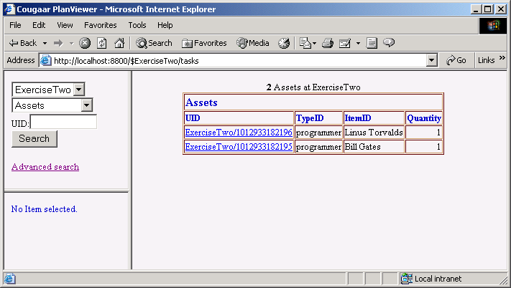
Browser-based Debug UI

Slide 71
Exercise 2
Create an LDM Plugin to create Programmers using prototypes.
Use the /tasks tool to view the Programmer assets.

Slide 72
Exercise 2
LDM
Plugin
Agent
Data Source
Publish
Programmer
Assets
BLACKBOARD
Prog
Prog

Slide 73
Classes to Write
ProgrammerAsset
  Generated from programmer_asset.def and properties.def in tutorial/assets
ProgrammerLDMPlugin
  Extends org.cougaar.core.plugin.ComponentPlugin
  setupSubscriptions: creates and publishes some programmer assets
  execute: does nothing

Slide 74




Generated Classes
TypeIdentificationPG
ItemIdentificationPG
typeIdentification : String
Asset
itemIdentification : String
nomenclature : String
nomenclature : String
alternateTypeIdentification : String
alternateItemIdentification : String
SkillsPG
LanguagePG
yearsExperience : int
ProgrammerAsset
knowsJava : boolean
SLOCPerDay : int
knowsJavaScript : boolean
Notes:
This diagram shows the programmer asset class and associated classes created by the asset writer operation. The TypeIdentificationPG (property group) and the ItemIdentificationPG are present on all assets. The SkillsPG and LanguagePG are property group classes generated from the .def files in the tutorial/assets directory. The Schedule object will be used in later exercises to keep track of what this programmer is doing each month.

Slide 76
Exercise Notes
Using property groups is clumsy. Is it worth the effort?
How many assets might a real agent use? How much benefit is there in the prototype asset system?
Any other issues?

Slide 77
Cougaar Tasks

Slide 78
Human Cognitive Process
When we try to solve a problem, we invoke several strategies over and over
  Decomposing : Break a problem into smaller sub-problems
  Delegating : Give some problem to a resource to solve
  Consolidating : Take a number of independent pieces and handle them as a single problem
  Monitoring : Continually checking to make sure things are proceeding as planned, and correcting/reacting accordingly
  Gathering : Get information from outside world
  Reporting : Report back to outside world
  Acting : Perform some action that impacts with real entities in real-time

Slide 79
What do Plugins do?
Plugins should be designed to model some step in the Human Cognitive Process
  Allocator (Delegating) : Allocate tasks to appropriate resources for final handling or further disposition
  Expander (Decomposing) : Break down task into a workflow of sub-tasks
  Aggregator (Consolidating) : Join a set of tasks into a single super-task
  Assessor (Monitoring) : Assess blackboard for internal consistency, and force replanning when necessary
  LDM Plugin (Gathering) : Read new/changed information from external data sources
  UI Plugin (Reporting) : Provide external user interface
  Execution (Acting) : Interact with external entities, objects, systems

Slide 80
Tasks
The fundamental element on which Cougaar operates is a task. A task represents a requirement to do or plan something.
  Verb
  Direct Object
  Prepositional Phrases
  Preferences
Notes:
We will look at verbs and direct objects now; prepositions and preferences later.

Slide 81
Verbs and Direct Objects
Each task has a verb
  The action to be planned/performed
Each task may have a direct object
  The asset to which the task refers
For example
  TRANSPORT :: A Tank
  SUPPLY :: Sandwiches
  REPORT_TO :: An Organization
Notes:
There is a class of asset called “AbstractAsset” that is often used as a direct object if the direct object is more conceptual than physical.

Slide 82
PLAN Elements
Each agent maintains a blackboard consisting of plan elements:
  Allocation
  Expansion
  Aggregation

Slide 83
Allocation
Plan Element
(Allocation)
E
Estimated
AR
Task-1
R
Reported
AR
Asset
Notes:
An allocation is a Cougaar plan element representing the assignment of a task to a particular asset
Represents ‘leaf’ of planning tree
Allocation of a task to OrganizationalAsset causes that task to be sent to the associated agent for further processing
Expansion/Allocation process continues

Slide 84
Expansion
Plan Element
(Expansion)
E
Estimated
AR
Task-1
R
Reported
AR
Workflow
Subtask-1.1
Subtask-1.2
Notes:
An Expansion is a Cougaar plan element that represents a decomposition of a task into subtasks
Contains a workflow representing the subtasks
Potentially contains constrained interrelations among subtasks
E.g. sub-Task1 must finish before sub-Task2 starts
What is a real-world example of a task expansion?

Slide 85
Aggregation
Task-1
Task-2
Plan Element
(Aggregation)
Plan Element
(Aggregation)
Composition
Task-3
Notes:
An Aggregation is a Cougaar plan element that represents the merging of separate tasks into a single task
Contains a ‘Composition’ representing the incoming tasks and their mapping to an outgoing task
Inverse of an Expansion
What is a real-world example of a task aggregation?

Slide 86
Plan Hierarchical Structure
A complete plan is a hierarchical decomposition of a set of tasks
For every task, either
  Allocate task to an asset
  Expand tasks to sub tasks
Tasks Allocated Assets
Compile Proposal
Gather Team
Setup Manager’s Meeting Person-A
Schedule Kickoff Person-B
Prepare to Write
Research Competition Person-A
Research Customer Person-B
Design Technical Approach Person-C
Write Proposal
Write Section 1 Person-B
Write Section 2 Person-C
Write Section 3 Person-C
Process Document Person-D
Ship Document Person-D
Notes:
You can navigate this structure using the /tasks servlet

Slide 87
Creating Tasks
In PlanningFactory
public NewTask newTask()
create a new Task object
public Plan getRealityPlan()
Return a reference to the the plan object which represents "reality" in this agent.

Slide 88
Manipulating Tasks
Task Methods
Creating a Verb
public void setPlan()
The plan this task is attached to
public void setVerb(Verb aVerb)
The setVerb method sets the verb of the Task. For example, in the Task "fuel vehicles...", the Verb is the object represented by "fuel".
public static Verb get(java.lang.String vs)
Create or retrieve a verb with the string given.

Slide 89
Abstract Assets
Used to represent conceptual assets
  Capacities, projects, etc.
Use as the direct object for the task
Asset what_to_code = factory.createPrototype("AbstractAsset", "The Next Killer App");
// Now I can set property groups as on any asset
new_task.setDirectObject(what_to_code);

Slide 90
Creating The Allocation
In PlanningFactory
public Allocation createAllocation(Plan aPlan, Task aTask, Asset anAsset, AllocationResult estimatedresult, Role aRole)
Build a new Allocation (planelement)
Parameters:
aPlan - - The Plan this PlanElement is against
aTask - - The Task being disposed
anAsset - - The Asset that the task is being assigned to.
estimatedresult - - allowed to be null
aRole - - The role of the Asset while performing this Task.

Slide 91
For Example…
Creating a task
Making an allocation
NewTask new_task = factory.newTask();
new_task.setVerb(Verb.get("CODE"));
new_task.setPlan(factory.getRealityPlan());
Allocation allocation = factory.createAllocation(task.getPlan(), task, asset, null, Role.ASSIGNED);

Slide 92
Exercise 3
Incorporate the Programmer LDM Plugin from exercise 2 to create programmer assets.
  This class is provided
Modify the ManagerPlugin from exercise 1 to create “CODE” tasks and publish them.
  Use an AbstractAsset for the direct object
Create an Allocator Plugin that subscribes to “CODE” tasks and programmer assets and allocates the tasks to programmer assets.
Use the /tasks servlet UI to view the tasks and allocations.

Slide 93
Exercise 3
Allocator
LDM
Plugin
Manager
Data Source
Publish
Allocations
Subscribe
to Tasks and
Programmers
Publish
Tasks
Publish
Programmer
Assets
BLACKBOARD
Prog
Prog

Slide 94
Classes to Write
ManagerPlugin
  Publish “CODE” tasks
ManagerAllocatorPlugin
  setupSubscriptions : Subscribe to tasks with verb “CODE” and programmer assets
  execute : allocate the CODE tasks to programmer assets

Slide 96
Exercise Notes
How would you decide on the vocabulary of verbs and direct objects?
Any other issues?

Slide 97
Outline
Wednesday
Agents 9:00
  Lab Exercise Four
Cougaar User Interfaces 11:00
  Lab Exercise Five
Lunch
Task Preferences 1:00
  Lab Exercise Six
Dynamic Planning 3:00
  Lab Exercise Seven

Slide 98
Splitting the Agent
What is involved in taking the Plugins and moving them into separate agents?
  How do agents know about each other?
  How do we task another agent?
  How does the response flow back from one agent to another?

Slide 99
Inter-agent Communication
Agents are represented by organization assets in the military logistics domain
  Other assets can represent agents in other domains
Allocating a task to an organization causes it to be copied into the blackboard of the other agent
Standard Cougaar Plugins manage organizational assets
  org.cougaar.mlm.plugin.organization.OrgRTDataPlugin
  org.cougaar.mlm.plugin.organization.OrgReportPlugin

Slide 100
Cougaar Organization
Management Plugin
Creates copy of ‘self’ Organization in local blackboard
Creates copy of ‘superior’ Organization in local blackboard, and copies ‘self’ as subordinate into agent of superior
Agent A
Agent B
Org B
[Superior]
Org B
[Self]
Org A
[Self]
Org A
[Subordinate]
Transfer Copy of Self
as Subordinate
Notes:
The organization management Plugins and the Organization asset are in the “GLM” part of the Cougaar software. The GLM is distributed with its own JAR file.

Slide 101
Inter-Agent Data Flow
By allocating a task to an Organization Asset, a copy of the task is automatically put in blackboard of the associated agent
  New task knows what agent it came from

Slide 102
Agent Relationships
Read from <agent_name>-prototype-ini.dat
Specifies relationships
  Superior/Subordinate
  Supported/Supporting (Customer/Provider)
Specifies roles
  The set of capabilities of an organization
Specifies identifiers
  The name(s) by which the organization is known

Slide 103
A Prototype-ini.dat File
[Prototype] Organization
[UIC] "Development"
[Relationship]
Supporting "Management" "SoftwareDevelopment"
[TypeIdentificationPG]
TypeIdentification String "UTC/RTOrg"
Nomenclature String "Software Development"
AlternateTypeIdentification String "Bob's Department"
[OrganizationPG]
Roles Collection<Role> "SoftwareDevelopment, CoffeeDrinking"

Slide 104
A Prototype-ini.dat File
Base class for Org asset (from org.cougaar.glm.ldm.asset)
Relationship
“Supported” (denoting my customer)
OR
“Superior” (denoting my boss)
Unique identifier for the organization
(often the same as the agent name)
Role (capability) offered to
the customer
Agent name of the related cluster
[Prototype] Organization
[UIC] "Development"
[Relationship]
Supporting "Management" "SoftwareDevelopment"
[TypeIdentificationPG]
TypeIdentification String "UTC/RTOrg"
Nomenclature String "Software Development"
AlternateTypeIdentification String "Bob's Department"
[OrganizationPG]
Roles Collection<Role> "SoftwareDevelopment, CoffeeDrinking"
Specifies relations with other agents
Defining a PropertyGroup
List of this org’s Role information

Slide 105
Threading Models
Selected by calling chooseThreadingModel()
  In SimplePlugin
  Must be called in Plugin constructor or load()
  Options are SHARED_THREAD or SINGLE_THREAD
This feature is currently under
revision and is unavailable
Notes:
The threading model defines how Plugins are mapped to Java threads. The two main choices are
The Plugins all share a thread (SHARED_THREAD). This means that one Plugin’s execute method must complete before another can start. This is the default behavior.
Each Plugin has its own thread (SINGLE_THREAD). So more than one Plugin can be executing at a time. The SINGLE_THREAD model is good for Plugins that take a long time in their execute() methods either because of computation load or delays accessing external data. It allows other Plugins to run.
You can also define your own threading model. See the javadoc for PluginAdapter for details.

Slide 106
Persistence
Stores all agent blackboard data periodically
  Uses Java serialization
  Can store to files or a database
  Significant performance impact
Allows agents to restore themselves to a previous consistent state.
Notes:
Works by storing the blackboard state whenever the agent interacts with another agent. This allows an agent to go away (crash) and come back to the place it left off with regard to other agents in the society. The operating principle is “An agent can do whatever it wants as long as no other agent can see.”
For agents that interact with non-Cougaar systems transactional integrity becomes an issue. You need to synchronize the persistence epochs with the updates of the external systems. Using the database persistence (rather than files) can let you piggyback on the commit/rollback features of the database to control transactional integrity.
See the Cougaar architecture document for details. Contact cougaar-help@cougaar.org if you need help with this.

Slide 107
Wrapping
The process of making the resources of a non-Cougaar system available to a Cougaar society
  Databases
  Algorithms
  User interfaces
Notes:
The ability to use the functionality and data that exist in non-Cougaar systems is an important Cougaar design goal. One of the simplest and most common wrapping operations is populating an agent’s assets from a database or XML files.

Slide 108

Component Model
Node
Agent
Message Transport
Plugin Manager
Blackboard
Servlet Manager
Plugin
Logic Provider
Servlet
Notes:
A Component Model describes how modular software Components relate to each other: How one
Component may contain another, and how one Component may request services from another.
Cougaar adds an additional layers of insulating objects in between each pair of interacting Components: Binders between
parent and child Components, ServiceProxies between server and client objects. These insulating objects
may be anything from simple forwarding objects, merely delegating calls to higher-level objects, or may
implement arbitrarily complex adaptive behavior. Furthermore, all interaction between a Component and
higher levels of the Component hierarchy are mediated at some point by the Binder, so arbitrary levels of
security, auditing or adaptation may be implemented.

Slide 109
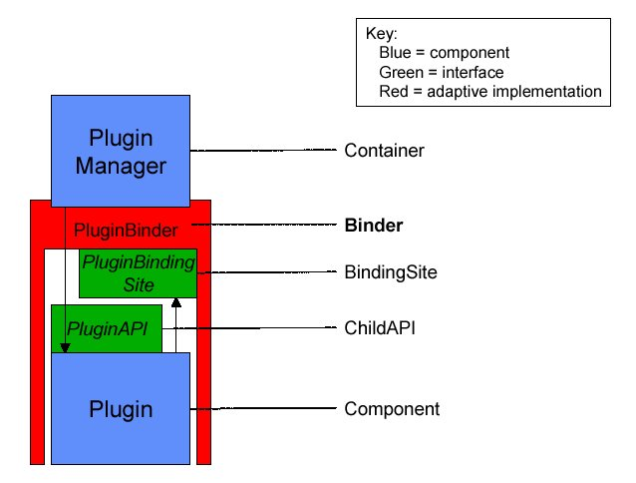
Binders
Notes:
A Binder is an object which acts as a proxy for a Component’s parent container. The Binder is an object
implementing a BindingSite on behalf of a parent Container for use by one of its child components.
Typically the BindingSite offers services to the child component and it protects the parent from the child.
The parent component will often delegate child management duties to the associated Binders.
Binder implementations will often have privileged access to facilities offered by the Container which are
not directly available to the child.

Slide 110
Exercise 4
Separate the Manager into a separate agent from the Programmer LDM Plugin. Call the agents “Management” and “Development”
The Development agent will be a supplier for the Manager agent. Role is “SoftwareDevelopment”
Create an allocator in the Development agent to allocate the incoming CODE tasks to programmer assets. Add the allocated task to the ProgrammerAsset’s Schedule object in the next available month.
Modify the ManagerAllocator to allocate to the development organization rather than individual programmer assets
View the results with the /tasks servlet.

Slide 111
Exercise 4
2) Task transmitted
by infrastructure
3) Allocator
subscribes
to new tasks
4) Allocator allocates
to programmer assets
1) Allocate to
Organization
Asset
Manager
(Allocator)
Allocator
LDM
Plugin
Data Source
BLACKBOARD
CODE Tasks
BLACKBOARD
Org
Org
Prog
Management
Supported
Supporting
Development

Slide 112
Classes to Write
DevelopmentAllocatorPlugin
  setupSubscriptions : subscribe to CODE tasks and programmer assets
  execute : allocate tasks to programmer assets

Slide 114
Exercise Notes
Why would you want to divide Plugins into more than one agent?
Any other issues?

Slide 115
Cougaar User Interfaces

Slide 116
Options
Java UI components (Swing/AWT)
  Not thread safe
  Display tied to the same computer as the UI Plugin
HTTP-based UI
  Browser or thin client UI
  Scalable
  Supported by Cougaar servlet component model

Slide 117
Cougaar Servlets
Provide external visibility and control over blackboard objects
Accessed using HTTP
Addressed by URL
http://<hostname>:8800/$<agentname>/<path>/<name>?<args>

Slide 118
Built-in Servlets
http://localhost:8800/
  Generate a simple help page, plus links to some of the built-in servlets
http://localhost:8800/agents
  List agent names. This servlet supports any combination of these URL-parameters:
    "?local" -- list local agent names (default)
    "?all" -- list all agent names (instead of "?local")
    "?html" -- generate a pretty html page (default)
    "?text" -- generate plain text, one name per line (instead of "?html")
http://localhost:8800/list
  List all the servlet paths registered
http://localhost:8800/$Development/list
  List all the servlet paths registered on the agent “Development” Note that if the $<name> URL path is omitted, the server picks an agent at random.

Slide 119
Configuring The Cougaar Servlet Server
Enabled by default.
  Use -Dorg.cougaar.core.servlet.enable=false to disable
Other –D options:
-Dorg.cougaar.lib.web.scanRange=INT
(defaults to 100)
-Dorg.cougaar.lib.web.http.port=INT
(defaults to 8800, -1 disables HTTP)
-Dorg.cougaar.lib.web.https.port=INT
(defaults to -1 (disabled). Typical value is 8400)
-Dorg.cougaar.lib.web.https.clientAuth=BOOL
(defaults to false)
Notes:
The "scanRange" sets a limit for the server's search for an open port. First the given HTTP/HTTPS ports are tried, then they are both incremented by one, tried again, etc. If more than "scanRange" ports are already in use then the server throws a BindException and quits. Setting the "scanRange" to 1 will force exact port addresses.
Disabling HTTPS and only using HTTP simplifies this installation and is a good idea when attempting a first-time installation. See the servlet release notes in $COUGAAR_INSTALL_PATH/doc/details/Servlet.html for details.

Slide 120
Configuring Cougaar Servlets
Configured like Plugins in the agent’s .ini file.
Can also be dynamically loaded
e.g.:
[ Plugins ]
plugin = org.cougaar.core.servlet.SimpleServletComponent(
org.cougaar.planning.servlet.PlanViewServlet, /tasks)

Slide 121
Servlet Base Class
Packages: javax.servlet and javax.servlet.http
HttpServlet
  Initialized with support object
  Methods are overridden to handle HTTP requests (GET, POST, etc.)
public setSimpleServletSupport(SimpleServletSupport support)
Gets reference to a “support” object so it can
reference the agent services (Blackboard, etc.)
public void doGet(
HttpServletRequest request,
HttpServletResponse response) throws IOException, ServletException
Handles HTTP GET requests
public void doPost(
HttpServletRequest request,
HttpServletResponse response) throws IOException, ServletException
Handles HTTP POST requests

Slide 122
Servlet Operation
doGet() or doPost() called when an appropriate HTTP request received
Subscriptions are available through the SimpleServletSupport object
URL parameters are available from the HttpServletRequest object
Servlet may add, remove, or change blackboard objects
HttpServletResponse provides data stream to client

Slide 123
HttpServletRequest Methods
public String getMethod()
Returns the HTTP method under which this request was made.
One of “GET”, “POST”, etc….
public String getQueryString()
Returns the string following the “?” in the URL.
public ServletInputStream getInputStream()
Returns an input stream containing POST data.

Slide 124
SimpleServletSupport Methods
public java.lang.String getEncodedAgentName()
Get the URL- and HTML-safe (encoded) name of the Agent that
contains this Servlet instance.
public java.util.Collection queryBlackboard(UnaryPredicate pred)
Query the blackboard for all Objects that match the given
predicate.
Notes:
Each call to "queryBlackboard" is a snapshot of the blackboard that may contain different information than the last "queryBlackboard" call, even within the same Servlet "service(..)" request. The Objects returned should be considered read-only!
This is the only blackboard access that is provided to simple Servlets. Servlets that need to publish/subscribe/etc will require more complex transaction open/close logic -- they should obtain the ServletService directly. See SimpleServletComponent as a guide.

Slide 125
HttpServletResponse Methods
public PrintWriter getWriter()
Returns a PrintWriter stream to which data to the client can be
written using “println” etc.

Slide 126
HTML 101
Start your output with <HTML>
Insert newlines with <BR>
End your output with </HTML>

Slide 127
Exercise 5
Write a servlet for the Development agent that prints the schedule for a programmer as HTML (or XML)
  Use the getRoleSchedule method of the ProgrammerAsset to get the list of Allocations
View the servlet output in a browser.

Slide 128
Exercise 5
Manager
(Allocator)
Allocator
LDM
Plugin
Data Source
Tasks
BLACKBOARD
BLACKBOARD
Org
Prog
2) Query for programmer asset
Schedule
Servlet
1) Client requests Servlet
3) Servlet responds with data
HTTP
Client
Notes:
A Servlet is not exactly a Plugin, but I’ll use the same symbology for simplicity.

Slide 129
Classes to Write
ScheduleServlet
  execute
    perform a query “subscription” for programmer assets
    print each programmer’s schedule to the PrintWriter

Slide 131
Exercise Notes
What are the limitations of the servlet approach?
How do you suppose the $<agentname> URL finds the right agent?
Any other issues?

Slide 132
Specifying Task Requirements
Prepositions and Preferences

Slide 133
Prepositions
Each task may contain a list of prepositional phrases
Phrases are pairs of prepositions (String) and indirect objects (Object)
For example
  USING :: Some technique
  FROM :: Some place
  TO :: Some place

Slide 134
Creating Prepositions
In PlanningFactory
In PrepositionalPhrase
In Task
public NewPrepositionalPhrase newPrepositionalPhrase()
public void setPreposition(String apreposition)
Set the String representation of the Preposition
public void setIndirectObject(Object anindirectobject)
Set the IndirectObject of the PrepositionalPhrase
public void setPrepositionalPhrases(Enumeration prepPhrases)
Sets the prepositional phrases of the Task.
Notes:
A PrepositionalPhrase object contains a String representation of the preposition (from, to, with, etc.) and an object representing the indirect object. The indirect object can be an Asset (or AssetGroup), a Location (or two) or a Capability. For example, in the task “Requisition commodityB from UnitC"... The PrepositionalPhrase is "from UnitC".

Slide 135
Aspects
Aspects are attribute dimensions of a task allocation against which we measure, report and optimize
Cougaar provides a standard set of Aspects
  START_TIME, END_TIME, COST, QUANTITY, INTEGRITY,READINESS, DANGER, RISK, CUSTOMER_SATISFACTION
Specific implementations can supply their own Aspect Types

Slide 136
Preferences
A task contains zero or more Preferences that represent how the allocating agent would like the task to be handled
Each preference contains
  A scoring function indicating aspect values that are better, worse and unacceptable
  Aspect indicating the dimension in which a preference is being expressed
  Weight for inter-preference comparison and aggregating scores from individual preferences

Slide 137
Example Preferences
“By June 20”
Score
20Jun
Date
“On June 20”
Score
20Jun
Date
“Every 10 days from June 10 to July 20”
Score
10Jun
20Jun
30Jun
10Jul
20Jul
Date
“Below $1,000”
Score
$1,000
Cost
“Minimize Cost”
“Minimize cost”
Score
Cost

Slide 138
ScoringFunction
A score is a unitless quantity into which aspects are mapped for purposes of comparison and aggregation between aspects
A Scoring Function is a mapping from a point in some aspect space to a score
Score
Aspect Value

Slide 139
Creating ScoringFunctions
Use the static methods in ScoringFunction
  createStrictlyAtValue(AspectValue value)
    A single point with vertical sides in score space
  createPreferredAtValue(AspectValue value, double slope)
    A single point with slanted sides in score space
  createNearOrAbove(AspectValue value, double slope)
      Prefer as close as possible to value from above. The score at the inflection point is BEST
  createNearOrBelow(AspectValue value, double slope)
      Prefer as close as possible to value from below. The score at the inflection point is BEST
  createStrictlyBetweenValues(AspectValue low, AspectValue high)
    A flat basin with straight sides. BEST defaults to low point.
Notes:
There are many other scoring functions available. Look in the javadoc for org.cougaar.planning.ldm.plan.ScoringFunction. You can also create your own scoring function.
To get the “best” value for a scoring function use getScoringFunction().getBest().getAspectValue().getValue()

Slide 140
Creating AspectValues
Type
  one of the constants in org.cougaar.planning.ldm.plan.AspectType
Value
  Units must be agreed upon by all Plugins in the society
AspectValue:
public static AspectValue newAspectValue(int type, double value)
Notes:
AspectValues are created using “newAspectValue” There is not a factory interface.
See the javadoc for org.cougaar.planning.ldm.plan.AspectType for the current list of aspect types. You could also define your own aspect types. Make aspect type integers > AspectType. _LAST_ASPECT to avoid conflicts with the built-in types.
The units on the value parameter must be agreed upon by the Plugins in the society. For example, in the lab exercise we will use an AspectType of START_TIME and END_TIME and interpret “value” to be months. In most societies time values with be something like seconds since 1970.

Slide 141
Creating Preferences
In PlanningFactory:
public Preference newPreference(int aspecttype,
ScoringFunction scorefunction)
Create a new Preference.
Parameters:
aspecttype - The AspectType this preference is
about.
scorefunction - The function that defines the
scoring curve

Slide 142
Exercise 6
Modify the Manager Plugin to specify a prepositional phrase “USING_LANGUAGE” “C++”
Modify the Manager Plugin to specify preferences for the code task (dates)
Modify the Development allocator to add the scheduled task to the programmers’ schedule object in accordance with the preference value.
View the tasks and allocations with the /tasks servlet tool and the servlet from the previous exercise (provided).

Slide 143
Exercise 6
4) Allocates in accordance with preferences
1) Sets preposition & preferences
3) Infrastructure
copies task to Development agent
2) Allocates to Development Org asset
Manager
(Allocator)
Allocator
LDM
Plugin
Manager
Data Source
BLACKBOARD
BLACKBOARD
Org
Org
CODE Tasks

Slide 144
Classes to Write
No new classes, just modifications

Slide 146
Exercise Notes
How could Plugin developers agree on a vocabulary for prepositions and preferences?
What should a Plugin do if it can’t satisfy the preferences on a task?
Any other issues?

Slide 147
Dynamic Planning

Slide 148
Dynamic Planning
Cougaar implements a dynamic planning process by supporting a dialog between agents/Plugins about the state of allocations
  Tasks are allocated to assets (physical or organizational) with preferences of how they would like the task handled
  Allocations return allocationResult structures indicating results of allocation (success/failure, when, how much, etc.)
  Allocating agent can replan depending on results
    Rescind
    Modify Preferences

Slide 149
Dynamic Replanning Dialogs
Cougaar processing is built on a series of dialogs between agents on how tasks should be handled and how they have been handled
  Tasking agent may need to preserve particular inter-task relationships (temporal, aggregate, etc.)
  Tasking agent may want to perform some tradeoff analysis over several variables to determine options
  Tasking agent may be managing multiple “providers” and needs to accommodate changing requirements/capabilities over time

Slide 150
AllocationResults
A plan element (Allocation, Expansion, Aggregation) contains two allocationResults : estimated and reported
An allocationResult contains
  Indication of success/failure of allocation
  Aspect-by-Aspect results (possibly phased)
AllocationResult aspects match the aspects provided on task preferences

Slide 151
Example Allocation Dialog
Allocation ‘phased’ across multiple dimensions
Customer : I want 20 units by June 20 (preference).
Provider : Here’s what you’ll get (allocationResult):
  Summary :
    QUANTITY = 20, START_TIME = June 20
  Time-Phased :
    QUANTITY = 7, START_TIME = June 10;
    QUANTITY = 6, START_TIME = June 15;
    QUANTITY = 7, START_TIME = June 18;

Slide 152
Inter-Agent Data Flow
Agent A
Agent B
Plan Element
(Task From
Agent A)
E
Allocation
(Task To
Agent B)
E
Estimated AR
Estimated AR
R
R
Reported AR
Reported AR
Internal Cougaar Logic Provider Copies Estimated AR
to Reported AR of Previous Plan Element (Allocation)
Notes:
When ‘estimated’ allocationResult is set on PlanElement (Allocation, Expansion, e.g.) on receiving agent, value is automatically copied to ‘reported’ allocationResult’ on allocation in sending agent.

Slide 153
Creating AllocationResults
In PlanningFactory
public AllocationResult newAllocationResult(double rating, boolean success, AspectValue[] avrs)
Create a new NON-PHASED AllocationResult
public Allocation createAllocation(Plan aPlan,
Task aTask,
Asset anAsset,
AllocationResult estimatedresult,
Role aRole)
Create a new Allocation

Slide 154
Exercise 7
Modify the DevelopmentAllocator to set its tasks’ allocation results to reflect the success/failure of the allocation and the aspect results
Modify the ManagerAllocatorPlugin to detect changes in its allocations and System.out the allocation results

Slide 155
Exercise 7
2) Publishes allocation (with allocation Result)
3) Infrastructure
copies estimated
result to reported
1) Subscribe to
changed
allocations
Manager
(Allocator)
Allocator
LDM
Plugin
Data Source
Allocation Results
BLACKBOARD
BLACKBOARD
Org
Org
CODE Tasks
Notes:
#1 says “subscribe to changed allocations.” By that I mean the Plugin should subscribe to it’s own allocations and manage the changed list to see the reported allocation results.

Slide 157
Exercise Notes
How could you ensure that your Plugin doesn’t get into an infinite cycle of failed allocation/retry?
Any other issues?

Slide 158
Outline
Thursday
Expansion 9:00
  Lab Exercise Eight
Constraints 10:30
  Lab Exercise Nine
Execution Monitoring 12:00
  Lab Exercise Ten
Lunch
Cougaar Design Decisions 2:30
  Lab Exercise Eleven

Slide 159
Expansions and Expander Plugins

Slide 160
Expansion
A set of sub-tasks that must be performed to complete a task
Task-1
Plan Element
(Expansion)
Workflow
Subtask-1.1
Subtask-1.2
Subtask-1.3
...
Plan Element
(Allocation)
...
Asset

Slide 161
Expansion API
In PlanningFactory
public NewWorkflow newWorkflow()
public Expansion createExpansion(Plan aPlan, Task aTask, Workflow aWorkflow, AllocationResult estimatedresult)
Build a new Expansion (plan element)
Parameters:
aPlan -
aTask -
aWorkflow -
estimatedresult - -allowed to be null

Slide 162
Workflow Methods
Task methods
Workflow methods
public void setParentTask(Task pt)
Sets the base or parent task of a given task, where the given task is an expansion of the base task. The parent task could be "move vehicles from point a to point b ...". An expanded task could be "fuel vehicles ...".
public void setParentTask(Task parentTask)
setParentTask allows you to set the parent task or base task of a Worflow.
public void addTask(Task newTask)
addTask allows you to add a Task to a Workflow.

Slide 163
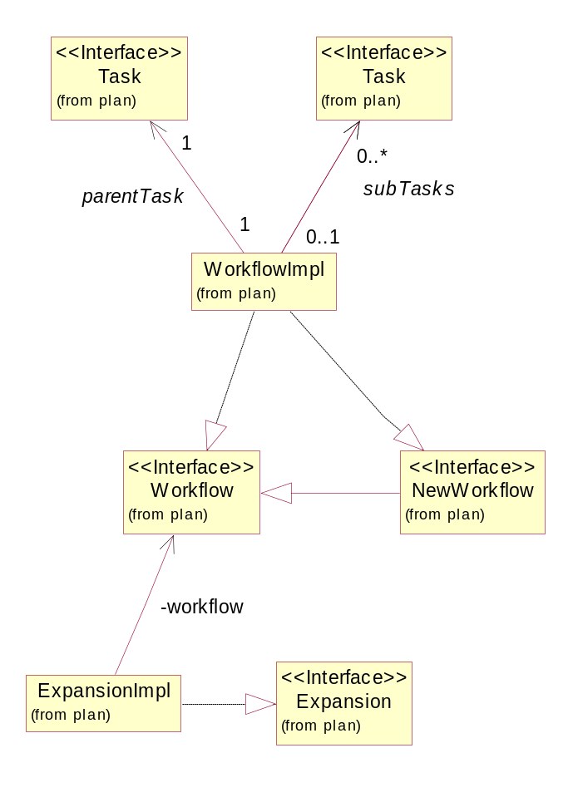
Expansion Class Relations

Slide 164
Exercise 8
Create an expander in the Development agent to expand the incoming code task into a workflow subtasks. Verbs: “Design” “Develop” “Test.” The expander should set the subtask preferences to instruct the allocator when to schedule the subtasks
View the results with the /tasks servlet.

Slide 165
Exercise 8
2) Task transmitted
by infrastructure
3) Expander
subscribes
to new tasks
1) Allocate to
Organization
Asset
Manager
(Allocator)
Allocator
Expander
LDM
Plugin
Data Source
BLACKBOARD
CODE Tasks
BLACKBOARD
Org
Org
Supported
Supporting

Slide 166
Exercise 8
5) Allocator subscribes
to subtasks
6) Allocator allocates
to programmer assets
4) Expander
publishes workflow,
expansion and subtasks
Manager
(Allocator)
Allocator
Expander
LDM
Plugin
Data Source
BLACKBOARD
CODE Tasks
BLACKBOARD
Org
Org
Prog
Supported
Supporting

Slide 167
Classes to Write
DevelopmentExpanderPlugin
  setupSubscriptions : subscribe to CODE tasks
  execute : create Expansion for the CODE tasks.
DevelopmentAllocatorPlugin
  setupSubscriptions : subscribe to tasks of verb DESIGN, DEVELOP, TEST and also programmer assets
  execute : schedule the tasks and allocate tasks to programmer assets in accordance with preferences

Slide 169
Exercise Notes
What are some algorithms that might be appropriate for aggregating allocation results?
It seems that the expander specifies how the tasks should be allocated through preferences. Do we need constraints?
Any other issues?

Slide 170
Constraining Tasks

Slide 171
Constraints
Specify pair-wise relations between sub-tasks in an expansion
Task aspects
  AspectType.START_TIME
  AspectType.END_TIME
  Others
Relationships
  Constraint.Before
  Constraint.After
  Constraint.Coincident

Slide 172
Constraints
1) Task 1 Completed before Task 2 Initiated
2) Task 1 Initiated before Task 3 Initiated
3) Task 3 Completed before Task 4 Initiated
Task 1
1
Task 2
2
Task 3
3
Task 4

Slide 173
Workflow Methods
Workflow methods
public void setConstraints(java.util.Enumeration enumofConstraints)
setConstraints allows you to add an Enumeration of Constraints to a Workflow. Each Constraint has a relationship with a pair of Tasks in a Workflow.

Slide 174
Constraint API
In PlanningFactory
Constraint Methods
public NewConstraint newConstraint()
public void setConstrainingTask(Task task)
public void setConstrainingAspect(int aspect_type)
public void setConstrainedTask(Task task)
public void setConstrainedAspect(int aspect_type)
public void setConstraintOrder(int order)
Notes:
The “Constraining” task is the task that is already planned (i.e. allocated) and should not be changed. The “Constrained” task is the task that can be planned relative to the constraining task.
So if you want to express “Task A must complete before Task B begins”:
Constraining task = Task A
Constraining aspect = AspectType.END_TIME
Constrained task = Task B
Constrained aspect = AspectType.START_TIME
Constraint order = Constraint.BEFORE
Constraining and constrained aspect are one of the constants in AspectType
Constraint order is one of Constraint.COINCIDENT, Constraint.BEFORE or Constraint.AFTER

Slide 175
Constraining Expanded Tasks
An Expander Plugin must manage the allocation of the subtasks by controlling the preferences to enforce the constraints
An expander can set the preferences on the subtasks to meet the constraints before publishing all of the tasks.
It may be better to publish the subtasks one at a time and use its allocation results to set the preferences on the next task.
Notes:
There is a good discussion of this in Chapter 5 of the Plugin Developers’ Guide.

Slide 176
Using Constraints to Set Preferences
Workflow
Constraint
Constraint getNextPendingConstraint()
Return constraint for which constraining event is defined and constrained event is
undefined or violated
boolean constraintViolation()
Has a constraint been violated?
ConstraintEvent getConstrainedEventObject()
Return the ConstraintEvent object for the constrained task.
double computeValidConstrainedValue()
Compute a value for the constrained task’s aspect that will satisfy the constraint
Notes:
These methods are used by expanders to work through the set of constraints in a workflow.
Use Workflow.getNextPendingConstraint to get a constraint to work on
Use Constraint.getConstrainedEventObject to get the ConstraintEvent for the Constrained task (actually a SettableConstraintEvent object)
Use Constraint.computeValidConstrainedValue to examine the constraining task’s allocation results to get a valid value for the constrained task’s preference.
Use SettableConstraintEvent.setValue (see next slide) to set a preference on the constrained task that will satisfy the constraint.

Slide 177
Using Constraints to Set Preferences
SettableConstraintEvent
void setValue(double value);
Sets (preferences for) the aspect value needed to satisfy the constraint placed on the task of this event.
value: the constraining value (from Constraint.computeValidConstrainedValue())
Notes:
This is the signature for the SettableConstraintEvent setValue method. It is used to update the preferences on a constrained task based on the allocation results for the constraining task.

Slide 178
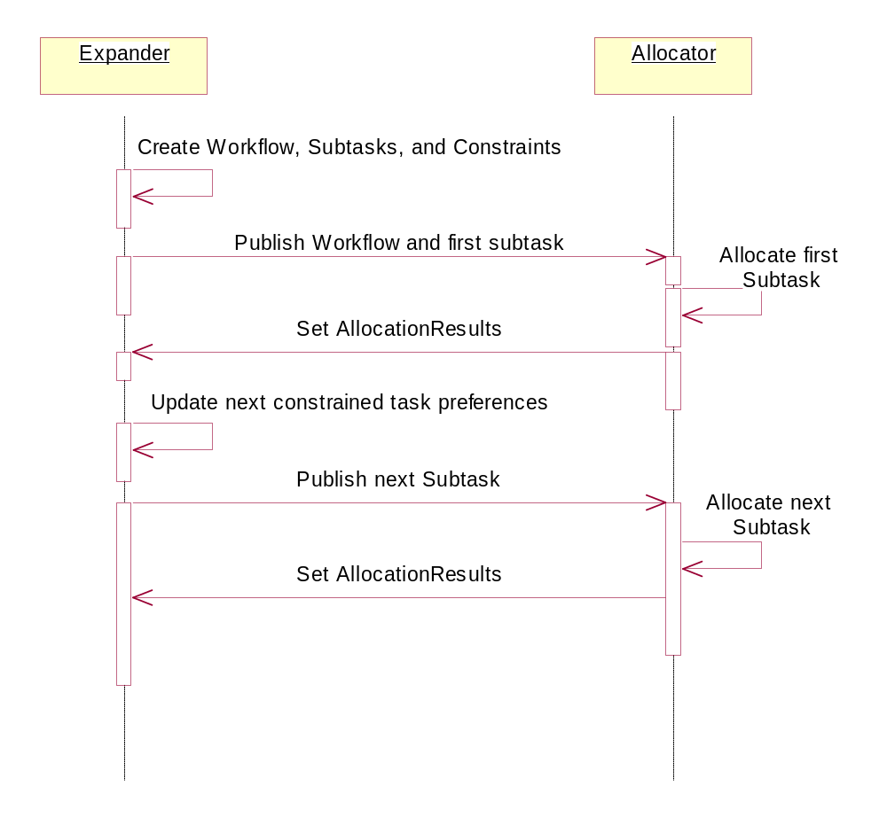
Expansion and Allocation
Notes:
This diagram shows the interaction between an expander and an allocator Plugin. Notice how the allocator deals with each subtask individually. The expander manages the inter-task dependencies.

Slide 179
Using Constraints to Set Preferences
Workflow wf = exp.getWorkflow();
Constraint c = wf.getNextPendingConstraint();
if (c != null) {
ConstraintEvent ced = c.getConstrainedEventObject();
if (ced instanceof SettableConstraintEvent)
{
((SettableConstraintEvent)ced).setValue(c.computeValidConstrainedValue());
getBlackboardService().publishAdd(c.getConstrainedTask());
}
}
Notes:
This snippet from an expander shows how to use the Workflow, Constraint, and ConstraintEvent to update the preferences on a constrained task.

Slide 180
Exercise 9
In the Development Expander, use constraints to show that “Design” comes before “Develop” comes before “Test”
The expander should set the subtask preferences to instruct the allocator when to schedule the subtasks
Monitor the allocation results to be sure that the constraints are not violated. Rescind and re-plan subtasks as necessary.
View the results with the /tasks servlet.

Slide 181
Exercise 9
2) Task transmitted
by infrastructure
3) Expander
subscribes
to new tasks
1) Allocate to
Organization
Asset
Manager
(Allocator)
Allocator
Expander
LDM
Plugin
Data Source
BLACKBOARD
CODE Tasks
BLACKBOARD
Org
Org
Supported
Supporting

Slide 182
Exercise 9
5) Allocator subscribes
to subtasks
6) Allocator allocates
to programmer assets
4) Expander
publishes workflow,
expansion and subtasks
Manager
(Allocator)
Allocator
Expander
LDM
Plugin
Data Source
BLACKBOARD
CODE Tasks
BLACKBOARD
Org
Org
Prog
Supported
Supporting

Slide 183
Classes to Write
DevelopmentExpanderPlugin
  setupSubscriptions : subscribe to CODE tasks and subtasks
  execute : create Expansion for the CODE tasks. Monitor allocation results for subtasks. Replan as needed.
DevelopmentAllocatorPlugin
  setupSubscriptions : subscribe to tasks of verb DESIGN, DEVELOP, TEST and also programmer assets
  execute : schedule the tasks and allocate tasks to programmer assets in accordance with preferences

Slide 184
Execution Monitoring and
Dynamic Replanning

Slide 185
Execution Monitoring Structures
An Assessor is a Plugin prototype behavior that monitors asset state (as changed by LDM Plugins) for conflicts within the blackboard.
  Forces replanning by Allocator/Expander Plugins when necessary
Triggers are objects injected into the Agent LDM to support simple general purpose assessment mechanism:
  Monitor : Set of objects to be monitored for some feature
  Test : Determine if set of objects has particular feature
  Action : Perform specified action on given set of objects (e.g. Rescind, Reallocate, ChangePreferences, GenerateTask)

Slide 186
An Asset’s RoleSchedule
A RoleSchedule is a representation of an asset's scheduled commitments.
These commitments(plan elements) are stored in a Collection.
RoleSchedules do not travel with an asset across agent boundaries, therefore, the RoleSchedule is only valid while that asset is assigned to the current agent.

Slide 187
An Asset’s RoleSchedule
Asset methods
RoleSchedule methods
public RoleSchedule getRoleSchedule()
Returns the RoleSchedule object associated with this Asset
public Enumeration getRoleScheduleElements()
an Enumeration of PlanElements representing the entire roleschedule
public Collection getScheduleElementsWithTime(long aDate)
a time sorted Collection of planelements which include this time.
public Collection getEncapsulatedRoleSchedule(long start, long end)
start - Start time of the desired range. end - End time of the desired range.
Returns a sorted Collection containing plan elements whose estimatedschedule falls within the given date range.
Notes:
There are many more RoleSchedule methods that are useful in certain circumstances. See the javadoc for more details.

Slide 188
Exercise 10
Look at the new Servlet in the Development agent that schedules vacation for programmer assets.
Add an assessor Plugin to the Development agent that notes the vacation conflicts and updates the reported results for that task’s allocation.
Modify the Development Allocator to reschedule the tasks updated by the new assessor.
Modify the Development Expander to replan workflows whose constraints become violated.
View the allocation results with the /tasks tool.

Slide 189
Exercise 10
2) Subscribe to programmer asset change
Manager
(Allocator)
Allocator
Expander
LDM
Plugin
Data Source
Allocation Results
BLACKBOARD
BLACKBOARD
Org
Prog
Assessor
Vacation
3) Update allocation
result to reflect change
1) Update programmer’s calendar to reflect unavailable time

Slide 190
Exercise 10
4) Look at changed allocations. Re-plan updating allocation results
7) Examine changed allocations for allocation results. Act as necessary.
5) Look at changed expansions. Aggregate allocation results using PluginHelper
Manager
(Allocator)
Allocator
Expander
LDM
Plugin
Data Source
Allocation Results
BLACKBOARD
BLACKBOARD
Org
Prog
Assessor
Vacation
6) Changed allocation results propagate back
Notes:
This is how the changed allocation result propagates back to the tasking agent.

Slide 191
Classes to Write
TakeVacationServlet
  This new class is provided. It demonstrates how to write a servlet that modifies a blackboard object.
DevelopmentAssessorPlugin that compares the programmers’ internal schedule to their role schedule. Creates a failed allocation result if there is a conflict.
Modify the DevelopmentAllocator to subscribe to modifications in its allocations and reallocate changed tasks.

Slide 192
Classes to Write
Modify the DevelopmentExpander to subscribe to modifications in its subtasks and expansions. Replan workflows when constraints are violated.
Notes:
In a real-world assessor, it would probably compare the asset’s RoleSchedule with an external database like a calendar application. In this exercise, the internal ProgrammerAsset schedule represents the external authoritative source.
Be sure that the DevelopmentAllocator publishRemoves the old allocation before making the new one.

Slide 193
APIs Used
PlanElementForAssessor.setReceivedResult
  Allocation method used by Assessors to update a reported result
Notes:
Since Plugins usually set the estimated result (which gets copied to the reported result by the infrastructure) Cougaar requires a type cast to set the allocation’s reported result. For example:
AllocationResult failed_result = factory.newAllocationResult(1.0, false, avrs);
((PlanElementForAssessor)allocation).setReceivedResult(failed_result);

Slide 195
Exercise Notes
What might be some real-world data that an assessor might use?
The non-Cougaar world changes constantly. How should an assessor react to constant change?
Any other issues?

Slide 196
CSMART
Society configuration and control

Slide 197
CSMART
Society Configurator & Controller
Society Monitoring, Analysis & Reporting tool makes it easy to configure, run, and monitor large Cougaar Societies
Think of it as the command console where Cougaar societies are tuned, laid out across available hosts, and run - all from a single consolidated window
  No configuration files to copy and keep up to date
For details: http://www.cougaar.org/projects/csmart/csmart-usersguide.pdf

Slide 198
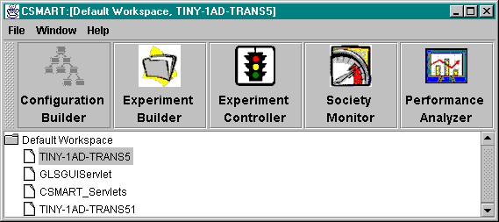
CSMART Tools
Configuration Builder
Experiment Builder
Experiment Controller
Society Monitor
Performance Analyzer
Notes:
CSMART consists of several tools to assist in the configuration, running, and monitoring of a cougaar society.

Slide 199
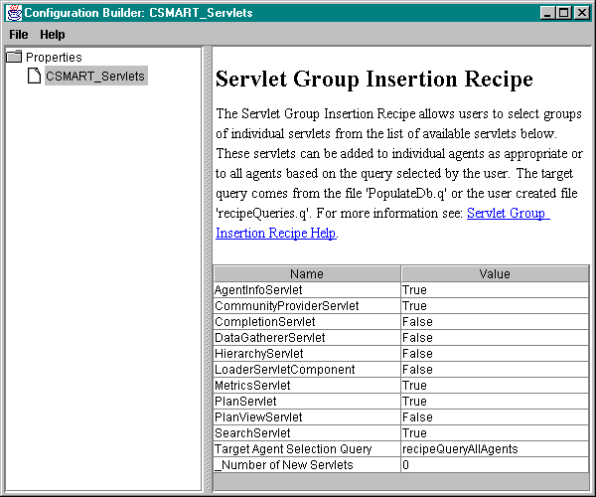
Configuration Builder
CSMART provides several built-in ‘Recipes’ which are modified to configure the society
  Add an Agent with an OrgAsset
  Add Plugin or binder
  Add an argument to existing component
Notes:
A recipe is a set of steps for a small modification to ANY society.
Typically a recipe adds a single component to one or more places (agents, nodes) in the society
e.g. add a specific Plugin to certain agents

Slide 200
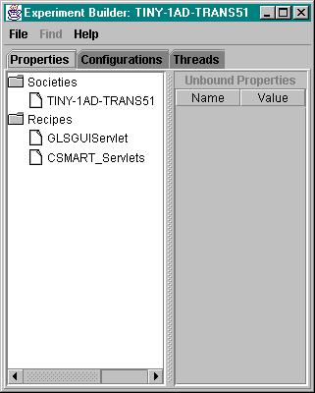
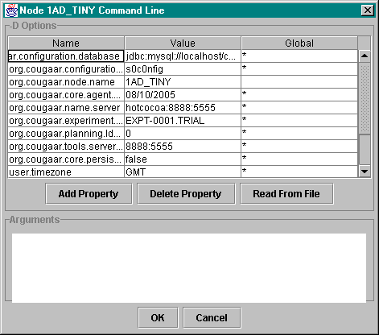
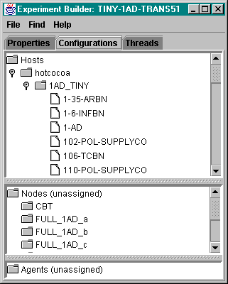
Experiment Builder
Add Recipes (DnD in to specify that they be applied)
Assign agents to nodes/hosts (simple DnD interface for easy re-configuration of Agents across available resources)
Set command-line arguments (no Node.bat, setarguments.bat)
Notes:
This is how recipes are applied: by inclusion in the Experiment Builder.
Easy tree folders for moving Agents between Nodes and Hosts.
Once your configuration is set, save it to the database, and you are ready to run.

Slide 201
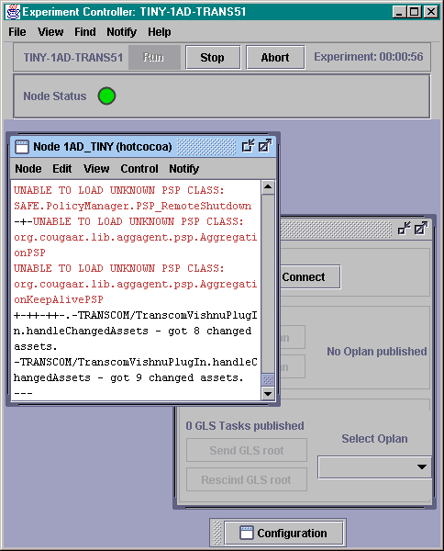
Experiment Controller
Button to Run/Stop society
Monitor node output
  Search and get notifications (alerts you when a string, such as “exception” is seen)
  All node output saved to local log files
Stop/Restart nodes
CPU usage and stacktraces available on Linux
View running configuration
Notes:
Single screen monitoring of Node’s STDOUT, with “notifications” to alert you of Exceptions, etc.
One button society start, stop. Easily restart individual nodes.
This makes running large societies much easier for developers.

Slide 202
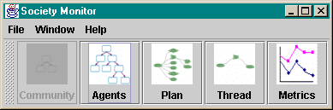
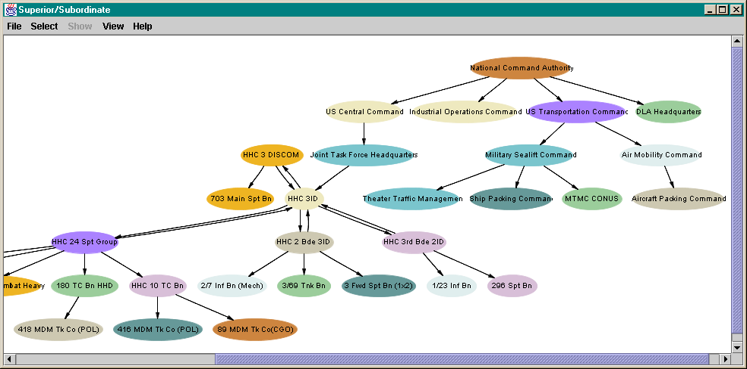
Society Monitor
View Blackboard contents and Org relationships (shown)
Servlet based tools to graphically visualize Blackboard contents
Plan View shows Blackboard (with attributes of each object), and allows searching “up” or “down” a thread of processing (“What did this Task cause?”)
Notes:
Monitor tools may be used standalone on any cougaar society.

Slide 203
Cougaar Design Considerations
Applying the Cougaar architecture
Notes:
Given a problem statement, what are methods and analyses that help map that problem into an effective model for implementing in the Cougaar architecture?
Note that this is the hard part - once you have answered all these parts of the design, the rest is ‘just code’
Agent Breakdown
Role/Relationship Analysis
Plugin Enumeration
Publish/Subscribe Analysis
Task Grammar
Plan Element Map
Execution Monitoring and Dynamic Replanning Analysis
Asset/Property Requirements Analysis
Node Structure

Slide 204
Cougaar Design Methodology
Agent Enumeration
Role/Relationship Analysis
Plugin Enumeration
Publish/Subscribe Analysis
Task Grammar
Plan Element Map
Asset/Property Requirements Analysis
Execution Monitoring and Dynamic Replanning Analysis
Node Structure

Slide 205
Agent Breakdown
Define agent entities as fundamental agents in design
What determines what should be a agent?
  Represent discrete functionality, organization, algorithm
  Allow for future expansion, dynamics of function/role/relations
Agents communicate with each other by messages, and Plugins communicate by sharing objects through publish/subscribe, so functions that will be sharing detailed information (and not synopses) should be lumped together in an agent
Notes:
We use represent organizations with agents in the military logistics domain. What might agents represent in these domains:
Network security
Game theory
Manufacturing
Others?

Slide 206
Role/Relationship Analysis
For each agent, determine the roles or services they provide to other agents
Determine who is a customer of these services
Determine what superior / subordinate relationships exist among the agents
Notes:
The names of the roles and relationships will depend on the entities represented by the agent. As we have seen, at some level these are just identifiers that the agents in a society must interpret consistently.

Slide 207
Plugin Enumeration
Decompose the essential functionality of the agent until all pieces play a simple well defined role.
Where possible, map pieces onto prototype Plugin behaviors
Notes:
Allocator : Takes tasks and dispositions them to an asset (Physical or Organizational) with the agent
Expander : Takes tasks and decomposes them into a workflow of subtasks
Aggregator : Takes a series of tasks and joins them into a single super-task
Assessor : Monitors state of particular assets for consistency within the blackboard, and forces replanning as needed
Input : An ‘LDM Plugin’ which creates, changes and deletes objects in the agent based on outside stimulus (UI, Database, sensor, etc.)
Output : A ‘UI Plugin’ that provides some output from the agent

Slide 208
Publish/Subscribe Analysis
For each agent, define what every Plugin is publishing and subscribing to
Does someone subscribe to everything I publish?
Does someone publish everything I subscribe to?
Do multiple Plugins have overlapping publishes?
Notes:
A spreadsheet is a good tool for doing this analysis.
A mechanism for automating this analysis and verifying configurations is currently under development.

Slide 209
Task Grammar
Declare task verb, prepositions, direct/indirect objects for all tasks created/expected by agents
  Match input/output specs of interoperating agents
Declare preferences for tasks
  Which aspects, how used, units, what criteria for acceptability
  Specify ScoringFunctions for each aspect with bounds, weights, preferred ‘best’ values
Notes:
This is the process of defining the “language” of the society.

Slide 210
Plan Element Map
Sketch out for each agent the decomposition of tasks into expansions, aggregations, and allocations
Follow the forward and backward flow of tasks, preferences and allocationResults through this agent
  Make sure there are no breaks in the chain

Slide 211
Asset/Property Analysis
Define what assets are owned/managed by each agent
  How do these assets get created and updated?
What are the properties of these assets?
  Can these be built on existing Cougaar assets, or do we need to create new asset types or property groups?
Maximize reuse by inheriting from common base asset types and prototypes
Notes:
Remember new property groups can be added to any asset so if you’re working in military logistics, the asset you need probably exists.

Slide 212
Execution Monitoring / Dynamic Replanning Analysis
Determine acceptability criteria (how good is good enough for an allocation result)
Determine how to react to ‘bad news’ (failed allocations)
  Reallocate
  Change preferences and try again
  Report failure upwards
Define execution monitoring modules (LDM Plugins that monitor/simulate execution)
Define assessors or triggers that will force replanning based on changes to assets
Notes:
This often requires some hard analysis of the problem domain.

Slide 213
Node Structure
Determine how agents should be allotted to nodes
When should agents be co-located in a node?
  Agent has no sense of its node or co-resident agents
  Entirely a matter of configuration convenience and efficiency
Take advantage of locality of data sources
Run node and associated agents near anticipated user/operator community
Minimize network traffic between closely coupled agents
Balance resource loading
  Optimize use of available resources : CPU, DB, Memory...

Slide 214
Multi-Node Configuration
The file ‘alpreg.ini’ defines the configuration of the name server
  AKA “Admin Node”
[ Registry ]
address=hostname
alias=AlpFDS
port=8003
Notes:
This little file has been present in the examples already. The entries are:
address : the hostname or IP address of the name server
alias: a key into the name server database. All agents in a society must use the same string. (Everyone uses “AlpFDS”)
port : the TCP port of the name server. All agents in a society must use the same port.
A node uses this algorithm to find a name server
Try to contact a name server at the address:port in alpreg.ini. If successful → connect
If “address” is the same as my computer’s address/name (or localhost) → create a name server and connect
Else, wait and poll for a name server (printing “!” as it polls)
If you put address=localhost in your alpreg.ini file, only nodes running on the local computer can connect to the name server – use the hostname instead

Slide 215
Exercise 11
Separate the Manager and Programmers agent into separate nodes.
Create two node .ini files and run them in two windows.
View the results with /tasks and the Schedule servlet developed previously (provided).
Notes:
When you get the two nodes talking on your computer, try configuring the nodes on separate computers.

Slide 216
Exercise 11
Management Node
Development Node
Manager
(Allocator)
Allocator
Manager
Expander
LDM
Plugin
Management
Agent
Development
Agent
Allocation Results
Assessor
CODE Tasks
Schedule
Servlet
Vacation
Notes:
The only change here is that the agents are now in separate nodes. None of the Plugins change.

