Slide 1


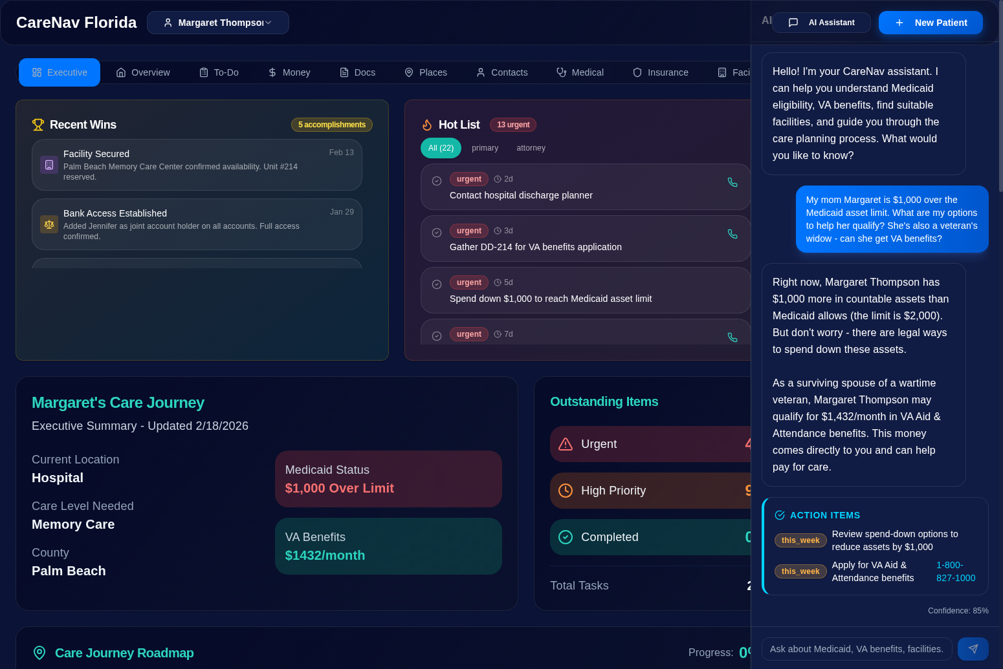


CareNav Florida
github.com/gregnatkatz/carenav
AI-Powered Elder Care Navigation
Built by Gregory Katz & Rick Weyenberg • Microsoft • Open Source MIT
THE PROBLEM
THE SOLUTION
10,000
6 AI agents coordinated via GitHub Copilot SDK
4 MCP servers
exposing Florida-specific rules
55 documents
• 39 tests • Azure integration
Americans turn 65 every day
$500K+
decisions with zero training
200+
pages of rules per state
100
Medicare days before families pay full rate
35
25
15
15
15
15
10
10
Enterprise
Azure
Ops
RAI
Story
Foundry IQ
Customer
Feedback

Slide 2





Architecture & Enterprise Value
GitHub Copilot SDK → MCP Servers → Azure Stack
SYSTEM ARCHITECTURE
ENTERPRISE VALUE
React Frontend
Health Systems at Scale
TypeScript • Vite • Dark Theme • 10 Tabs
AdventHealth — 55 hospitals, $19.8B revenue
Thousands of care transitions annually
State-agnostic:
Swap MCP servers for any state's rules
Reusable for HCA, CommonSpirit, Kaiser, VA
▼
GitHub Copilot SDK
Agentic orchestration • CLI server mode • BYOK
▼
6 AI Agents + 4 MCP Servers
What's Under the Hood
Medicaid • VA Benefits • Facilities • Document RAG
6 Agents
Orchestrator, Eligibility, Facility, Legal, Validator, Summarizer
▼
4 MCP Servers
Medicaid rules, VA benefits, Facility search, Document RAG
Azure Integration
55 Documents
3 years medical records, bank statements, legal docs
39+ Tests
100% pass rate — eligibility, chat, CRUD, end-to-end
OpenAI • AI Search + Foundry IQ • SQL Database
RAI Compliant
Synthetic data, disclaimers, human-in-the-loop, auditable
CareNav Florida • GitHub Copilot SDK Enterprise Challenge • github.com/gregnatkatz/carenav • Deadline: March 7, 2026

Slide 3






Technical Architecture
github.com/gregnatkatz/carenav
React → Copilot SDK → Agents + MCP → Azure AI → Data
React + TypeScript Frontend
FastAPI Backend
GitHub Copilot SDK
REST API
17 routers • LLM abstraction layer
Provider pattern: Azure OpenAI ↔ Copilot SDK
Async SQLAlchemy • Pydantic validation
Family
Caregiver
Vite • Tailwind • shadcn/ui • 16 components
10 tabs: Executive, Overview, To-Do, Money,
Docs, Places, Contacts, Medical, Insurance, Facility
Agentic orchestration
CLI server mode (JSON-RPC)
BYOK: Azure OpenAI gpt-5.2
6 AI AGENTS
dispatch
Orchestrator
Eligibility
Facility
Legal
Validator
Summarizer
Routes queries
Coordinates all
Medicaid/VA
calculations
Search & score
ALF/MC/SNF
Spend-down
debt rules
Cross-check
all numbers
Plain English
action plans
4 MCP SERVERS
MCP
AZURE AI STACK
Medicaid
Server
VA Benefits
Server
Facility Search
Server
Document RAG
Server
Azure OpenAI
FL ICP rules • $2K limit
60-mo look-back
Spend-down calc
Aid & Attendance
$1,432/mo survivor
Required docs
ALF/MC/SNF scoring
Medicaid acceptance
Admission gaps
Semantic search
55 patient docs
Category filter
gpt-5.2 + gpt-5-nano
text-embedding-3-large (3072d)
▼
466 lines
433 lines
522 lines
257 lines
Azure AI Search
DATA LAYER
Hybrid vector + semantic ranking
+ Foundry IQ agentic retrieval
Azure SQL Database
RAG Knowledge Base
Microsoft Fabric
RAI + Quality
18 SQLAlchemy models
Patients, Tasks, Documents,
Financials, Facilities, Insurance
10 FL elder law policy docs
Medicaid ICP, VA A&A, ALF regs
Hybrid search via AI Search
Analytics lakehouse
Power BI dashboards
Care transition insights
39+ tests — 100% pass rate
Synthetic data only, no PII
Human-in-the-loop decisions
Not legal/medical advice
14,500+
18
6
4
55
39+
17
16
lines of code
data models
AI agents
MCP servers
demo docs
tests
API routes
components

