Slide 1

MOBILE PRICE PREDICTION

Slide 2
CH.NITHIN KUMAR
2203A52010
B.LOKESH
2203A52008
J.VINAY KUMAR
2203A52090

Slide 3

PROBLEM STATEMENT
“Create a machine learning model to predict mobile phone prices based on their specifications, enabling consumers to make informed buying decisions. The model should consider attributes like processor, camera, RAM, and brand to estimate mobile prices accurately."

Slide 4

INTRODUCTION
The "Mobile Price Prediction" project utilizes a dataset containing mobile phone attributes, including Product_id, Sale status, Weight, Resolution, PPI, CPU Frequency, Internal Memory, RAM, Rear Camera, Front Camera, Battery, and Thickness. It employs supervised machine learning, specifically regression, to build a model that estimates mobile phone prices based on these attributes. This project aids consumers in informed purchasing decisions and provides valuable insights to manufacturers and retailers regarding pricing strategies in the competitive mobile phone market. It highlights the practical applications of machine learning in enhancing decision-making processes and understanding market dynamics.

Slide 5
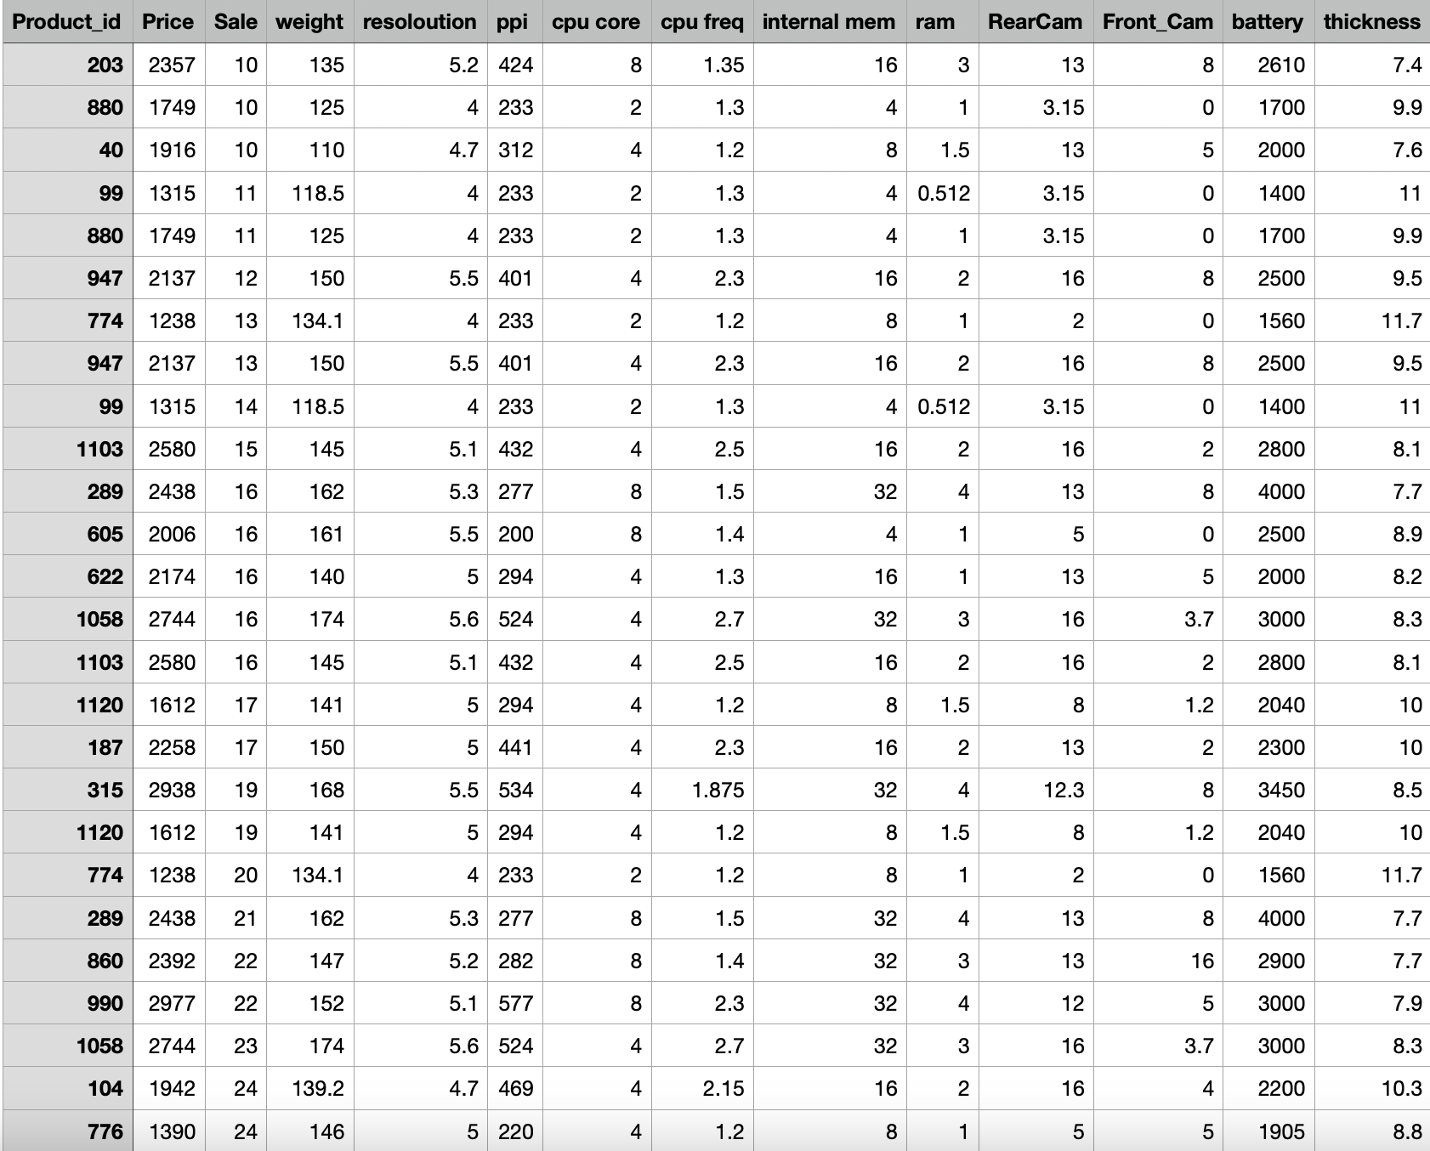

Data Set

Slide 6
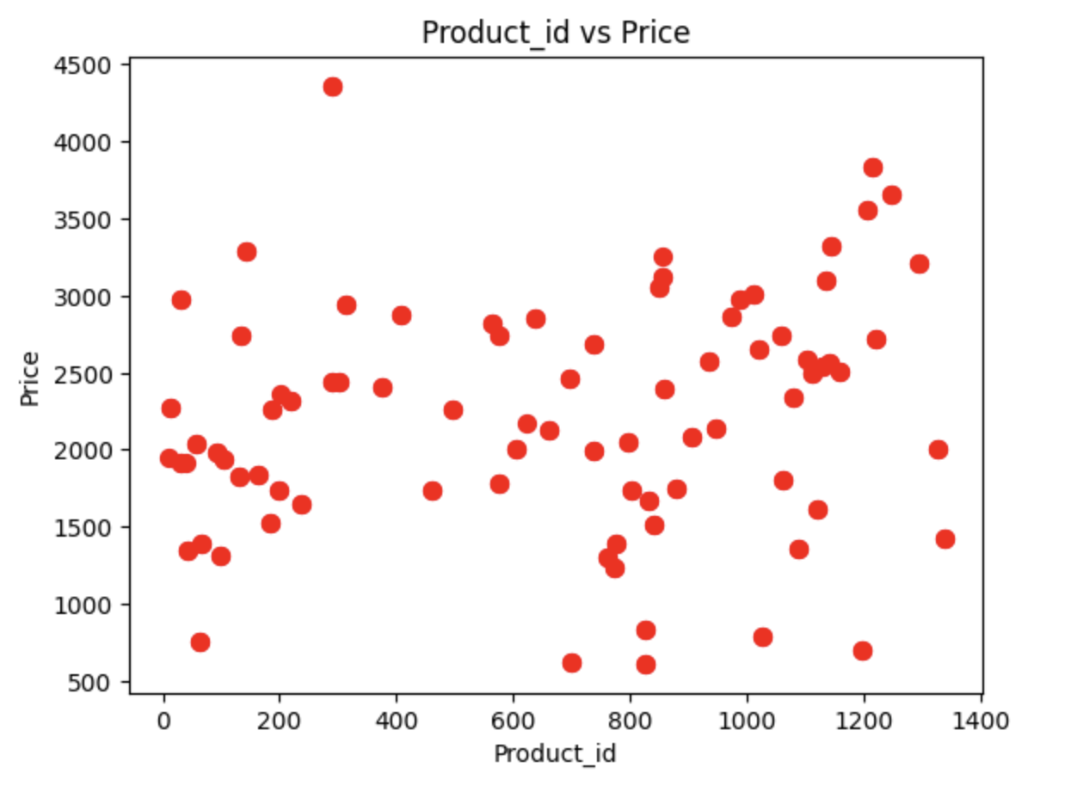
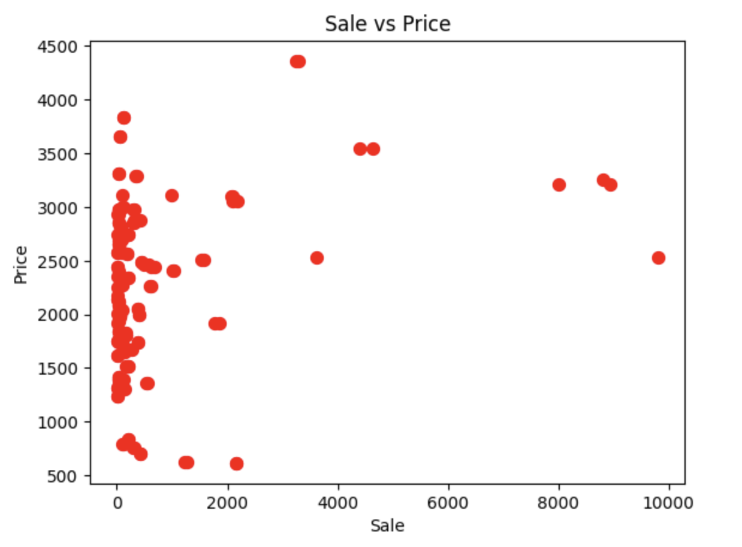
Graphs

Slide 7
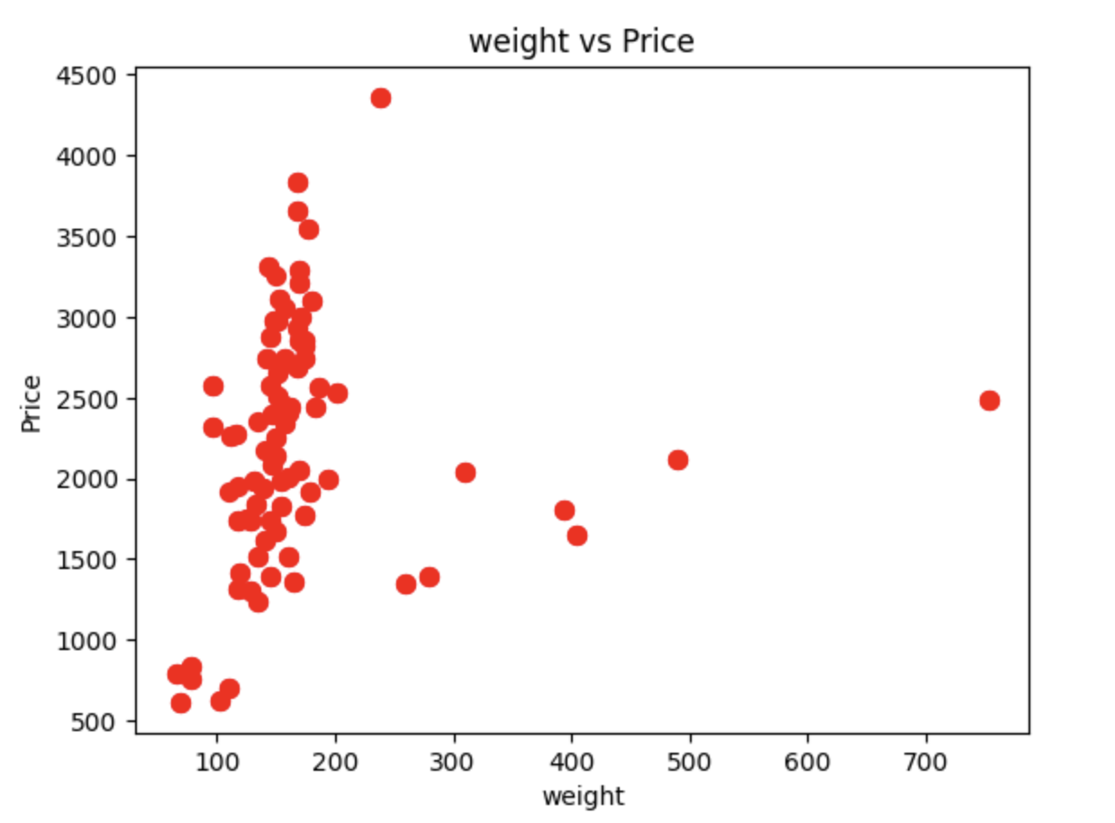
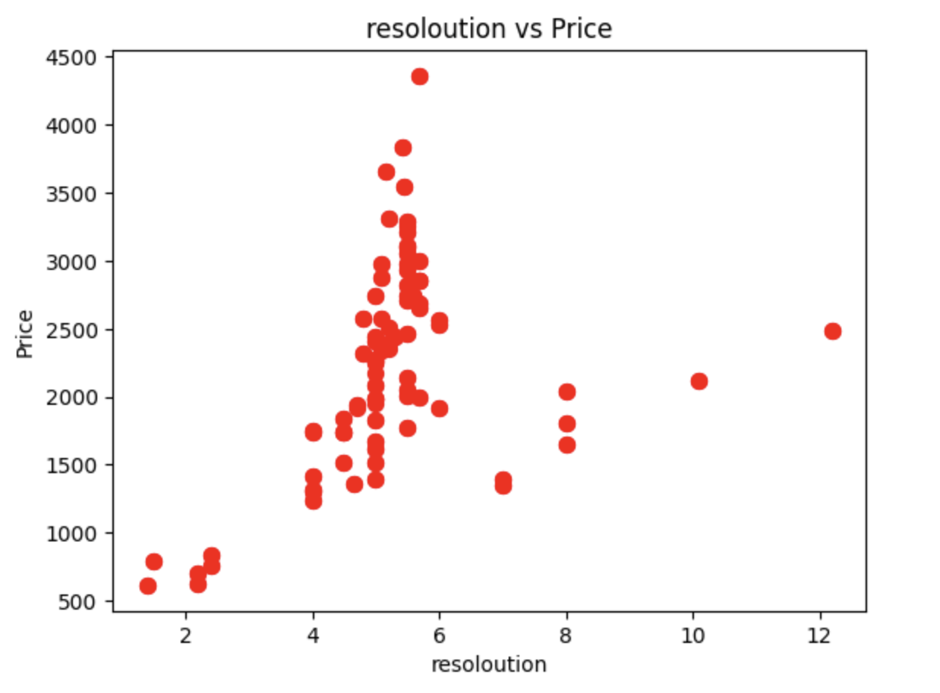
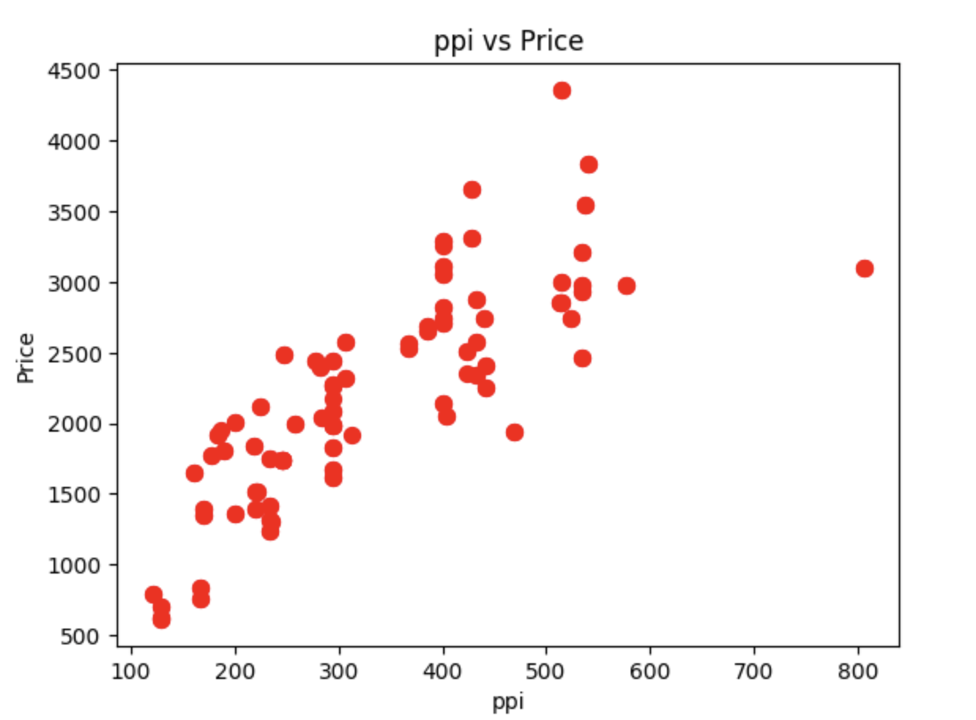

Slide 8
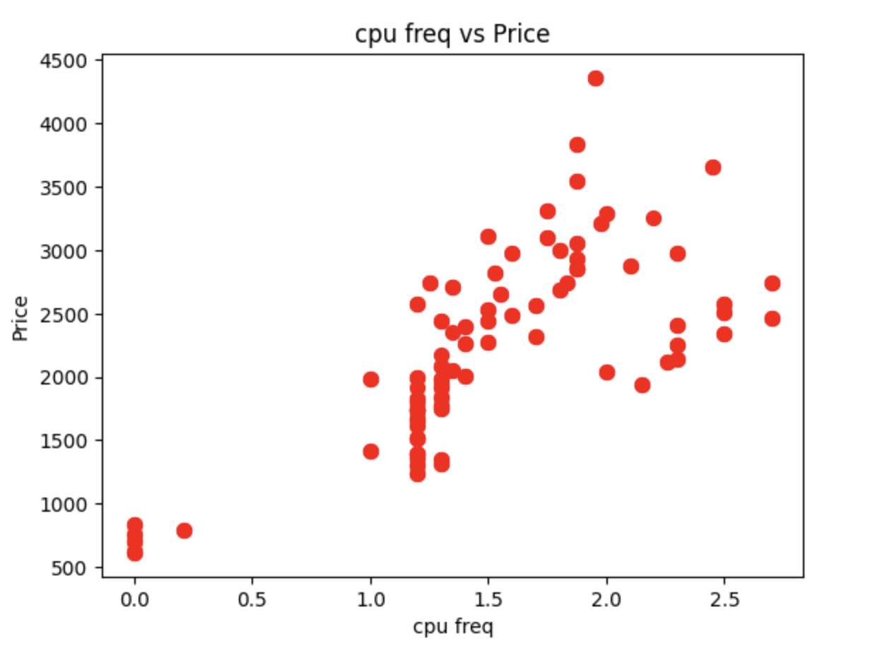
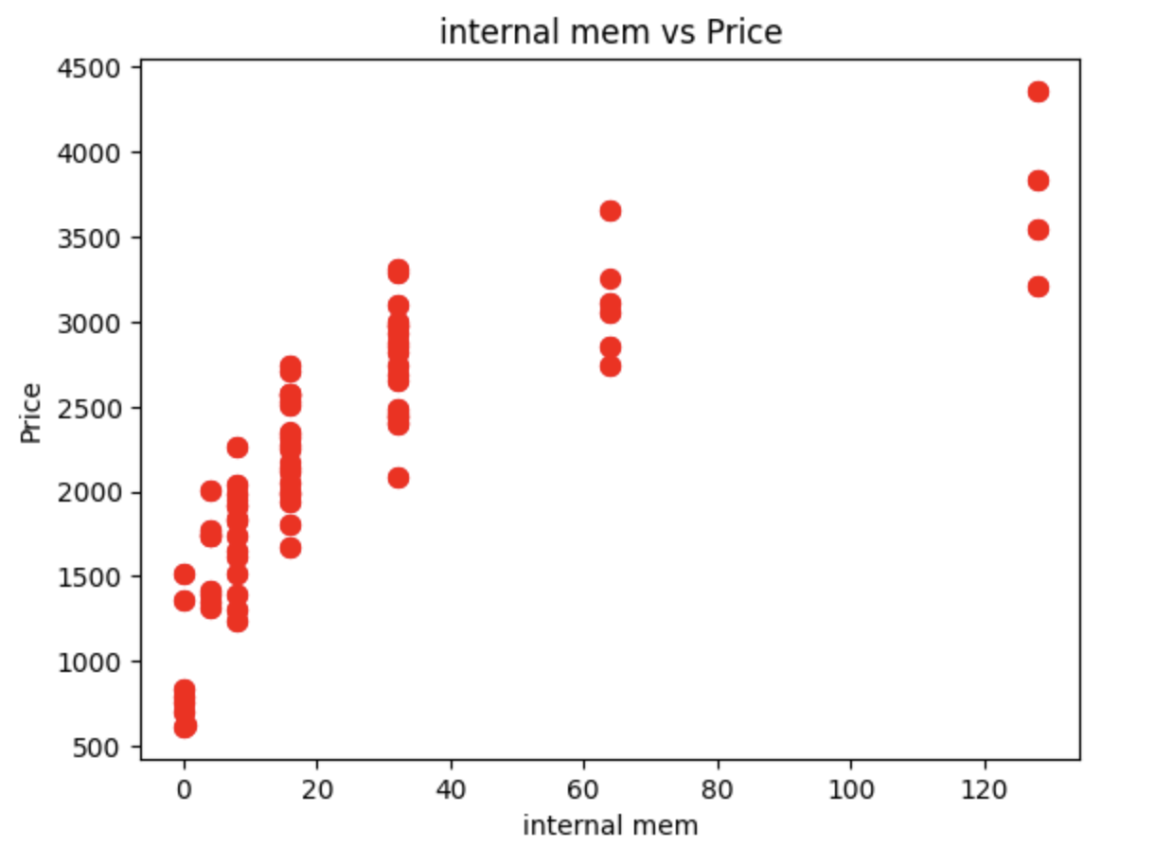
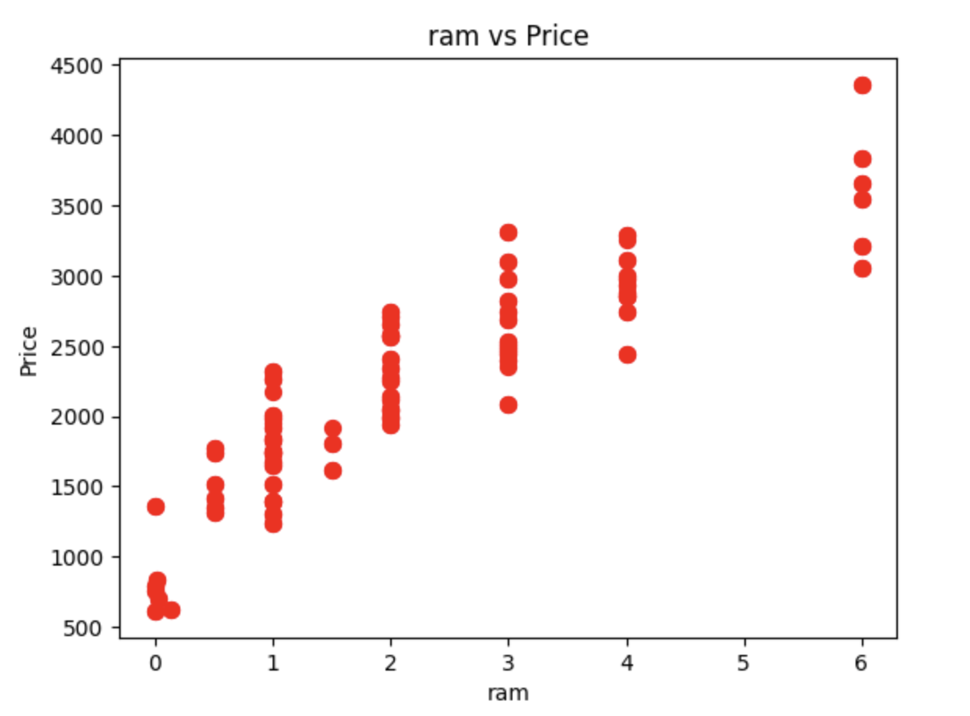
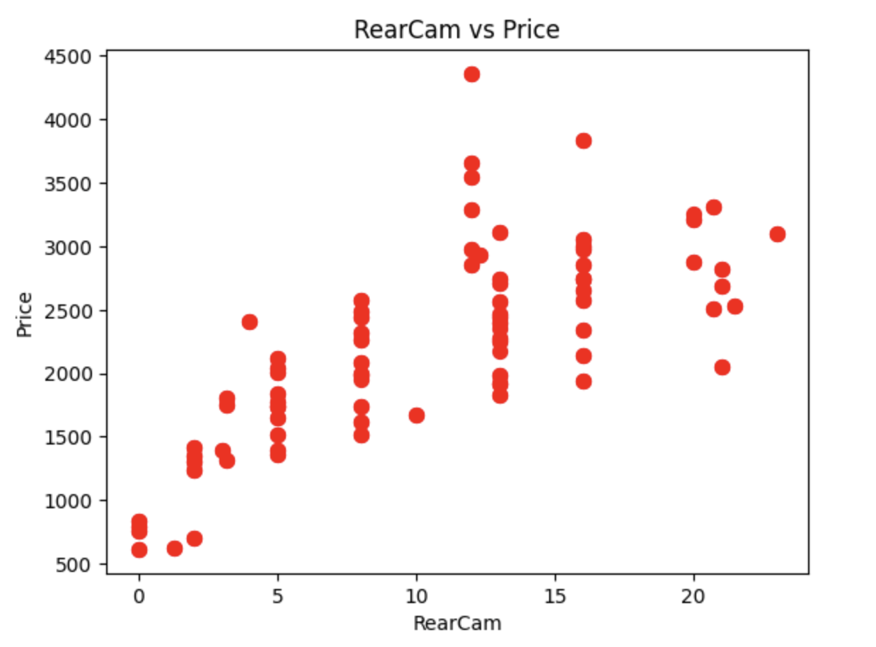

Slide 9
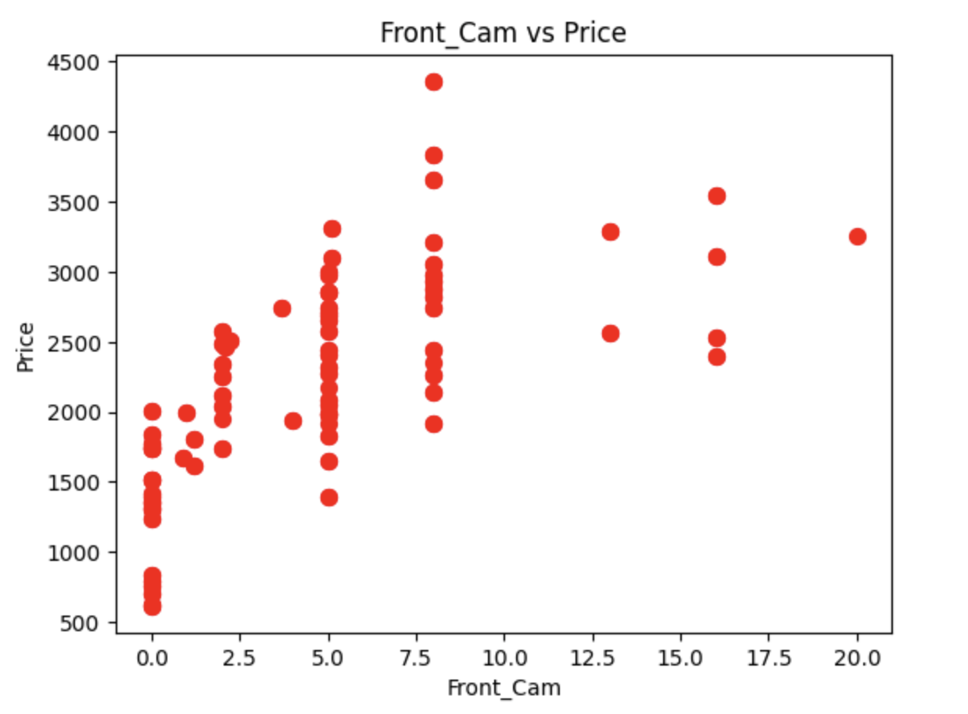
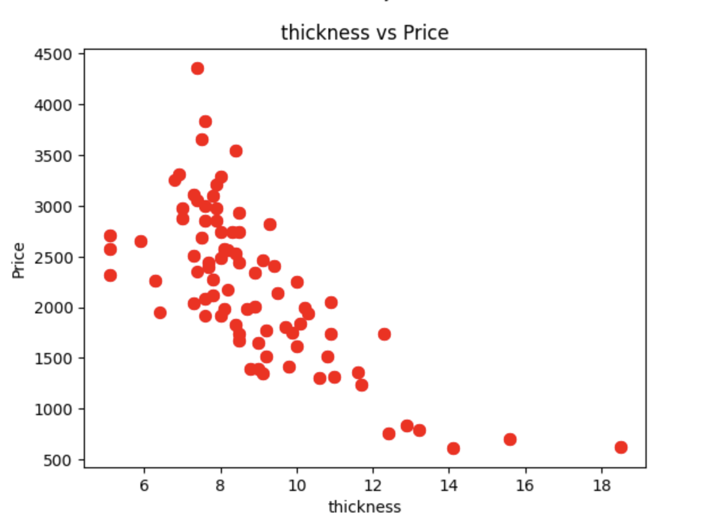
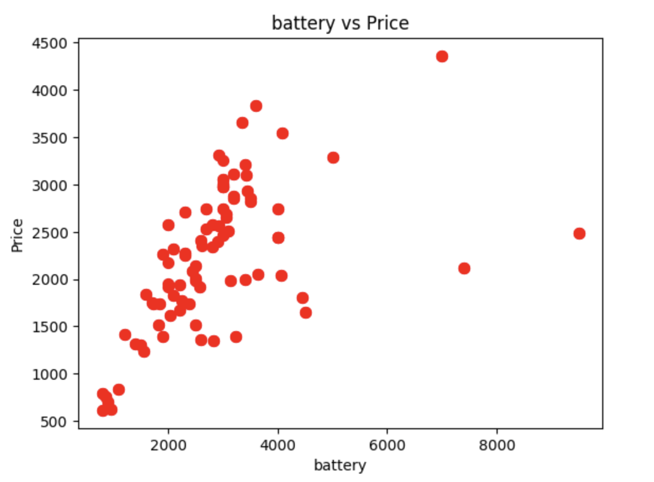

Slide 10

Attributes List
>Product_id
>Sale
>Weight
>Resoloution
>ppi
>CPU Freq.
>Internal Memory
>Ram
>Rear cam
>Front cam
>Battery
>Thickness

Slide 11
Features
1>Product_id: This is typically a unique identifier for each mobile phone in the dataset. It doesn't contribute directly to price prediction but can help track and identify specific devices.
2>Sale: This feature might indicate whether the phone is currently on sale or has a discount. Sales and discounts can affect the price of the phone, so this feature can be relevant for price prediction.
3>Weight: The weight of the mobile phone in grams. Heavier phones may have larger batteries or additional features, which can influence their price.
4>Resolution: This likely refers to the resolution of the phone's display screen, usually specified in pixels (e.g., 1920x1080). Phones with higher screen resolutions often come at a higher price point, as they offer better display quality.
5>PPI (Pixels Per Inch): PPI is a measure of pixel density on the screen. Phones with higher PPI values tend to have sharper and more detailed displays, which can impact their price.
6>CPU Frequency: The clock frequency of the phone's central processing unit (CPU), usually measured in gigahertz (GHz). Faster CPUs can handle more demanding tasks and may contribute to a higher price.
7>Internal Memory: This indicates the amount of built-in storage on the phone, typically measured in gigabytes (GB) or terabytes (TB). Phones with larger internal storage capacities often have higher prices.
8>RAM (Random Access Memory): RAM is the temporary memory used by the phone for running applications. Phones with larger RAM capacities tend to perform better and may be priced higher.
9>Rear Camera: The quality of the rear camera is a significant factor influencing the price of a mobile phone. This feature might specify the camera's resolution in megapixels or other camera-related details.
10>Front Camera: Similar to the rear camera, the quality and specifications of the front-facing camera can affect the price, especially for devices focused on selfie photography.
11>Battery: This feature likely specifies the battery capacity of the phone, usually measured in milliampere-hours (mAh). Phones with larger batteries can offer longer battery life and may be priced accordingly.
12>Thickness: The thickness of the mobile phone, often measured in millimeters (mm). Slimmer phones may have a sleeker design but can sometimes sacrifice battery capacity or other features.

Slide 12

Implementation
Linear Regression
Support Vector Machine

Slide 13
Linear Regression
Linear regression is a supervised learning algorithm used for predicting a continuous target variable based on one or more input features. It's a parametric approach that models the relationship between the inputs and the target as a linear equation, typically represented as y = mx + b, where y is the predicted value, x is the input feature, m is the slope (coefficient), and b is the intercept. The algorithm learns the best-fit line that minimizes the sum of squared differences between predicted and actual values. Linear regression is widely used for tasks like price prediction, trend analysis, and understanding relationships between variables.

Slide 14
Support Vector Machine
Support Vector Machine (SVM) is a supervised learning algorithm used for classification and regression tasks. It's a parametric approach that finds a hyperplane (line in two dimensions) that best separates data into different classes while maximizing the margin between them. SVM aims to find a decision boundary with the largest distance between the nearest data points of each class, known as support vectors. The line equation in SVM can be represented as w·x + b = 0, where w is the weight vector, x is the input vector, and b is the bias term. SVM is effective for both linear and non-linear classification tasks, kernel functions that can transform data into higher-dimensional spaces for better separation.

Slide 15
Errors from Linear Regression
Mean Squared Error (MSE): 28947.31450
Mean Absolute Error (MAE): 139.04295
Root Mean Squared Error (RMSE): 170.13910

Slide 16
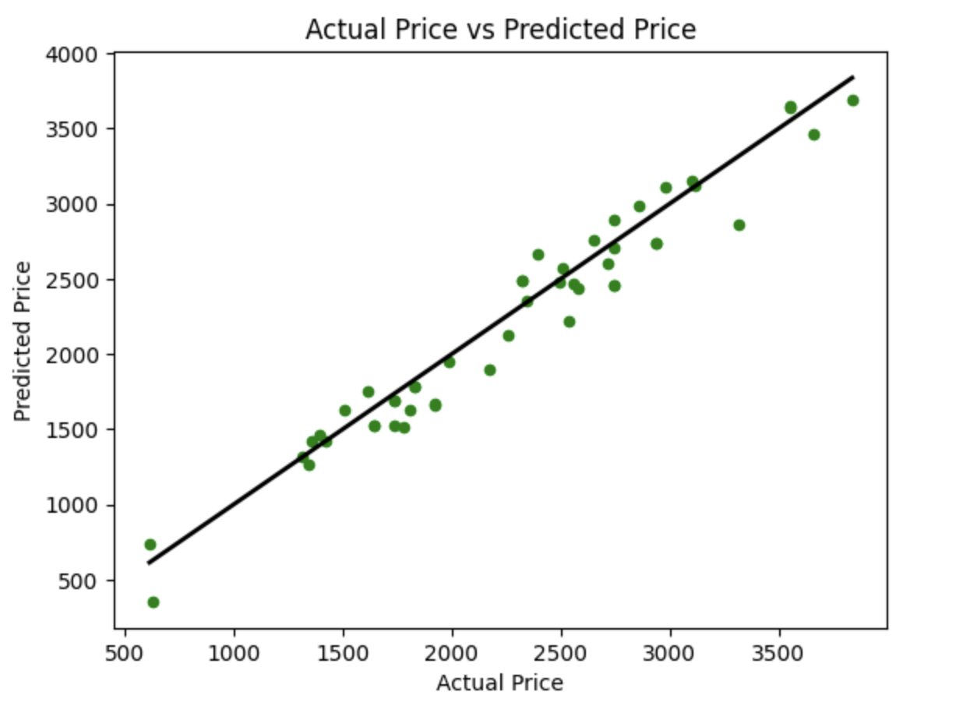
Best fit line with Linear Regression

Slide 17
Errors from SVM
Mean Squared Error: 598064.1619885144
Mean Absolute Error: 637.9818796171741
Root Mean Squared Error: 773.3460816403704

Slide 18
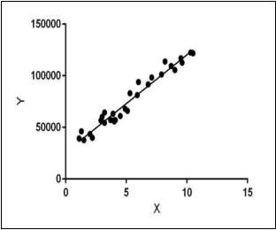
We will proceed with reading the data, and then perform data analysis. The practice of examining data using analytical or statistical methods in order to identify meaningful information is known as data analysis. After data analysis, we will find out the data distribution and data types. We will train 4 classification algorithms to predict the output. We will also compare the outputs. Let us get started with the project implementation.
Enough methods are performed on the data to evaluate the data set and gather knowledge about the data. Let's perform some Machine Learning model and Experimentation to create a model that helps us to achieve the goal I stated in the problem definition. In this we talk about the various machine learning algorithms used for the project. They are Linear regression, Logistic regression, Svm, Knn, Ridge regression and Lasso regression.
4.1 LINEAR REGRESSION: Linear regression is a type of supervised machine learning algorithm that computes the linear relationship between a dependent variable and one or more independent features. When the number of the independent feature, is 1 then it is known as Univariate Linear regression, and in the case of more than one feature, it is known as multivariate linear regression. The goal of the algorithm is to find the best linear equation that can predict the value of the dependent variable based on the independent variables. The equation provides a straight line that represents the relationship between the dependent and independent variables. The slope of the line indicates how much the dependent variable changes for a unit change in the independent variable. One of the most important supervised learning tasks is regression. In regression set of records are present with X and Y values and these values are used to learn a function so if you want to predict Y from an unknown X this learned function can be used. In regression we have to find the value of Y, So, a function is required that predicts continuous Y in the case of regression given X as independent features. Here Y is called a dependent or target variable and X is called an independent variable also known as the predictor of Y. There are many types of functions or modules that can be used for regression.
Methodology :
In the business world, linear regression can be used to predict customer churn based on various factors like customer tenure, usage patterns, and customer service interactions. Churn (yes/no) is the dependent variable, and customer-related factors are the independent variables. Utility companies can employ linear regression to forecast energy consumption based on historical data, seasonal trends, and weather conditions. Energy consumption is the dependent variable, and time, weather, and other relevant factors serve as independent variables. Retailers can use linear regression to predict future sales based on factors such as advertising spending, time of year, and past sales data. Sales are the dependent variable, and marketing budgets and time-related factors are independent variables.

Slide 19
Thank You

