Slide 1
Utilizing LLM Agents for Efficent Requirement Analysis and specification
Aboze Brain John

Slide 2

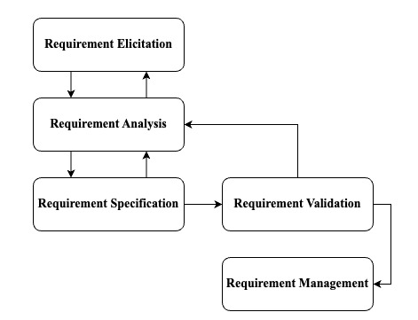

Let’s talk requirement engineering
The software development lifecycle (SDLC) involves several critical phases, with Requirement Engineering (RE) as the foundational step.
RE is essential as it involves documenting stakeholder needs, ensuring that projects remain aligned with these needs throughout the development process.
Despite its importance, RE can be time-consuming, prone to miscommunication, and susceptible to errors, leading to project delays or failures.
There is a need for innovative solutions that can enhance the accuracy and efficiency of RE processes.

Slide 3
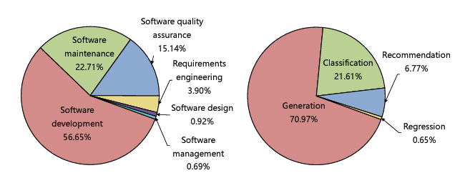
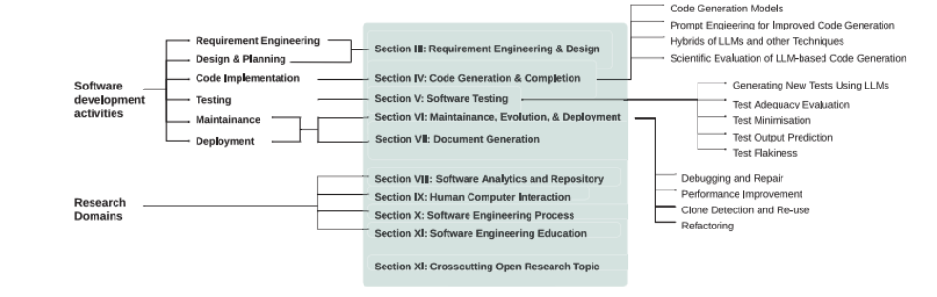
Research GAP
LLMs have shown significant potential in various software engineering tasks, including requirement engineering (RE), code generation, and testing. However, their application in RE is still emerging and under-researched (Hou et al, 2023).
Application of LLMs in Requirement Analysis
Zhang et al. (2024b): Explored the use of an Autonomous LLM-based Agent System (ALAS) powered by OpenAI GPT models to enhance the clarity and alignment of user stories within agile teams. The study highlighted improvements in user story quality but emphasized the need for human oversight to maintain factual accuracy.
Sami et al. (2024): Presented a tool that uses AI agents and prompt engineering to automate task prioritization in agile project management, addressing the challenge of aligning requirements with stakeholder needs within time and budget constraints.
De Bari (2024): Assessed the feasibility of using LLMs to generate UML Class Diagrams, showing that while LLMs can achieve accuracy comparable to humans, challenges remain in representing complex semantic links.
Application of LLMs in Requirement Specification:
Krishna et al. (2024): Investigated the use of LLMs for generating and validating Software Requirement Specification (SRS) documents, finding that LLMs like GPT-4 excelled in improving requirement quality over traditional methods.
Wei (2024): Demonstrated how LLMs could assist in refining requirements into software design, test cases, and implementation code, emphasizing the practical effectiveness of LLMs in real-world software development projects.
Hou, X., Zhao, Y., Liu, Y., Yang, Z., Wang, K., Li, L., Luo, X., Lo, D., Grundy, J. and Wang, H., 2023. Large language models for software engineering: A systematic literature review. arXiv preprint arXiv:2308.10620.
Zhang, Z., Rayhan, M., Herda, T., Goisauf, M. and Abrahamsson, P., 2024b, May. LLM-based agents for automating the enhancement of user story quality: An early report.
Sami, M.A., Rasheed, Z., Waseem, M., Zhang, Z., Herda, T. and Abrahamsson, P., 2024. Prioritizing Software Requirements Using Large Language Models. arXiv preprint arXiv:2405.01564. Vancouver.
De Bari, D., 2024. Evaluating large language models in software design: A comparative analysis of uml class diagram generation (Doctoral dissertation, Politecnico di Torino).
Krishna, M., Gaur, B., Verma, A. and Jalote, P., 2024. Using LLMs in Software Requirements Specifications: An Empirical Evaluation. arXiv preprint arXiv:2404.17842.
Wei, B., 2024. Requirements are All You Need: From Requirements to Code with LLMs. arXiv preprint arXiv:2406.10101

Slide 4

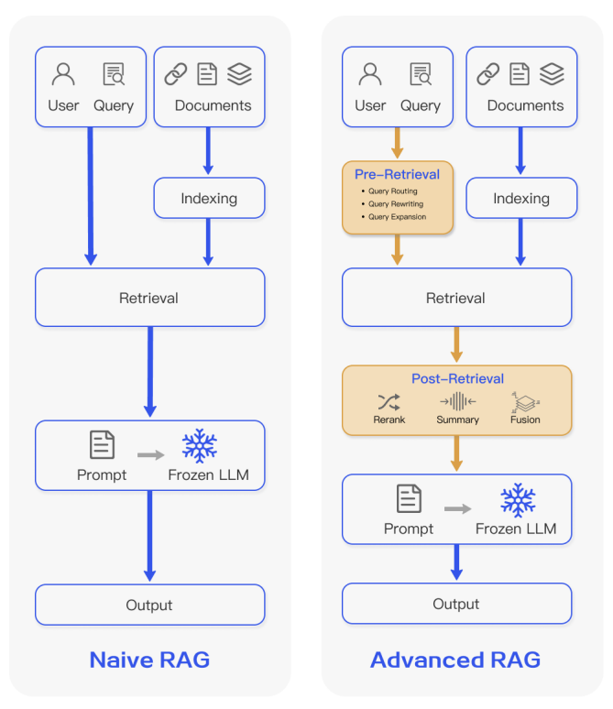
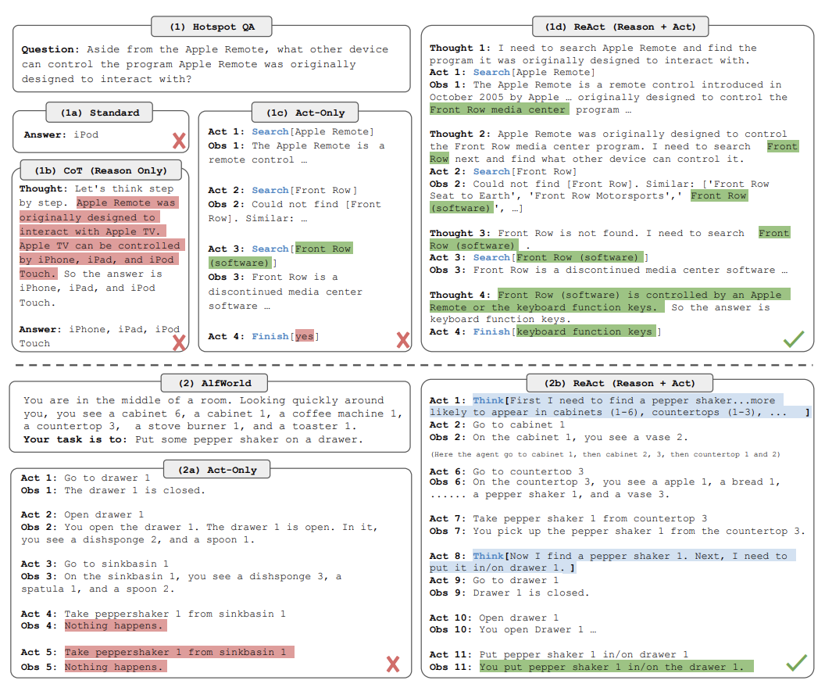
What are LLM Agents?
How we often interact with LLMs
Some limitations resolution via RAG
Moving to Agents (ReAct)
Gao, Y., Xiong, Y., Gao, X., Jia, K., Pan, J., Bi, Y., Dai, Y., Sun, J. and Wang, H., 2023. Retrieval-augmented generation for large language models: A survey. arXiv preprint arXiv:2312.10997.
Yao, S., Zhao, J., Yu, D., Du, N., Shafran, I., Narasimhan, K. and Cao, Y., 2022. React: Synergizing reasoning and acting in language models. arXiv preprint arXiv:2210.03629.

Slide 5
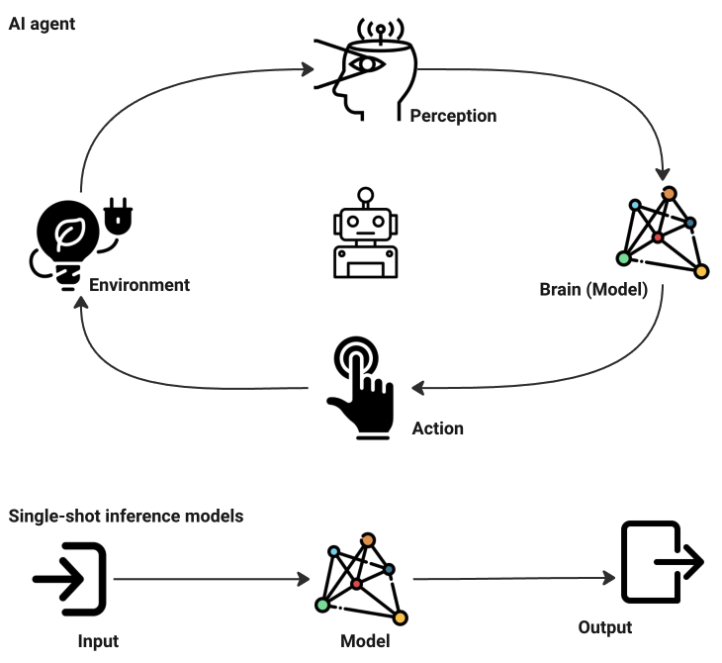
LLM Agents vs. Single-Shot Inference Models
While Generative AI (GenAI) models like GPT-4o are excellent at producing outputs like text, images, or audio from given inputs, they often operate on single-shot inference—processing input and generating output without further interaction.
In contrast, AI agents extend these capabilities by continuously interacting with their environment. They perceive changes, plan actions, execute them, and evaluate outcomes across multiple iterations. This makes agents more suitable for autonomous systems, such as chatbots, virtual assistants, or autonomous vehicles.

Slide 6

LLM Agents core components
Perception Layer
Orchestration Layer
Decision-making Layer
Action Layer
Memory Layer
Learning Layer
Notes:
The perception layer is the gateway through which the agent understands the world.
The Orchestrator layer (Central coordinator): This layer plays a pivotal role in managing the flow of information across the agent's components, ensuring tasks are executed efficiently. It handles inter-layer coordination, task delegation, process management, and multi-agent coordination.
Decision layer acts as the agent's brain, combining reasoning planning to make informed decisions.
Action Layer enables the AI agent to execute decisions, interacting with digital or physical environments through APIs, tools, or devices.
The Memory Layer enables AI agents to engage in personalized, coherent, and contextually aware interactions. Types of memory include short-term, long-term, entity, and contextual memory.
Learning layer interacts with the memory system allows AI agents to improve by analysing user feedback.

Slide 7
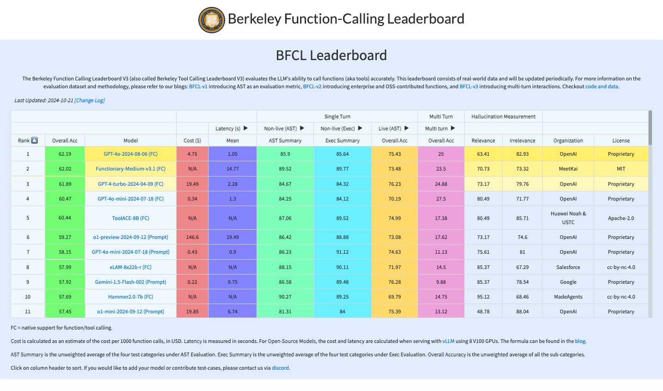
Tools for this workshop
SerperDevTool
WebsiteSearchTool
ArxivSearchTool
PerplexitySearchTool
Summary Index
Semantic Index
FileReadTool
CodeInterpreterTool

Slide 8
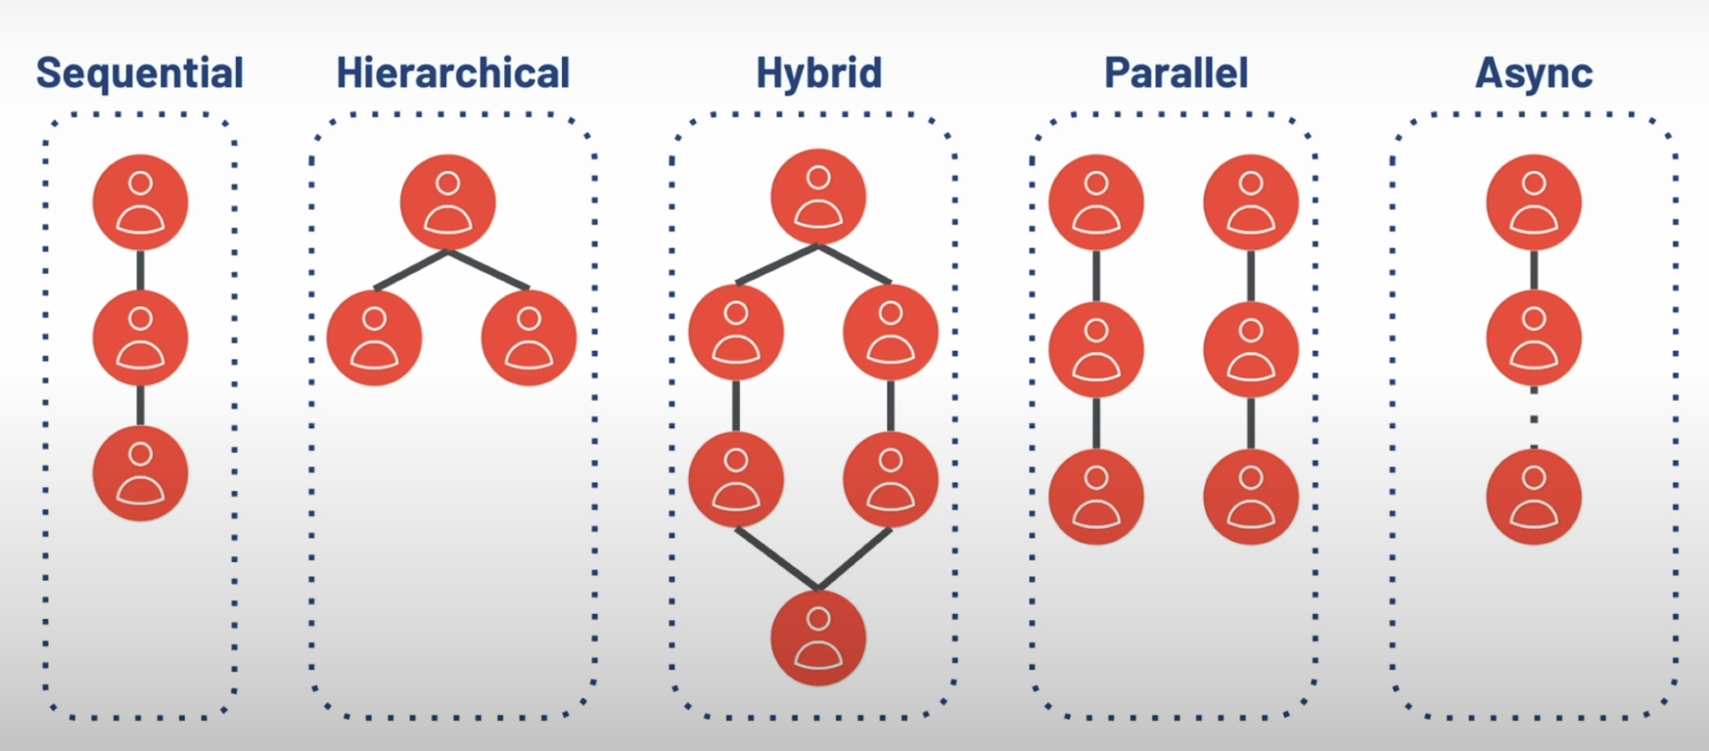
Agent Orchestration

Slide 9

Agents to be utilized
requirements_elicitation_agent
data_analysis_agent*
market_researcher_agent
requirement_developer_agent
compliance_specialist_agent
quality_control_analyst_agent

Slide 10

Let’s Run The Agentic System

Slide 11



