Slide 1
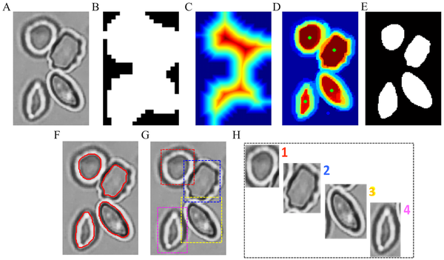

Fig 4. Workflow of RBC patch generation from ROIs with touching RBCs.
Xu M, Papageorgiou DP, Abidi SZ, Dao M, Zhao H, et al. (2017) A deep convolutional neural network for classification of red blood cells in sickle cell anemia. PLOS Computational Biology 13(10): e1005746. https://doi.org/10.1371/journal.pcbi.1005746
https://journals.plos.org/ploscompbiol/article?id=10.1371/journal.pcbi.1005746

