Slide 1
AI-Powered Medical Assistant : 🩺 Dr. LOL – Because laughter is the best medicine! 😂
Revolutionizing Patient-Doctor Interaction with AI
Presented By: Avinash Chavan
Institution: Adsul’s Technical Campus

Slide 2
Introduction
What is the AI-Powered Medical Assistant?
An AI-driven chatbot designed to enhance medical consultations.
Integrates speech recognition, medical image analysis, and AI-powered responses.
Aims to improve efficiency, accessibility, and accuracy in healthcare communication.
Reduces wait times and assists in preliminary diagnosis.

Slide 3
Problem Statement
Challenges in Healthcare Communication:
Patients struggle to describe symptoms accurately, leading to misdiagnosis.
Doctors face time constraints and administrative burdens.
Lack of accessible healthcare support in remote or underserved areas.
Need for an AI-driven solution to assist in medical interactions and improve diagnostic accuracy.

Slide 4
Project Objectives
Develop an AI chatbot that:
Converts speech to text using Whisper AI for real-time transcription.
Analyzes medical images to detect potential abnormalities.
Generates expert-like responses based on patient symptoms and images.
Converts text to speech for better accessibility, assisting visually impaired patients.
Provides real-time assistance to patients and doctors for informed decision-making.
Enhances patient engagement with AI-powered personalized health guidance.

Slide 5
Project Layout
Phase 1 – Setup the Brain of the Doctor (Multimodal LLM):
Setup GROQ API key.
Convert image to required format.
Setup Multimodal LLM.
Phase 2 – Setup Voice of the Patient:
Setup Audio recorder (FFMPEG & PortAudio).
Setup Speech-to-Text (STT) model for transcription.
Phase 3 – Setup Voice of the Doctor:
Setup Text-to-Speech (TTS) model (gTTS & ElevenLabs).
Use Model for text output to voice.
Phase 4 – Setup UI for the VoiceBot:
Implement VoiceBot UI using Gradio.

Slide 6
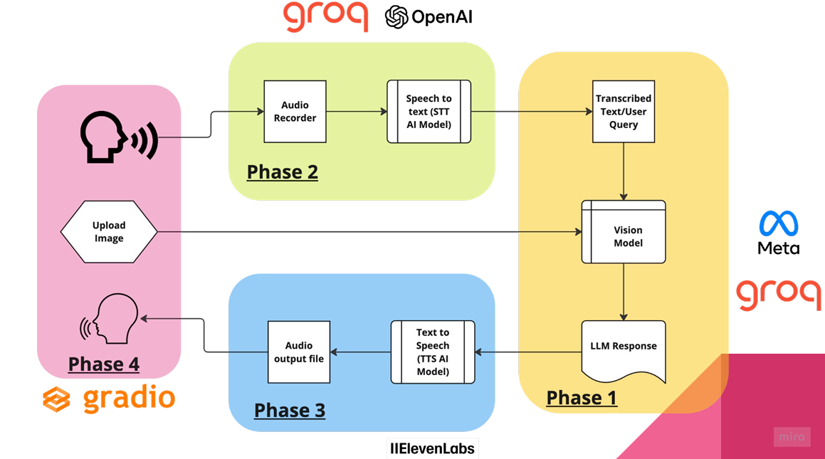
System Architecture

Slide 7
Workflow Process
1. Patient records symptoms via microphone.
2. AI transcribes speech into text.
3. User uploads a medical image (optional) for visual diagnosis.
4. AI analyzes the image and cross-references findings with speech input.
5. AI generates a doctor-like response based on medical insights.
6. Text response is converted into speech and played back for patient comprehension.
7. Feedback loop implemented to refine AI responses based on user validation.

Slide 8
Technologies Used
Programming Language: Python
Frameworks & APIs:
- Gradio: User interface development.
- Groq API: Optimized processing for AI models.
- ElevenLabs API & Google TTS: High-quality AI-generated speech.
- OpenAI Models (LLaMA-3 Vision): Handles medical query analysis.
Libraries:
- SpeechRecognition: Captures and processes patient speech.
- gTTS & Pydub: Converts text to speech and handles audio playback.
- Pygame: Enables seamless user interaction and media playback.

Slide 9
Live Demonstration
Showcase of the AI Assistant in Action:
Speech-to-text conversion.
Uploading and analyzing a medical image.
AI-generated medical advice.
AI-generated voice response.
Patient-Doctor interaction simulation mimicking real-life consultation.

Slide 10
Key Benefits
For Patients:
Quick AI-based insights and recommendations.
Provides 24/7 healthcare assistance.
Accessible for people with speech or hearing impairments.
For Doctors:
Reduces workload by pre-analyzing patient inputs.
Saves time by generating preliminary diagnoses and suggested treatments.
For Healthcare System:
Scalable AI-driven solution for preliminary diagnosis.
Can be integrated with telemedicine platforms for remote patient monitoring.

Slide 11
Future Enhancements
Integration with Electronic Health Records (EHRs).
Expanding AI model training.
Multi-language support.
Mobile application development.
AI-powered drug recommendations.
Predictive health analytics using AI for risk assessment.

Slide 12
Conclusion
AI is transforming healthcare by bridging gaps in medical communication.
Our chatbot enhances patient engagement and improves consultation efficiency.
A scalable, efficient, and impactful solution for healthcare.
Looking forward to advancements in AI-driven healthcare.

Slide 13
References & Acknowledgments
APIs & Libraries Used: Whisper AI, LLaMA-3, ElevenLabs, Gradio, Groq API.

