Slide 1
TRACERISK / THE PITCH
AZINHACK 2026
TRAVEL AWARENESS, MADE CLEARER
TraceRisk
The travel field guide
for India.
Know what could affect your trip—
before you go.
Place. Dates. Context.
AZINHACK 2026 / PROJECT PRESENTATION
THE TRAVEL FIELD GUIDE FOR INDIA
01 / 12
Notes:
Hello everyone. This is TraceRisk, the travel field guide for India. Before a trip, we usually book tickets and hotels, but information about local conditions is scattered. TraceRisk brings those updates into one source-linked briefing for the place and dates we choose. Our goal is simple: help people travel with better context. I will show the product, explain how it works, and share a proposed way to earn revenue through transparent hotel promotions.

Slide 2
TRACERISK / THE PROBLEM
AZINHACK 2026
Too many tabs. Too little context.
Before you travel,
what has changed?
01
Local reports
Does this story apply to my destination?
02
Transport updates
Could my route or journey be affected?
Useful information exists.
Connecting it takes time.
03
Weather & notices
Does the information cover my dates?
The need: one useful briefing for a specific trip.
THE TRAVEL FIELD GUIDE FOR INDIA
02 / 12
Notes:
Imagine planning a trip to Manali. You might check weather in one tab, roads in another, and local news somewhere else. Each source may cover a different area or date. The difficult part is deciding what actually matters for your trip. Missing information can also look like an all-clear. TraceRisk reduces this research effort by organising the information around a confirmed destination and travel dates. It supports planning; it does not promise safety.

Slide 3
TRACERISK / THE EXPERIENCE
AZINHACK 2026
One trip. One clear briefing.
A simple flow from travel plans to useful context.
01
02
03
Plan your trip
Confirm the place
Read your briefing
Choose a destination
and travel dates.
Select the right city,
district and state.
Review findings, sources
and information gaps.
Save a plan. Check the evidence. Keep the briefing.
THE TRAVEL FIELD GUIDE FOR INDIA
03 / 12
Notes:
The flow has three steps. First, enter a destination and travel dates. Second, confirm the correct place, because similar names must not lead to the wrong local information. Third, read the briefing. It includes findings, source links and coverage gaps. Travellers can save plans in their browser and download a text briefing. Reopening a saved plan requires fresh location confirmation; it is not a saved safety verdict.

Slide 4
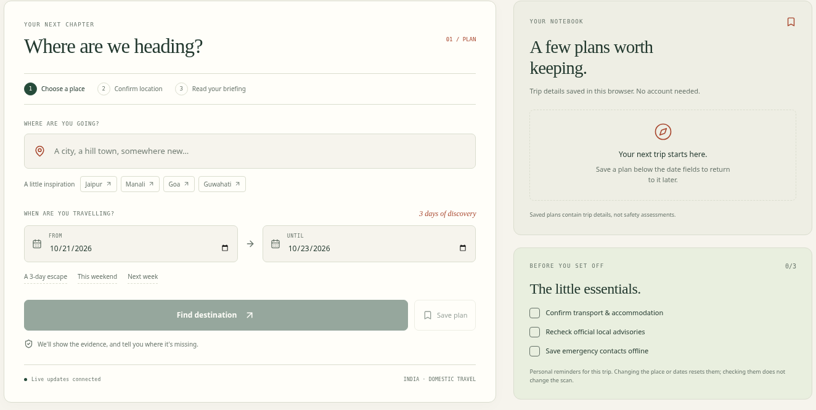
TRACERISK / THE PRODUCT
AZINHACK 2026
A travel notebook you can actually use.
01
Plan in seconds
Date shortcuts and
place confirmation.
02
Stay organised
Saved plans and
a trip checklist.
03
Make it yours
Light / dark themes.
Download your briefing.
ACTUAL INTERFACE / PLANNING SCREEN / NO LIVE SCAN SHOWN
THE TRAVEL FIELD GUIDE FOR INDIA
04 / 12
Notes:
This is the actual planning interface. The design matches a travel notebook: ivory pages, forest-green text and terracotta accents. It works on mobile and includes an evening theme. For a quick demo, enter a place, choose dates, confirm the destination and save the plan. Then start a scan and review coverage before discussing findings. If provider access fails during the demo, show the error honestly and continue with the interface walkthrough. This screenshot is a planning screen, not a successful live scan.

Slide 5
TRACERISK / WHAT WE CHECK
AZINHACK 2026
The local picture, from four angles.
Eight search lanes, plus weather and river-model context.
01 / GETTING THERE
02 / LOCAL CONDITIONS
Roads & traffic
Public transport
Infrastructure
Civil unrest
Official advisories
Regional news
03 / PERSONAL AWARENESS
04 / NATURAL CONDITIONS
Health reports
Crime reports
Weather forecasts
River-flow outlooks
MODELS PROVIDE PLANNING CONTEXT; OFFICIAL WARNINGS STILL NEED CHECKING.
THE TRAVEL FIELD GUIDE FOR INDIA
05 / 12
Notes:
TraceRisk looks at eight search categories: roads, public transport, infrastructure, civil unrest, official advisories, regional news, health and crime. Alongside those reports, it uses weather forecasts and river-flow models for the location. These inputs help identify topics worth checking before travel. They are not all equally complete, and forecasts may not cover every trip date. The app shows those gaps. Model-based weather or river context should not be presented as an official warning.

Slide 6
TRACERISK / HOW IT WORKS
AZINHACK 2026
Collect. Review. Explain.
A small pipeline turns scattered inputs into a readable briefing.
01
02
03
Collect
Review
Explain
→
→
TinyFish: local reports.
Open-Meteo: places
and forecasts.
Gemini reviews reports.
Groq or labelled rules
provide a fallback.
Cited findings.
Collection coverage.
Missing forecast dates.
Interface: React + Vite | Server: Node.js + Express
THE TRAVEL FIELD GUIDE FOR INDIA
06 / 12
Notes:
The system has three stages. Collect: TinyFish discovers and extracts relevant reports, while Open-Meteo handles place lookup and forecasts. Review: Gemini assesses the evidence. Optional Groq can be used if configured, and a clearly labelled rules-based fallback keeps the result understandable when AI access fails. Explain: the frontend presents source-linked findings and collection coverage. React and Vite power the interface, with a Node and Express backend. The value is the complete trip-focused workflow, including honest failure handling.

Slide 7
TRACERISK / TRUST & LIMITATIONS
AZINHACK 2026
Confidence starts with honesty.
01
Show the evidence
Citations, dates and source-quality labels.
02
Show what is missing
Collection gaps and uncovered forecast dates.
03
Keep the score in context
A planning signal, not a probability of harm.
No findings does not mean no risk.
THE TRAVEL FIELD GUIDE FOR INDIA
07 / 12
Notes:
Trust is central to the product. A result should show where its information came from and where collection is incomplete. The risk score is a heuristic planning signal, not the probability that something bad will happen. A low score or an empty list cannot prove safety. AI can make mistakes, sources can be old, and providers can fail. Travellers should still check local authorities and transport operators when making important decisions. This same principle also shapes our proposed advertising model.

Slide 8
TRACERISK / WHAT IS READY
AZINHACK 2026
A working prototype, with a clear next step.
BUILT TODAY
LOCAL VERIFICATION
Trip planning, saved plans & themes
33 + 12
Source-linked findings & coverage gaps
Node tests +
browser tests
Filters, briefing download & print
Cancellation, fallbacks & request limits
Production build passed.
Fixture-based checks; not a live-provider certification.
Next: traveller feedback and a small, clearly labelled hotel-ad pilot.
THE TRAVEL FIELD GUIDE FOR INDIA
08 / 12
Notes:
This is a working prototype, with trip planning, browser-saved plans, themes, source-linked findings and briefing exports. It also handles cancellation, provider fallbacks and bounded requests. The latest local verification passed 33 Node tests, 12 browser tests and the production build. Those automated checks use fixtures, so they do not certify live provider access or a production deployment. There are no hotel ads or bookings implemented today. The next step is feedback from travellers and a small hotel-ad pilot.

Slide 9
TRACERISK / MONETIZATION / PROPOSED
AZINHACK 2026
Evidence first. Sponsored stays second.
Earn from hotel visibility while keeping the travel briefing independent.
1. Check the destination
SPONSORED
MOCK-UP
Use fresh, adequate evidence and review warnings.
2. Show relevant hotel ads
Example stay
Hide ads if evidence is weak or warnings appear.
A hotel near your
selected destination.
3. Keep a clear boundary
Label ads. Payment never changes the assessment.
View hotel details →
Lower concern is not a safety guarantee. Hotel quality needs separate checks.
THE TRAVEL FIELD GUIDE FOR INDIA
09 / 12
Notes:
Our proposed monetization is sponsored hotel listings near selected destinations. The idea is to promote relevant stays only after fresh and adequate evidence checks, and to suppress ads when data is weak or warning signals appear. This policy still needs design and validation. Each listing would be clearly marked Sponsored. Paying hotels could never change risk scores or hide warnings. A lower-concern destination is not guaranteed safe, and hotel quality requires separate checks. The example on this slide is a mock-up, not a partner or an implemented feature.

Slide 10
TRACERISK / THE REVENUE MODEL / PROPOSED
AZINHACK 2026
Start with a simple hotel subscription.
ILLUSTRATIVE PILOT PRICING / NO CURRENT REVENUE
FIRST
10 hotels × ₹1,000 / month
Monthly sponsored placement
₹10,000
gross revenue / month
LATER / OPTIONAL
Booking-referral fees,
if partners agree
Pilot questions: will hotels pay, will travellers click, and what does each scan cost?
Hypothetical math. API, hosting, marketing, fees and taxes reduce net income.
THE TRAVEL FIELD GUIDE FOR INDIA
10 / 12
Notes:
We can start with a monthly placement fee instead of building a booking platform immediately. For an easy example, ten hotels paying one thousand rupees per month would produce ten thousand rupees in gross monthly revenue. This is hypothetical pricing, not actual sales or profit. API usage, hosting, marketing, fees and taxes would reduce income. We would test willingness to pay, ad clicks, hotel renewals and cost per scan. Booking-referral fees could be explored later, only with suitable partner agreements.

Slide 11
TRACERISK / THE NEXT CHAPTER
AZINHACK 2026
A focused path from prototype to pilot.
01 / LEARN
02 / PILOT
03 / IMPROVE
Test with travellers
Pilot hotel ads
Improve coverage
Test with travellers.
Improve clarity.
Measure usefulness.
Verify hotel details.
Label every promotion.
Test willingness to pay.
Evaluate source freshness.
Add local-language reporting.
Prepare to scale.
Pilot targets and future work—not existing users, partners or revenue.
THE TRAVEL FIELD GUIDE FOR INDIA
11 / 12
Notes:
The next chapter is deliberately small. First, observe travellers using TraceRisk and learn which parts of the briefing are helpful or confusing. Second, approach a small group of hotels to test clearly labelled sponsored placements, with verified property details and independent assessment rules. Third, evaluate freshness and location relevance, improve local-language coverage and strengthen infrastructure for wider use. These are planned steps, not existing partnerships or user traction. We would value feedback on both the travel experience and the pilot business model.

Slide 12
TRACERISK / THANK YOU
AZINHACK 2026
EXPLORE WITH CURIOSITY. TRAVEL WITH CONTEXT.
Good journeys start
with better context.
TraceRisk
Thank you. Questions?
github.com/codeby-irFAN/TraceRisk
THE TRAVEL FIELD GUIDE FOR INDIA
12 / 12
Notes:
TraceRisk helps travellers connect local updates, forecasts and source evidence before a trip. The product is built around one clear principle: show useful context and be honest about what is missing. Our proposed hotel sponsorship model follows the same rule—transparent ads that cannot influence the assessment. Thank you for listening. I would be happy to show the interface and answer questions about the technology, the limitations or the pilot plan.

