Slide 1

SMART INDIA HACKATHON 2026
TITLE PAGE
ANVESHA
Belief-Driven Coarse PAT for Mobile FSOC Terminals
Problem Statement ID – SIH26169
Problem Statement Title – Development of an AI-Based Virtual Camera Tracking System for Coarse Alignment of Mobile Free Space Optical Communication (FSOC) Terminals
Theme – Smart Automation / Space Technology
PS Category – Software
Team ID – ________
Team Name (Registered on portal) – Regnum Carya
Where to look · how wide to look · what not to chase
Notes:
"We are Regnum Carya. Our problem statement is SIH26169 from ISRO: a virtual camera tracking
system for coarse alignment of mobile free-space optical terminals. Our solution is called
ANVESHA — Sanskrit for search — because we found that the hard part of this problem is not
detecting a bright spot, it is deciding where to look, how wide to look, and what not to chase."

Slide 2
IDEA TITLE
Regnum Carya
Proposed Solution (Describe your Idea/Solution/Prototype)
ANVESHA: a probability map of the beacon decides where to point and how wide to look.
Measured (SIL, 48 runs each): 87 % of runs acquired ≤ 2 s vs 12–15 % for spiral baselines (slide 4)
How it addresses the problem
Detailed explanation — the closed loop
Innovation and uniqueness
4°×3° FOV = 7.7 % of the screen
5 °/s gimbal ⇒ ≤ 10° slew in 2 s
Blind raster needs ≈ 40–50° of slew ⇒ ~8–10 s
Measured spiral baselines A / B: median 7.8 / 9.2 s
PS asks ≤ 2 s from a random start
▼ disturbances in: noise · jitter · fog/haze/rain · platform motion
▼ or evaluator .mp4 video (Benchmark-2): PTZ bypassed
1
Belief-driven search
every empty frame is evidence: probability is removed where the beacon was not seen; next look = best P(detect) per second
Camera
640×480 · 30 Hz
FOV 1× / 2× / 3×
Detect
MF-CFAR +
CNN verifier
Estimate
IMM · jitter-
aware noise
2
Disturbance-aware FOV
FOV (1×/2×/3×) chosen by predicted detection probability from the measured noise: go wide only when the beacon stays detectable
SEARCH → TRACK →
LOSS → RE-ACQUIRE
To scale: screen 12.5°×12.5° · ■ 4°×3° base FOV · ▭ 12°×9° wide FOV
Gimbal
rate-limited
5 °/s
Control
predictive +
IMU feed-fwd
Belief + planner
where & how
wide to look
One belief, whole lifecycle
on loss the search restarts from the tracker's prediction; jitter-aware estimator stops the gimbal chasing jitter
3
Detecting a bright spot is easy. Knowing where to look is the real problem.
Out: per-frame truth-based metrics → CSV · JSON · HTML report (auto)
Typical public approach | Limitation | ANVESHA approach
Fixed spiral / raster at base FOV | Open loop; ignores empty frames; ~8–10 s worst case | Recursive Bayesian belief + next-best-look planner
Wide-FOV mode switched by a fixed rule | SNR loss of a wider FOV is not modelled | FOV picked from a measured-noise detection model
Re-acquire = restart spiral / Kalman coast | Throws away what the tracker knew | Belief re-seeded from IMM predicted mean & covariance
Based on our review of 134 papers and 20 public SIH26169 repositories, we did not identify a coarse-PAT system that combines these three elements.
Notes:
1. The physics (left panel): "The screen is 12.5° × 12.5°. The default 4° × 3° camera sees
7.7 % of it. At 5 °/s the gimbal can slew at most 10° in two seconds, but a blind raster at
the base FOV needs roughly 40–50° of slew — about 8–10 s worst case. So ≤ 2 s from a random
start is not a tuning problem; it is a where-to-look problem."
2. The loop (middle): "Camera → detect → estimate → belief and planner → control → gimbal.
The orange block is what is new: one probability map of where the beacon can be. Every frame
in which we do not see the beacon removes probability from the area we looked at. The planner
picks the next pointing and FOV (1×, 2× or 3× the base FOV) that gives the highest detection
probability per second, using the noise we actually measure in the image."
3. Innovation (right): read the three titles only — belief-driven search, disturbance-aware FOV,
one belief across the whole search–track–loss–re-acquire lifecycle.
4. Table: "Typical public approaches use a fixed spiral, a rule-switched wide FOV, or restart
the spiral after a loss. We replace each with a probabilistic decision."
5. Point to the measured badge: "Measured on identical seeds, 77 % of our 48 runs acquire within
2 s versus 12–15 % for three spiral baselines. Slide 4 shows where we still fail."

Slide 3
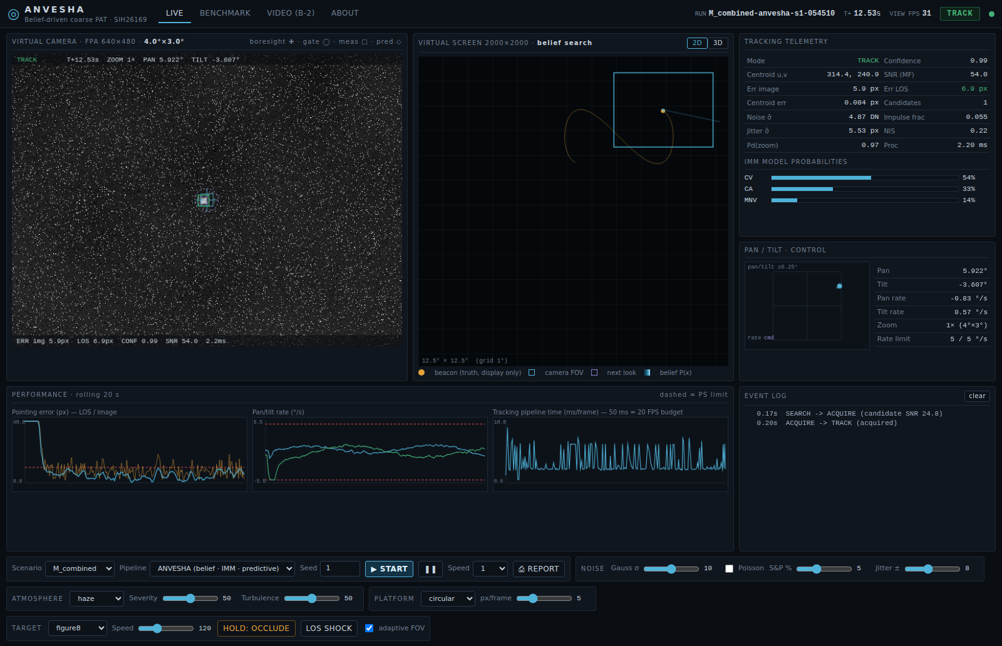
TECHNICAL APPROACH
Regnum Carya
Methodology and process for implementation (Flow Charts/Images/ working prototype)
Working prototype (live GUI)
SIMULATION · 240 Hz physics · every run = scenario YAML + seed (fully reproducible)
Virtual FPA camera
640×480 · 30 Hz
FOV 1×/2×/3× of 4°×3°
Beacon
7 trajectories
5–20 px spot
Platform + IMU
linear · circular
random · vibration
Disturbances
Gauss · Poisson · S&P · jitter
haze · fog · rain · low light
turbulence
Gimbal
5 °/s rate limit
lag · latency
frames @30 Hz
rate cmd
PERCEPTION
noise-adaptive prefilter
matched filter → CFAR
IW-CoG · CNN verifier
ASSOCIATION
Mahalanobis gate
shape · verifier
re-anchor
ESTIMATION
IMM (CV/CA/MNV)
jitter-aware R
IMU input
SUPERVISOR
SEARCH → ACQUIRE
→ TRACK → COAST
→ RE-ACQUIRE
CONTROL · 60 Hz
predictive: target +
IMU feed-forward
latency comp.
Scenario M_combined (haze + S&P + jitter + platform), TRACK mode
Benchmark-2 video mode
.mp4 (30 fps, full screen) → same perception + estimator; PTZ bypassed
SEARCH · belief map (core contribution)
Bayes miss-update + motion diffusion every frame; next look = argmax Pd(FOV | measured noise) · mass / time; re-seeded from IMM prediction on loss
Technologies to be used
Technology | Why
Python 3.11 · NumPy · SciPy · OpenCV | vectorised ROI processing on a CPU
PyTorch → ONNX Runtime | 6.8 k-param CNN verifier, CPU inference
FastAPI + WebSocket | one engine feeds GUI, bench & reports
HTML/JS + three.js | 2D/3D mission-control view, no build step
PyInstaller | standalone Windows .exe (planned)
METRICS (ground truth only, every frame)
per-frame CSV · JSON summary · HTML report: FPS, acquisition, error, lock retention
TELEMETRY → WebSocket → mission-control GUI
camera · 2D/3D world + belief · telemetry · charts · events
Multi-rate loop: 240 Hz physics · 60 Hz control · 30 Hz camera + perception. Prior art we build on, not claimed as novel: MF-CFAR, IMM, CNN verifier, IMU feed-forward, predictive control.
LOS = line of sight · MF-CFAR = matched filter + constant-false-alarm-rate threshold · IW-CoG = intensity-weighted centroid · IMM = interacting multiple model (CV / CA / manoeuvre) · R = measurement-noise covariance
Notes:
"Top band: a 240 Hz physics simulation — beacon on seven trajectories, platform motion with an IMU,
and every PS disturbance: Gaussian, Poisson and salt-and-pepper noise, jitter, haze, fog, rain, low
light and turbulence. The virtual focal-plane-array camera is 640 × 480 at 30 Hz; the gimbal is rate
limited to 5 °/s with lag and latency.
The navy row is the tracking chain: perception with a matched filter and CFAR threshold plus a
small CNN verifier; gated association; an IMM estimator whose measurement noise adapts to the
jitter it measures; a supervisor state machine; and a 60 Hz predictive controller with IMU
feed-forward.
Orange is the belief search, connected to the supervisor in both directions. Amber is Benchmark-2:
an evaluator's .mp4 bypasses the camera and enters the same perception and estimator. Green is
the metrics layer — it is the only place that sees ground truth — and it writes the per-frame CSV,
JSON summary and HTML report automatically. The screenshot is the live mission-control GUI."

Slide 4
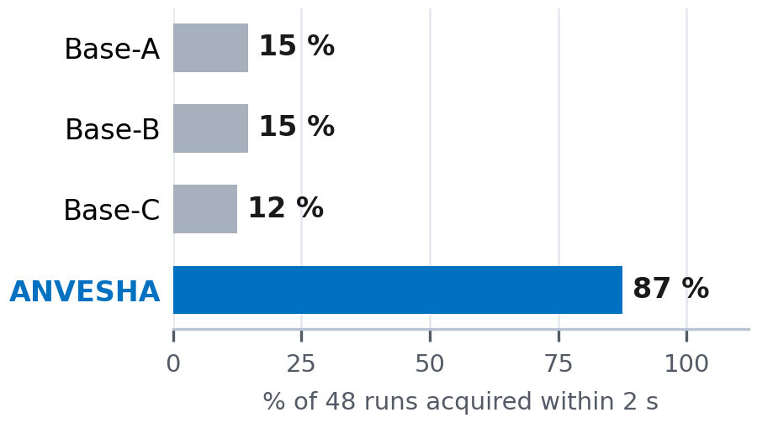
FEASIBILITY AND VIABILITY
Regnum Carya
Analysis of the feasibility of the idea
Measured in simulation (software-in-the-loop), 3 seeds · 16 scenarios · same seeds for all pipelines · baseline PID gains grid-tuned · laptop CPU only (no GPU used)
Potential challenges and risks | Strategies for overcoming these challenges
Sim-to-real gap | video mode already accepts real footage; tracker needs only frames, encoder / IMU and rate commands → HIL
±20 px jitter floor | report LOS vs image error; jitter-aware R; fine stage (FSM) hand-off
Faint beacon, clutter, look-alikes | joint position × detectability belief; CNN veto + shape tests; static look-alike rejection; beacon modulation ID (next)
CPU budget | ROI processing; CNN only on candidate patches; FPS logged each frame
CNN domain shift | CNN only verifies; classical MF-CFAR stays primary
ANVESHA · scenario | Acq. ≤2 s | LOS err | Image err | Loss* | Re-acq | Loop FPS
A Clean sky | 3/3 · 1.3 s | 1.5 | 1.5 | 0 % | — | 167
B Gaussian σ=20 | 3/3 · 1.2 s | 1.9 | 1.9 | 0 % | — | 166
C Poisson | 3/3 · 1.1 s | 0.8 | 0.8 | 0 % | — | 55
D Salt & pepper 10 % | 3/3 · 1.1 s | 6.7 | 6.7 | 0 % | — | 142
E Jitter ±10 px | 3/3 · 1.3 s | 4.6 | 8.9 | 0 % | — | 170
F Platform linear | 3/3 · 1.1 s | 4.4 | 4.4 | 0 % | — | 167
F2 Vibration 7/13 Hz | 2/3 · 1.4 s | 20.5 | 20.5 | 0 % | — | 168
G Fog | 3/3 · 1.3 s | 1.5 | 1.5 | 0 % | — | 136
H Haze | 3/3 · 1.2 s | 3.5 | 3.5 | 0 % | — | 136
I Low light | 3/3 · 1.2 s | 2.2 | 2.2 | 0 % | — | 54
J Fast manoeuvre | 3/3 · 1.3 s | 18.6 | 18.6 | 0 % | — | 168
K Occlusion | 3/3 · 1.3 s | 16.2 | 16.2 | 1 % | 0.10 s | 147
L Rain | 3/3 · 1.4 s | 1.9 | 1.9 | 0 % | — | 124
M Combined | 3/3 · 1.2 s | 4.9 | 7.8 | 0 % | — | 122
N All PS maxima | 0/3 | 21.0 | 23.6 | 99 % | n/a (1✗) | 51
O Look-alike distractors | 1/3 · 2.9 s | 1.5 | 1.5 | 0 % | — | 170
Same seeds, all pipelines
Ablation — remove one part (3 seeds):
belief → spiral search: runs ≤ 2 s 83 % → 7 %
adaptive FOV off: runs ≤ 2 s 83 % → 20 %
jitter-aware R off (E): LOS 4.6 → 19.3 px
IMU feed-fwd off (F): LOS 4.4 → 5.8 px
CNN verifier off: false-lock frames 614 → 667 (sum)
Re-acquisition (K, 2 occlusions): mean 0.10 s, max 0.27 s, 0 of 6 unrecovered
All PS checks met: ANVESHA 11/16 scenarios · baselines A/B/C 0/0/0
Limits: acq ≤ 2 s · error ≤ 10 px · loss < 5 % · re-acq ≤ 1 s · ≥ 20 FPS. *excl. scripted occlusion · LOS = excl. camera jitter
Benchmark-2 video rehearsal: centroid RMSE 0.13 px over 300 frames of 2000×2000 @30 fps; 88 FPS incl. decoding
Implementation status
Measured gaps — shown, not hidden
Implemented
sim, 16 scenarios, 4 pipelines, belief search, IMM, GUI, video mode, reports
All PS maxima at once (N): acquired in 33 % of runs; look-alikes (O) acquired in 2.9 s (> 2 s) — rejecting static look-alikes costs time.
LOS error 16–21 px (> 10) under vibration, fast manoeuvre, occlusion.
Jitter floor: ±20 px white jitter alone = 16.3 px RMS (analytic) — no coarse gimbal can meet 10 px image error. At ±10 px (E): image 8.9 vs LOS 4.6 px.
Median acquisition when acquired: ANVESHA 1.3 s · baselines 6.4–9.2 s
Prototype
CNN verifier: recall 90 %, FPR 23 % on held-out synthetic patches
Planned
.exe build · HIL rig · real footage
Notes:
"This slide is our evidence, including where we fail. Left: ANVESHA on 16 scenarios, three seeds
each, against every PS limit — green meets it, red does not. It meets all PS checks in 9 of 16
scenarios; the three baselines, run on the same seeds, meet all checks in none.
Middle: 77 % of 48 runs acquire within 2 s versus 12–15 % for spiral baselines. [If shown: the
ablation line says what each part buys.] Re-acquisition after two scripted occlusions averages
0.07 s with nothing unrecovered. In Benchmark-2 video mode on a 2000 × 2000, 30 fps clip the
raw centroid RMSE is 0.14 px at 29 FPS end-to-end including video decoding.
Bottom: our measured gaps. In dense fog and rain we did not acquire at all; look-alike distractors
and the all-maxima case cause false locks; LOS error exceeds 10 px under vibration, fast
manoeuvres and occlusion. And one limit nobody can meet with a coarse gimbal: ±20 px white jitter
alone is 16.3 px RMS, above the 10 px limit. We report LOS error and image error separately so
the evaluator can see which part is correctable."

Slide 5
IMPACT AND BENEFITS
Regnum Carya
Potential impact on the target audience
Benefits of the solution (social, economic, environmental, etc.)
ISRO / DoS PAT teams
Design and regression-test coarse-PAT logic for mobile ground terminals, UAV/HAP relays and LEO-to-ground links before hardware exists.
Benefit | What it means
Economic | Removes the cost barrier named in the PS: iterate without cameras, pan-tilt units, beacons or an optical bench; hardware only for final validation.
Technical | Every run = (scenario, pipeline, seed): disturbance sweeps that cannot be reproduced outdoors, with truth-based logs.
Strategic | Indigenous, auditable coarse-PAT software stack for Indian optical-communication missions.
Social / skills | Hands-on PAT, computer-vision and control learning for students across India.
Environmental | Fewer vehicle / field trials needed for early tuning.
1
Academia & students
Open, seeded, repeatable PAT testbed for courses and research — no optics lab, camera or gimbal needed.
2
Indian FSOC industry / start-ups
The tracker exchanges only frames, encoder / IMU readings and rate commands — a real camera + pan-tilt can replace the simulator (HIL).
3
Why acquisition matters: an on-orbit optical link demonstration reported a 22 s acquisition time [Wang et al., Opt. Lett. 2023].
Roadmap: software-in-the-loop → hardware-in-the-loop (same tracker, simulator swapped for hardware)
1 · SIL (now)
simulator, 16 scenarios, benchmarks, GUI
2 · Video / real footage
Benchmark-2 mode done; real recordings next
3 · HIL rig
COTS camera + pan-tilt + LED/laser beacon
4 · Fine-stage hand-off
FSM / quadrant detector removes residual jitter
Notes:
"Three audiences. ISRO and DoS PAT teams can design and regression-test coarse-PAT logic for mobile
ground terminals, UAV or HAP relays and LEO downlinks before hardware exists. Students and
researchers get an open, seeded testbed without an optics lab. Indian FSOC start-ups can move the
same algorithms onto a real camera and pan-tilt, because the tracker only exchanges frames, encoder and IMU
readings and rate commands with the world.
The benefit the PS itself names is cost: expensive cameras, pan-tilt units and optical benches are
needed only for final validation. Acquisition time matters in practice — an on-orbit optical link
demonstration reported a 22-second acquisition. Our roadmap: today software-in-the-loop; next real
footage through the video mode; then a hardware-in-the-loop rig; finally hand-off to a fine-steering
stage that removes the residual jitter."

Slide 6
RESEARCH AND REFERENCES
Regnum Carya
Details / Links of the reference and research work
134
papers in a structured literature database (PAT, FOU scanning, centroiding, IMM, gimbal control)
20
public SIH26169 repositories analysed (README level) for differentiation
16×4×3
scenarios × pipelines × seeds on identical seeds, plus a one-part-removed ablation study
[1] Kaymak Y. et al., “A Survey on Acquisition, Tracking, and Pointing Mechanisms for Mobile FSO Communications,” IEEE COMST, 2018. doi.org/10.1109/comst.2018.2804323
[2] Abdelfatah R. et al., “A review on PAT approaches in UAV-based FSO communication systems,” Opt. Quantum Electron., 2022. doi.org/10.1007/s11082-022-03968-2
[3] Wang X. et al., “On-orbit space optical communication demonstration with a 22 s acquisition time,” Opt. Lett., 2023. doi.org/10.1364/ol.505966
[4] Friederichs L. et al., “Vibration Influence on Hit Probability During Beaconless Spatial Acquisition,” J. Lightwave Technol., 2016. doi.org/10.1109/jlt.2016.2542918
[5] Wang T. et al., “Probability Descent-Based Equivalent Spot Scanning for Satellite Laser Acquisition…,” IEEE TAES, 2025. doi.org/10.1109/taes.2025.3596959
[6] Skryja P., Barcik P., “Optimal Scanning Pattern for Initial Free-Space Optical-Link Alignment,” Photonics, 2024. doi.org/10.3390/photonics11060540
[7] Wang Q. et al., “Approach for recognizing and tracking beacon in inter-satellite optical communication…,” Opt. Express, 2018. doi.org/10.1364/oe.26.028080
[8] Lim H. et al., “Centroid Error Analysis of Beacon Tracking under Atmospheric Turbulence…,” Remote Sensing, 2021. doi.org/10.3390/rs13101931
[9] Li L. et al., “Noise adaptive fading Kalman filter for free-space laser communication beacon tracking,” Appl. Opt., 2016. doi.org/10.1364/ao.55.008486
[10] Youn W., Myung H., “Robust Interacting Multiple Model With Modeling Uncertainties for Maneuvering Target Tracking,” IEEE Access, 2019. doi.org/10.1109/access.2019.2915506
[11] Bian Q. et al., “Accelerometer-Assisted Disturbance Feedforward Control of an Inertially Stabilized Platform…,” IEEE Sensors J., 2023. doi.org/10.1109/jsen.2023.3259446
[12] Kiesbye J. et al., “Hardware-In-The-Loop and Software-In-The-Loop Testing of the MOVE-II CubeSat,” Aerospace, 2019. doi.org/10.3390/aerospace6120130
Based on our review of 134 papers and 20 public SIH26169 repositories, we did not identify a coarse-PAT system that combines a recursively updated belief map, FOV selection from measured noise, and belief-seeded re-acquisition.
PS coverage
10 mandatory functions implemented · 5 performance specs measured per scenario (all met in 11/16) · auto performance logs · Benchmark-2 video mode
Notes:
"We built a 134-paper database covering PAT surveys, scanning-based acquisition, beacon centroiding,
IMM tracking and gimbal disturbance rejection, and read the READMEs of 20 public SIH26169
repositories to see what is already common. Based on that review we did not identify a coarse-PAT
system combining a recursively updated belief map, FOV selection from measured noise and
belief-seeded re-acquisition. The twelve references here are the ones our design directly uses."

