Slide 1

SMART INDIA HACKATHON 2026
ANVESHA
Finds a mobile FSOC beacon in 1.3 s (median, simulated) by deciding where and how wide to look — then tracks it
Problem Statement ID : SIH26169
Problem Statement Title : Development of an AI-Based Virtual Camera Tracking System for Coarse Alignment of Mobile Free Space Optical Communication (FSOC) Terminals
Theme : Smart Automation / Space Technology
PS Category : Software
Team ID : ________
Team Name (Registered on portal) : Regnum Carya
1.3 s
median acquisition
spiral baselines 6.4–9.2 s
87 %
of runs acquired ≤ 2 s
baselines 12–15 %
11/16
scenarios meet every PS limit
baselines 0/16
Measured in simulation (software-in-the-loop): 16 scenarios × 3 seeds, identical seeds for all pipelines
Notes:
"We are Regnum Carya. Our problem statement is SIH26169 from ISRO: a virtual camera tracking
system for coarse alignment of mobile free-space optical terminals. Our solution is called
ANVESHA — Sanskrit for search — because we found that the hard part of this problem is not
detecting a bright spot, it is deciding where to look, how wide to look, and what not to chase."

Slide 2
IDEA TITLE
Regnum Carya
Proposed Solution (Describe your Idea/Solution/Prototype)
ANVESHA: a probability map of the beacon decides where to point and how wide to look.
Measured (SIL, 16 scenarios × 3 seeds): 87 % of runs acquired ≤ 2 s vs 12–15 % for spiral baselines (slide 4)
How it addresses the problem
Detailed explanation — the closed loop
Innovation and uniqueness
4°×3° FOV = 7.7 % of the screen
5 °/s gimbal ⇒ ≤ 10° slew in 2 s
Blind raster needs ≈ 40–50° of slew ⇒ ~8–10 s
Measured spiral baselines A / B: median 7.8 / 9.2 s
PS asks ≤ 2 s from a random start
▼ disturbances in: noise · jitter · fog/haze/rain · platform motion
▼ or evaluator .mp4 video (Benchmark-2): PTZ bypassed
1
Belief-driven search
every empty frame is evidence: probability is removed where the beacon was not seen; next look = best P(detect) per second
Camera
640×480 · 30 Hz
FOV 1× / 2× / 3×
Detect
MF-CFAR +
CNN verifier
Estimate
IMM · jitter-
aware noise
2
Disturbance-aware FOV
FOV (1×/2×/3×) chosen by predicted detection probability from the measured noise: go wide only when the beacon stays detectable
SEARCH → TRACK →
LOSS → RE-ACQUIRE
To scale: screen 12.5°×12.5° · ■ 4°×3° base FOV · ▭ 12°×9° wide FOV
Gimbal
rate-limited
5 °/s
Control
predictive +
IMU feed-fwd
Belief + planner
where & how
wide to look
One belief, whole lifecycle
on loss the search restarts from the tracker's prediction; jitter-aware estimator stops the gimbal chasing jitter
3
Detecting a bright spot is easy. Knowing where to look is the real problem.
Out: per-frame truth-based metrics → CSV · JSON · HTML report (auto)
Typical public approach | Limitation | ANVESHA approach
Fixed spiral / raster at base FOV | Open loop; ignores empty frames; ~8–10 s worst case | Recursive Bayesian belief + next-best-look planner
Wide-FOV mode switched by a fixed rule | SNR loss of a wider FOV is not modelled | FOV picked from a measured-noise detection model
Re-acquire = restart spiral / Kalman coast | Throws away what the tracker knew | Belief re-seeded from IMM predicted mean & covariance
Based on our review of 134 papers and 20 public SIH26169 repositories, we did not identify a coarse-PAT system that combines these three elements.
Notes:
1. The physics (left panel): "The screen is 12.5° × 12.5°. The default 4° × 3° camera sees
7.7 % of it. At 5 °/s the gimbal can slew at most 10° in two seconds, but a blind raster at
the base FOV needs roughly 40–50° of slew — about 8–10 s worst case. So ≤ 2 s from a random
start is not a tuning problem; it is a where-to-look problem."
2. The loop (middle): "Camera → detect → estimate → belief and planner → control → gimbal.
The orange block is what is new: one probability map of where the beacon can be. Every frame
in which we do not see the beacon removes probability from the area we looked at. The planner
picks the next pointing and FOV (1×, 2× or 3× the base FOV) that gives the highest detection
probability per second, using the noise we actually measure in the image."
3. Innovation (right): read the three titles only — belief-driven search, disturbance-aware FOV,
one belief across the whole search–track–loss–re-acquire lifecycle.
4. Table: "Typical public approaches use a fixed spiral, a rule-switched wide FOV, or restart
the spiral after a loss. We replace each with a probabilistic decision."
5. Point to the measured badge: "Measured on identical seeds, 77 % of our 48 runs acquire within
2 s versus 12–15 % for three spiral baselines. Slide 4 shows where we still fail."

Slide 3
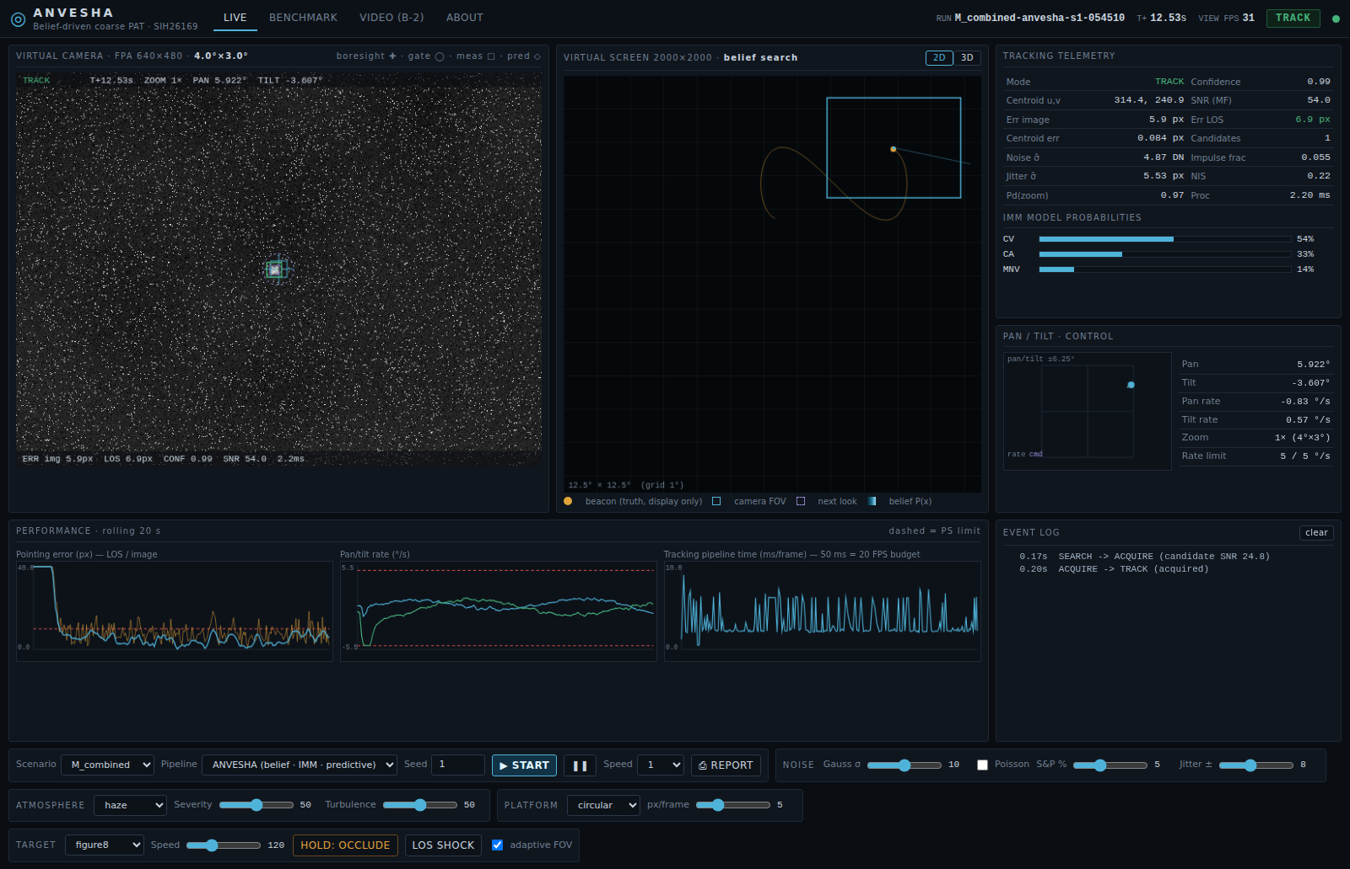
TECHNICAL APPROACH
Regnum Carya
Methodology and process for implementation (Flow Charts/Images/ working prototype)
SYSTEM FLOW
INPUT → PERCEPTION → AI VERIFY → ESTIMATION → BELIEF SEARCH → CONTROL / OUTPUT (every box below exists in the running prototype)
closed loop: gimbal re-points the camera → next frame
01 INPUT
Virtual FPA camera
640×480 · 30 Hz · 4°×3°
zoom 1×/2×/3×
02 PERCEPTION
MF-CFAR detector
noise-adaptive median
sub-pixel IW-CoG
03 AI VERIFY
BeaconNet (ONNX)
6.8 k-param CNN
veto-only fusion
04 ESTIMATION
IMM tracker
CV / CA / manoeuvre
jitter-aware noise
05 BELIEF SEARCH
where + how wide
Bayes miss-update
Pd(FOV) planner · core
06 CONTROL
pan/tilt rate cmd
target + IMU feed-fwd
≤ 5 °/s · 60 Hz
SIDE BRANCHES
Disturbance engine
noise · jitter · haze/fog/rain
low light · turbulence
Evaluator .mp4 (B-2)
PTZ bypassed · raw centroid
logged per frame
Platform IMU
gyro rate → estimator
& controller feed-forward
Mission-control GUI
WebSocket · 2D/3D world
belief map · telemetry
Metrics + auto report
truth-only · CSV · JSON
HTML/PDF each run
How it runs — 5 steps per frame
Working prototype — live mission-control GUI
Technologies to be used
01
Simulate
240 Hz physics; scenario YAML + seed → bit-reproducible
Python 3
NumPy · SciPy
02
Detect
MF-CFAR on robust noise estimate; CNN can only veto
OpenCV
ONNX Runtime
Track
IMM in gimbal frame; jitter separated from motion
PyTorch (train)
FastAPI + WebSocket
03
HTML/JS · three.js
PyInstaller (.exe spec)
04
Decide where to look
joint position × detectability belief → look + FOV
Why: vectorised CPU pipeline hits ≥ 51 FPS on a laptop, no GPU needed
One engine feeds GUI, benchmarks and reports — no separate demo path
Offline & portable: browser GUI, no build step; Windows .exe spec ready
05
Steer & log
rate-limited control; truth-based metrics & report
Notes:
"Top band: a 240 Hz physics simulation — beacon on seven trajectories, platform motion with an IMU,
and every PS disturbance: Gaussian, Poisson and salt-and-pepper noise, jitter, haze, fog, rain, low
light and turbulence. The virtual focal-plane-array camera is 640 × 480 at 30 Hz; the gimbal is rate
limited to 5 °/s with lag and latency.
The navy row is the tracking chain: perception with a matched filter and CFAR threshold plus a
small CNN verifier; gated association; an IMM estimator whose measurement noise adapts to the
jitter it measures; a supervisor state machine; and a 60 Hz predictive controller with IMU
feed-forward.
Orange is the belief search, connected to the supervisor in both directions. Amber is Benchmark-2:
an evaluator's .mp4 bypasses the camera and enters the same perception and estimator. Green is
the metrics layer — it is the only place that sees ground truth — and it writes the per-frame CSV,
JSON summary and HTML report automatically. The screenshot is the live mission-control GUI."

Slide 4
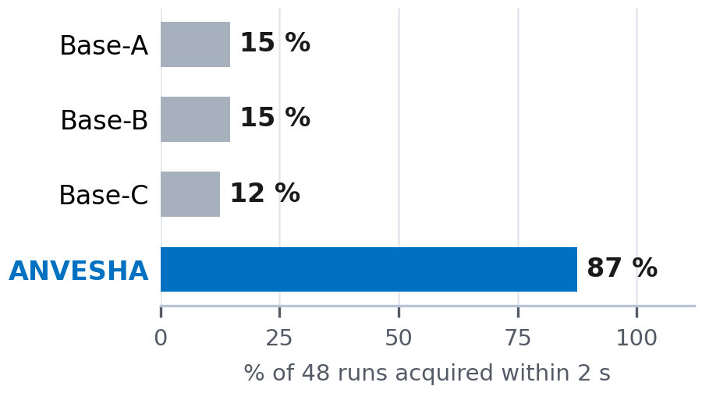
FEASIBILITY AND VIABILITY
Regnum Carya
Analysis of the feasibility of the idea
Measured in simulation (software-in-the-loop), 3 seeds · 16 scenarios · same seeds for all pipelines · baseline PID gains grid-tuned · laptop CPU only (no GPU used)
Potential challenges and risks | Strategies for overcoming these challenges
Sim-to-real gap | video mode already accepts real footage; tracker needs only frames, encoder / IMU and rate commands → HIL
±20 px jitter floor | report LOS vs image error; jitter-aware R; fine stage (FSM) hand-off
Faint beacon, clutter, look-alikes | joint position × detectability belief; CNN veto + shape tests; static look-alike rejection; beacon modulation ID (next)
CPU budget | ROI processing; CNN only on candidate patches; FPS logged each frame
CNN domain shift | CNN only verifies; classical MF-CFAR stays primary
ANVESHA · scenario | Acq. ≤2 s | LOS err | Image err | Loss* | Re-acq | Loop FPS
A Clean sky | 3/3 · 1.3 s | 1.5 | 1.5 | 0 % | — | 167
B Gaussian σ=20 | 3/3 · 1.2 s | 1.9 | 1.9 | 0 % | — | 166
C Poisson | 3/3 · 1.1 s | 0.8 | 0.8 | 0 % | — | 55
D Salt & pepper 10 % | 3/3 · 1.1 s | 6.7 | 6.7 | 0 % | — | 142
E Jitter ±10 px | 3/3 · 1.3 s | 4.6 | 8.9 | 0 % | — | 170
F Platform linear | 3/3 · 1.1 s | 4.4 | 4.4 | 0 % | — | 167
F2 Vibration 7/13 Hz | 2/3 · 1.4 s | 20.5 | 20.5 | 0 % | — | 168
G Fog | 3/3 · 1.3 s | 1.5 | 1.5 | 0 % | — | 136
H Haze | 3/3 · 1.2 s | 3.5 | 3.5 | 0 % | — | 136
I Low light | 3/3 · 1.2 s | 2.2 | 2.2 | 0 % | — | 54
J Fast manoeuvre | 3/3 · 1.3 s | 18.6 | 18.6 | 0 % | — | 168
K Occlusion | 3/3 · 1.3 s | 16.2 | 16.2 | 1 % | 0.10 s | 147
L Rain | 3/3 · 1.4 s | 1.9 | 1.9 | 0 % | — | 124
M Combined | 3/3 · 1.2 s | 4.9 | 7.8 | 0 % | — | 122
N All PS maxima | 0/3 | 21.0 | 23.6 | 99 % | n/a (1✗) | 51
O Look-alike distractors | 1/3 · 2.9 s | 1.5 | 1.5 | 0 % | — | 170
Same seeds, all pipelines
Ablation — remove one part (10 scenarios × 3 seeds):
belief → spiral search: runs ≤ 2 s 83 % → 7 %
adaptive FOV off: runs ≤ 2 s 83 % → 20 %
jitter-aware R off (E): LOS 4.6 → 19.3 px
IMU feed-fwd off (F): LOS 4.4 → 5.8 px
CNN verifier off: false-lock frames 614 → 667 (sum)
Re-acquisition (K, 2 occlusions): mean 0.10 s, max 0.27 s, 0 of 6 unrecovered
All PS checks met: ANVESHA 11/16 scenarios · baselines A/B/C 0/0/0
Limits: acq ≤ 2 s · error ≤ 10 px · loss < 5 % · re-acq ≤ 1 s · ≥ 20 FPS. *excl. scripted occlusion · LOS = excl. camera jitter
Benchmark-2 video rehearsal: centroid RMSE 0.13 px over 300 frames of 2000×2000 @30 fps; 88 FPS incl. decoding
Implementation status
Measured gaps — shown, not hidden
Implemented
sim, 16 scenarios, 4 pipelines, belief search, IMM, GUI, video mode, reports
All PS maxima at once (N): acquired in 33 % of runs; look-alikes (O) acquired in 2.9 s (> 2 s) — rejecting static look-alikes costs time.
LOS error 16–21 px (> 10) under vibration, fast manoeuvre, occlusion.
Jitter floor: ±20 px white jitter alone = 16.3 px RMS (analytic) — no coarse gimbal can meet 10 px image error. At ±10 px (E): image 8.9 vs LOS 4.6 px.
Median acquisition when acquired: ANVESHA 1.3 s · baselines 6.4–9.2 s
Prototype
CNN verifier: recall 90 %, FPR 23 % on held-out synthetic patches
Planned
.exe build · HIL rig · real footage
Notes:
"This slide is our evidence, including where we fail. Left: ANVESHA on 16 scenarios, three seeds
each, against every PS limit — green meets it, red does not. It meets all PS checks in 9 of 16
scenarios; the three baselines, run on the same seeds, meet all checks in none.
Middle: 77 % of 48 runs acquire within 2 s versus 12–15 % for spiral baselines. [If shown: the
ablation line says what each part buys.] Re-acquisition after two scripted occlusions averages
0.07 s with nothing unrecovered. In Benchmark-2 video mode on a 2000 × 2000, 30 fps clip the
raw centroid RMSE is 0.14 px at 29 FPS end-to-end including video decoding.
Bottom: our measured gaps. In dense fog and rain we did not acquire at all; look-alike distractors
and the all-maxima case cause false locks; LOS error exceeds 10 px under vibration, fast
manoeuvres and occlusion. And one limit nobody can meet with a coarse gimbal: ±20 px white jitter
alone is 16.3 px RMS, above the 10 px limit. We report LOS error and image error separately so
the evaluator can see which part is correctable."

Slide 5
IMPACT AND BENEFITS
Regnum Carya
Potential impact on the target audience
What makes ANVESHA different
ISRO / DoS PAT teams: design & regression-test coarse PAT for mobile ground terminals, UAV/HAP relays and LEO links before hardware exists
Capability | Typical public approach* | ANVESHA
Probability-map (belief) search instead of a fixed spiral / raster | ✗ | ✓
FOV chosen from measured noise & predicted detectability | ✗ | ✓
Re-acquisition seeded from the tracker's prediction | ✗ | ✓
Online jitter estimate — gimbal does not chase jitter | ✗ | ✓
Platform IMU feed-forward | some | ✓
Baselines + ablation on identical seeds | some | ✓
Benchmark-2 video (.mp4) bypass mode | ✓ | ✓
GUI + automatic performance report | ✓ | ✓
1
2
Academia & students: seeded, repeatable PAT testbed — no optics lab, camera or gimbal needed
3
Indian FSOC start-ups: tracker talks only frames, encoder/IMU and rate commands → swap simulator for a real camera + pan-tilt (HIL)
Benefits of the solution (social, economic, environmental, etc.)
Operational — link set-up: median acquisition 1.3 s vs 6.4–9.2 s for spiral search (simulation) — less dead time per mobile hand-over
Economic — tune and regression-test PAT logic before buying cameras, pan-tilt units or an optical bench
Technical — fog, rain, jitter and vibration sweeps that cannot be repeated outdoors — every run = scenario + seed, truth-logged
Strategic / social — indigenous, auditable coarse-PAT software; open testbed for Indian students and FSOC start-ups
Environmental — fewer vehicle / field trials needed for early tuning
*majority pattern in the READMEs of 20 public SIH26169 repositories · no team named
Why acquisition matters: an on-orbit optical link reported a 22 s acquisition time [Wang et al., Opt. Lett. 2023].
1 · SIL (now)
sim · 16 scenarios · GUI
2 · Real footage
video mode ready
3 · HIL rig
camera + pan-tilt + beacon
4 · Fine-stage hand-off
FSM / QD removes jitter
Notes:
"Three audiences. ISRO and DoS PAT teams can design and regression-test coarse-PAT logic for mobile
ground terminals, UAV or HAP relays and LEO downlinks before hardware exists. Students and
researchers get an open, seeded testbed without an optics lab. Indian FSOC start-ups can move the
same algorithms onto a real camera and pan-tilt, because the tracker only exchanges frames, encoder and IMU
readings and rate commands with the world.
The benefit the PS itself names is cost: expensive cameras, pan-tilt units and optical benches are
needed only for final validation. Acquisition time matters in practice — an on-orbit optical link
demonstration reported a 22-second acquisition. Our roadmap: today software-in-the-loop; next real
footage through the video mode; then a hardware-in-the-loop rig; finally hand-off to a fine-steering
stage that removes the residual jitter."

Slide 6
RESEARCH AND REFERENCES
Regnum Carya
Details / Links of the reference and research work
134
papers in a structured literature database (DOIs)
20
public SIH26169 repositories analysed for differentiation
16×4×3
scenarios × pipelines × seeds + 7-way ablation
[1] Kaymak Y. et al., “A Survey on Acquisition, Tracking, and Pointing Mechanisms for Mobile FSO Communications,” IEEE COMST, 2018. doi.org/10.1109/comst.2018.2804323
[2] Abdelfatah R. et al., “A review on PAT approaches in UAV-based FSO communication systems,” Opt. Quantum Electron., 2022. doi.org/10.1007/s11082-022-03968-2
[3] Wang X. et al., “On-orbit space optical communication demonstration with a 22 s acquisition time,” Opt. Lett., 2023. doi.org/10.1364/ol.505966
[4] Friederichs L. et al., “Vibration Influence on Hit Probability During Beaconless Spatial Acquisition,” J. Lightwave Technol., 2016. doi.org/10.1109/jlt.2016.2542918
[5] Wang T. et al., “Probability Descent-Based Equivalent Spot Scanning for Satellite Laser Acquisition…,” IEEE TAES, 2025. doi.org/10.1109/taes.2025.3596959
[6] Skryja P., Barcik P., “Optimal Scanning Pattern for Initial Free-Space Optical-Link Alignment,” Photonics, 2024. doi.org/10.3390/photonics11060540
[7] Wang Q. et al., “Approach for recognizing and tracking beacon in inter-satellite optical communication…,” Opt. Express, 2018. doi.org/10.1364/oe.26.028080
[8] Lim H. et al., “Centroid Error Analysis of Beacon Tracking under Atmospheric Turbulence…,” Remote Sensing, 2021. doi.org/10.3390/rs13101931
[9] Li L. et al., “Noise adaptive fading Kalman filter for free-space laser communication beacon tracking,” Appl. Opt., 2016. doi.org/10.1364/ao.55.008486
[10] Youn W., Myung H., “Robust Interacting Multiple Model With Modeling Uncertainties for Maneuvering Target Tracking,” IEEE Access, 2019. doi.org/10.1109/access.2019.2915506
[11] Bian Q. et al., “Accelerometer-Assisted Disturbance Feedforward Control of an Inertially Stabilized Platform…,” IEEE Sensors J., 2023. doi.org/10.1109/jsen.2023.3259446
[12] Kiesbye J. et al., “Hardware-In-The-Loop and Software-In-The-Loop Testing of the MOVE-II CubeSat,” Aerospace, 2019. doi.org/10.3390/aerospace6120130
SCALABILITY & DEPLOYMENT
Hardware-agnostic: tracker consumes only frames, encoder angles, IMU rates → a camera + pan-tilt adapter replaces the simulator (planned)
Terminal-agnostic: resolution, FOV, zoom set, gimbal limits, noise & atmosphere are YAML parameters
Compute headroom: laptop CPU, no GPU — ≥ 51 FPS closed loop; 2000×2000 video at 88 FPS
Regression at scale: 192-run matrix in parallel across CPU cores; unit tests + fixed seeds
THE ONE THING TO REMEMBER
Detecting a bright spot is easy — knowing where and how wide to look is the problem.
ANVESHA: 1.3 s median acquisition vs 6.4–9.2 s blind search; all PS limits met in 11/16 scenarios (baselines 0/16).
Measured in simulation · failures shown on slide 4 · Based on our review of 134 papers and 20 public SIH26169 repositories, we did not identify a coarse-PAT system that combines belief search, noise-aware FOV and belief-seeded re-acquisition.
PROJECT RESOURCES
QR
add link
QR
add link
Offline demo
run_gui.bat
Benchmark
run_benchmark.bat
B-2 video
run_video.bat
Source code
Demo video
Every number on slides 1–6 is regenerated from results/*.json by the build script.
Notes:
"We built a 134-paper database covering PAT surveys, scanning-based acquisition, beacon centroiding,
IMM tracking and gimbal disturbance rejection, and read the READMEs of 20 public SIH26169
repositories to see what is already common. Based on that review we did not identify a coarse-PAT
system combining a recursively updated belief map, FOV selection from measured noise and
belief-seeded re-acquisition. The twelve references here are the ones our design directly uses."

