Slide 1
Can’t - Activity

Slide 2
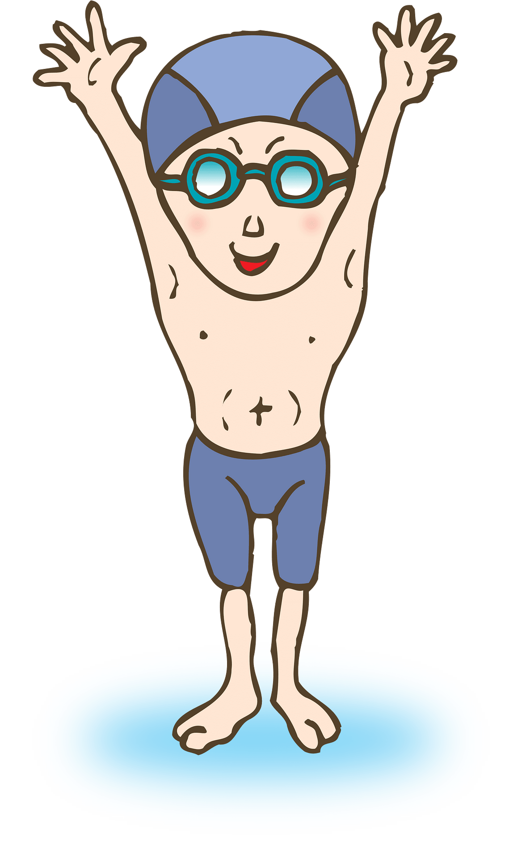
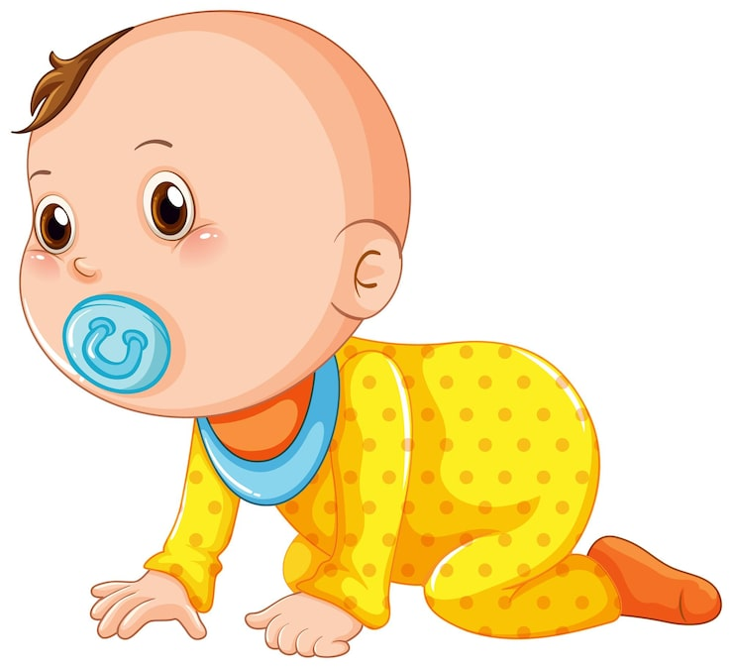
Who can’t swim?

Slide 3
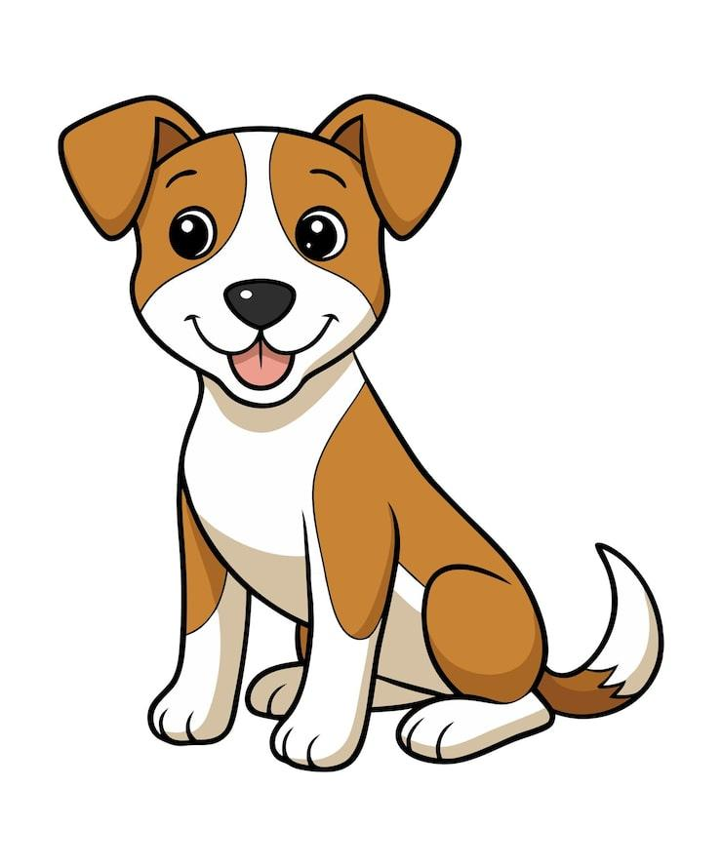
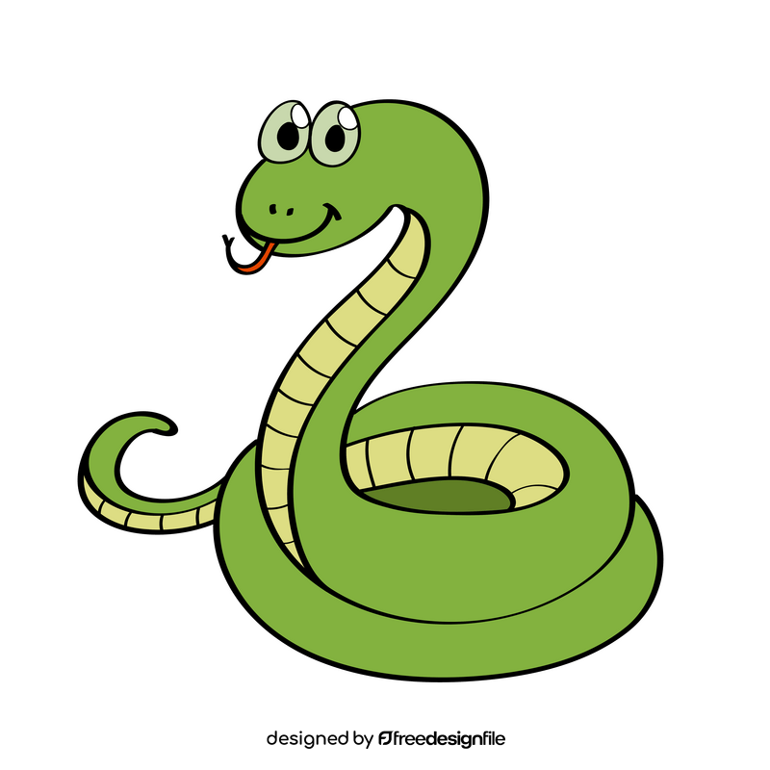
Who can’t walk?

Slide 4
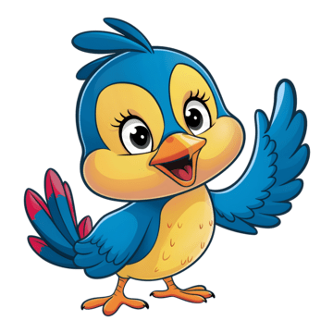
Who can’t fly?

Slide 5
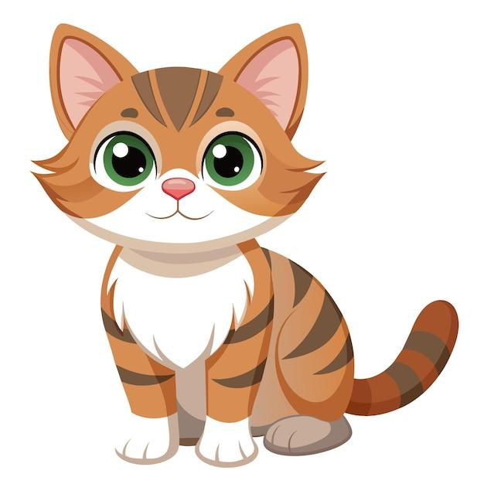
Who can’t bark?

Slide 6
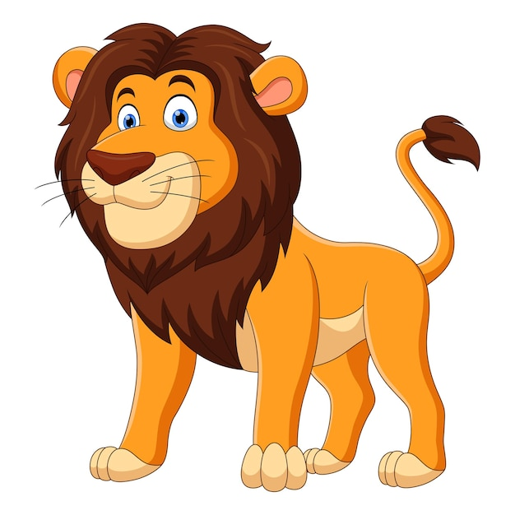
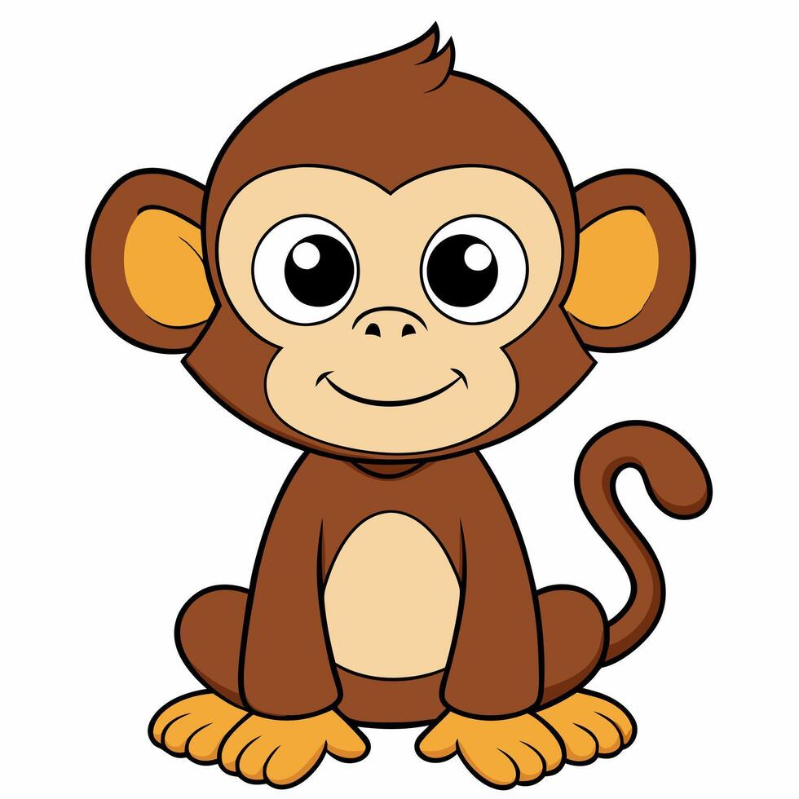
Who can’t climb a tree?

Slide 7
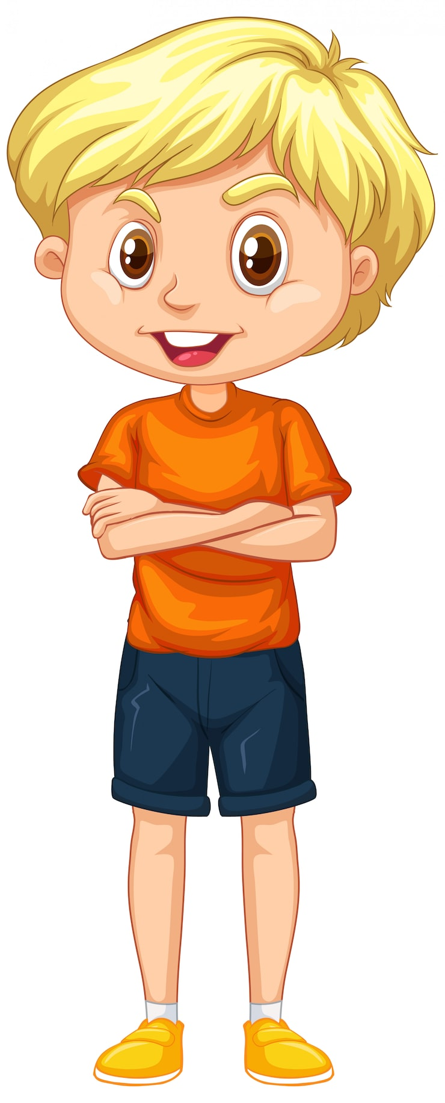
Who can’t ride a bike?

Slide 8
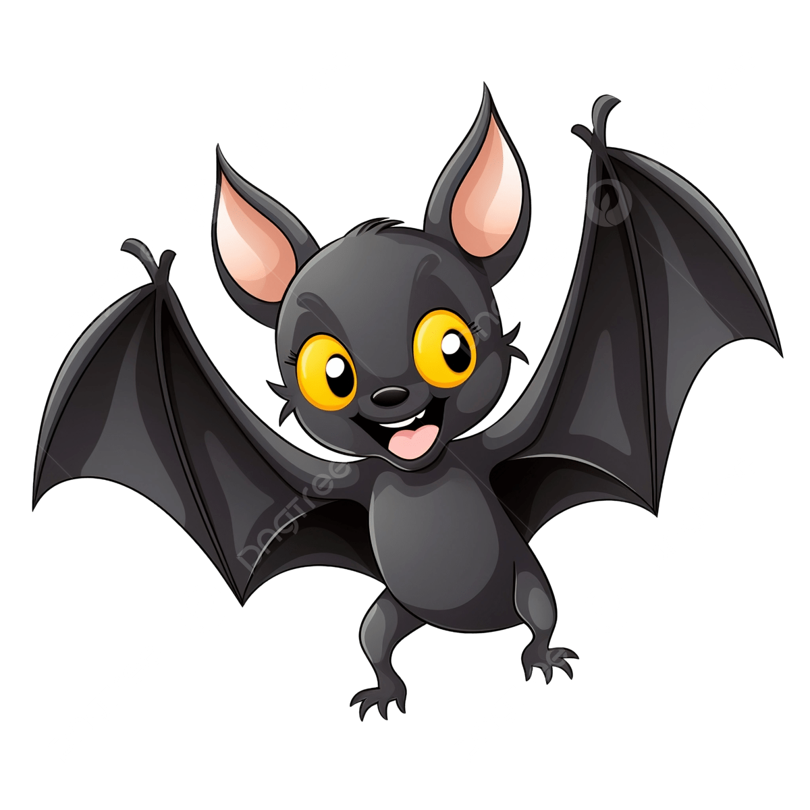
Who can’t see in the morning?

Slide 9
Who can’t sing?

Slide 10
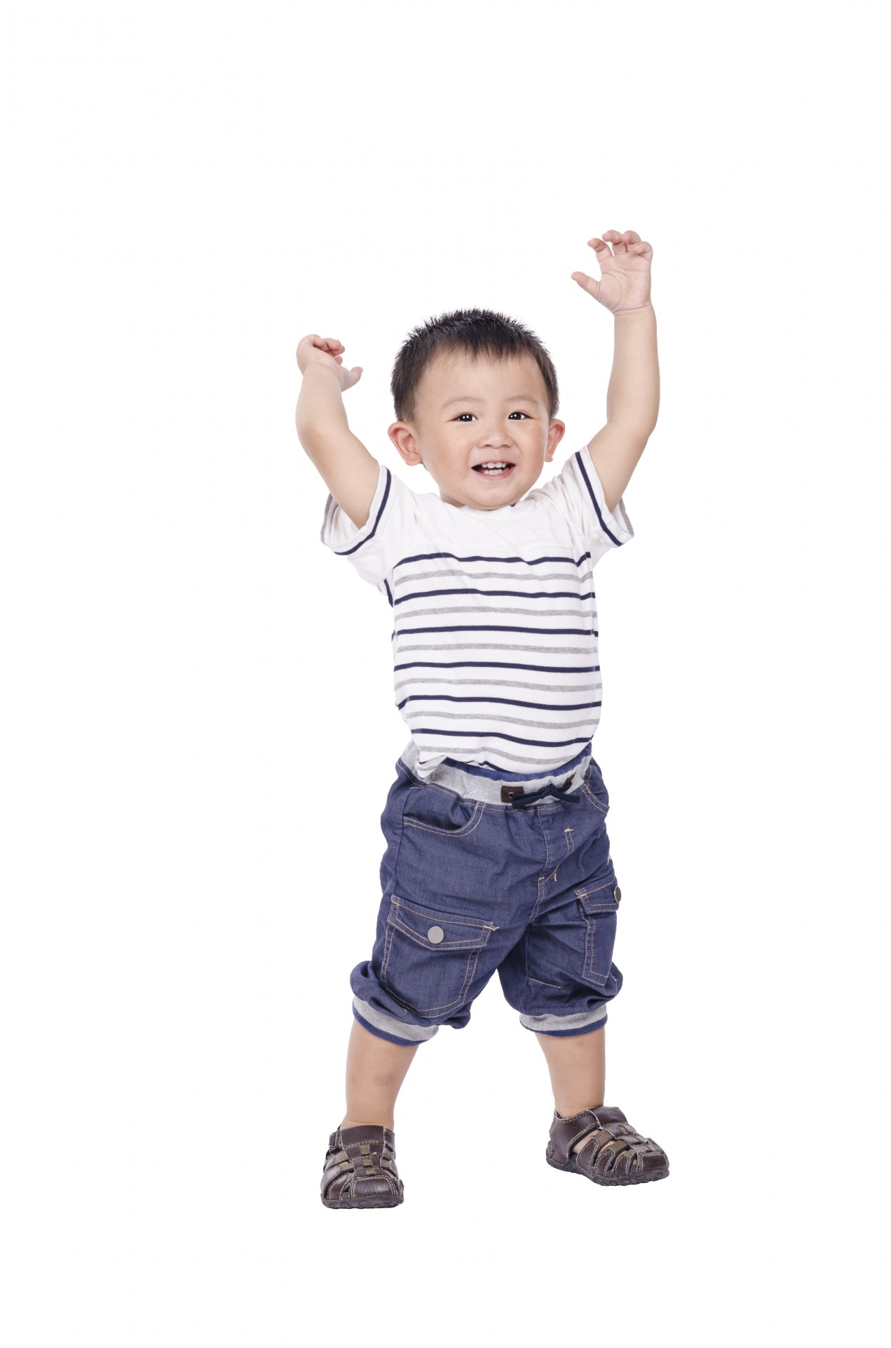
Who can’t go to school?

Slide 11
Who can’t roar?

