Slide 1
APPIUM – CROSS PLATFORM MOBILE AUTOMATION
BY - HANUMANTHA REDDY
WWW.CODEBYDEV.COM
Notes:
I’m Hanumantha Reddy
Working as a Lead Engineer in Aditi – Symphony Teleca – Harman – Samsung

Slide 2
Automation Testing
Agenda
Problem Statement
Mobile Automation Tools
Introduction to Appium
Appium Philosophy
Appium Server
Appium Architecture
Code Demo
Q & A
References

Slide 3
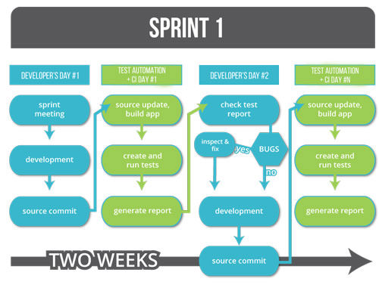
Problem statement
What is mobile app all about?
An average consumer spends 180+ minutes in a day on mobile phone
1: 6.5 times mobile devices compared to PCs
Wide market
Multiple platforms
Hardware and software fragmentation
New features roll out
Frequent release cycles
Time to market
Notes:
For everything there is a app.
Sky is the limit, everyone is having 2-3 connections as many handsets are coming with multiple sim options, Personal and professional connection
Millions of app downloads are happening everyday
If you want your app to be reached to everyone, release it in Android/IOS/Windows
600 mhz to 2.2 ghz octa core/ 512 MB to 6 GB/ 8GB to 256 GB/ 3.5 inch to 6.3 inch
Andoid 2.2,2.3, 4.4 5 6 7… Ios 4,5…

Slide 4
Automation Testing
Time to Market

Slide 5







Mobile automation tools
Mobile automation tools
MonkeyRunner

Slide 6
Introduction to Appium
Introduction to Appium
Free
Open source
Cross platform
Supports ios, Android, Firefox OS
Appium allows native, hybrid and web application testing
Supports automation test on physical devices
Supports automation test on emulators or simulators
No dependency on Mobile device OS
supports C#, Java, Objective-C, JavaScript with node.js, PHP, Ruby, Python
uses the WebDriver JSON wire protocol
Notes:
Easy to convince your bosses or clients as it is free.
If you know Selenium which is becoming defacto web application testing framework, you already know most of Appium as it is a superset of Selenium.

Slide 7

Appium Philosophy
Appium Philosophy

Slide 8

Appium Philosophy
Appium Philosophy

Slide 9
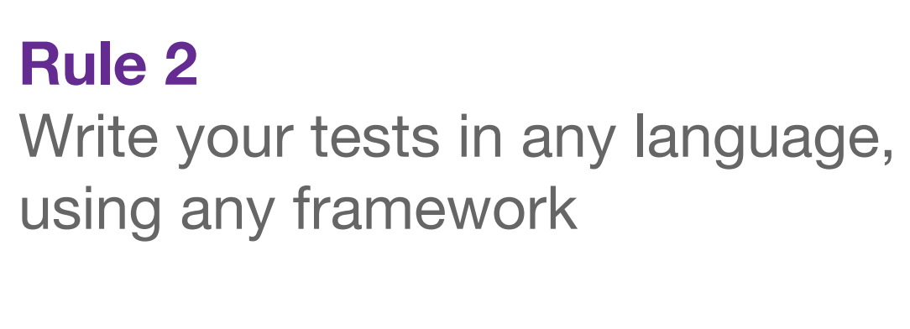
Appium Philosophy
Appium Philosophy

Slide 10
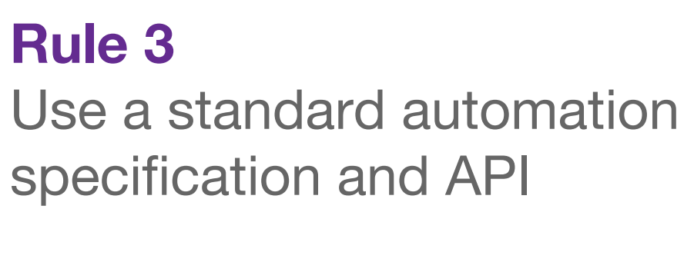
Appium Philosophy
Appium Philosophy

Slide 11

Appium Philosophy
Appium Philosophy

Slide 12
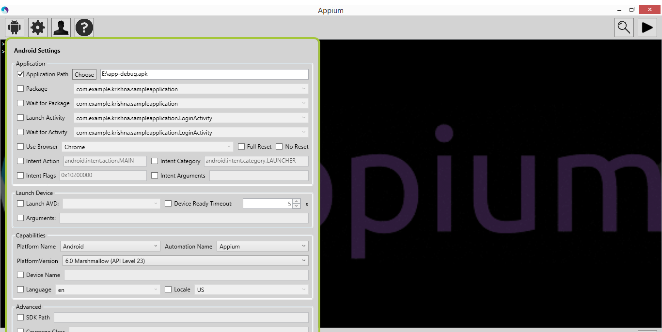
Appium Server
Appium Server
Appium is a server written in Node.js
It receives connections from a client
listens for commands
executes those commands on a mobile device
responds with an HTTP response representing the result of the command execution

Slide 13
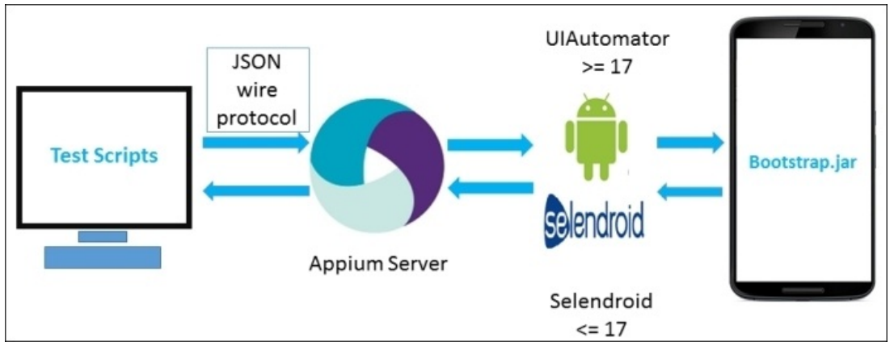
Appium Architecture for Android
Appium Architecture
Notes:
On an Android device, Appium uses the UIAutomator framework to automate the apps. UIAutomator is a framework that is developed by the Android developers to test the Android user interface.
We have a UIAutomator/Selendroid in place of Apple instruments and bootstrap.jar in place of the bootstrap.js file.
Appium supports Android versions greater than or equal to 17; for earlier versions, it uses the Selendroid framework. When we execute the test scripts, Appium sends the command to the UIAutomator or Selendroid on the basis of the Android version.
Here, bootstrap.jar plays the role of a TCP server, which we can use to send the test command in order to perform the action on the Android device using UIAutomator/Selendroid.

Slide 14
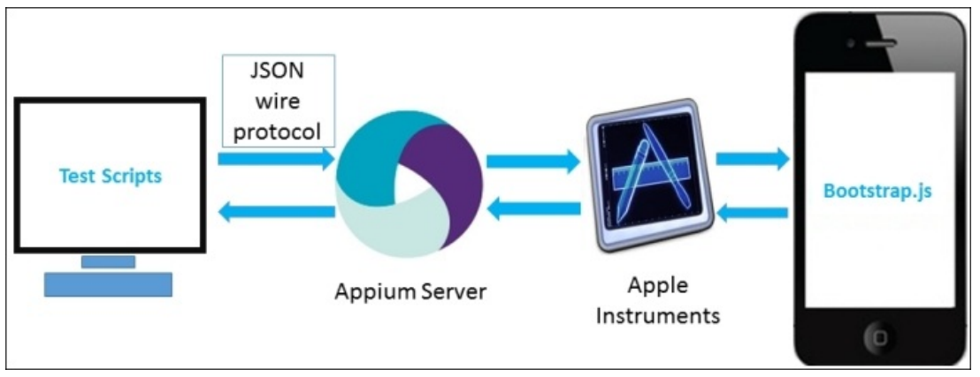
Appium Architecture for IOS
Appium Architecture
Notes:
On an iOS device, Appium uses Apple’s UIAutomation API to interact with the UI elements. UIAutomation is a JavaScript library provided by Apple to write test scripts. Appium utilizes these same libraries to automate iOS apps.
When we execute the test scripts, it goes in the form of JSON through an HTTP request to the Appium server. The Appium server sends the command to the instruments, and the instruments look for the bootstrap.js file, which is pushed by the Appium server to the iOS device. Then, these commands execute in the bootstrap.js file within the iOS instruments’ environment. After the execution of the command, the client sends back the message to the Appium server with the log details of the executed command.

Slide 15
Appium architecture
JSON wire protocol
The JSON wire protocol (JSONWP) is a transport mechanism
It is a specific set of predefined, standardized endpoints exposed via a RESTful API
Appium implements the Mobile JSONWP, the extension to the Selenium JSONWP
Ex:
/session/:sessionId
/session/:sessionId/element
/session/:sessionId/elements
/session/:sessionId/element/:id/click
/session/:sessionId/source
/session/:sessionId/url
/session/:sessionId/timeouts/implicit_wait
Notes:
The JSON wire protocol (JSONWP) is a transport mechanism created by WebDriver developers. This wire protocol is a specific set of predefined, standardized endpoints exposed via a RESTful API. The purpose of WebDriver and JSONWP is the automated testing of websites via a browser such as Firefox driver, IE driver, and Chrome driver.
Appium implements the Mobile JSONWP, the extension to the Selenium JSONWP, and it controls the different mobile device behaviors, such as installing/uninstalling apps over the session.

Slide 16
Appium architecture
Desired capabilities
Notes:
Desired capabilities is a JSON object (a set of keys and values) sent by the client to the server. It describes the capabilities for the automation session in which we are interested.

Slide 17
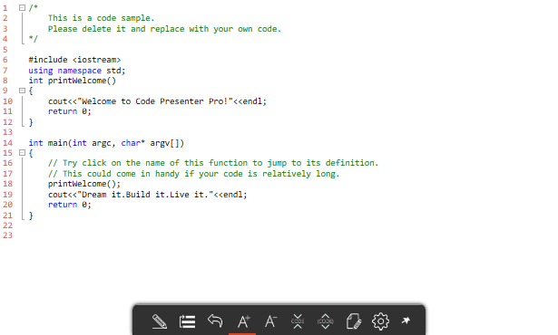
Code Demo
Code Demo

Slide 18

Questions and Answers
Q & A

Slide 19
References
appium.io
github.com/appium/appium

Slide 20
Thank You

