Slide 1
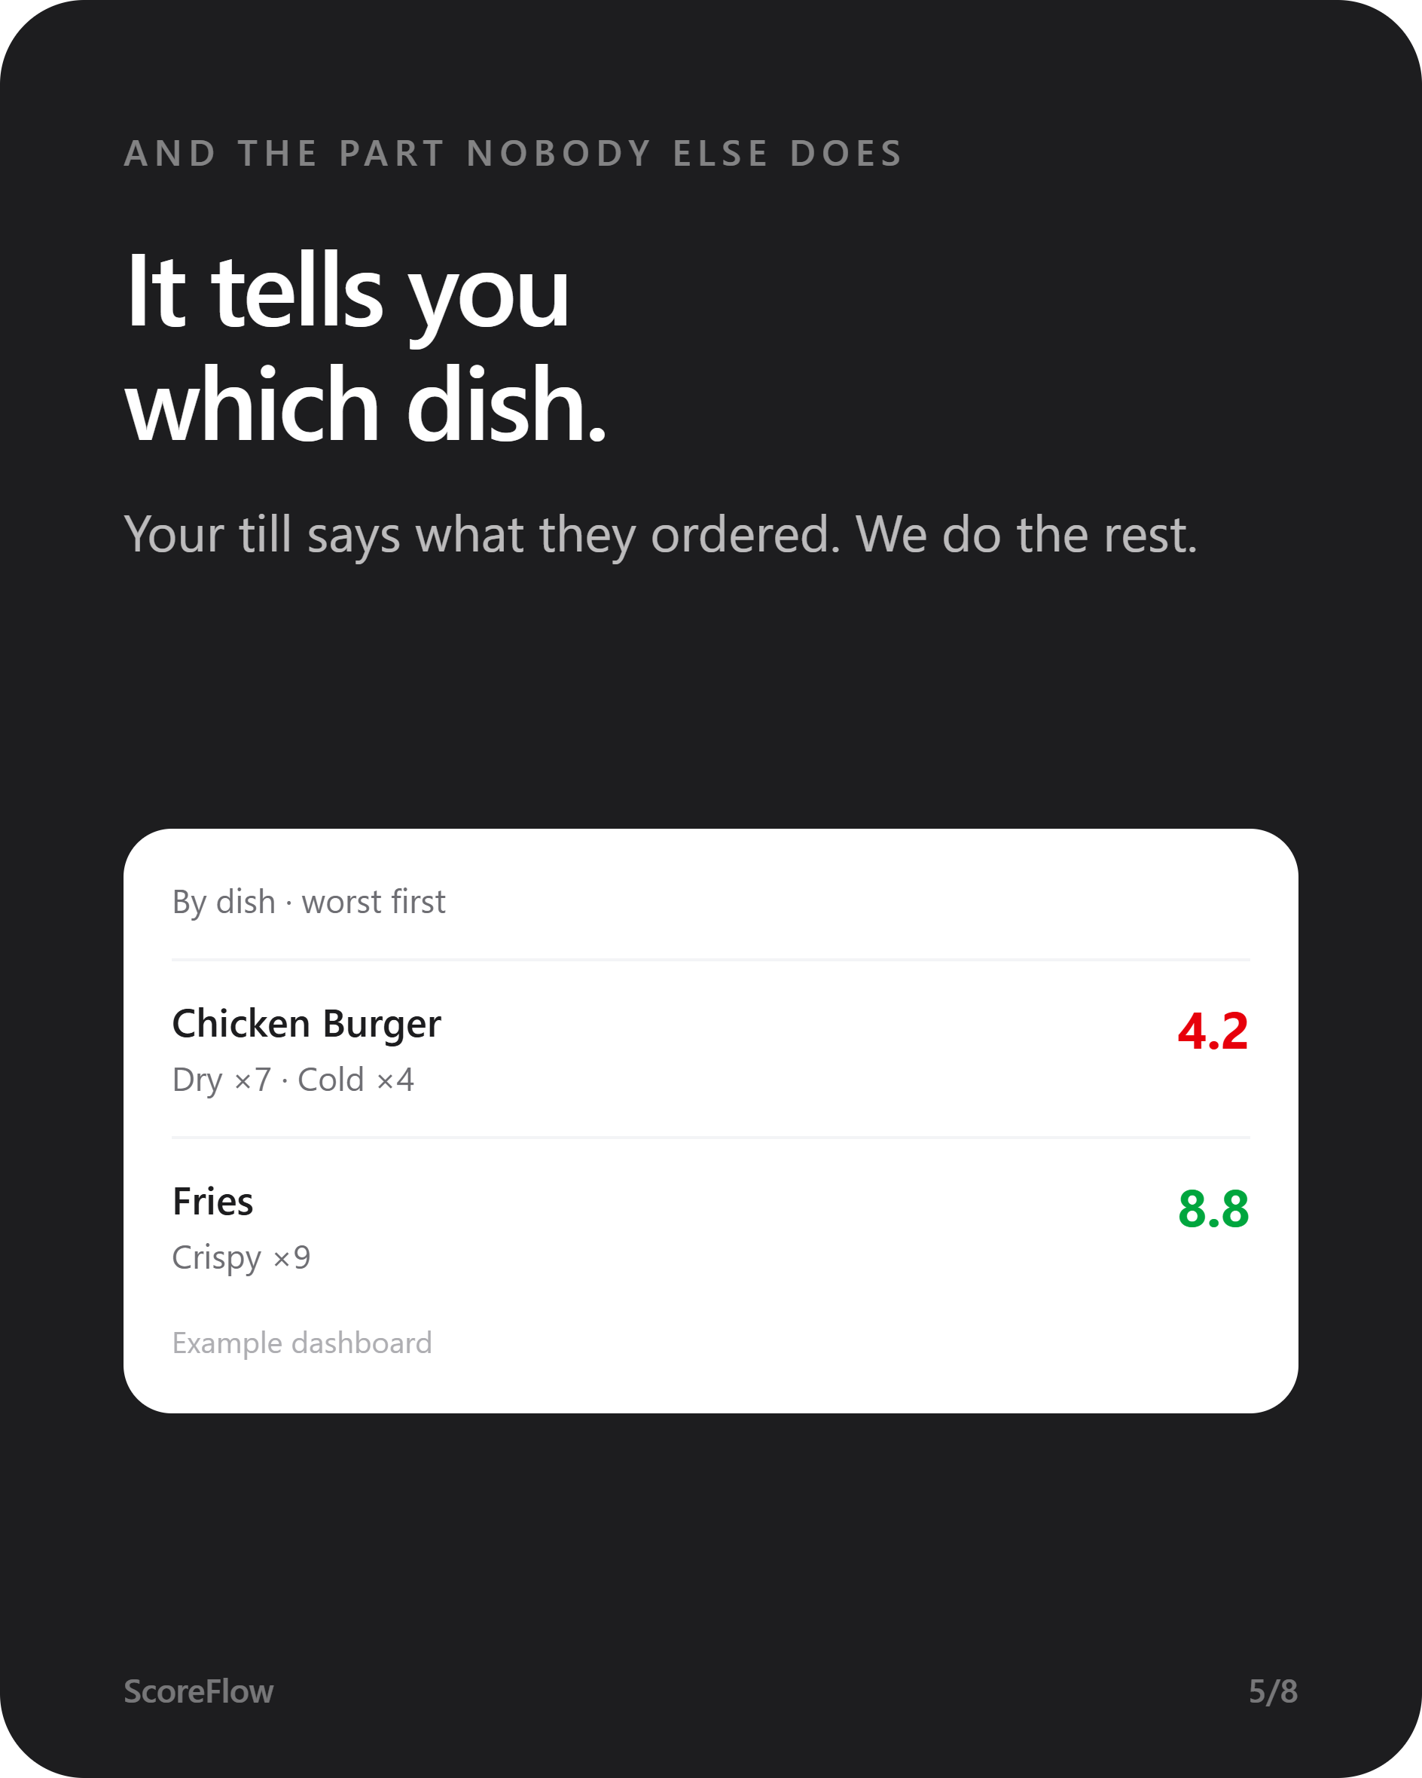
SCOREFLOW
Hear it at the table.
Not on Google.
Guests rate their meal in ten seconds. If someone's unhappy, you know before they've left the building — and you know which dish.
Notes:
One line: restaurants find out their food was bad from a public review, days later. We move that moment to the table.

Slide 2
CONTENTS
Five minutes.
Click any card to jump straight there.
01
02
03
04
05
The problem
How it works
Which dish
Why trust it
Price & setup
A guest leaves unhappy
and says nothing.
A card on the table.
Ten seconds, no app.
The part nobody else does.
Every guest gets
the review link.
Live tonight.
Nothing to buy.
Notes:
This slide is clickable in Slide Show mode. Use it if someone asks to skip ahead — jump straight to 'Which dish'.

Slide 3

Menu
01 · THE PROBLEM
A guest hated the burger.
They didn't tell you.
They told Google. Four days later. In public — where every person deciding where to eat tonight can read it.
Notes:
The moment the money is lost is silent. Nobody complains — they just don't come back, and they warn everyone else.

Slide 4
Menu
01 · THE PROBLEM
A bad review isn't one bad night.
Public
Permanent
Unanswerable
Anyone choosing a restaurant tonight sees it first.
It outlives the shift, the chef, and the recipe.
By the time you read it, they're long gone.
Notes:
No statistics here on purpose — we don't invent numbers. These three facts are self-evident to any owner.

Slide 5
Menu
THE IDEA
What if you knew
in 30 seconds?
A problem you hear about at the table is a free dessert.
The same problem on Google is a one-star, forever.
Notes:
Pause here. This is the pivot of the whole pitch.

Slide 6
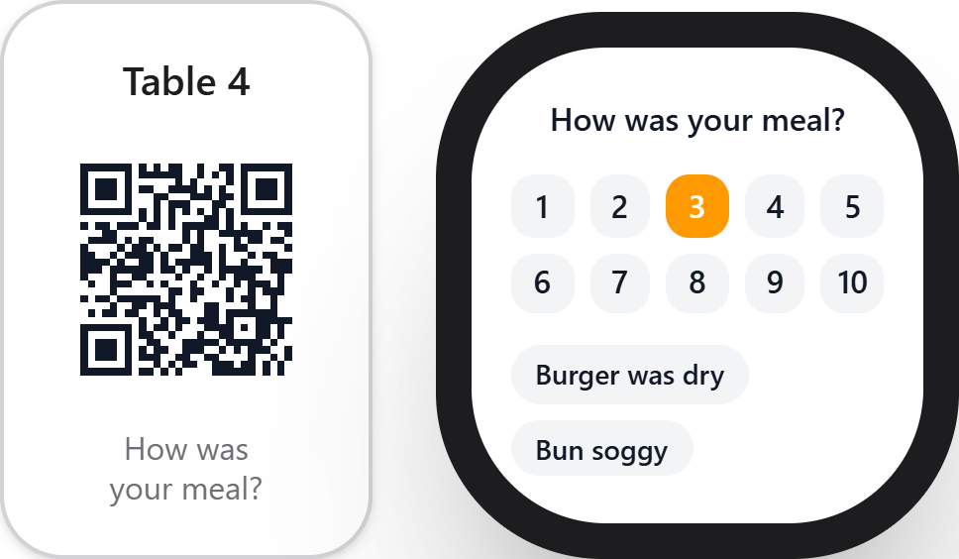
Menu
02 · HOW IT WORKS
A card on the table.
They scan it and rate the meal out of ten. No app to download, nothing to sign up for, no typing.
1
You print the cards — we generate them
2
One goes on each table
3
That's it. You're live tonight.
Notes:
Ten seconds is the whole trick. Ask for more and guests don't finish.

Slide 7
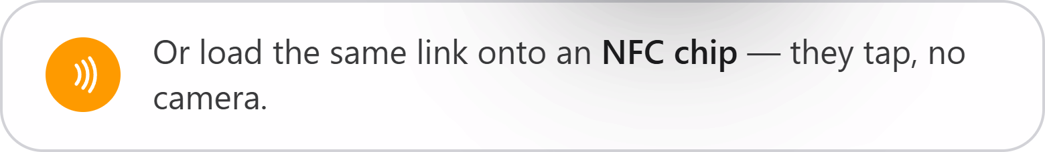
Menu
02 · HOW IT WORKS
No camera? Tap instead.
Load the same link onto a reusable NFC chip and guests just tap their phone to the table. Buy the chips once — they last years.
Notes:
NFC came first on this product; QR was added so there's nothing to buy. Both work — same link.

Slide 8
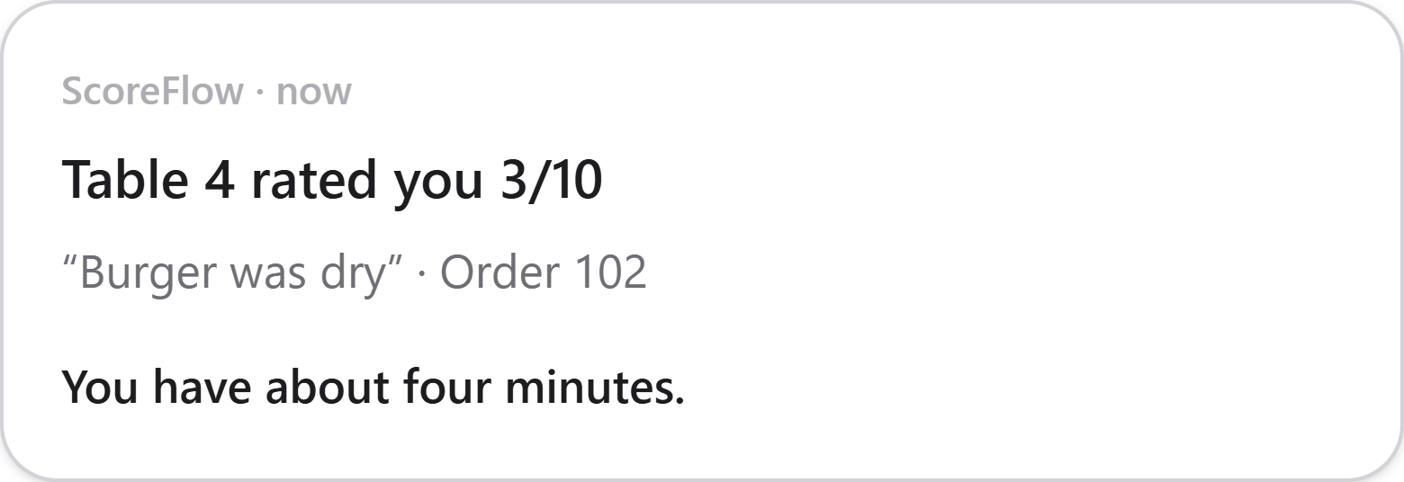
Menu
02 · HOW IT WORKS
Your phone buzzes
before they've paid.
A poor score reaches you with the table number, the order and what went wrong — while they're still sitting there.
You have about four minutes.
Notes:
Four minutes is the window to send over a dessert and turn it around.

Slide 9
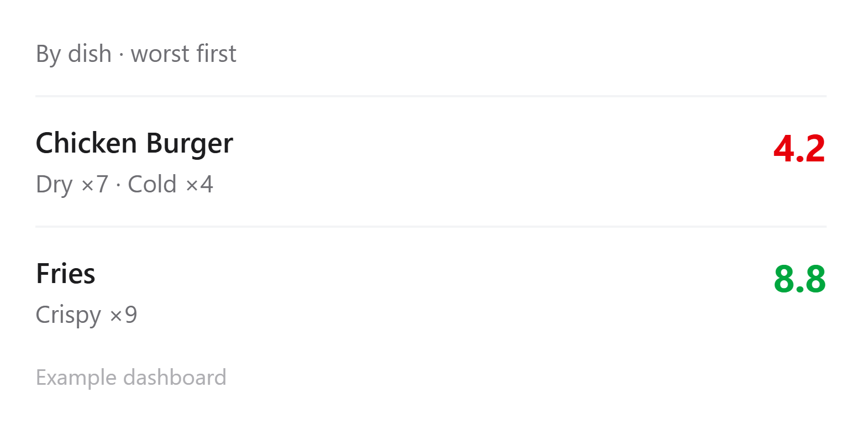
Menu
03 · THE PART NOBODY ELSE DOES
It tells you which dish.
Your till says what was on the order, so a poor score is tied to the food it was actually about. Guests are asked nothing extra.
“Someone was unhappy” is a worry.
“The chicken burger is dry” is a job.
Notes:
THIS is the slide that sells it. Slow down. An alert says something is wrong; this says what to fix on Monday morning.

Slide 10
Menu
03 · WHICH DISH
It works because your till already knows.
Your till
The guest
ScoreFlow
sends the order —
table 4, chicken burger
→
rates the meal 3/10
and taps “dry”
→
matches the two
and names the dish
One-off setup by whoever supports your till. We publish the integration guide — no vendor approval needed.
Notes:
If they ask 'will this work with my POS?' — yes, it's a generic endpoint with a per-restaurant key. See docs/POS_INTEGRATION.md.

Slide 11
Menu
04 · WHY YOU CAN TRUST IT
Every guest gets the review link.
Even the unhappy one.
If a competitor filters your bad reviews, the risk is yours — not theirs.
Tools that hide the review link from unhappy guests break Google's rules and UK review law. We never hide it — that's the product, not a compromise.
Notes:
This is the one thing a competitor can't copy without changing their own product. Worth labouring if they've been sold review-gating before.

Slide 12
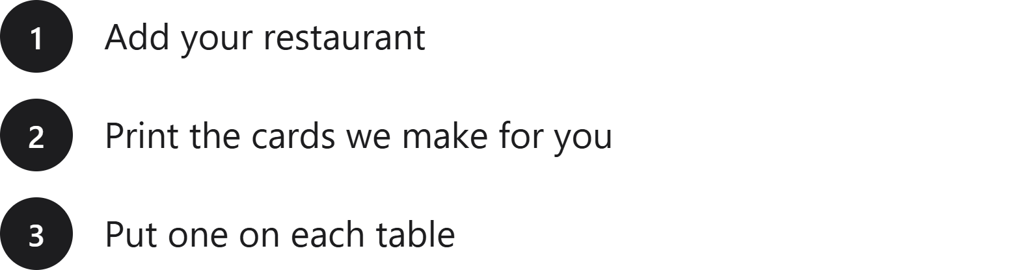
Menu
05 · PRICE & SETUP
Live tonight. Nothing to buy.
£29
per location, per month
14 days free · no card
Cancel whenever. Prices exclude VAT.
Notes:
A printer is the only equipment. If they already have NFC chips, those work too.

Slide 13
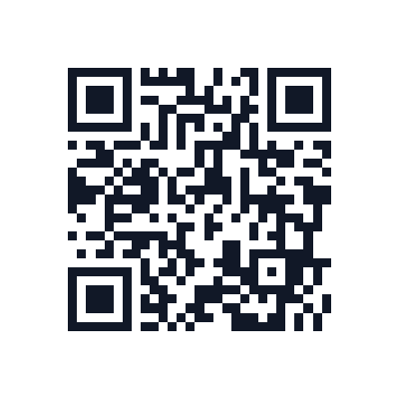
The next unhappy guest
tells you, not Google.
Start 14 days free
Scan it — this code is live.
Notes:
The QR is real and resolves to the signup page — let them scan it off the screen.

