Slide 1








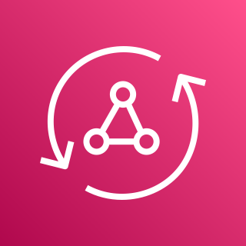








Mobile Apps for Location-based Engagement
For the architecture description, refer to the full diagram.
AWS Cloud
3
operations
users
web app
AWS Amplify
Amazon DynamoDB
Amazon Location SDK
1
2
5
7
user
mobile app
AWS Amplify
AWS AppSync
Lambda function
4
6
Lambda function
Amazon Location SDK
Track
Geofence
Amazon EventBridge
Amazon Pinpoint
Map
Amazon Location Service
© 2021, Amazon Web Services, Inc. or its affiliates. All rights reserved.
Notes:
A developer initiates an activity in AWS CI/CD pipeline such as push code changes. These activities create Amazon CloudWatch events.
An Amazon EventBridge event rule detects the CloudWatch events and sends the event data to an Amazon Kinesis Firehose Delivery Stream. One event rule per event source.
An event rule is also created to capture event data from Amazon CloudWatch Synthetics Canary if customer has set up the canary – only needed for MTTR.
The Firehose uses a Lambda function for data transformation. It extracts relevant data and sends it to an Amazon S3 bucket.
An Amazon Athena database queries the S3 data and returns the query result to an Amazon QuickSight.
An Amazon QuickSight obtains the query result and builds dashboard displays for the management team.

Slide 2
Resources
To get started with customizing your architecture diagram, refer to the following resources.
For all service icons, refer to AWS Architecture Icons.
For more architecture diagrams, refer to AWS Architecture Center.
For more AWS best practices, refer to AWS Well-Architected.

