Slide 1
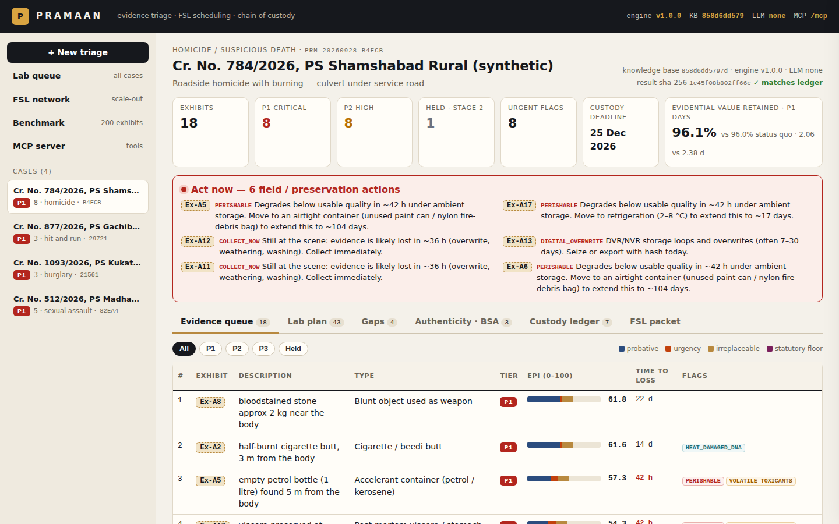
IBM BOB AI HACKATHON · AI TRACK
PRAMAAN
Explainable crime-scene evidence triage & FSL scheduling — an MCP server that IBM Bob drives
From a free-text seizure list to a ranked, flagged, sequenced and scheduled forensic-lab submission — with a tamper-evident chain of custody.
Team Pramaan

Slide 2
THE PROBLEM
Decisive evidence waits in a first-come, first-served queue
200+
3,000+
Weeks
60 / 90 days
exhibits seized in the 2019 Hyderabad case
scene photographs to review
typical FSL testing delay
custody clock, BNSS §187(3)
A DNA-bearing cigarette butt that helped link the accused was nearly lost among roadside litter.
BNSS 2023 §176(3) now mandates forensic scene visits for offences punishable with 7+ years — more scenes, same laboratories.
Forwarding letters list exhibits in seizure order: no signal of what is decisive, perishable or deadline-bound.
Officers decide what to seize, preserve and send within hours — without structured, defensible guidance.

Slide 3
THE CHALLENGE
Why evidence triage is hard
Needles in volume
Perishability varies 1000×
Examinations interfere
It must hold up in court
Most exhibits are near-identical litter; a handful decide the case — and they look alike on a list.
Wet swab: a day. Viscera at room temperature: two. CCTV: overwritten in days. A knife: years.
Powdering for prints can destroy touch DNA; destructive tests must come last.
Black-box scores are unusable. Every decision must be explainable, reproducible and logged — without personal data.

Slide 4
SOLUTION
How Pramaan works — one deterministic engine
Parse
Classify
Degrade
Score
Flag
Sequence
Stage
Schedule
seizure list → exhibits, quantities, distances, conditions
41 evidence types, modifiers, context
quality half-life by storage; field windows
Evidentiary Priority Index 0–100
ACT NOW: collect, seal, refrigerate, seize DVR
least-destructive-first exam DAG
first-round batch; near-body never held
FSL plan vs FIFO & status quo
Outputs ranked queue with reasons · gap analysis (missing reference samples, CCTV canvass, photo coverage) · FSL submission packet (PDF) · SHA-256 hash-chained custody ledger
Surfaces IBM Bob via the MCP server (21 tools) · web dashboard + REST API · CLI — all sharing one live database. Optional watsonx.ai Granite may parse prose and pick a type from a closed vocabulary; it never scores.

Slide 5
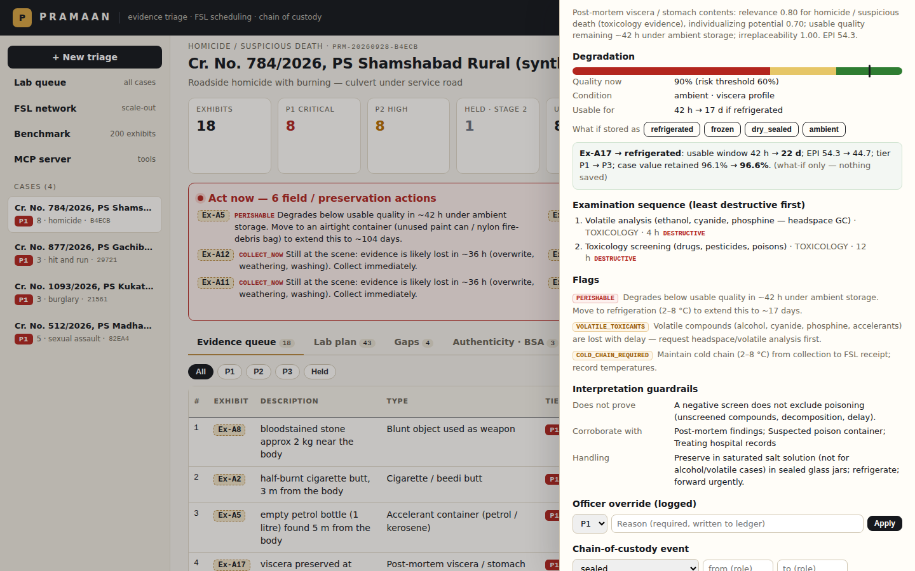
EVIDENTIARY PRIORITY INDEX
Every priority is explainable, factor by factor
EPI = 100 × ( wₚ·P + wᵤ·U + wᵣ·R )
P probative — crime-type relevance × individualizing potential × linkage (distance to body, recovered from accused)
U urgency — hours until quality or the collection window is lost
R irreplaceability — can it ever be re-collected?
Weights per crime type; BNSS §184 samples floored at 85
Each exhibit carries its caveat (what it does NOT prove) and what to corroborate it with

Slide 6
PRESERVATION & COLLECTION
Act now: degradation-aware urgency
Viscera at room temperature: usable ~42 h — refrigerated ~17 days (quantified what-if)
CCTV DVR not seized: overwrite risk → seize or export with hash today (BSA §63)
Tyre and footwear impressions: rain shrinks the window six-fold
Volatile accelerants: seal in an airtight can, not paper
Examinations sequenced so touch-DNA swabbing precedes powdering

Slide 7
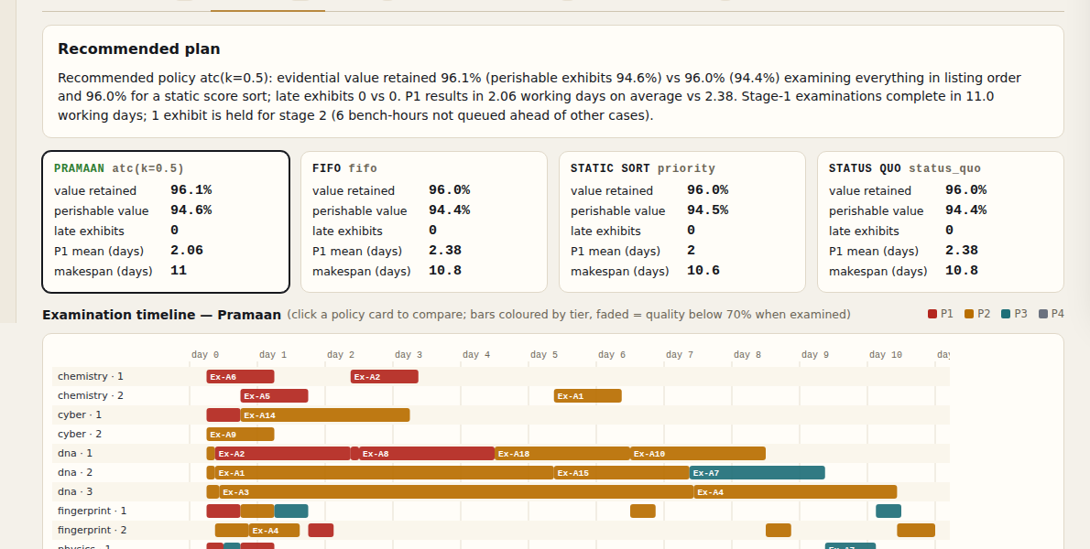
FSL PLAN
Staged testing + a scheduler that is measured, not claimed
Many near-identical exhibits? The 3 most promising go first; the rest are held for stage 2
Proximity trumps volume — traces within 10 m of the body are never held
Job-shop simulation across divisions and examiners; Apparent-Tardiness-Cost portfolio
Quality due dates and the BNSS §187(3) report deadline drive the order
Always shown beside status quo, FIFO and static-sort baselines

Slide 8
RESULTS
Hyderabad-scale benchmark: 200 exhibits, 5 hidden needles
93.2%
0
6.6 d
5 / 5
vs 85.5%
vs 13
vs 29.3 d
needles
evidential value retained
exhibits analysed late
P1 results (working days)
surfaced as P1 (worst rank 36/200)
Baseline = every exhibit examined in listing order (status quo). Staging removes 124 duplicates from the first queue; ordering speeds up P1 results.
Needles: the half-burnt butt 3 m from the body, viscera at ambient, uncollected toll-plaza CCTV, fingernail scrapings, reference blood.
Honest caveats: synthetic data and heuristic half-lives/capacities — reproducible with `python -m pramaan benchmark`; 46 automated tests in CI.

Slide 9
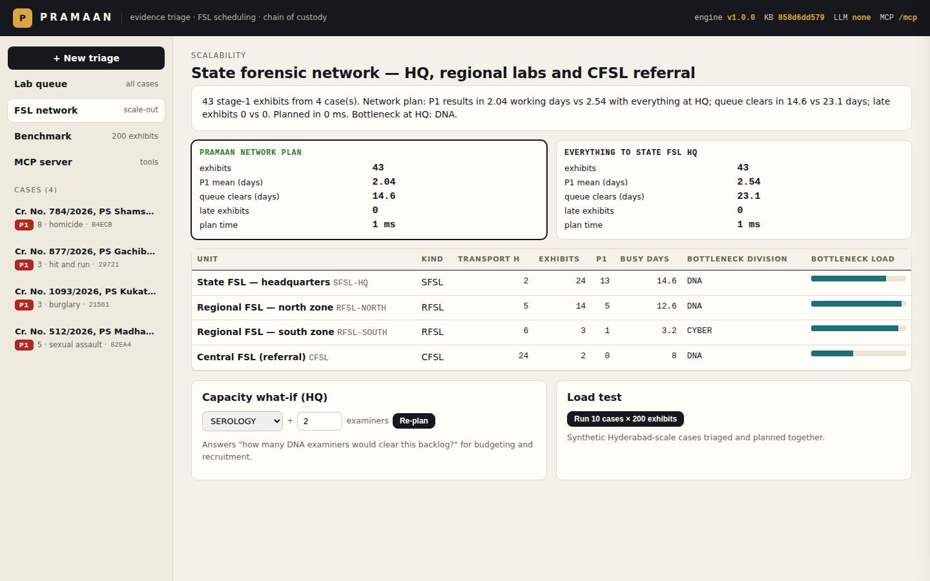
FSL SCALABILITY
Scales from one lab to the state's forensic network
2000
38.39 d
312.0 d
10 ms
exhibits from 10 cases
vs 84.85 d
vs 492.0 d
planning time
triaged in 4.51 s (443/s), one laptop core
P1 results: network plan vs everything to State FSL HQ
queue clears across 788 stage-1 exhibits
heap timelines: O(J·U·ops·log E)
State FSL HQ + Regional FSLs + CFSL referral (P1/P2 only) planned as ONE resource pool (laboratory.yaml → network:)
Each exhibit goes to the unit where it completes earliest, including transport; all its exams stay on one object
Capacity what-if per division (+N DNA examiners) for recruitment and budget requests; bottleneck shown per unit
One queue across all open cases: a perishable exhibit from today overtakes a stable one from last week
Stateless API, stdio or HTTP MCP, Docker, no CDN — runs in air-gapped district labs

Slide 10
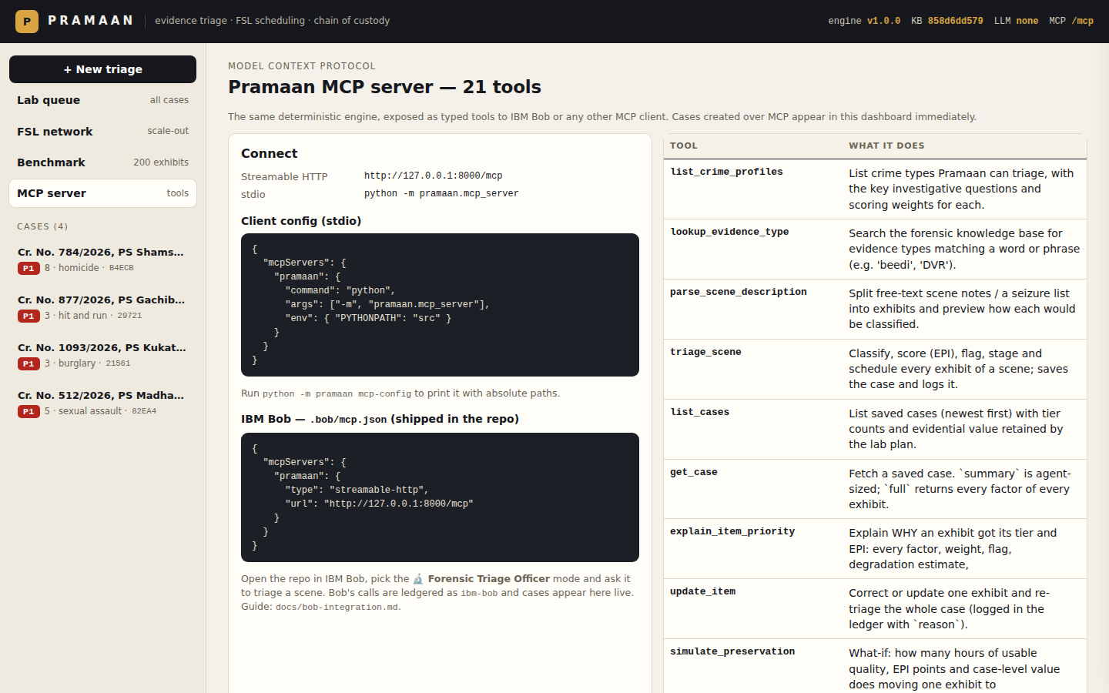
IBM BOB INTEGRATION
IBM Bob is the officer's agent — the engine stays in charge
Officer
AGENTS.md — the agent protocol (IBM Bob's counterpart of SAVVYDFIR's CLAUDE.md)
7 skills in .bob/skills/ — 7-phase evidence-triage-workflow, classification, preservation & custody, FSL scheduling, court-ready outputs, BSA authenticity, tools reference
4 custom modes — 🔬 Forensic Triage (edits only case-notes/), 🧪 FSL Liaison, ⚖️ Court Reviewer, 🛡️ Legal Cell (BSA); rules + slash commands
5 lifecycle hooks — briefing, privacy block, evidence-store write guard, MCP audit, Stop completion gate
.bob/mcp.json → Pramaan MCP; Bob never invents a score
IBM Bob agent loop
AGENTS.md · skills · modes
Pramaan MCP
21 tools · /mcp
Engine + KB
+ ledger
state.json · audit.jsonl
report.html · graph.html

Slide 11
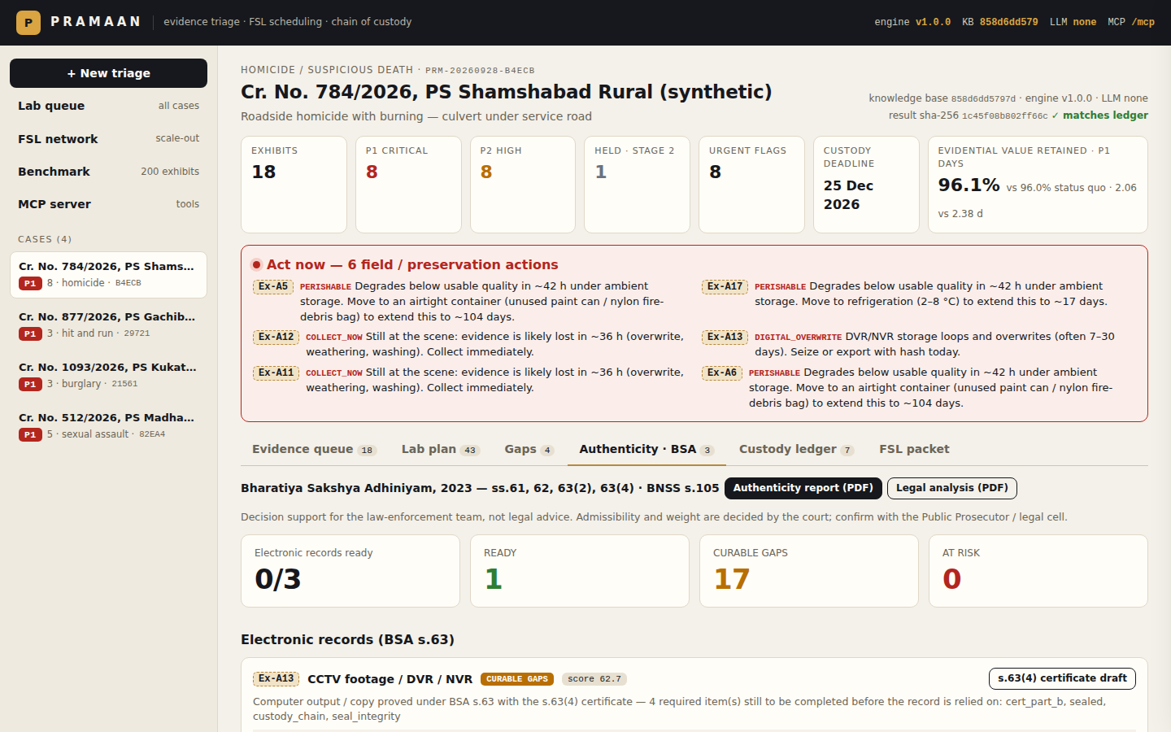
BHARATIYA SAKSHYA ADHINIYAM, 2023
Law enforcement: is the evidence authentic, reliable and provable?
BSA s.61
Electronic records recognised; not refused merely for being electronic
BSA s.62
Contents proved under s.63 — route: original device vs computer output
BSA s.63(2)
(a) regular use · (b) ordinary course · (c) proper operation · (d) derived output
BSA s.63(4)
Schedule certificate: Part A (person in charge) + Part B (expert) with hash
Integrity
FSL re-hash must equal seizure hash — mismatch = AT RISK
BNSS s.105
Search & seizure recorded on video; custody seals at every hand-over
READY · CURABLE GAPS · AT RISK per exhibit, remedies by role (IO, device in-charge, FSL expert, legal cell), authenticity report PDF, pre-filled s.63(4) certificate drafts. Legal flags never change forensic priority; the court decides admissibility.

Slide 12
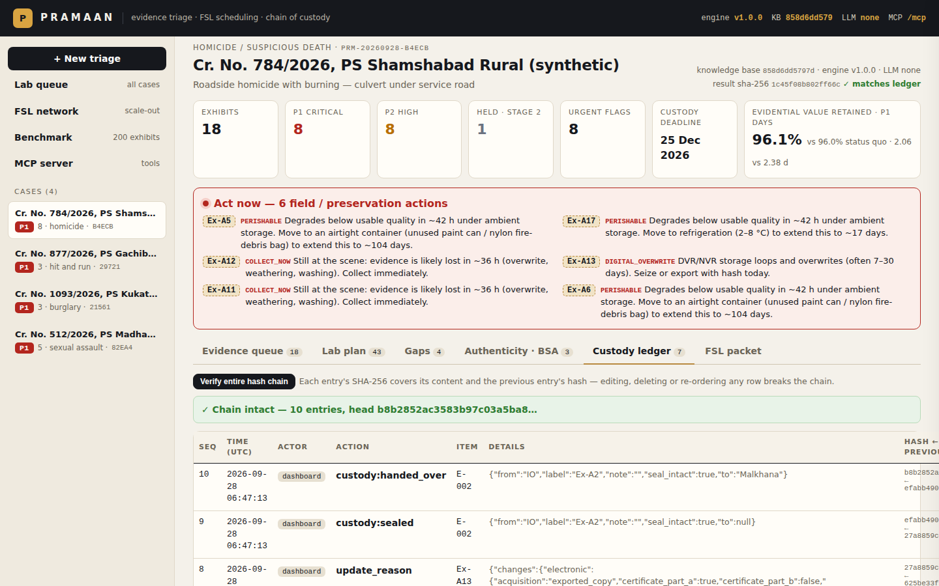
TRUST
Integrity, privacy and the law — enforced in code
SHA-256 hash-chained ledger: edit one row and verification pinpoints it
Knowledge-base hash + result hash on every run and every packet page
Privacy gate on every surface: Aadhaar, phone, e-mail, hashed protected names (BNS §72, DPDP Act)
Officer overrides need a reason and are logged
Deterministic engine: same input + same KB = same ranking

Slide 13
FOR THE JUDGES
Anchored in the code — evaluation criteria
Technical implementation quality
Innovation & differentiation
scoring.py — explainable EPI, per-factor points
degradation.py · sequencing.py (Kahn DAG)
scheduler.py — FIFO/static/ATC portfolio with baselines
network.py — heap timelines, capacity what-if
bsa.py — BSA ss.61-63 checks, Schedule certificate PDF
store.py — SHA-256 hash-chained ledger; privacy.py gate
mcp_server.py — 21 typed tools; api.py; cli.py; web/
46 tests + CI; .bob contract tests
Staged testing with a ≤10 m proximity exemption (Hyderabad butt stays in batch 1)
Urgency = hours to evidential-quality loss; preservation what-ifs
Custody-deadline (BNSS s.187(3)) aware scheduling
Legal readiness decoupled from forensic priority (tested)
Certificates drafted from structured facts + hash verification
Network scale-out: earliest completion incl. transport; CFSL for P1/P2
LLM proposes, rules dispose (proved by test)
IBM Bob guard-rails as code: hooks + completion gate
Full map with file paths: docs/judging-criteria.md

Slide 14
WHAT'S NEXT
From hackathon to a State FSL pilot
Calibrate
See photos
Integrate
Anchor
Half-lives, exam hours and examiner counts with a partner FSL; the KB hash versions every change.
watsonx.ai vision to flag exhibits visible in scene photos but missing from the list.
Seizure data from e-Sakshya / CCTNS; FSL LIMS hand-off; PostgreSQL + SSO for state-wide scale.
RFC 3161 timestamps on the ledger head for court-grade custody proofs.
Run it: docker compose up --build → http://127.0.0.1:8000 · Bob guide: docs/bob-integration.md
Team Pramaan · Pramaan means "proof"

