Slide 1


New Arts Commerce and Science College Parner
Courier Management System
Project Guide:-
Prof.Patade madam
Presented By:-
Kiran Dongare
Aniket Takle

Slide 2
INTRODUCTION
“Courier management system” Are one of the most reputed and fast growing courier services to our clients.
Our services are widely acknowledge for their features like time shaving and very efficient in use.
Sending the courier across the internet and no need to visit anywhere.
The system is used for daily activities such as booking a courier and track courier etc.

Slide 3
MAJOR MODULES
There are some main modules in the project which are further classified into different sub-modules that are.
Login Module
1. Customer
2. Supervisor
3. Admin
Registration Module
Courier Module
1. Pickup request
2. Track Courier

Slide 4
TECHNOLOGY USED
In this project, we used some technology which are:
Platform :- Windows Professional
Front end :- PHP (Drupal 7)
Back end :- MySQL
Web Server :- WAMP (Window Apache MySql & Php)
:- XAMPP (Apache MySql Php & Pearl)
Development tools :- Adobe Dreamweaver, Notepad++

Slide 5
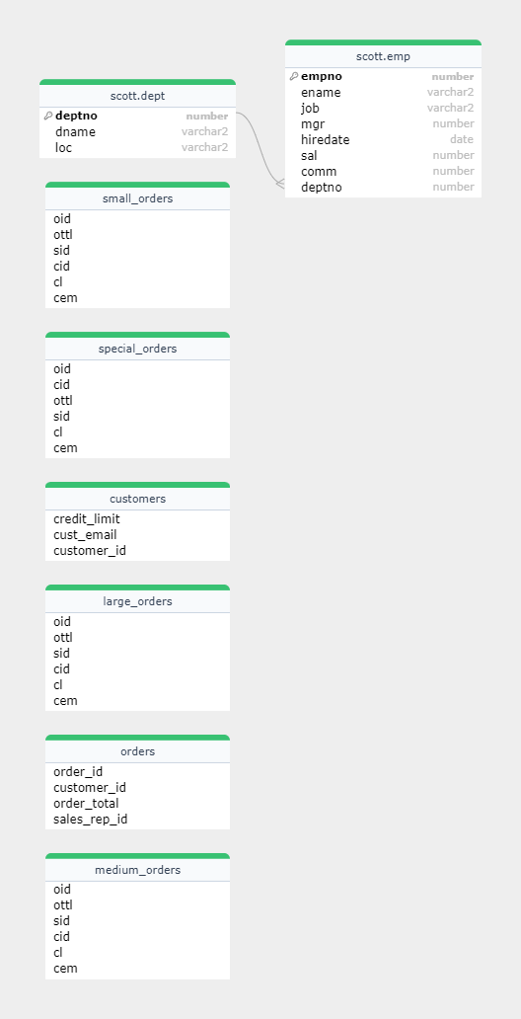
E-R DIAGRAM

Slide 6
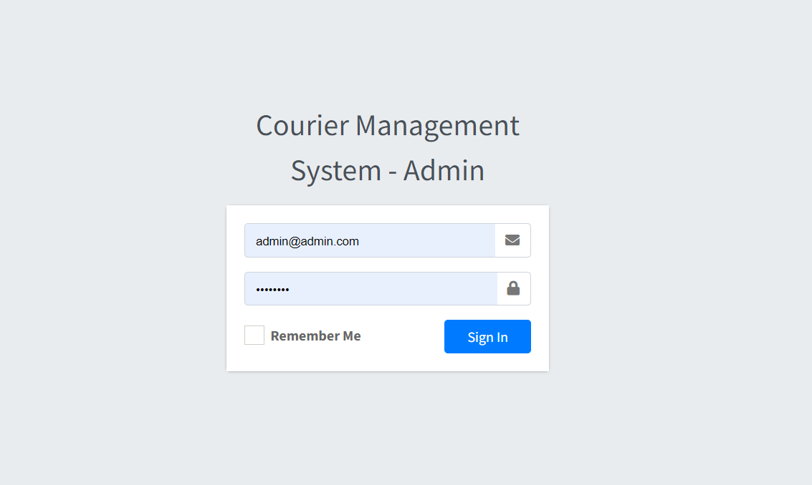
Login Page

Slide 7
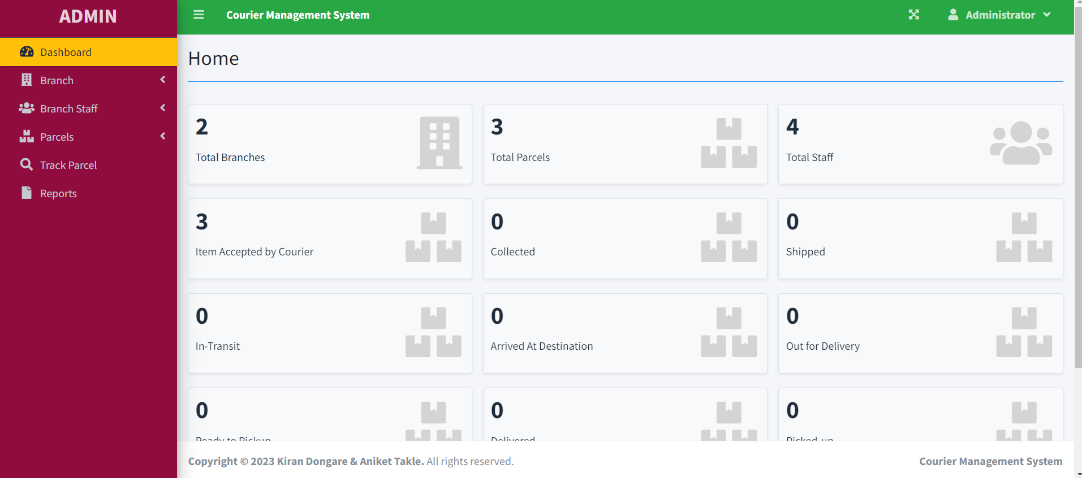
Home Page

Slide 8
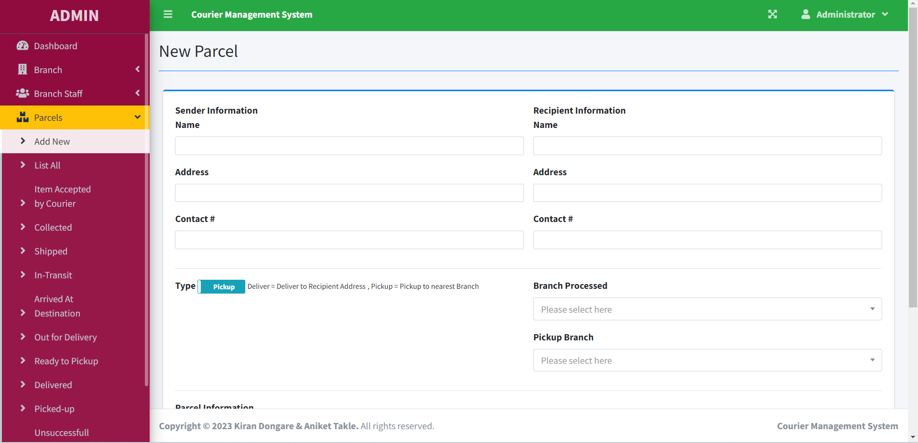
New Parcel

Slide 9
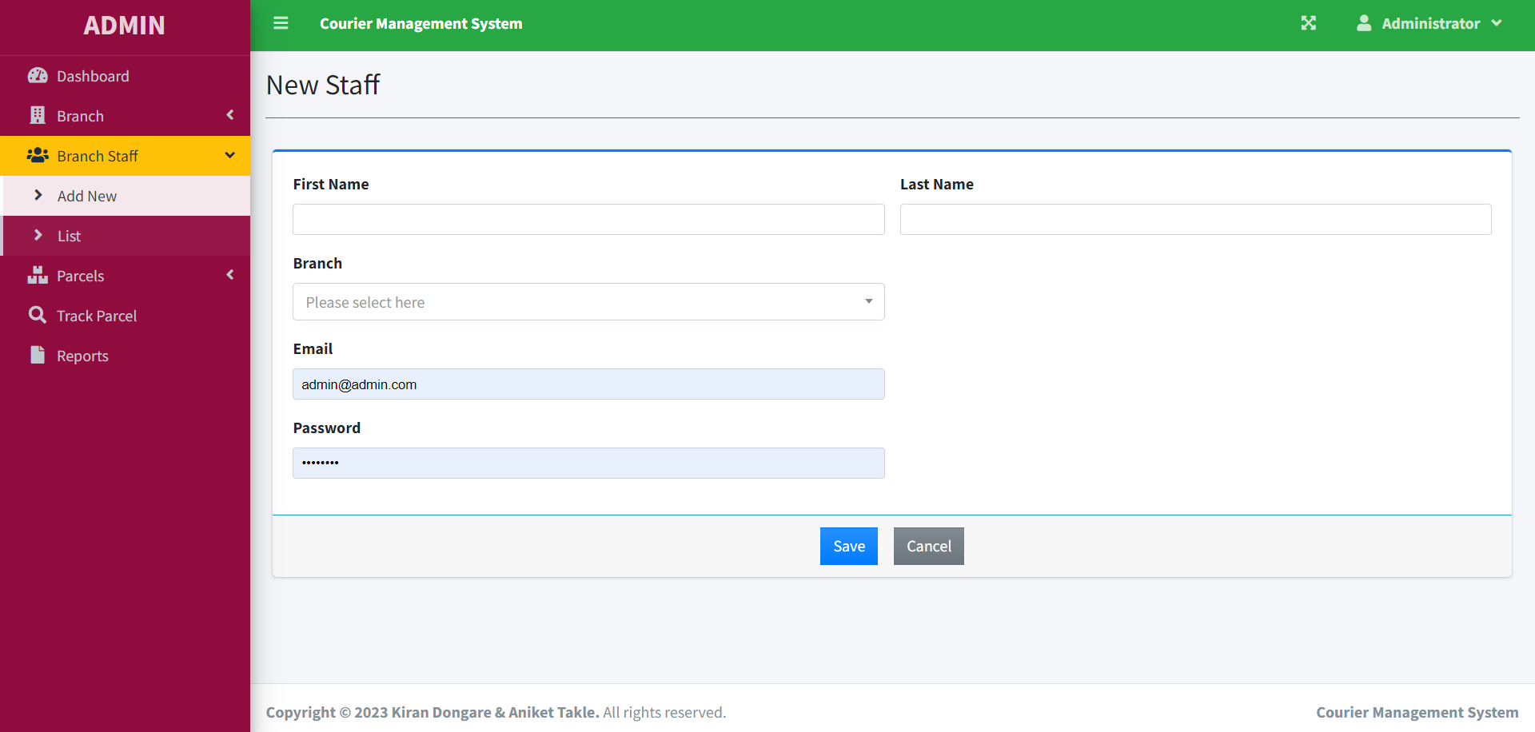
Staff Add

Slide 10
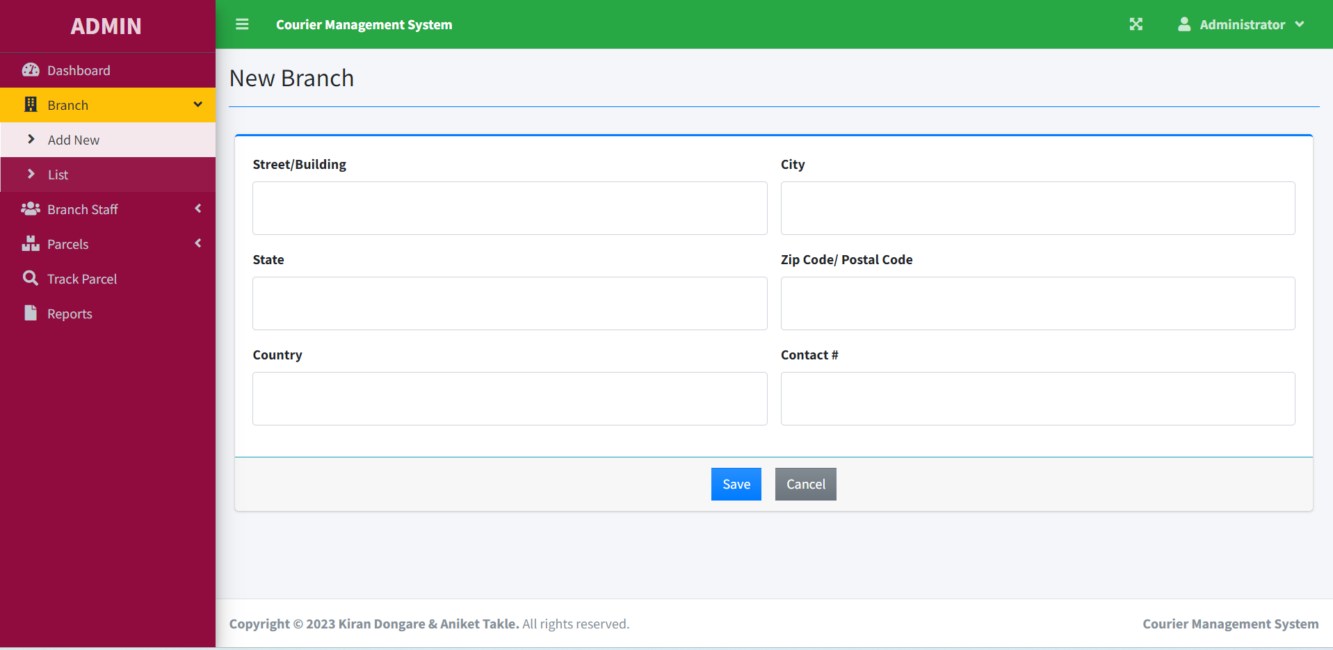
Branch Add

Slide 11
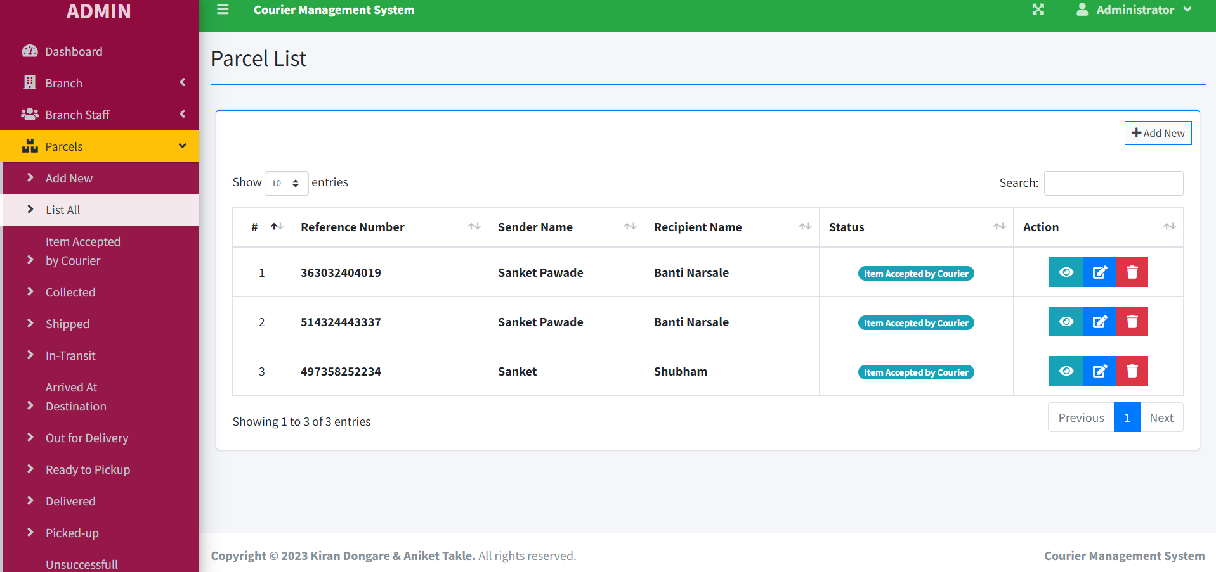
Parcel List

Slide 12
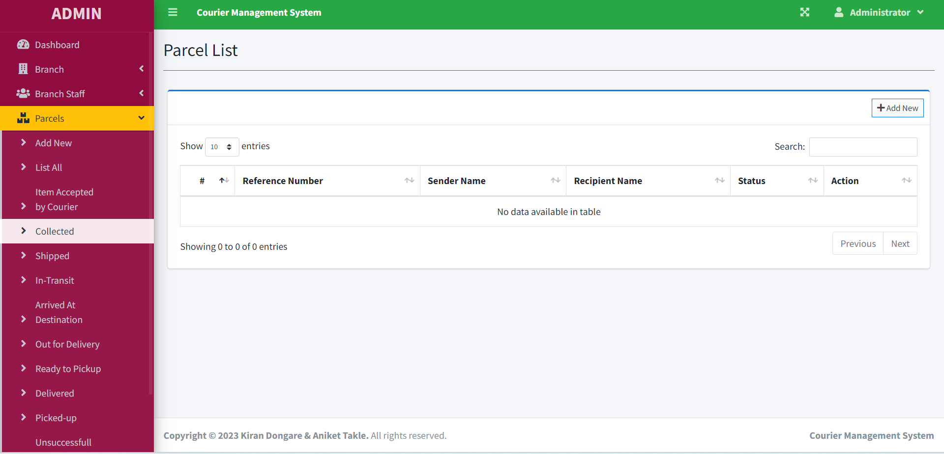
Collected

Slide 13
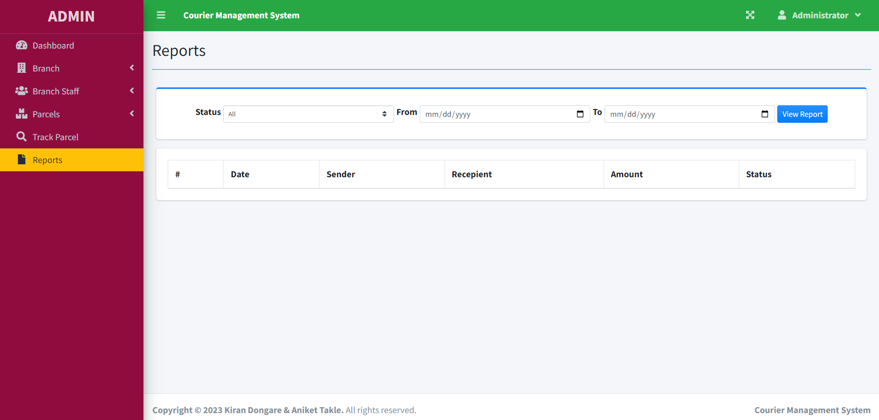
Reports

Slide 14
FUTURE SCOPE OF SYSTEM
In courier services sector more company is providing services but in India my courier system is leading company in courier sector.
The use of this System for the better services and faster processing.
The application is very useful and easy to use.
Courier facility in India is very cheaper and maximum charges but we can send the courier to destination in minimum charges.
More time will be save.

Slide 15



