Slide 1
工作汇报
汇报日期：2025年9月9日 汇报人：徐伟

Slide 2
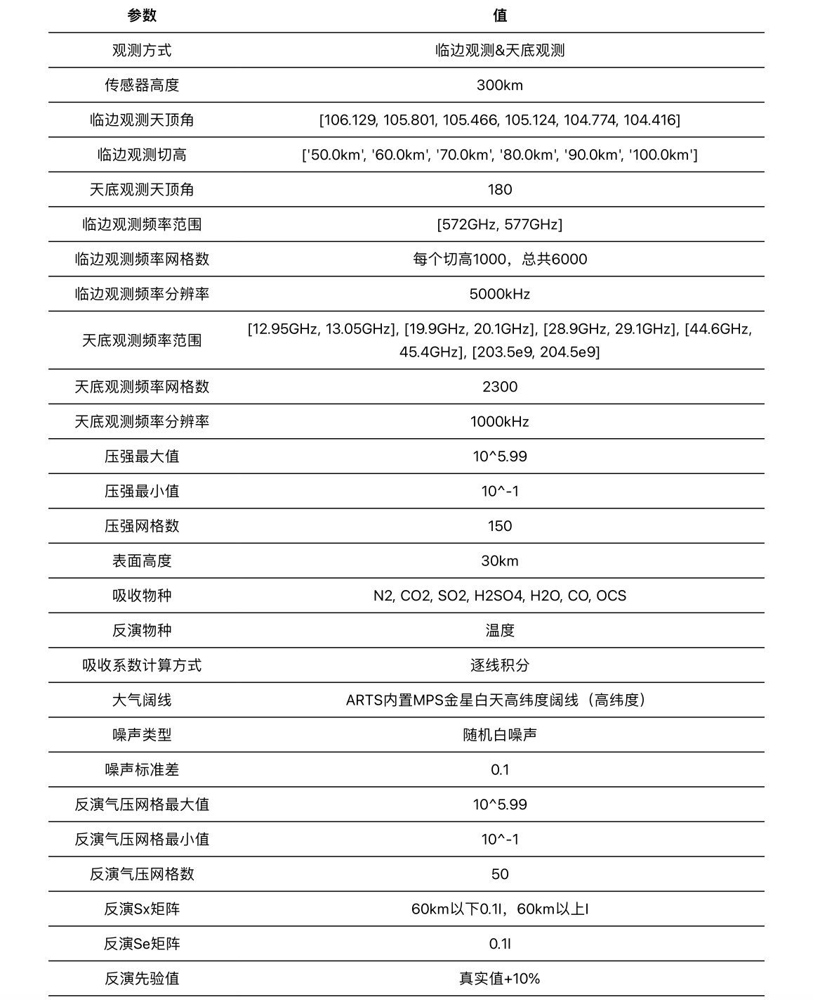
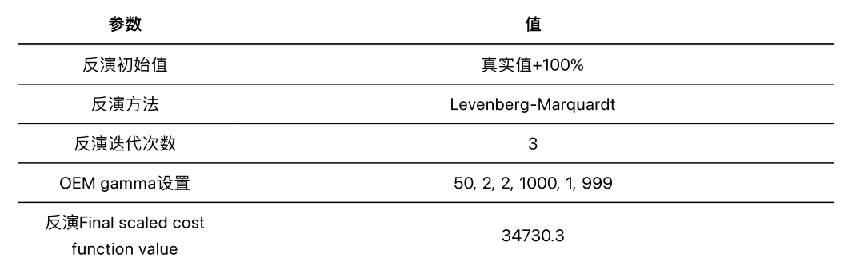
增大gamma阻尼

Slide 3
增大gamma阻尼

Slide 4
增大gamma阻尼

Slide 5
增大gamma阻尼

Slide 6
增大gamma阻尼

Slide 7
增大gamma阻尼

Slide 8
增大gamma阻尼

Slide 9
增大gamma阻尼

Slide 10
增大gamma阻尼

Slide 11
增大gamma阻尼

Slide 12
增大gamma阻尼

Slide 13
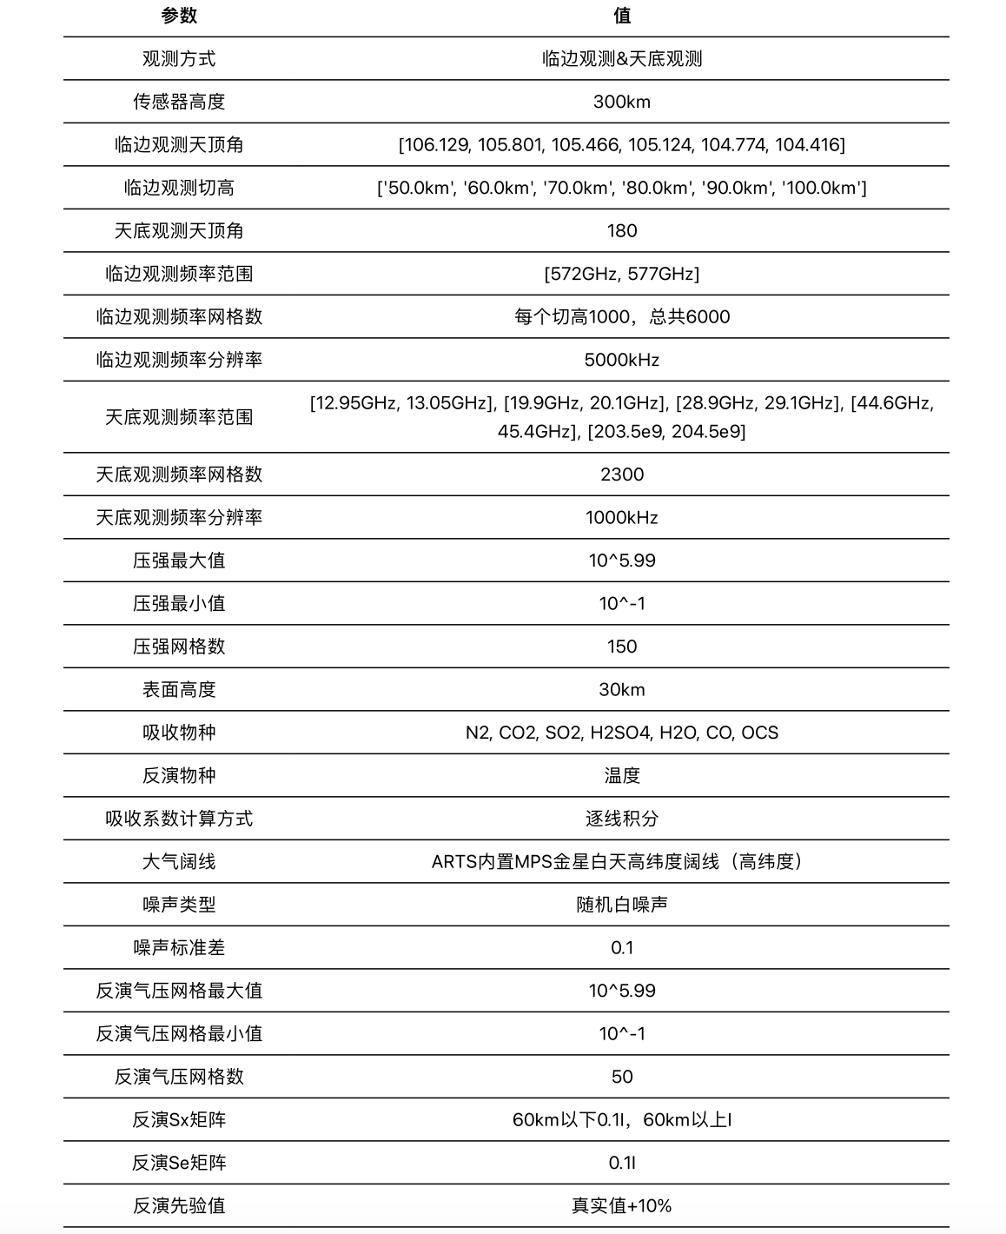
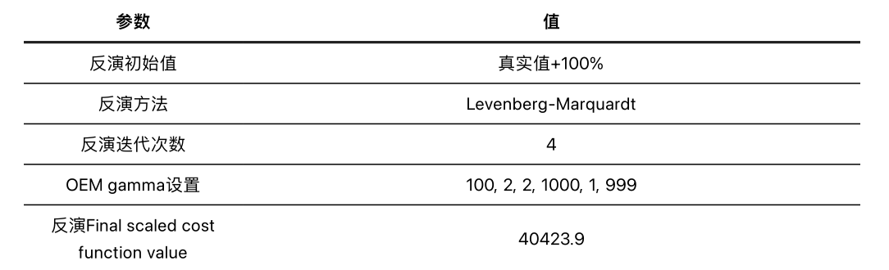
增大gamma阻尼

Slide 14
增大gamma阻尼

Slide 15
增大gamma阻尼

Slide 16
增大gamma阻尼

Slide 17
增大gamma阻尼

Slide 18
增大gamma阻尼

Slide 19
增大gamma阻尼

Slide 20
增大gamma阻尼

Slide 21
增大gamma阻尼

Slide 22
增大gamma阻尼

Slide 23
增大gamma阻尼

Slide 24
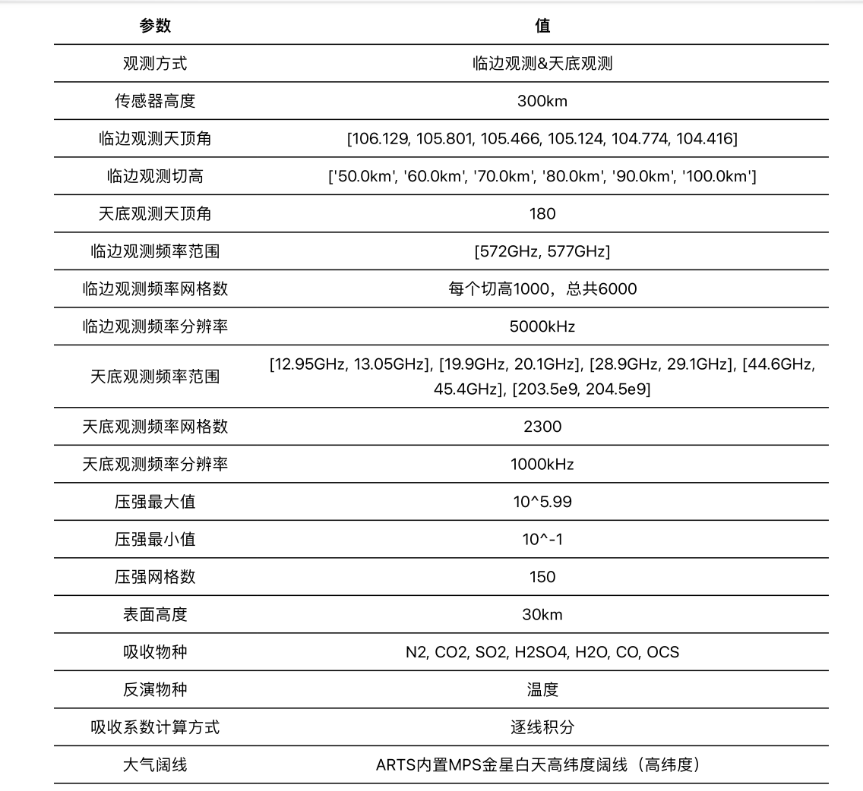
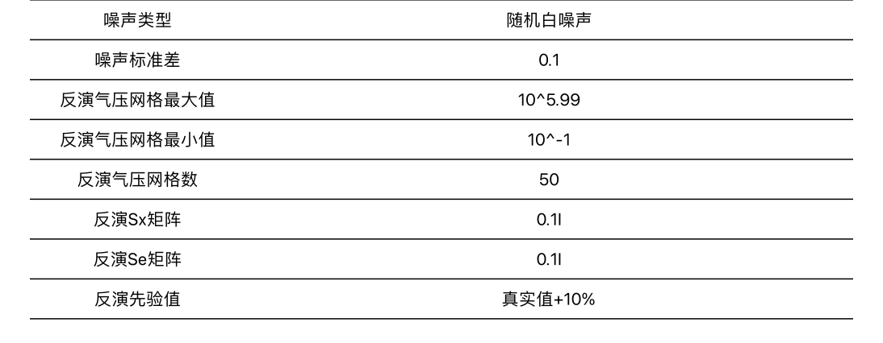
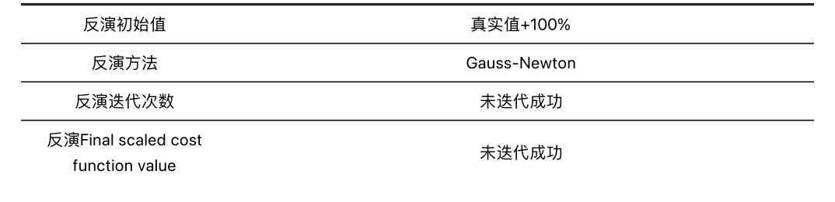
Gauss-Newton反演

Slide 25
ARTS团队回复
Dear Xu Wei,
About Question 1. ARTS is not optimized for Venus or any planet. It has been tested though, and as long as you input valid spectroscopy it should work.
I leave question 2 to others. I do not know how the append-methods work. It seems to me, though, that it would be easier to have just a single pair of sensor_pos/los that contain both the limb and nadir simultaneously.
With hope,
//Richard

Slide 26
ERA5
ERA5官方提供了Python的cdsapi库，可以获取其数据
已测试2024年数据可以正常下载

