Slide 1
String Matching

Slide 2
Pattern Matching
Given a text string T[0..n-1] and a pattern P[0..m-1], find all occurrences of the pattern within the text.
Example: T = 000010001010001 and P = 0001, the occurrences are:
  first occurrence starts at T[1]
  second occurrence starts at T[5]
  third occurrence starts at T[11]

Slide 3
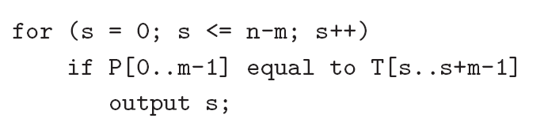
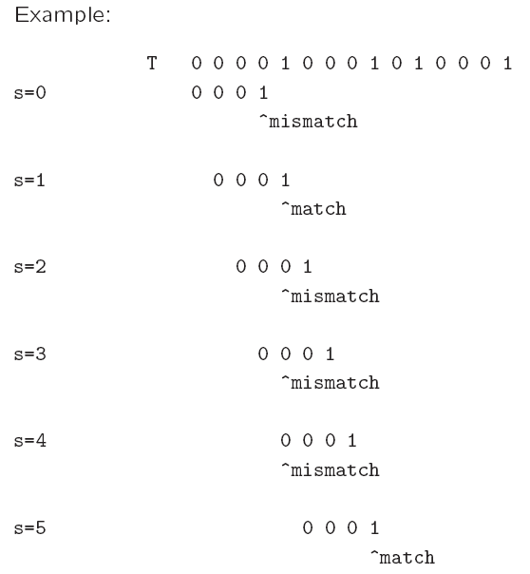
Naïve algorithm
Worst-case running time = O(nm).

Slide 4
Rabin-Karp Algorithm
Key idea:
  think of the pattern P[0..m-1] as a key, transform (hash) it into an equivalent integer p
  Similarly, we transform substrings in the text string T[] into integers
    For s=0,1,…,n-m, transform T[s..s+m-1] to an equivalent integer t_{s}
  The pattern occurs at position s if and only if p=t_{s}
If we compute p and t_{s} quickly, then the pattern matching problem is reduced to comparing p with n-m+1 integers

Slide 5
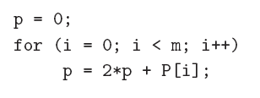
Rabin-Karp Algorithm …
How to compute p?
  p = 2^{m-1} P[0] + 2^{m-2} P[1] + … + 2 P[m-2] + P[m-1]
Using horner’s rule
This takes O(m) time, assuming each arithmetic operation can be done in O(1) time.

Slide 6
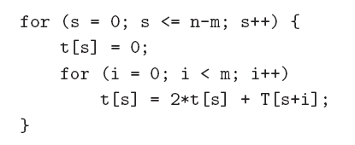
Rabin-Karp Algorithm …
Similarly, to compute the (n-m+1) integers t_{s} from the text string
This takes O((n – m + 1) m) time, assuming that each arithmetic operation can be done in O(1) time.
This is a bit time-consuming.

Slide 7
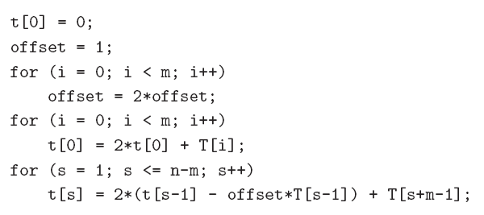
Rabin-Karp Algorithm
A better method to compute the integers is:
This takes O(n+m) time, assuming that each arithmetic operation can be done in O(1) time.

Slide 8
Problem
The problem with the previous strategy is that when m is large, it is unreasonable to assume that each arithmetic operation can be done in O(1) time.
  In fact, given a very long integer, we may not even be able to use the default integer type to represent it.
Therefore, we will use modulo arithmetic. Let q be a prime number so that 2q can be stored in one computer word.
  This makes sure that all computations can be done using single-precision arithmetic.

Slide 9
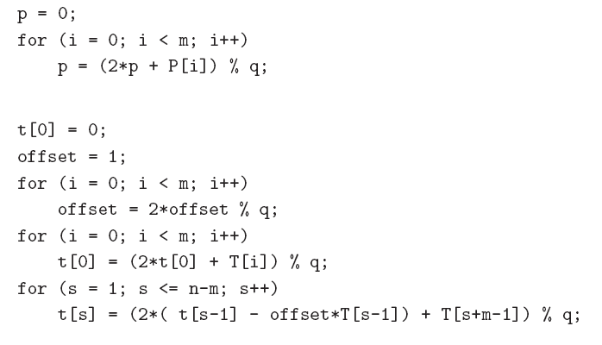

Slide 10
Once we use the modulo arithmetic, when p=t_{s} for some s, we can no longer be sure that P[0 .. M-1] is equal to T[s .. S+ m -1 ]
Therefore, after the equality test p = t_{s}, we should compare P[0..m-1] with T[s..s+m-1] character by character to ensure that we really have a match.
So the worst-case running time becomes O(nm), but it avoids a lot of unnecessary string matchings in practice.

