Slide 1
Degradations and metrics

Slide 2
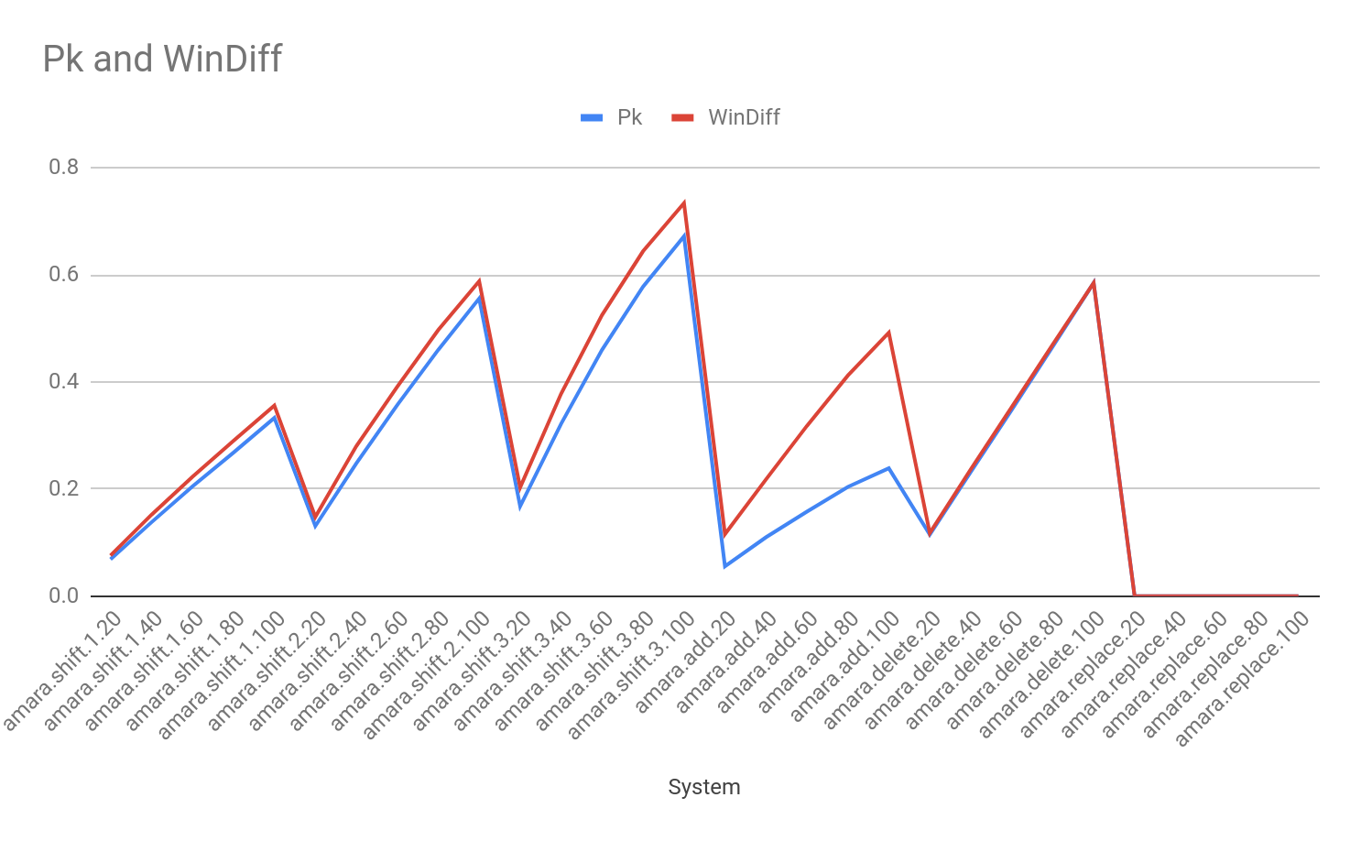
Pk and WindowDiff
WindDiff is more affected by additions and shifts than Pk
Notes:
Linear : helps prediction clear interpretation
TODO: check why windiff

Slide 3
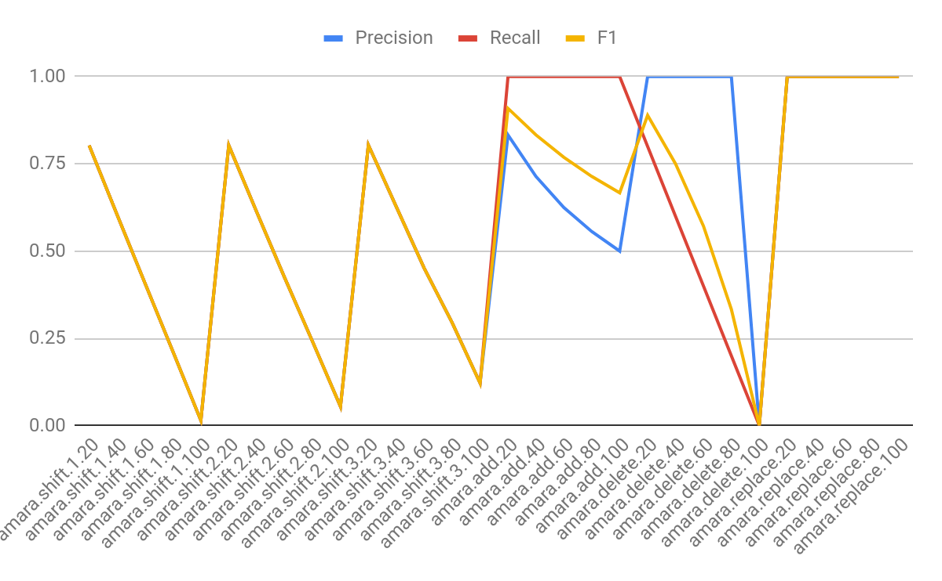
Precision, Recall, F1
Shifts: same behaviour-almost?
Additions: precision expected to drop
Deletions: high precision, low recall
Replacements do not affect
Notes:
No sensitivity to the degree of distance between 1-2-3 (accuracy)?????

Slide 4
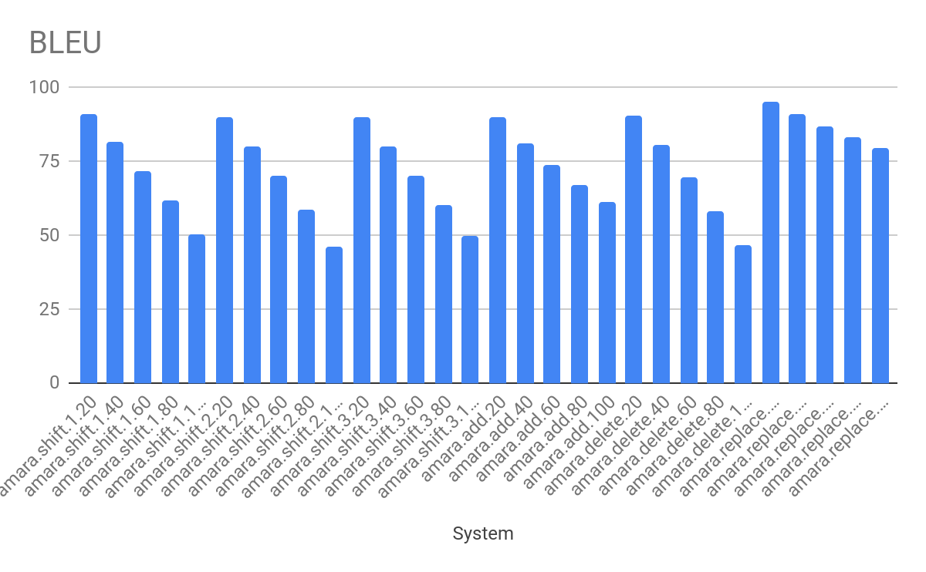
BLEU
Replacement less drop than other degradations
Notes:
Linearity? 20% degradation-20% BLEU drop?
Precision but delete is worse and additions are not
Brevity penalty? Deletions. How to adjust if text does not expand? Vary the number of tokens
Bleu diff. Compute # breaks

Slide 5
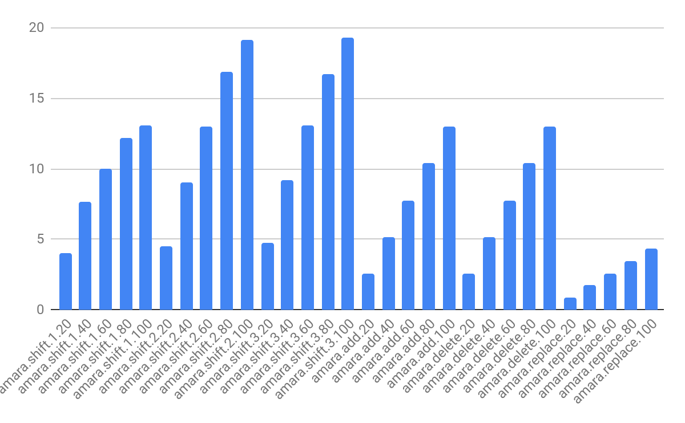
TER-br

Slide 6
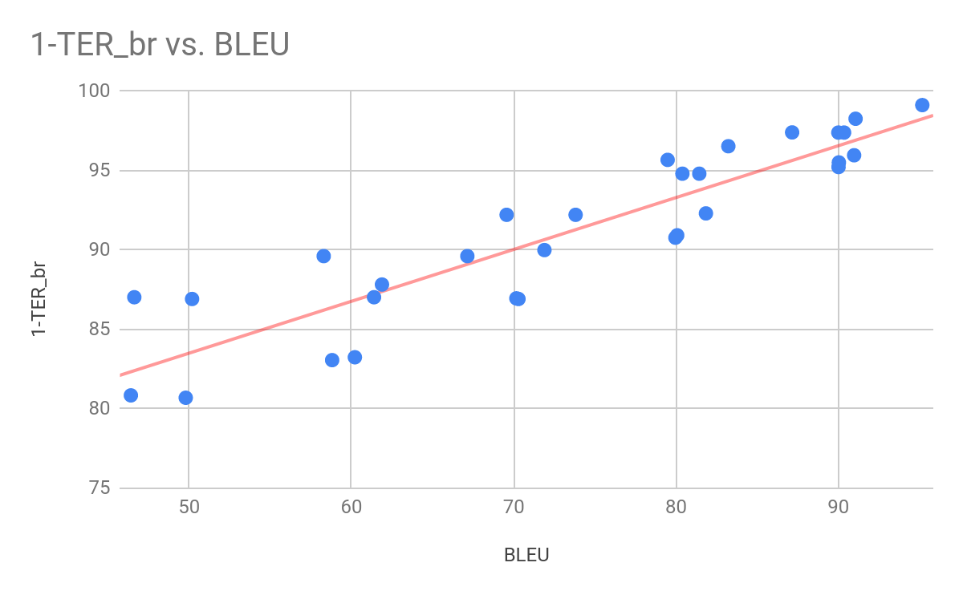

Slide 7
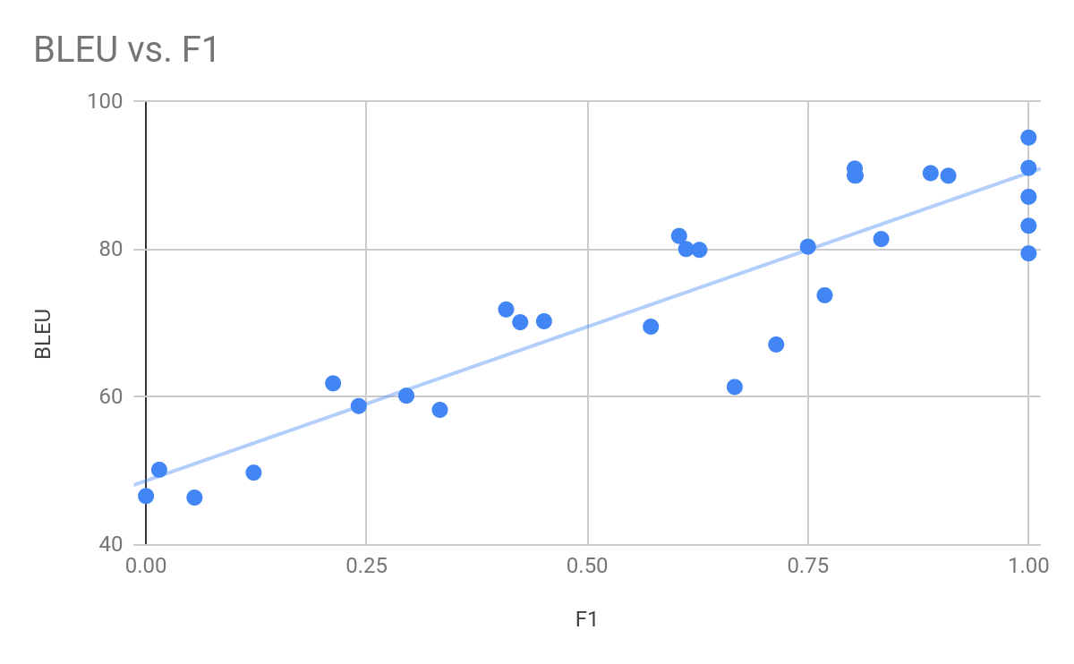

Slide 8
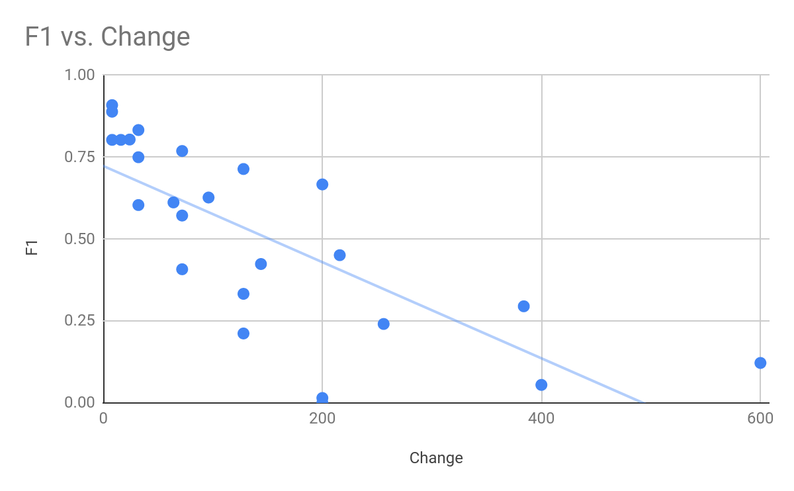

Slide 9
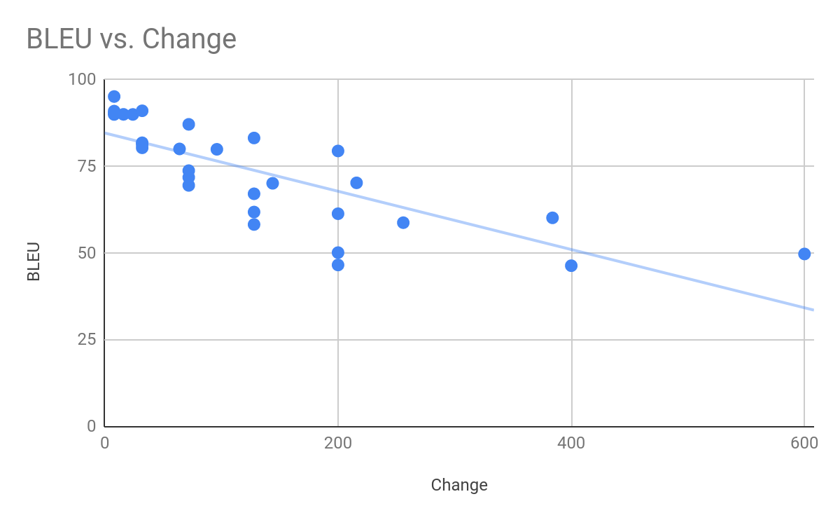

Slide 10
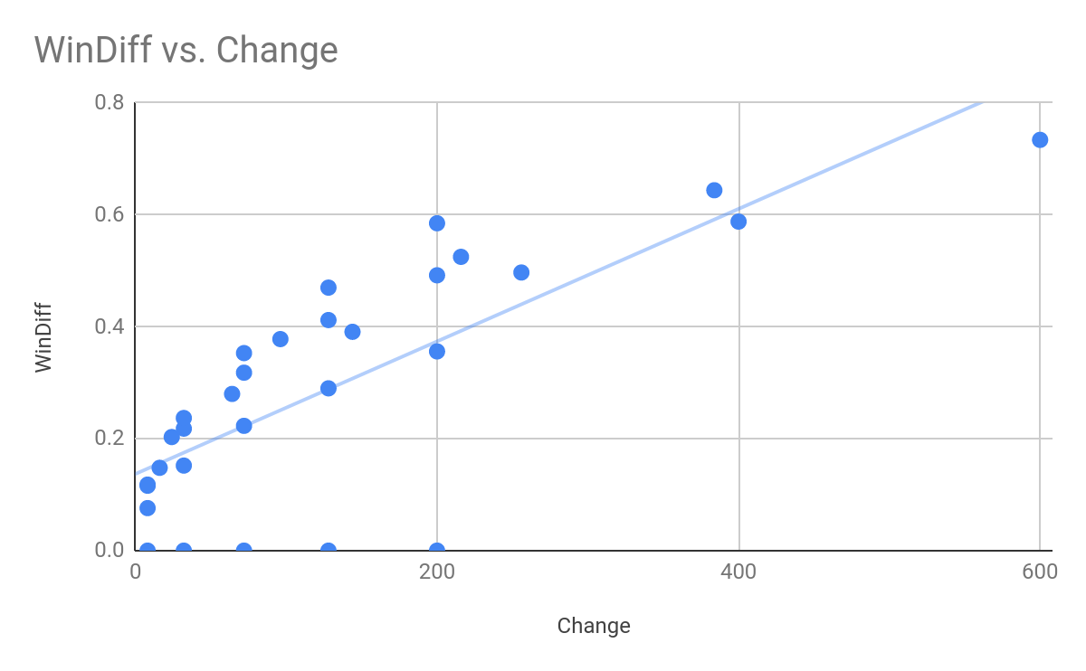
Notes:
Degradation of BLEU in a controlled way, see correlation with BLEU-br. Maybe first step before moving to actual translations.

