Slide 1
Computer Networks Hybrid Tunneling Mechanisms using Multithreading
VIGNESH ARAVINDH B – CS22B2004

Slide 2
Contents
Literature Review
Teredo
6RD
Hybrid
Architecture
Analysis
Outcomes

Slide 3
Literature Review

Slide 4
Introduction
Currently, Internet Protocol version 4 (IPv4) addresses have been depleted. Many Internet Service Providers (ISPs), researchers and end users are migrating from IPv4 to IPv6 due to strong features of IPv6 and limitation in IPv4. Different tunneling techniques have been deployed to migrate on IPv6 for ordinary users. However, these techniques create many issues such as compatibility, complexity, connectivity and traffic. Due to the dissimilar header structure and incompatibility of IPv4 and IPv6, the devices are unable to communicate with each other because devices do not support IPv6 addresses directly. The performance of network is also compromised due to huge increment in data transmission traffic. This project proposes a technique to provide full IPv6 connectivity and enhancing the network performances by combining two tunneling techniques such as IPv6 Rapid Deployment (6RD) and Teredo.

Slide 5
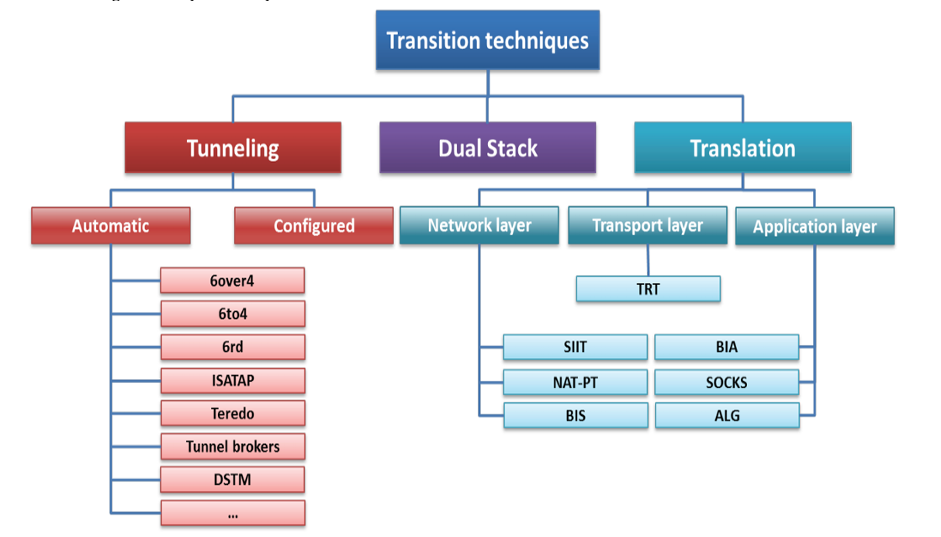

Slide 6
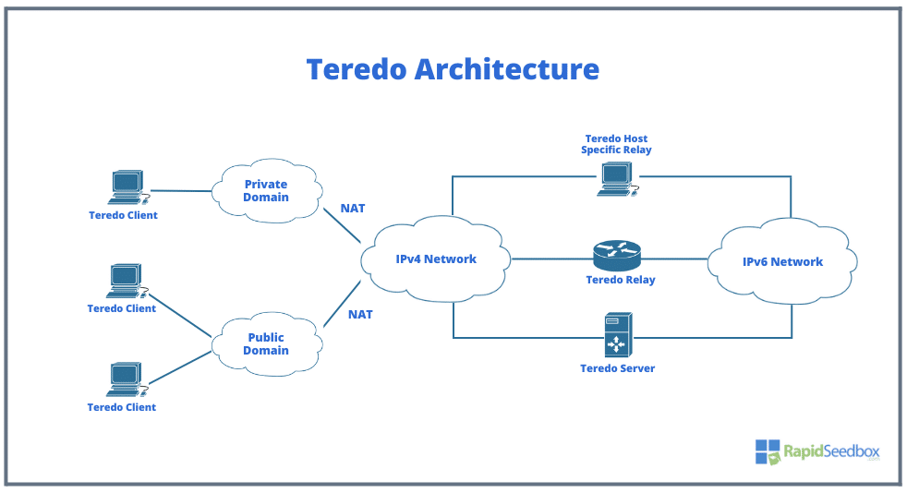
TEREDO
Teredo tunneling is a transition technology that allows IPv6 packets to be transmitted over an IPv4 network. It is primarily used to enable communication between IPv6-enabled devices across the IPv4 internet, even if the devices are behind NAT (Network Address Translation).

Slide 7
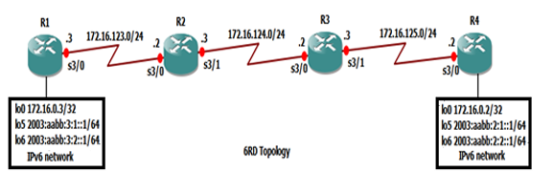
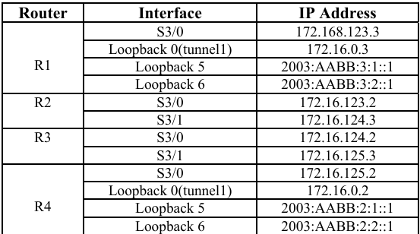
6RD
6RD (IPv6 Rapid Deployment) is a tunneling mechanism that enables Internet Service Providers (ISPs) to provide IPv6 connectivity to their customers over an existing IPv4 network. It is a stateless and cost-effective solution designed to accelerate IPv6 deployment without requiring a native IPv6 infrastructure
6RD SIMULATION CONFIGURATION GNS3

Slide 8
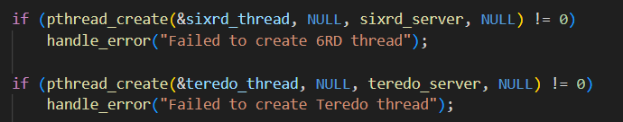
HYBRID TUNNELING SETUP USING SOCKET PROGRAMMING WITH THREADS
WHY HYBRID APPROACH ?
The proposed work merge Teredo and 6RD together to create a hybrid network. The features of both networks are combined to facilitate the current IPv4 addresses, the issues of 6RD can be covered in Teredo and vice versa. By combining both we make use of the positives of both setup and create a well
Connected and an enhanced with high performance and low latency.

Slide 9
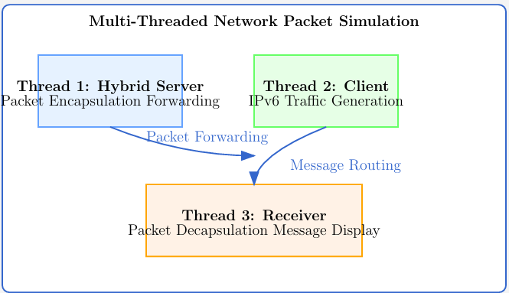

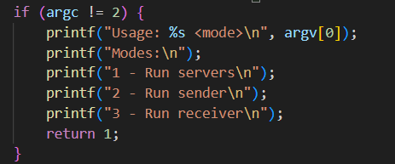
ARCHITECTURE
Two servers tunneling between a sender and a receiver

Slide 10
Analysis

Slide 11
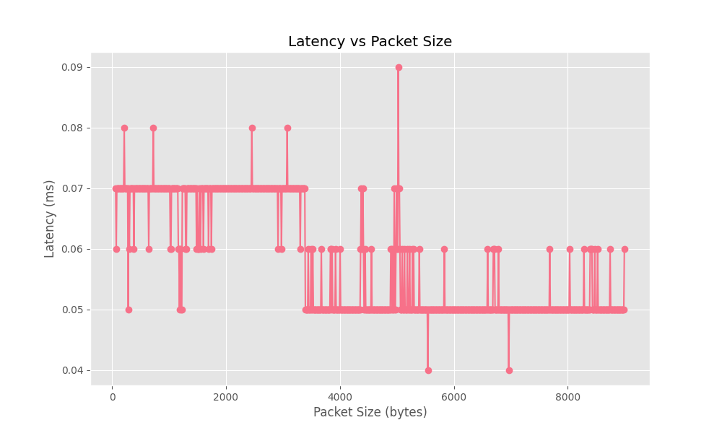
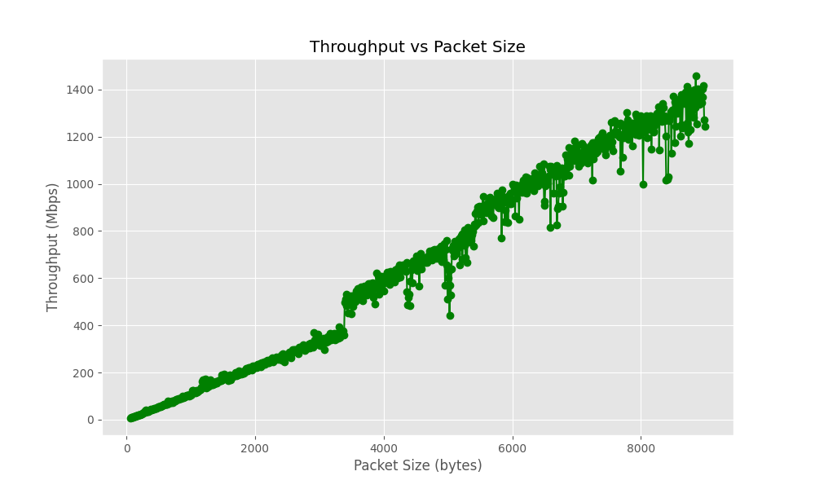
TEREDO TUNNELING:
Packet Size | Latency (ms) | Throughput(Mbps)
64 | 0.07 | 6.80
394 | 0.07 | 40.91
1214 | 0.05 | 169.57
2404 | 0.07 | 272.24
3054 | 0.07 | 331.34
4504 | 0.05 | 638.48
6984 | 0.05 | 1100.4
7894 | 0.0.5 | 1221.38
8994 | 0.06 | 1244.6

Slide 12
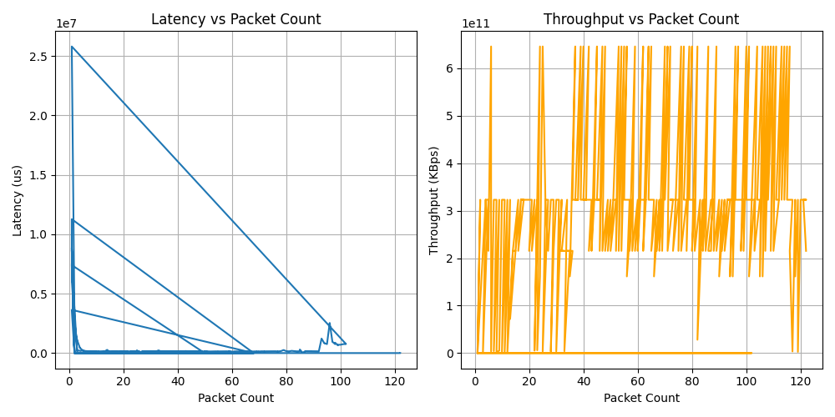
Hybrid Approach

Slide 13
Future Scope
Outcomes
Thus the hybrid performance network, a merge of 6RD and Teredo Tunneling mechanism has been analyzed using multithreaded socket simulating a basic tunnel over two hosts. The latency and throughput metrics have been measured against the packet size up to a jumbo size of 9000 bytes and has been compared in the graphs. It is noted that the hybrid approach has lower latency when it comes to a larger packet size with throughput almost remaining the same for most of the packets.
Enhance security with advanced encryption for tunneled packets.Reduced carbon footprint
Explore dynamic load balancing across tunneling mechanisms.

Slide 14
Thank You
VIGNESH ARAVINDH B
CS22B2004

