Slide 1

Dimensionality Reduction

Slide 2

Linear discriminant analysis(LDA)
What is LDA?
Dimensionality reduction technique
Separating two or more classes
History
Formulated by Ronald A.Fisher in 1936
Generalized as Multiple Discriminant Analysis by C.R.Rao in the year 1948

Slide 3
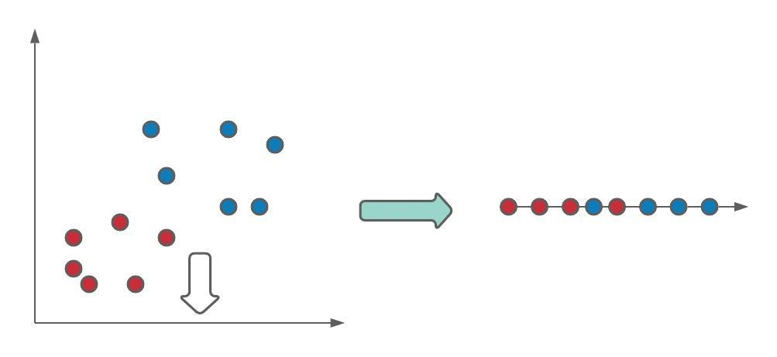
Example

Slide 4
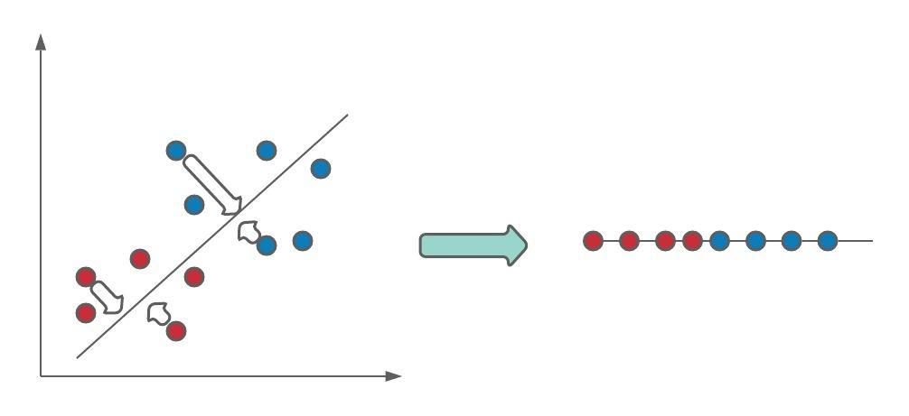
Example

Slide 5
Difference between LDA and PCA
Both LDA and PCA are linear transformation techniques: LDA is a supervised whereas PCA is unsupervised – PCA ignores class labels.

Slide 6
References
Youtube: StatQuest

