Slide 1
~/code-club · 04.17.2026
Cursor
An evaluation of the AI-native development environment
presenter
Raghuram Selvaraj
raghuselva99@gmail.com
$ cursor --version
> agent ready
> ctx loaded
CODE CLUB · CURSOR REVIEW
01 / 09

Slide 2



01 · UX OVERVIEW
An AI-native fork of VS Code
Cursor is built on top of VS Code, layering AI capabilities directly into the editor rather than keeping them in a sidebar. The result is three interaction modes that share the same editor surface.
Tab completion
Inline autocomplete as you type. Unlimited on paid plans.
Chat / Agent
Multi-file edits, command execution, autonomous iteration.
MAX MODE
Extends context window for large-codebase work
Plan Mode
Asks clarifying questions, then drafts a structured plan before writing code.
UX OVERVIEW
02 / 09

Slide 3
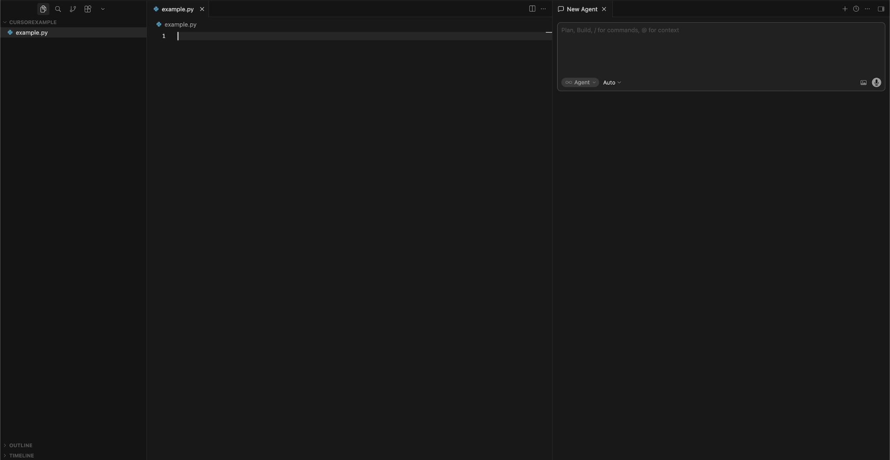
01 · UX OVERVIEW (contd.)
UX OVERVIEW (contd.)
03 / 09

Slide 4



02 · FEATURES
What's in the toolbox
Tab completion
Agent mode
Plan mode
Inline autocomplete, unlimited on paid plans
Multi-file edits, runs commands, iterates autonomously
Clarifies requirements, drafts structured plan first
Debug mode
MCP servers
Cloud agents
Generates hypotheses, adds logs, narrows root cause
Connect DBs, APIs, docs to the agent
Run long tasks in the background
FEATURES
04 / 09

Slide 5
03 · PROMPT SPECIFICITY
More detail → better architecture
VAGUE PROMPT
FUNC REQS ENUMERATED
PLAN MODE + FUNC REQS
Simple HTML + JS
Flask + HTML + SQLite
FastAPI + React + Postgres + Docker
Single-file output
No API layer
No storage
Misses Functional and Non-functional requirements by default
API layer generated
Hits functional reqs
Opts for simplicity
Odd UX decisions
Reuploads on each query
Clarifies stack & DB choice
Generates Alembic migrations
Full Docker compose stack
Swagger UI auto-generated
TAKEAWAY Plan Mode's clarifying questions enforce granularity without requiring upfront expertise
NFR1 · NFR2 · NFR4
05 / 09

Slide 6

04 · CONTAINERIZATION
Docker-ready in one follow-up prompt
Backend Dockerfile
DEBUG MODE · REAL BUG CAUGHT
Python base + Uvicorn entrypoint
"Load failed" on upload
Generated 5 hypotheses, added runtime logs, asked for repro.
Root cause: BACKEND_CORS_ORIGINS parsed as JSON by Pydantic Settings, backend crashed on startup.
→ Fixed in 1 prompt.
Frontend Dockerfile
Node build stage + static serve
docker-compose.yml
frontend · backend · db (Postgres)
CLOUD PATH
push images → managed Postgres → container runtime → env vars & smoke test
NFR3 · DEPLOYABILITY
06 / 09

Slide 7


05 · STACK CHOICES
What Plan Mode picked, and why
NFR5 · REST API
FastAPI + SQLAlchemy + Alembic
Auto-generated Swagger UI · schemas & models separated · 4 endpoints including /health
NFR6 · UI
React + Vite (JS)
No Tailwind unless requested · no UI unit tests by default · Vite dev server for local · Opted for JS instead of TS
NFR7 · DATABASE
PostgreSQL (recommended over MySQL)
JSONB for word_frequency · Alembic migrations applied on startup
Picks sensible defaults when asked to recommend · follows instructions cleanly when user specified custom stack
NFR5 · NFR6 · NFR7
07 / 09

Slide 8
06 · AUTO vs PREMIUM
Two routing modes, same UI
AUTO
PREMIUM
efficiency
intelligence
Routes to cost-efficient model
Unlimited · no credit draw
~$0.25/$1.25/$6.00 per M tokens
Best for routine edits, flow
Routes to a frontier model
Draws from $20 credit pool
API rates, no Cursor markup
Best for complex refactors, reasoning
MAX MODE stacks on top — extends context window at additional cost. Auto for flow, Premium when model choice matters.
NFR9 · MODEL ROUTING
08 / 09

Slide 9

07 · COST
What Code Club actually pays
Hobby
Pro
Pro+
Ultra
Teams
Free
$20 / mo
$60 / mo
$200 / mo
$40 / user
Limited completions + agent
Unlimited Tab & Auto · $20 frontier model API credits
3× credits
20× credits · priority access
SSO · admin · billing
RECOMMENDATION FOR CODE CLUB
Pro tier is likely sufficient — Auto mode handles most tasks without touching the credit pool.
$16/mo with annual billing · Free for 1 year with verified student (.edu) · Overages billed at API rates (no markup)
NFR8 · COST
09 / 09

