Slide 1
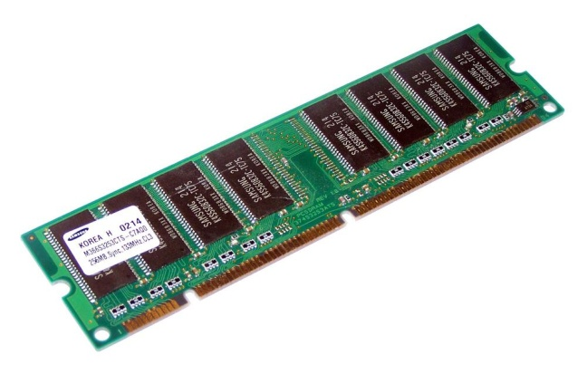
Shape 도형
private String lineColor
private String fillColor
----------------------
생성자→표기생략
메소드 g/s →표기생략
메소드 일반 toString()
draw()
일반화
ShapeApp
//필드 //생성자 2개 //메소드 g/s //메소드 일반 public static void main(String[] args){ 메모리가 움직이는 스토리 Shpae s01 = new Shape(“빨강”, “빨강”); Rectangle r01 = new Rectangle(“빨강”, “빨강”, 5, 5); }
Ractangle 추상화
Circle 추상화
Triangle 추상화
private String lineColor
private String fillColor
private int width
private int height
----------------------
생성자→표기생략
메소드 g/s →표기생략
메소드 일반 toString()
draw()
private String lineColor
private String fillColor
private int radius
----------------------
생성자→표기생략
메소드 g/s →표기생략
메소드 일반 toString()
draw()
private String lineColor
private String fillColor
private int width
private int height
----------------------
생성자→표기생략
메소드 g/s →표기생략
메소드 일반 toString()
draw()
//메소드 일반
public static void main(String[] args){
메모리가 움직이는 스토리
}
*Ractangle(사각형 그리기)
스태틱
Shape
//필드 protected String lineColor; protected String fillColor; //생성자 public Shape() { } public Shape(String lineColor, String fillColor) { //메모리에 올리는거 this.lineColor = lineColor; this.fillColor = fillColor; } //메소드 g/s public String getLineColor() { return lineColor; } public void setLineColor(String lineColor) { this.lineColor = lineColor; } public String getFillColor() { return fillColor; } public void setFillColor(String fillColor) { this.fillColor = fillColor; } //메소드 일반 @Override public String toString() { return "Shape [lineColor=" + lineColor + ", fillColor=" + fillColor + "]"; }
1
Ractangle[] rArray
1
1
Circle[] cArray
1
1
Triangle[] tArray
1
스택
Rectangle r01
0x199
Circle c01
0x299
Triangle r01
0x199
0x101
4
0x201
4
0x101
4
3
3
3
Shape
2
Shape
2
Shape
2
힙
//필드
protected String lineColor; //빨강
protected String fillColor; //빨강
//생성자
//메소드 g/s
public String getLineColor() {
return lineColor;
}
public void setLineColor(String lineColor) {
this.lineColor = lineColor;
}
public String getFillColor() {
return fillColor;
}
public void setFillColor(String fillColor) {
this.fillColor = fillColor;
}
//메소드 일반
@Override
public String toString() {
return "Shape [lineColor=" + lineColor + ", fillColor=" + fillColor + "]";
}
0x109
Ractangle[]
//필드
protected String lineColor; //빨강
protected String fillColor; //빨강
//생성자
//메소드 g/s
public String getLineColor() {
return lineColor;
}
public void setLineColor(String lineColor) {
this.lineColor = lineColor;
}
public String getFillColor() {
return fillColor;
}
public void setFillColor(String fillColor) {
this.fillColor = fillColor;
}
//메소드 일반
@Override
public String toString() {
return "Shape [lineColor=" + lineColor + ", fillColor=" + fillColor + "]";
}
0x299
Circle[]
//필드
protected String lineColor; //빨강
protected String fillColor; //빨강
//생성자
//메소드 g/s
public String getLineColor() {
return lineColor;
}
public void setLineColor(String lineColor) {
this.lineColor = lineColor;
}
public String getFillColor() {
return fillColor;
}
public void setFillColor(String fillColor) {
this.fillColor = fillColor;
}
//메소드 일반
@Override
public String toString() {
return "Shape [lineColor=" + lineColor + ", fillColor=" + fillColor + "]";
}
0x109
Triangle[]
public int length = 3
public int length = 3
public int length = 3
0x101
0x102
0x103
0x201
0x202
0x203
0x101
0x102
0x103
[0]
[1]
[2]
[0]
[1]
[2]
[0]
[1]
[2]
4
5
6
4
5
6
4
5
6
0x101
Rectangle
0x201
Circle
0x101
Rectangle
Ractangle extends Shape
//필드 private String lineColor; private String fillColor; private int width; private int height; //생성자 public Rectangle() { } public Rectangle(String lineColor, String fillColor, int width, int height) { super(lineColor, fillColor); this.width = width; this.height = height; } //메소드 g/s public int getWidth() { return width; } public void setWidth(int width) { this.width = width; } public int getHeight() { return height; } public void setHeight(int height) { this.height = height; } //메소드 일반 @Override //재정의 public String toString() { return "Rectangle [width=" + width + ", height=" + height + ", lineColor=" + lineColor + ", fillColor=" + fillColor + "]"; } public void draw() { System.out.println("선색:" + super.lineColor + " 면색:" + super.fillColor + " 가로:" + this.width + " 세로:" + this.height + " 사각형을 그렸습니다."); }
Circle extends Shape
//필드 private String lineColor; private String fillColor; private int width; // 7 private int height; // 7 // 생성자 public Circle() { super(); // Shape 기본생성자 Shape(); } public Circle(String lineColor, String fillColor, int radius) { super(lineColor, fillColor); this.radius = radius; } //메소드 g/s public int getWidth() { return width; } public void setWidth(int width) { this.width = width; } public int getHeight() { return height; } public void setHeight(int height) { this.height = height; } //메소드 일반 @Override //재정의 public String toString() { return "Rectangle [width=" + width + ", height=" + height + ", lineColor=" + super.lineColor + ", fillColor=" + fillColor + "]"; } public void draw() { System.out.println("선색:" + super.lineColor + " 면색:" + super.fillColor + " 가로:" + this.width + " 세로:" + this.height
Triangle extends Shape
//필드 private String lineColor; private String fillColor; private int width; // 5 private int height; // 5 //생성자 public Rectangle() { } public Rectangle(String lineColor, String fillColor, int width, int height) { super(lineColor, fillColor); this.width = width; this.height = height; } //메소드 g/s public int getWidth() { return width; } public void setWidth(int width) { this.width = width; } public int getHeight() { return height; } public void setHeight(int height) { this.height = height; } //메소드 일반 @Override //재정의 public String toString() { return "Rectangle [width=" + width + ", height=" + height + ", lineColor=" + super.lineColor + ", fillColor=" + fillColor + "]"; } public void draw() { System.out.println("선색:" + super.lineColor + " 면색:" + super.fillColor + " 가로:" + this.width + " 세로:" + this.height + " 삼각형을 그렸습니다."); }
//필드
private String lineColor;
private String fillColor;
private int width; // 5
private int height; // 5
//생성자
//메소드 g/s
public int getWidth() {
return width;
}
public void setWidth(int width) {
this.width = width;
}
public int getHeight() {
return height;
}
public void setHeight(int height) {
this.height = height;
}
//메소드 일반
@Override //재정의
public String toString() {
return "Rectangle [width=" + width + ", height=" + height + ", lineColor=" + super.lineColor + ", fillColor="
+ fillColor + "]";
}
public void draw() {
System.out.println("선색:" + super.lineColor + " 면색:" + super.fillColor + " 가로:" + this.width + " 세로:" + this.height + " 사각형을 그렸습니다.");
}
필드
private String lineColor;
private String fillColor;
private int radius;
// 생성자
// 메소드 g/s
public int getRadius() {
return radius;
}
public void setRadius(int radius) {
this.radius = radius;
}
// 메소드 일반
// 부모쪽에도 같은 메소드가 있다
// 부모쪽의 메소드 사용 못하게 할려고 같은 이름으로 "재정의"
@Override
public String toString() {
return "Circle [radius=" + radius + ", lineColor=" + lineColor + ", fillColor=" + fillColor + "]";
}
public void draw() {
System.out.println("선색:" + super.lineColor + " 면색:" + super.fillColor + " 반지름:" + this.radius + " 원을 그렸습니다.");
}
//필드
private String lineColor;
private String fillColor;
private int width; // 5
private int height; // 5
//생성자
//메소드 g/s
public int getWidth() {
return width;
}
public void setWidth(int width) {
this.width = width;
}
public int getHeight() {
return height;
}
public void setHeight(int height) {
this.height = height;
}
//메소드 일반
@Override //재정의
public String toString() {
return "Rectangle [width=" + width + ", height=" + height + ", lineColor=" + super.lineColor + ", fillColor="
+ fillColor + "]";
}
public void draw() {
System.out.println("선색:" + super.lineColor + " 면색:" + super.fillColor + " 가로:" + this.width + " 세로:" + this.height + " 삼각형을 그렸습니다.");
}

Slide 2
Shape 도형
private String lineColor
private String fillColor
----------------------
생성자→표기생략
메소드 g/s →표기생략
메소드 일반 toString()
draw()
일반화
ShapeApp
//필드 //생성자 2개 //메소드 g/s //메소드 일반 public static void main(String[] args){ 메모리가 움직이는 스토리 Shpae s01 = new Shape(“빨강”, “빨강”); Rectangle r01 = new Rectangle(“빨강”, “빨강”, 5, 5); }
Ractangle 추상화
Circle 추상화
Triangle 추상화
private String lineColor
private String fillColor
private int width
private int height
----------------------
생성자→표기생략
메소드 g/s →표기생략
메소드 일반 toString()
draw()
private String lineColor
private String fillColor
private int radius
----------------------
생성자→표기생략
메소드 g/s →표기생략
메소드 일반 toString()
draw()
private String lineColor
private String fillColor
private int width
private int height
----------------------
생성자→표기생략
메소드 g/s →표기생략
메소드 일반 toString()
draw()
//메소드 일반
public static void main(String[] args){
메모리가 움직이는 스토리
}
*Ractangle(사각형 그리기)
스태틱
1
1
1
Ractangle[] rArray
1
스택
Rectangle r01
Rectangle r02
Rectangle r03
0x333
0x233
4
0x233
5
0x233
6
3
Shape
//필드 protected String lineColor; protected String fillColor; //생성자 public Shape() { } public Shape(String lineColor, String fillColor) { //메모리에 올리는거 this.lineColor = lineColor; this.fillColor = fillColor; } //메소드 g/s public String getLineColor() { return lineColor; } public void setLineColor(String lineColor) { this.lineColor = lineColor; } public String getFillColor() { return fillColor; } public void setFillColor(String fillColor) { this.fillColor = fillColor; } //메소드 일반 @Override public String toString() { return "Shape [lineColor=" + lineColor + ", fillColor=" + fillColor + "]"; }
Shape
Shape
Shape
2
힙
//필드
protected String lineColor; //빨강
protected String fillColor; //빨강
//생성자
//메소드 g/s
public String getLineColor() {
return lineColor;
}
public void setLineColor(String lineColor) {
this.lineColor = lineColor;
}
public String getFillColor() {
return fillColor;
}
public void setFillColor(String fillColor) {
this.fillColor = fillColor;
}
//메소드 일반
@Override
public String toString() {
return "Shape [lineColor=" + lineColor + ", fillColor=" + fillColor + "]";
}
//필드
protected String lineColor; //노랑
protected String fillColor; //노랑
//생성자
//메소드 g/s
public String getLineColor() {
return lineColor;
}
public void setLineColor(String lineColor) {
this.lineColor = lineColor;
}
public String getFillColor() {
return fillColor;
}
public void setFillColor(String fillColor) {
this.fillColor = fillColor;
}
//메소드 일반
@Override
public String toString() {
return "Shape [lineColor=" + lineColor + ", fillColor=" + fillColor + "]";
}
//필드
protected String lineColor; //파랑
protected String fillColor; //파랑
//생성자
//메소드 g/s
public String getLineColor() {
return lineColor;
}
public void setLineColor(String lineColor) {
this.lineColor = lineColor;
}
public String getFillColor() {
return fillColor;
}
public void setFillColor(String fillColor) {
this.fillColor = fillColor;
}
//메소드 일반
@Override
public String toString() {
return "Shape [lineColor=" + lineColor + ", fillColor=" + fillColor + "]";
}
0x333
Ractangle[]
public int length = 3
0x123
0x987
0x437
[0]
[1]
[2]
4
5
6
0x233
Rectangle
0x233
Rectangle
0x233
Rectangle
//필드
private String lineColor;
private String fillColor;
private int width; // 5
private int height; // 5
//생성자
//메소드 g/s
public int getWidth() {
return width;
}
public void setWidth(int width) {
this.width = width;
}
public int getHeight() {
return height;
}
public void setHeight(int height) {
this.height = height;
}
//메소드 일반
@Override //재정의
public String toString() {
return "Rectangle [width=" + width + ", height=" + height + ", lineColor=" + super.lineColor + ", fillColor="
+ fillColor + "]";
}
public void draw() {
System.out.println("선색:" + super.lineColor + " 면색:" + super.fillColor + " 가로:" + this.width + " 세로:" + this.height + " 사각형을 그렸습니다.");
}
//필드
private String lineColor;
private String fillColor;
private int width; // 7
private int height; // 7
//생성자
//메소드 g/s
public int getWidth() {
return width;
}
public void setWidth(int width) {
this.width = width;
}
public int getHeight() {
return height;
}
public void setHeight(int height) {
this.height = height;
}
//메소드 일반
@Override //재정의
public String toString() {
return "Rectangle [width=" + width + ", height=" + height + ", lineColor=" + super.lineColor + ", fillColor="
+ fillColor + "]";
}
public void draw() {
System.out.println("선색:" + super.lineColor + " 면색:" + super.fillColor + " 가로:" + this.width + " 세로:" + this.height + " 사각형을 그렸습니다.");
}
//필드
private String lineColor;
private String fillColor;
private int width; // 10
private int height; // 10
//생성자
//메소드 g/s
public int getWidth() {
return width;
}
public void setWidth(int width) {
this.width = width;
}
public int getHeight() {
return height;
}
public void setHeight(int height) {
this.height = height;
}
//메소드 일반
@Override //재정의
public String toString() {
return "Rectangle [width=" + width + ", height=" + height + ", lineColor=" + super.lineColor + ", fillColor="
+ fillColor + "]";
}
public void draw() {
System.out.println("선색:" + super.lineColor + " 면색:" + super.fillColor + " 가로:" + this.width + " 세로:" + this.height + " 사각형을 그렸습니다.");
}
Ractangle extends Shape
//필드 private String lineColor; private String fillColor; private int width; private int height; //생성자 public Rectangle() { } public Rectangle(String lineColor, String fillColor, int width, int height) { super(lineColor, fillColor); this.width = width; this.height = height; } //메소드 g/s public int getWidth() { return width; } public void setWidth(int width) { this.width = width; } public int getHeight() { return height; } public void setHeight(int height) { this.height = height; } //메소드 일반 @Override //재정의 public String toString() { return "Rectangle [width=" + width + ", height=" + height + ", lineColor=" + lineColor + ", fillColor=" + fillColor + "]"; } public void draw() { System.out.println("선색:" + super.lineColor + " 면색:" + super.fillColor + " 가로:" + this.width + " 세로:" + this.height + " 사각형을 그렸습니다."); }
Circle
Triangle

Slide 3
ShapeApp
//필드 //생성자 2개 //메소드 g/s //메소드 일반 public static void main(String[] args){ 메모리가 움직이는 스토리 Shpae s01 = new Shape(“빨강”, “빨강”); Rectangle r01 = new Rectangle(“빨강”, “빨강”, 5, 5); }
Shape 도형
private String lineColor
private String fillColor
----------------------
생성자→표기생략
메소드 g/s →표기생략
메소드 일반 toString()
draw()
//메소드 일반
public static void main(String[] args){
메모리가 움직이는 스토리
}
일반화
*Ractangle(사각형 그리기)
스태틱
Ractangle 추상화
Circle 추상화
Triangle 추상화
1
1
Shape
//필드 protected String lineColor; protected String fillColor; //생성자 public Shape() { } public Shape(String lineColor, String fillColor) { //메모리에 올리는거 this.lineColor = lineColor; this.fillColor = fillColor; } //메소드 g/s public String getLineColor() { return lineColor; } public void setLineColor(String lineColor) { this.lineColor = lineColor; } public String getFillColor() { return fillColor; } public void setFillColor(String fillColor) { this.fillColor = fillColor; } //메소드 일반 @Override public String toString() { return "Shape [lineColor=" + lineColor + ", fillColor=" + fillColor + "]"; }
private String lineColor
private String fillColor
private int width
private int height
----------------------
생성자→표기생략
메소드 g/s →표기생략
메소드 일반 toString()
draw()
private String lineColor
private String fillColor
private int radius
----------------------
생성자→표기생략
메소드 g/s →표기생략
메소드 일반 toString()
draw()
private String lineColor
private String fillColor
private int width
private int height
----------------------
생성자→표기생략
메소드 g/s →표기생략
메소드 일반 toString()
draw()
스택
Shape s01
Rectangle r01
0x123
0x233
Shape
힙
1
//필드
protected String lineColor; //빨강
protected String fillColor; //빨강
//생성자
//메소드 g/s
public String getLineColor() {
return lineColor;
}
public void setLineColor(String lineColor) {
this.lineColor = lineColor;
}
public String getFillColor() {
return fillColor;
}
public void setFillColor(String fillColor) {
this.fillColor = fillColor;
}
//메소드 일반
@Override
public String toString() {
return "Shape [lineColor=" + lineColor + ", fillColor=" + fillColor + "]";
}
0x123
Shape
//필드
protected String lineColor; //빨강
protected String fillColor; //빨강
//생성자
//메소드 g/s
public String getLineColor() {
return lineColor;
}
public void setLineColor(String lineColor) {
this.lineColor = lineColor;
}
public String getFillColor() {
return fillColor;
}
public void setFillColor(String fillColor) {
this.fillColor = fillColor;
}
//메소드 일반
@Override
public String toString() {
return "Shape [lineColor=" + lineColor + ", fillColor=" + fillColor + "]";
}
1
Ractangle extends Shape
//필드 private String lineColor; private String fillColor; private int width; private int height; //생성자 public Rectangle() { } public Rectangle(String lineColor, String fillColor, int width, int height) { super(lineColor, fillColor); this.width = width; this.height = height; } //메소드 g/s public int getWidth() { return width; } public void setWidth(int width) { this.width = width; } public int getHeight() { return height; } public void setHeight(int height) { this.height = height; } //메소드 일반 @Override //재정의 public String toString() { return "Rectangle [width=" + width + ", height=" + height + ", lineColor=" + lineColor + ", fillColor=" + fillColor + "]"; } public void draw() { System.out.println("선색:" + super.lineColor + " 면색:" + super.fillColor + " 가로:" + this.width + " 세로:" + this.height + " 사각형을 그렸습니다."); }
0x233
Rectangle
//필드
private String lineColor;
private String fillColor;
private int width; // 5
private int height; // 5
//생성자
//메소드 g/s
public int getWidth() {
return width;
}
public void setWidth(int width) {
this.width = width;
}
public int getHeight() {
return height;
}
public void setHeight(int height) {
this.height = height;
}
//메소드 일반
@Override //재정의
public String toString() {
return "Rectangle [width=" + width + ", height=" + height + ", lineColor=" + super.lineColor + ", fillColor="
+ fillColor + "]";
}
public void draw() {
System.out.println("선색:" + super.lineColor + " 면색:" + super.fillColor + " 가로:" + this.width + " 세로:" + this.height + " 사각형을 그렸습니다.");
}
Circle
Triangle
Shpae s01 = new Shape(“빨강”, “빨강”);
Rectangle r01 = new Rectangle(“빨강”, “빨강”, 5, 5);

Slide 4
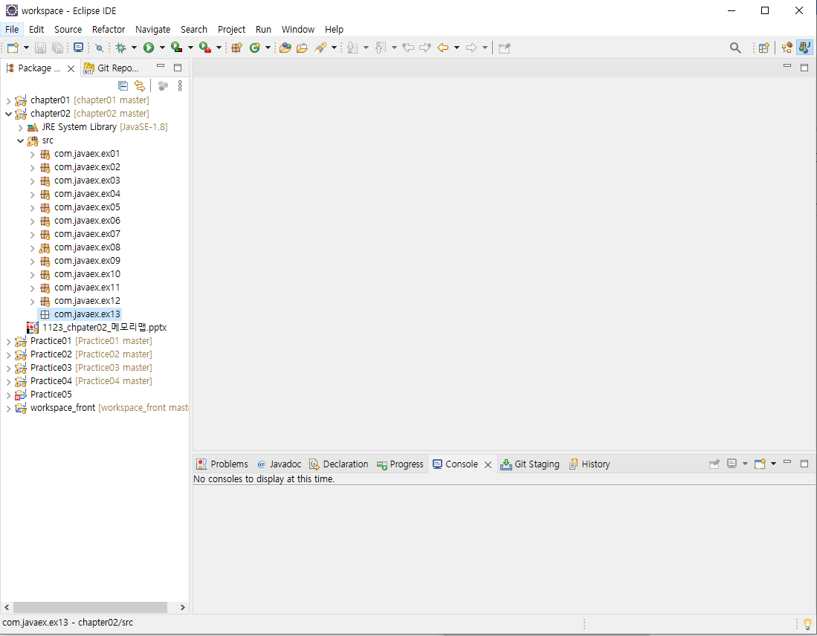

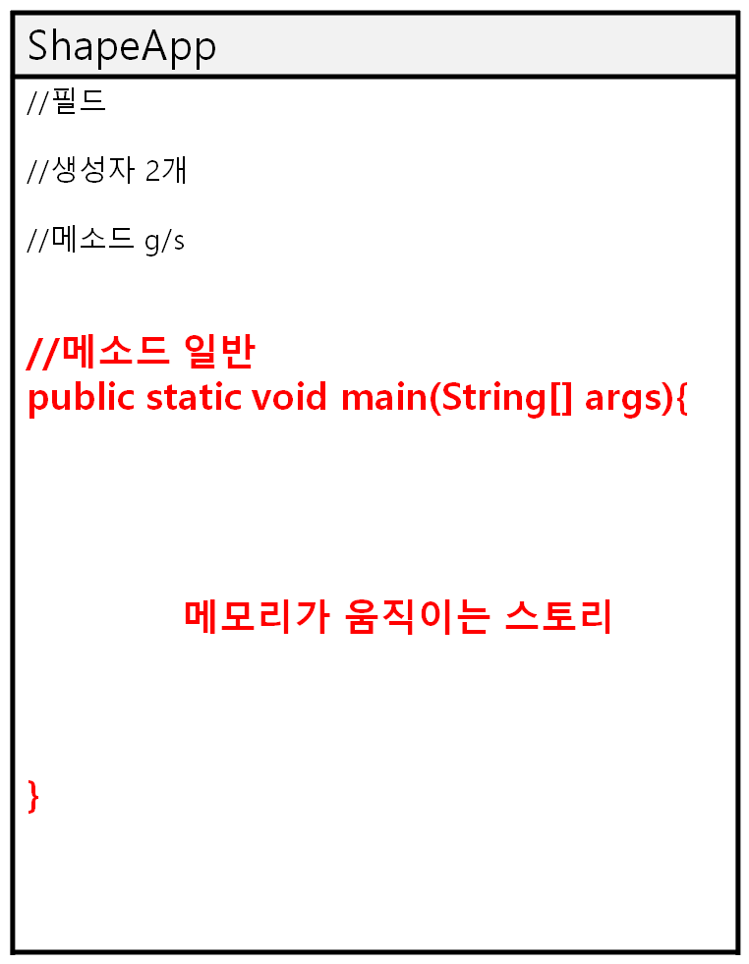
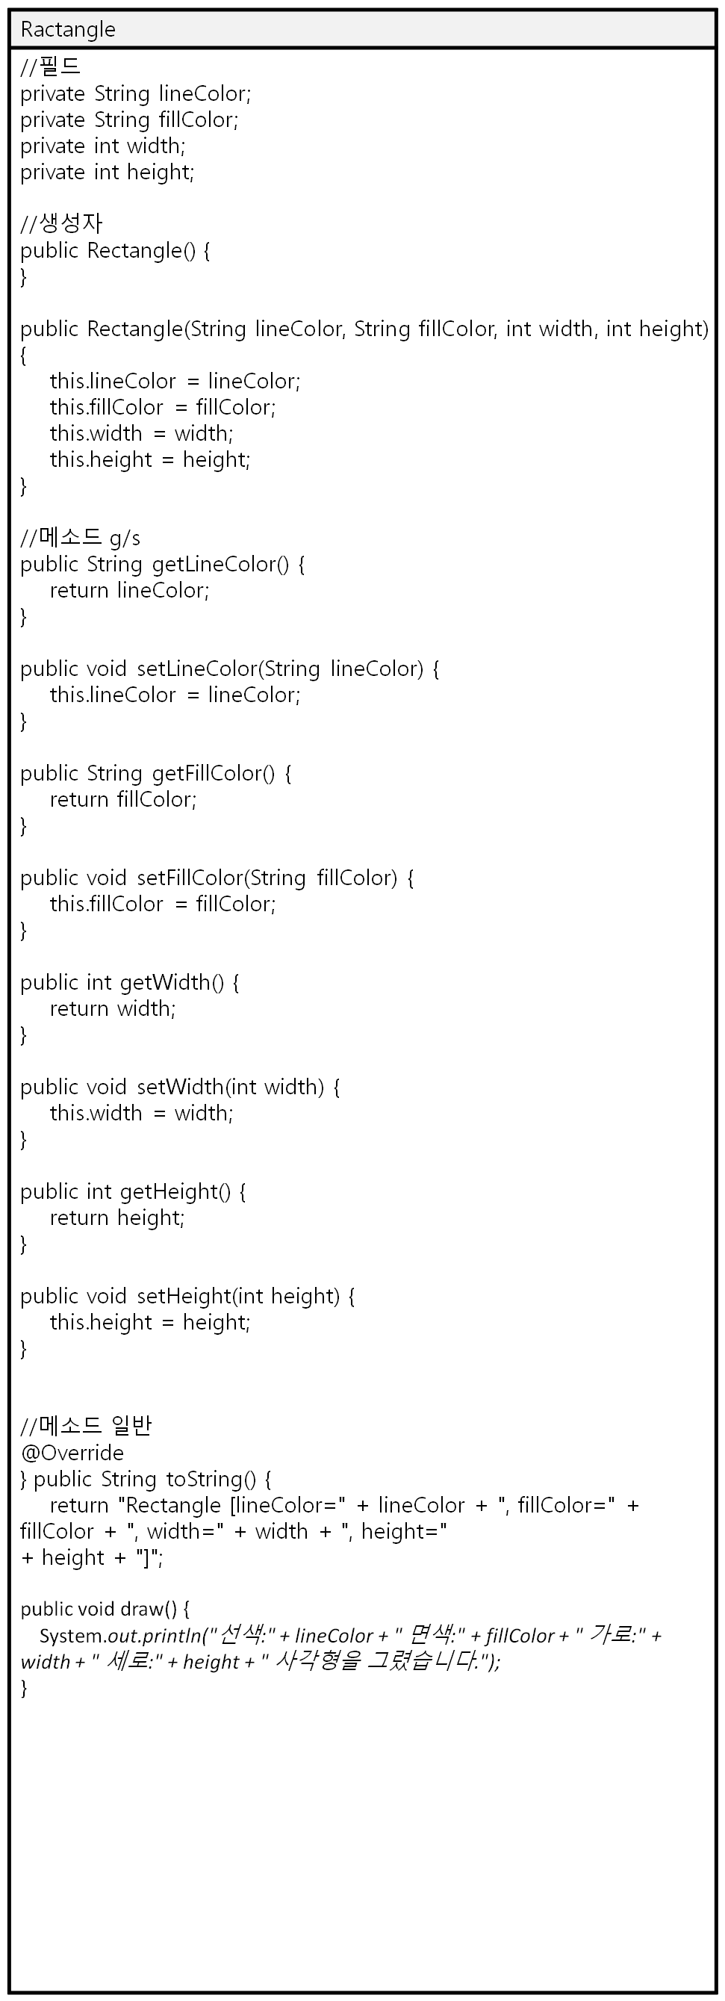
//메소드 일반
public static void main(String[] args){
메모리가 움직이는 스토리
}
*Ractangle(사각형 그리기)
Ractangle 추상화
스태틱
private String fillColor
private String lineColor
private int width
private int height
----------------------
생성자→표기생략
메소드 g/s →표기생략
메소드 일반 toString()
draw()
2
2
2
Ractangle r01
Ractangle r02
Ractangle r03
Ractangle[] rArray
1
스택
0x123
4
0x987
0x437
0x333
3
3
5
3
6
3
1
1
1
0x123
Ractangle
0x987
Ractangle
0x437
Ractangle
2
힙
//필드
private String lineColor; //빨강
private String fillColor; //노랑
private int width; // 5
private int height; // 5
//생성자
//메소드 g/s
public String getLineColor() {
return lineColor;
}
public void setLineColor(String lineColor) {
this.lineColor = lineColor;
}
public String getFillColor() {
return fillColor;
}
public void setFillColor(String fillColor) {
this.fillColor = fillColor;
}
public int getWidth() {
return width;
}
public void setWidth(int width) {
this.width = width;
}
public int getHeight() {
return height;
}
public void setHeight(int height) {
this.height = height;
}
//메소드 일반
@Override
} public String toString() {
return "Rectangle [lineColor=" + lineColor + ", fillColor=" + fillColor + ", width=" + width + ", height="
+ height + "]";
public void draw() {
System.out.println("선색:" + lineColor + " 면색:" + fillColor + " 가로:" + width + " 세로:" + height + " 사각형을 그렸습니다.");
}
//필드
private String lineColor; //파랑
private String fillColor; //노랑
private int width; // 10
private int height; // 20
//생성자
//메소드 g/s
public String getLineColor() {
return lineColor;
}
public void setLineColor(String lineColor) {
this.lineColor = lineColor;
}
public String getFillColor() {
return fillColor;
}
public void setFillColor(String fillColor) {
this.fillColor = fillColor;
}
public int getWidth() {
return width;
}
public void setWidth(int width) {
this.width = width;
}
public int getHeight() {
return height;
}
public void setHeight(int height) {
this.height = height;
}
//메소드 일반
@Override
} public String toString() {
return "Rectangle [lineColor=" + lineColor + ", fillColor=" + fillColor + ", width=" + width + ", height="
+ height + "]";
public void draw() {
System.out.println("선색:" + lineColor + " 면색:" + fillColor + " 가로:" + width + " 세로:" + height + " 사각형을 그렸습니다.");
}
//필드
private String lineColor; //빨강
private String fillColor; //빨강
private int width; // 55
private int height; // 77
//생성자
//메소드 g/s
public String getLineColor() {
return lineColor;
}
public void setLineColor(String lineColor) {
this.lineColor = lineColor;
}
public String getFillColor() {
return fillColor;
}
public void setFillColor(String fillColor) {
this.fillColor = fillColor;
}
public int getWidth() {
return width;
}
public void setWidth(int width) {
this.width = width;
}
public int getHeight() {
return height;
}
public void setHeight(int height) {
this.height = height;
}
//메소드 일반
@Override
} public String toString() {
return "Rectangle [lineColor=" + lineColor + ", fillColor=" + fillColor + ", width=" + width + ", height="
+ height + "]";
public void draw() {
System.out.println("선색:" + lineColor + " 면색:" + fillColor + " 가로:" + width + " 세로:" + height + " 사각형을 그렸습니다.");
}
0x333
Ractangle[]
1
1
1
public int length = 3
0x123
0x987
0x437
[0]
[1]
[2]
4
5
6
4
toString()으로 출력
4
toString()으로 출력
4
toString()으로 출력

