Slide 1

session
"authUser" UserVo
jsp
Controller
Dao
(SqlSession)
xml
메인
/
main()
index.jsp
*세션값으로 해더 처리

Slide 2
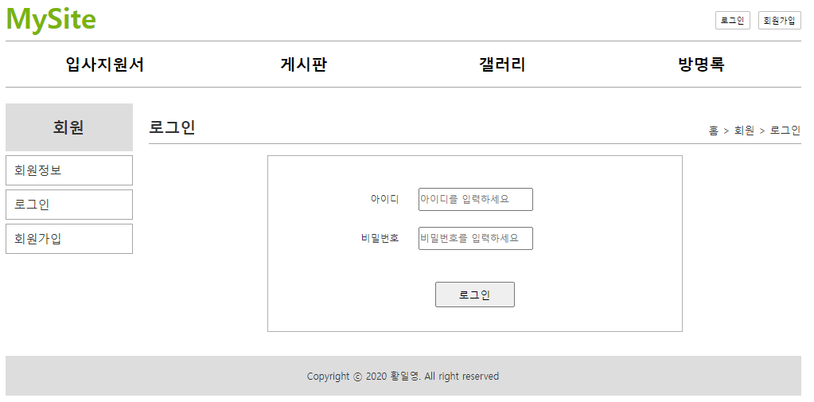
session
"authUser" UserVo
jsp
Controller
Dao
(SqlSession)
xml
userVo
id=aaa
password=1234
userVo
id=aaa
password=1234
userVo
id=aaa
password=1234
userVo
id=aaa
password=1234
id=aaa
password=1234
로그인
/mysite4/user/login
/user/login
login()
selectUser()
selectOne()
user.selectUser
authUser
no
name
authUser
no
name
authUser
no
name
성공했을때 {
세션에 저장
}
리다이렉트 /mystite4/
실패했을때 {
로그인폼 리다이렉트
}
리다이렉트 /user/loginForm?result=fail
로그아웃
/user/logout
logout()
리다이렉트 /mystite4/
*세션값 삭제

Slide 3
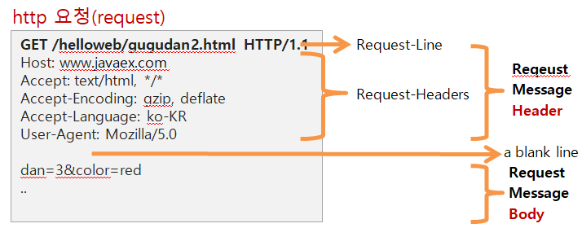

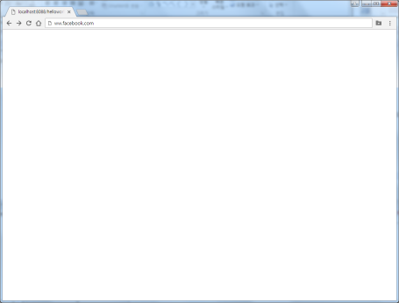
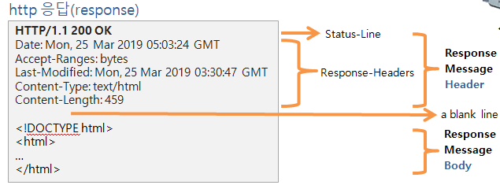
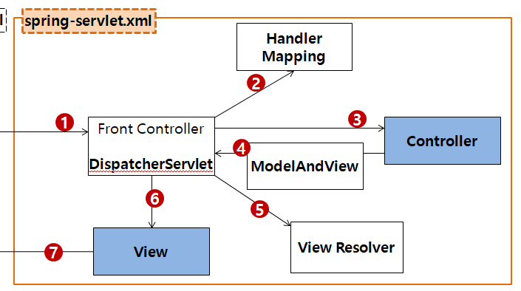
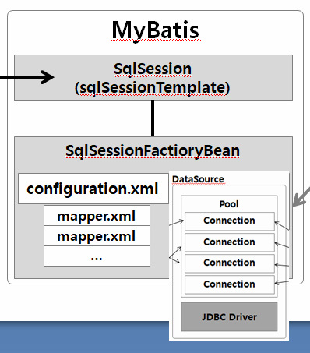
session
"authUser" authUser
setAttribute()
getAttribute()
session
"authUser" authUser
setAttribute()
getAttribute()
http://localhost:8088/phonebook3/phone/list
ip: 192.168.90.56
/phone/writeForm GET POST public void writeForm()
/phone/write GET POST public void write()
/phone/list GET POST public void list()
tomcat
pom.xml
mysite
Dynamic Web project
/WEB-INF/views/list.jsp
문서1.html
web.xml
phonebook3
port: 8088
rquest
*파라미터
name=유재석
hp=010-2222-2222
company=02-2222-2222
*어트리뷰트
getParameter()
setAttribute()
getAttribue()
getSession()
applicationContext.xml
phoneDao 객체
getPersonList()
DB
response
sendRedirect()
"personList" personList
/WEB-INF/views/list.jsp
com.javaex.dao
port: 8080

