Slide 1

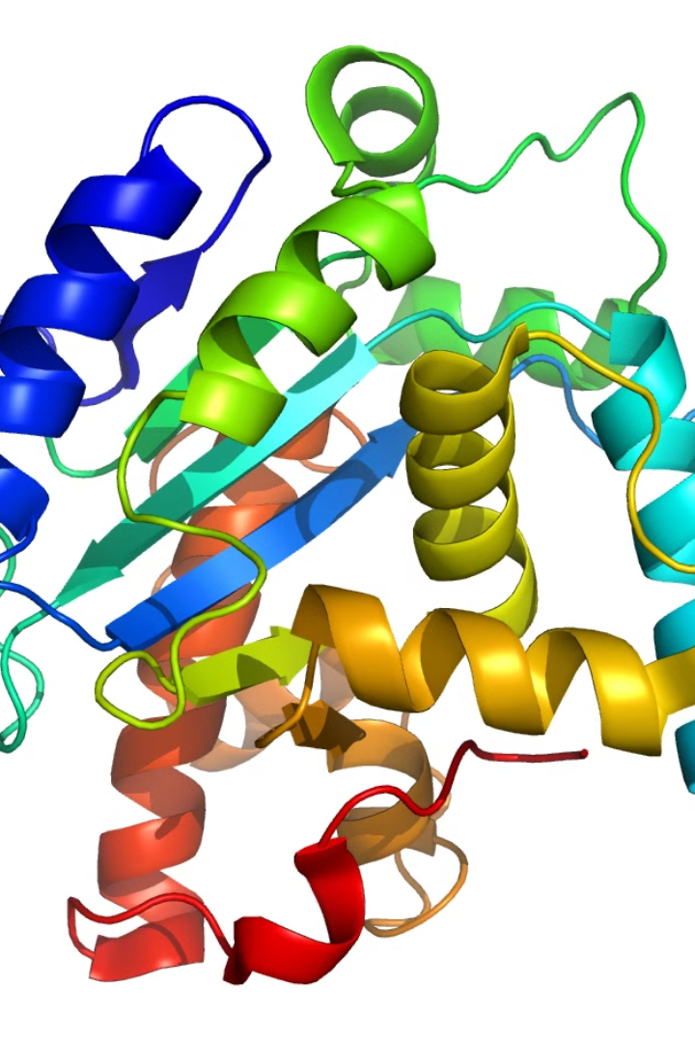
Amino Acid Contact Matrix Generation
This project focuses on analyzing amino acid interactions within protein complexes. By studying a large database of protein structures, we aim to understand the patterns and frequencies of amino acid contacts, which are crucial for protein folding and function.

Slide 2
Details of Our Group
1
Saikat Moi
2
Astitva
3
Rohit Kumar Prajapati
20CS10050
20CS30007
20CS30041

Slide 3


Data Collection
1
Protein Data Bank
We obtained 4,172 protein complex structures from the Protein Data Bank (PDB), a vast online repository of protein data.
2
Selection Criteria
Complexes with at least two protein subunits, determined by X-ray crystallography with a resolution cutoff of 2.2 Å and a sequence identity of 30%.
3
Data Processing
Each amino acid was assigned a unique number for efficient tracking and analysis.
4
Computational Methodology
A pair of residues from two subunits is identified as a contact pair, if two atoms (one from each subunit) are within distance 6 Angstrom.

Slide 4



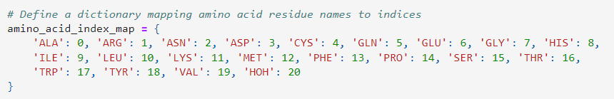
Amino Acid Index Mapping
Unique Numbers
Water Included
Locker Analogy
Each amino acid was assigned a unique number for efficient tracking.
Water, which plays a crucial role in protein interactions, was also assigned a number.
This system is similar to assigning students locker numbers for easy identification.

Slide 5
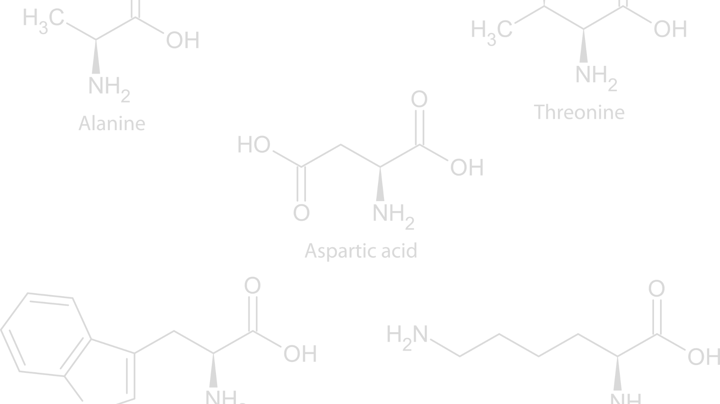



Amino Acid Contact Calculation
Distance Calculation
We calculated the Euclidean distance between atoms using the numpy library's np.linalg.norm() function.
Contact Determination
If the distance was less than or equal to 6.0 Angstroms, the atoms were considered in contact.
Contact Recording
Contacts between amino acid pairs were recorded for further analysis.

Slide 6
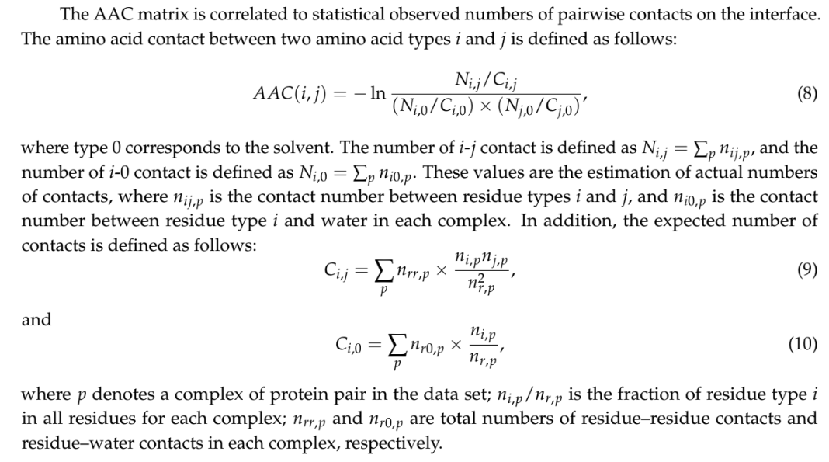
Amino Acid Contact Matrix

Slide 7
Amino Acid Contact Matrix
Observed Contacts
Expected Contacts
AAC Matrix
We counted the actual interactions between amino acid types i and j, denoted as Ni,j.
We calculated the expected contact numbers (Ci,j) based on amino acid fractions within complexes.
The AAC matrix quantifies the statistical significance of amino acid interactions using observed and expected contact numbers.

Slide 8
Computing the AAC Matrix
Step 1
Obtain the C matrix (expected contact numbers) and C vector (expected solvent contacts).
Step 2
Iterate over each amino acid pair (i, j).
Step 3
Compute the AAC value using a formula involving observed and expected contact numbers.
Step 4
The AAC matrix reflects the likelihood of amino acid interactions within protein complexes.

Slide 9
Results and Discussion
1
Biophysical Processes
2
Drug Design
The AAC matrix provides insights into protein folding and structure prediction from sequence data.
It can identify critical amino acid interactions for targeting in drug development.
3
Protein Engineering
4
Protein-Protein Interactions
Understanding interaction patterns guides the design of new proteins with desired functions.
Frequently contacting amino acid pairs may play key roles in protein-protein interactions.

Slide 10
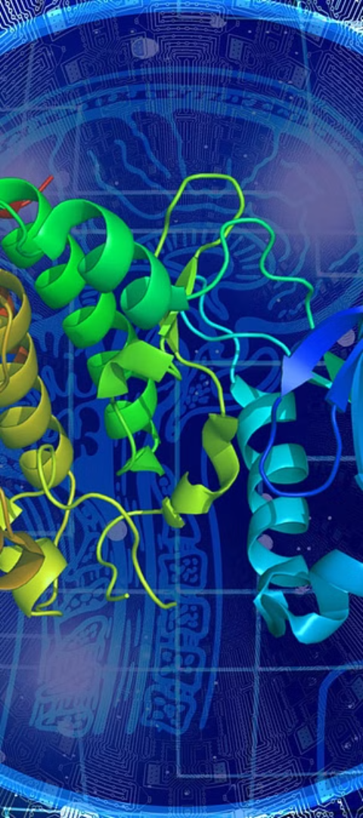
Conclusion
Insights
Implications
Our study provides valuable insights into the intricate world of protein-protein interactions through the AAC matrix.
The findings have implications in structural biology, drug discovery, and biotechnology.
Future Research
Future work could explore more complex systems, dynamic aspects, and experimental validation.

