Slide 1
Docker 101

Slide 2
Agenda
Containers are NOT VMs
Working with Docker (Build, Ship, Run)
Container Architecture
But Why?
Getting started
Q & A

Slide 3
Containers are not VMs
Notes:
Demo Tutum and Docker Hub

Slide 4
Docker containers are NOT VMs
Easy connection to make
Fundamentally different architectures
Fundamentally different benefits
Notes:
This is completely understandable, and many people have done the exact same thing when they first started working with Docker. It’s easy to connect those dots as both technologies share some characteristics. Both are designed to provide an isolated environment in which to run an application. Additionally, in both cases that environment is represented as a binary artifact that can be moved between hosts. There may be other similarities, but to these are the two biggest.
The key is that the underlying architecture is fundamentally different between the containers and virtual machines. The analogy we use here at Docker is comparing houses (virtual machines) to apartment buildings (Docker containers).

Slide 5

VMs
Notes:
Houses (the VMs) are fully self-contained and offer protection from unwanted guests. They also each possess their own infrastructure – plumbing, heating, electrical, etc. Furthermore, in the vast majority of cases houses are all going to have at a minimum a bedroom, living area, bathroom, and kitchen. It’s incredibly difficult to ever find a “studio house” – even if one buys the smallest house they can find, they may end up buying more than they need because that’s just how houses are built.
VMs are a full copy of an operating system with it’s own dedicated resources. If you decide you need a new house, you build a whole new house – it’s own foundation, plumbing etc. if you want a new VM you deploy a full copy of that environment – the OS, the apps, everything. VMs stand alone, and the leads to duplicating resources – every instance has it’s own full copy of the OS, for instance. Finally the smallest VMs are typically at least hundreds of MBs in size, and they take several minutes to boot up (partially due to the fact that you’re starting a full copy of the OS).

Slide 6
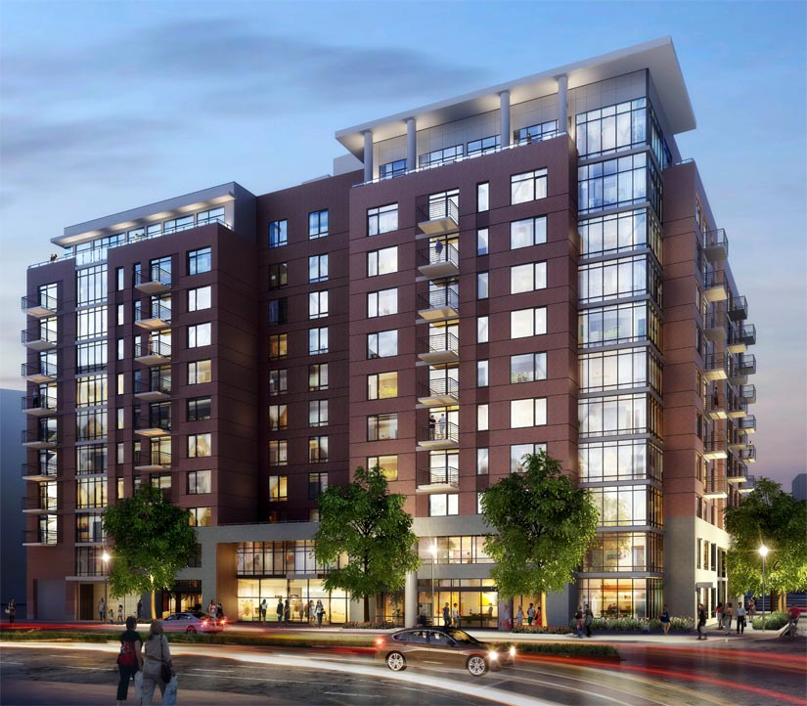
Containers
Notes:
Apartments (Docker containers) also offer protection from unwanted guests, but they are built around shared infrastructure. The apartment building (the server running the Docker daemon, otherwise known as a Docker host) offers shared plumbing, heating, electrical, etc. to each apartment. Additionally apartments are offered in several different sizes – from studio to multi-bedroom penthouse. You’re only renting exactly what you need.
Docker containers share the underlying resources of the Docker host. Furthermore, developers build a Docker image that includes exactly what they need to run their application: starting with the basics and adding in only what is needed by the application. Containers are very small (some base OS images are less than 3MBs) start up very quickly (< 3/8s of a second) because you’re not booting a full operating system. You’re just starting a process.

Slide 7
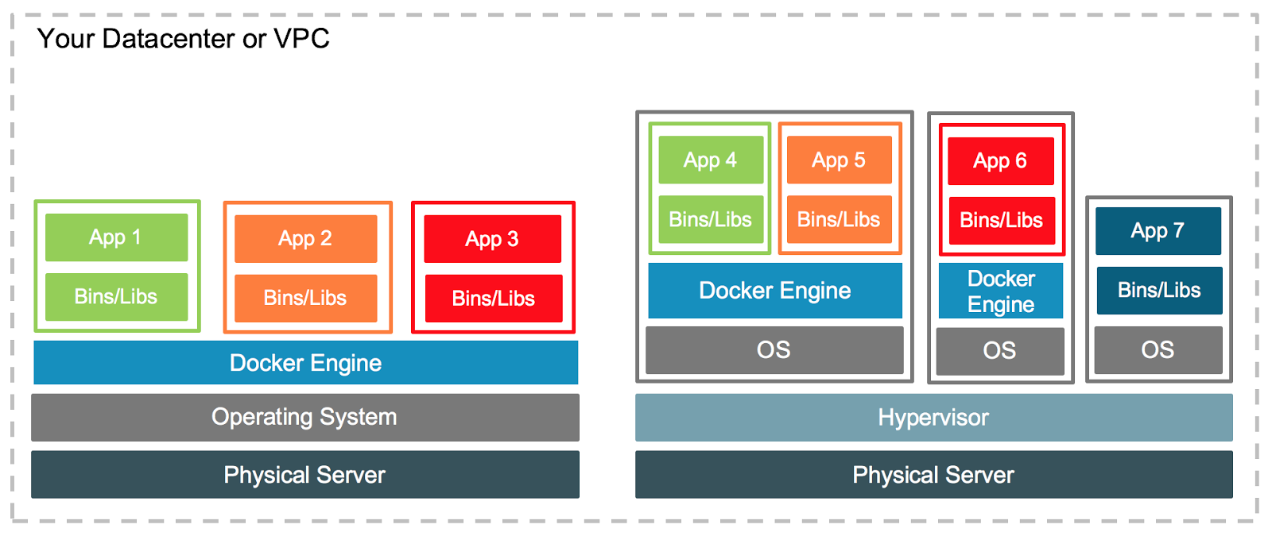
They’re different, not mutually exclusive
WS 2016
Linux
Notes:
So if containers are not VMs, a logical question is: Can VMs and Docker containers coexist?
The answer is a resounding “yes.”
At the most basic level VMs (in all their forms) are a great place for Docker hosts to run. Whether it’s a vSphere VM or a Hyper-V VM or an AWS EC2 instance, all of them will serve equally well as a Docker host. Depending on what you need to do, a VM might be the best place to land those containers. But the great thing about Docker is that, it doesn’t matter where you run containers – and it’s totally up to you.
Another question that is often asked relates to whether or not Docker container-based services can interact with VM-based services. Again, the answer is absolutely yes. Running your application in a set of Docker containers doesn’t preclude it from talking to the services running in a VM.
For instance, your application may need to interact with a database that resides in a virtual machine. Provided that the right networking is in place, your app can interact with that database seamlessly.
Another area where there can be synergy between VMs and Docker containers is in the area of capacity optimization. VMs gained early popularity because the enabled higher levels of server utilization. That’s still true today. A virtualization host, for instance, can host VMs that may house Docker hosts, but may also host any number of traditional monolithic VMs. By mixing and matching Docker hosts with “traditional” VMs, sysadmins can be assured they are getting the maximum utilization out of their physical hardware.
One of the most powerful things about Docker is the flexibility it affords IT organizations. The decision of where to run your applications can be based 100% on what’s right for your business. You’re not locked into any single infrastructure, you can pick and choose and mix and match in whatever manner makes sense for you organization. Docker hosts on vSphere? Great. Azure? Sure. Physical servers? Absolutely. With Docker containers you get a this great combination of agility, portability, and control.

Slide 8
Build, Ship, and Run
Notes:
Demo Tutum and Docker Hub

Slide 9
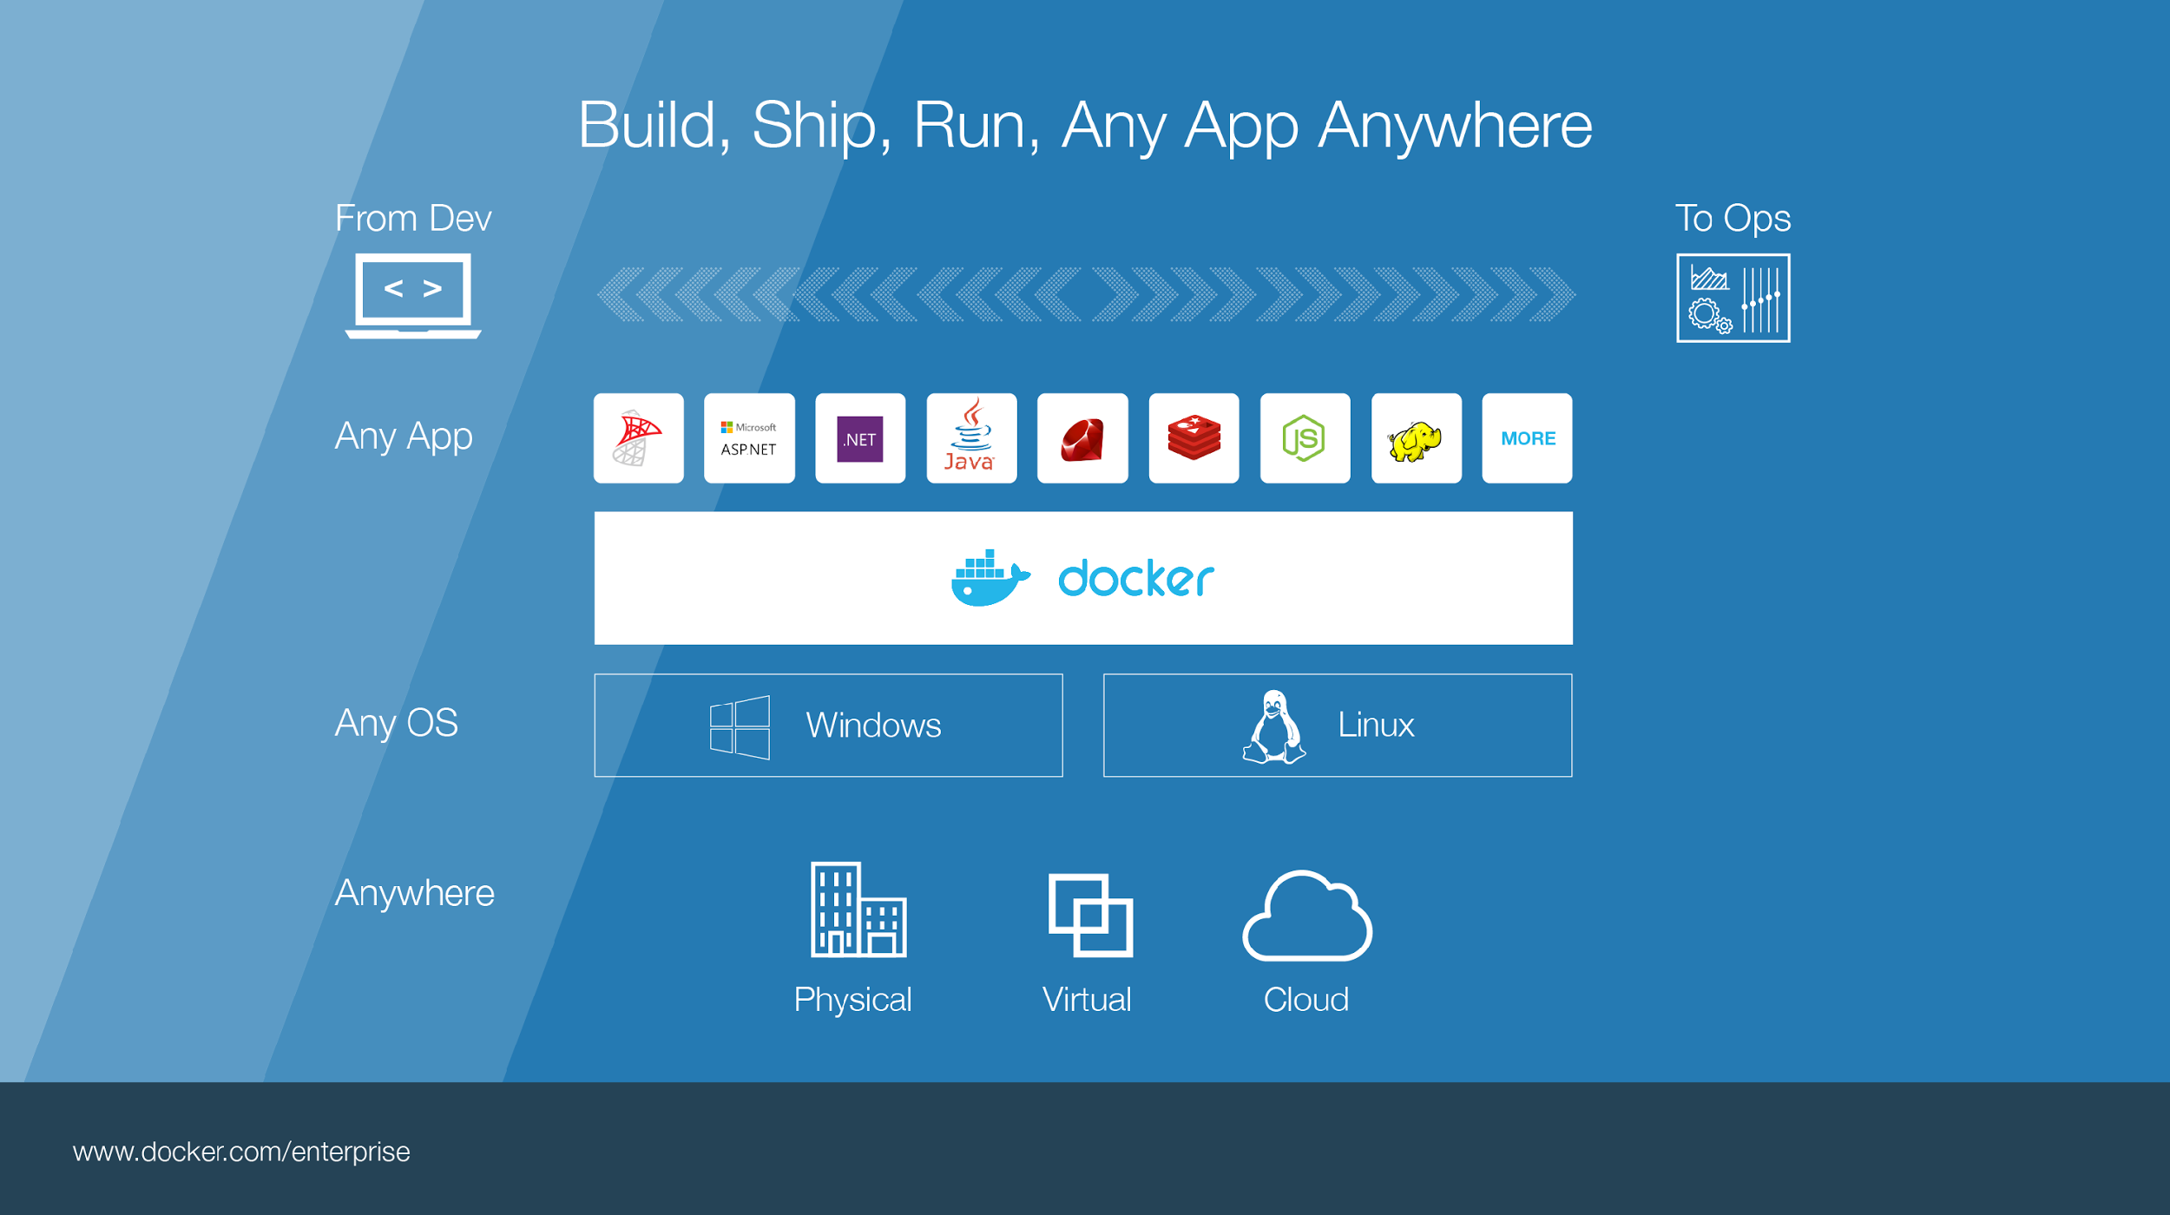

Notes:
Build, Ship, Run – Any App Anywhere – that’s Docker’s slogan
But, what does it mean?
What it essentially boils down to is that developers can choose whatever language or components they want to build their application – .Net, ASP, Java, Ruby, Redis, etc across both the Linux and Windows ecosystem. They are assured that whatever the code up, will run wherever the Ops team chooses to deploy it – Physical, virtual, or cloud – it makes no difference to Docker.
An application written on a developers laptop will run exactly the same on the largest bare metal servers, in the cloud, even on a Raspberry Pi in my den.
Move applications seamlessly from dev to test to production.

Slide 10




Some Docker vocabulary
Docker Image
The basis of a Docker container. Represents a full application
Docker Container
The standard unit in which the application service resides and executes
Docker Engine
Creates, ships and runs Docker containers deployable on a physical or virtual, host locally, in a datacenter or cloud service provider
Registry Service (Docker Hub or Docker Trusted Registry)
Cloud or server based storage and distribution service for your images
Notes:
Let’s take a look at what build, ship run means in a little more detail, but before that we need to level set some Docker vocabulary and commands:
Image
The static component that represents a on-running applicatoin
Containers are derived from images
images contain EVERYTHING an application needs to run
Should always be built via a Dockerfile (which we’ll talk about in a bit_
Container
The standard unit in which the application service resides
Package app and dependencies together
Isolated from other containers
One container per app / service
Docker Engine
The program that creates, ships and runs containers
Deployable on any physical or vm host locally, in datacenters or cloud
Communicates with Docker Hub
Registry
The service that store, distributes and manages container images
Receives commands from Docker Client via Engine
Access control with public, private repos

Slide 11
Basic Docker Commands
$ docker pull mikegcoleman/catweb:1.0
$ docker images $ docker run –d –p 5000:5000 –-name catweb mikegcoleman/catweb:latest
$ docker ps $ docker stop catweb (or <container id>)
$ docker rm catweb (or <container id>)
$ docker rmi mikegcoleman/catweb:latest (or <image id>)
$ docker build –t mikegcoleman/catweb:2.0 .
$ docker push mikegcoleman/catweb:2.0
Notes:
Docker pull pulls an image from the registry to the local host. This example shows us pulling the 1.0 version of the Catweb image from the mikegcoleman repo on Docker Hub
Docker images will list all the images on your docker host
Docker run will start a new container. In this case we are instructing the docker engine to run the mikegcoleman/catweb image we pulled earlier -d tells docker It should start the application in detached mode (running in the backgorund) and –p 5000:5000 tells docker engine that any requests coming into port 5000 on the host should be directed to port 5000 on this container. –name catweb specifies a name for our running container. If you do not specify a name, Docker will generate one (and they can be pretty funny)
Docker ps shows runing containers. ps –a will show all containers, including ones that have been stopped
Docker stop stops a running container (but does not delete it). You can specify the container name (catweb in our example) or the container ID (every image and container are assigned a unique ID)
Docker rm removes the stopped container. if you specify rm –f you will force docker to remove container even if it’s running. again you can specify the name or ID
Docker rmi removes the specified image
Docker build will create a new image from a docker file. In this example we are creating an image called mikegcoleman/catweb and we’re tagging it with a 2.0 version number. The period says to build the image from the docker file in the current directory. You can explicitly specify a path to your dockerfile if you so choose
Docker push is the opposite of Docker – it pushes an image up to a registry. In this case we’re pushing our newly created docker image up on to hub.

Slide 12
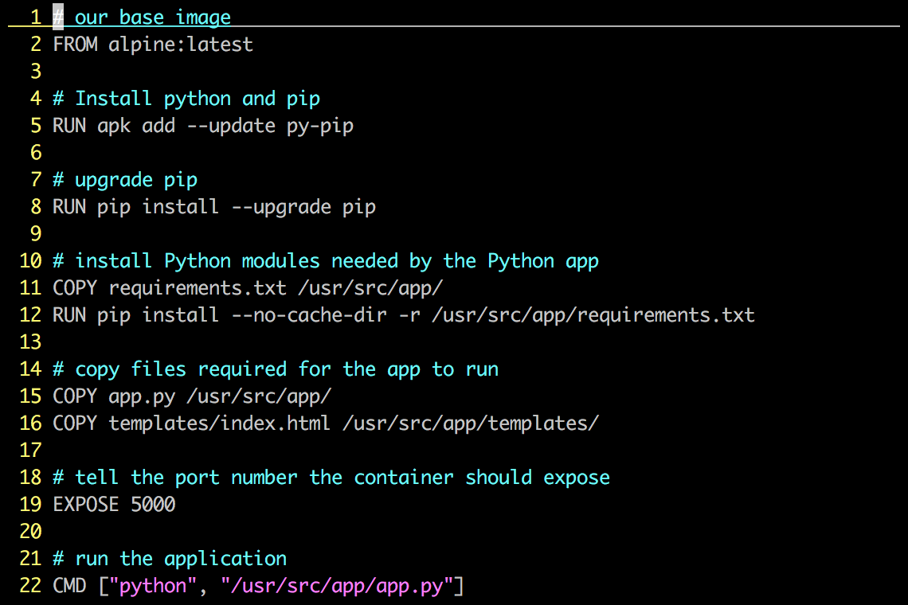
Dockerfile – Linux Example
Instructions on how to build a Docker image
Looks very similar to “native” commands
Important to optimize your Dockerfile
Notes:
A Dockerfile describes how to build a docker image (using the ‘docker build’ command). The commands in the file are a mix of commands you’d actually run to install an application locally (in this case we’re building a python app, and if you’re familiar with Python, you’ll instantly recognize much of what is up on the screen) and specific keywords that tell Docker what to do (RUN a command COPY a file, etc).
An important point about Dockefiles is that they can live with your source code, and be versioned by your version control system. This means Docker images are 100% reproducible. This is another area where VMs and Containers can be different – many times VMs are hand built, and if you lose your golden image you’re out of luck.
This Dockerfile builds a simple flask-based python webapp.
Let’s step through the Dockerfile line by line – note that when the Docker file is processed, all these commands are being run on the Docker image – not your local machine.
Line 1: Build this new Docker image based on the official Apline Linux base image
Line 5: Install Pythong and Pip (the python package manager)
Line 7: use Pip to ensure that Pip is the latest version
Line 11: Requirements.txt holds a list of libraries the app will need, and is used by pip to actually install the library. This line copies the file from your local machine into your Docker image
Line 12: Uses that file and Pip to install the requirements into the container
Line 15: Copy my application code (app.py) into the /usr/src/app directory of the image
Line 16: Copy our index.html file into the /usr/src/app/templates directory of the image
Line 19: The application communicates on port 5000, so we tell Docker to listen on that Port
Line 22: When the container starts up – we fire up Python and pass it out application code to start the app
Again, these steps are pretty much EXACTLY what you would do on a traditional machine to run this application, only here there are being used to create an Docker image.

Slide 13
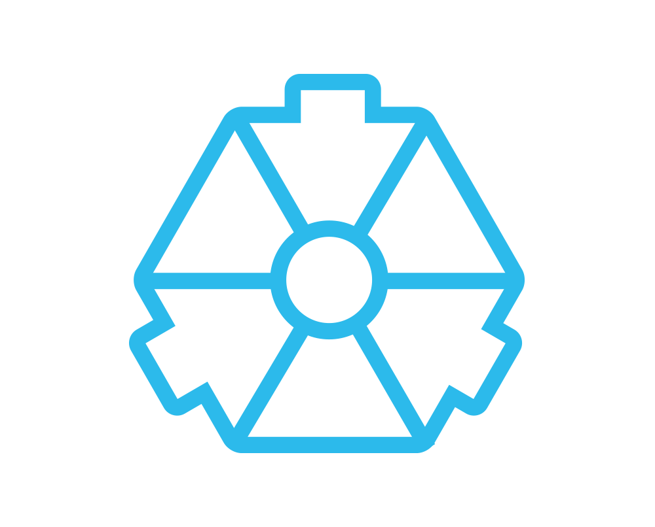
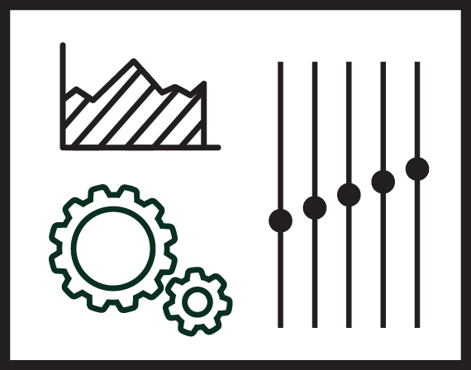
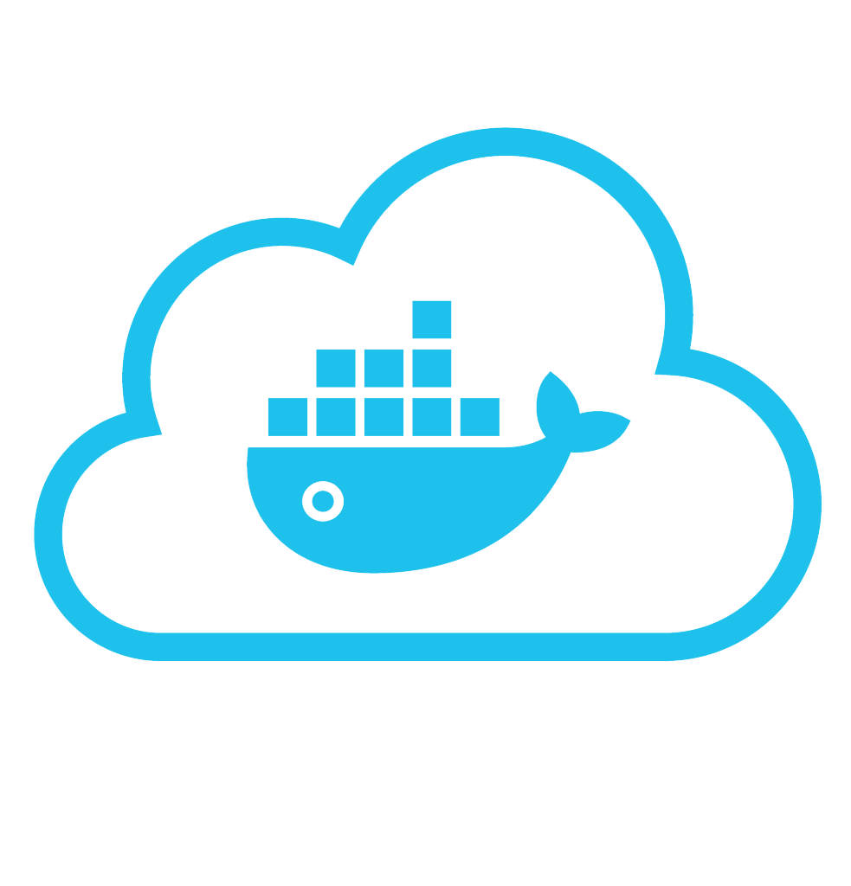


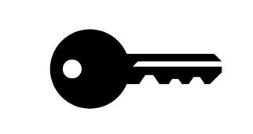
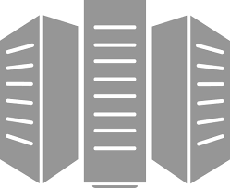
Put it all together: Build, Ship, Run Workflow
Developers
IT Operations
BUILD
Development Environments
SHIP
Create & Store Images
RUN
Deploy, Manage, Scale
Notes:
So, let’s put all this together and look how it might look in real environment
Starting in the middle, your IT organization might provide your developers with a set of blessed base images. These could be operating systems, languages, or components (redis, postgres, rabbitmq). Those keys indicate that those images are digitally signed, so your developers know that they are actually coming from your IT team (vs. being placed there by some nefarious actor in the hopes of introducing a security vulnerability into your organization).
Your developers download those signed images, add their code and libraries, and then build the application Docker images. These are then pushed back up to Docker hub. The important thing here is that developers still use all the tools they are familiar with – they use their preferred integrated development environment (IDE) for instance. The only major change is that at the end of the process they create a Docker file, and build an image.
We don’t show it here, but at some point you (hopefully) QA your app, and then we move over to the ops side of the house.
Here your ops team takes that application image and they put into production. They can use Docker Datacenter or Docker Cloud to deploy the application to whatever infrastructure makes sense. Cloud, physical, virtual, whatever. The important point here is that the application will run wherever they need it to, and the targeted server only needs to have the Docker engine – no need to control library versions, or ensure that all the right languages are installed. It just works.

Slide 14
Demo
Build, Ship, and Run
Notes:
You can find a complete demo script in the same repo as the slides, etc.
This demo is written around Docker for Mac (although you can use Docker for Windows or Machine).
You also need a second docker host. It’s most effective if the host is cloud-based simply for the demonstrative effect.
It also is built around using Docker Datacenter to run the image in the final step – however, you can simply push the image to Docker hub, and deploy it using Docker Run on the second docker host.
If you cannot do the demo live, you can use the demo recording which is in the same repo

Slide 15
Now you try it!
Visit http://docs.docker.com/installation
Install the right version of Docker for your machine
Docker for Mac
Docker for Windows
After Docker is installed, run Catweb
docker run –d –p 5000:5000 --name catweb mikegcoleman/catweb
Browse to port 5000 on your machine
http://localhost:5000
Notes:
Optional Slide: You could take a break here and have folks get their machine setup for the hands on labs (if you’re going to do them).

Slide 16
Docker Container Architecture

Slide 17
Image Layers
…
Install Requirements
Copy Requirements
Upgrade Pip
Install Python and Pip
Alpine Linux
Kernel
Notes:
Each action in a docker file creates a new layer in the image.
If we visualize our earlier dockerfile example, you can see the changes in the image that each step created (we only show the first five commands). Images are built from the bottom up, so any change made by a subsequent step, is layered on top of the previous changes already made.
Image layers can be shared between different images. This means that the layers are not duplicated on your Docker host (or on the Registry when they’re pushed). Depending on the underlying filesystem each of these layers is represented by a directory on the Docker host.
You’ll notice if you ever look at a complicated dockerfile that authors will work to put as many commands into a single line by concatenating them together. This is to reduce the numbers of layers in an image.
When you do a docker run command, an additional read / write layer is added to the image. An important point is that even if you started 100 containers, all that is created is 100 Read / Write layers, and they all point back to the read only image on the host.

Slide 18
Docker File System
Logical file system by grouping different file system primitives into branches (directories, file systems, subvolumes, snapshots)
Each branch represents a layer in a Docker image
Allows images to be constructed / deconstructed as needed vs. a huge monolithic image (ala traditional virtual machines)
When a container is started a writeable layer is added to the “top” of the file system
Notes:
As we mentioned on the previous slide, the layers are represented on the the disk as individual file primatives. In the case of AUFS each layer is a subdirectory holding the file system changes that layer created.
The layers are “stacked” on top of each other, and if you shell into a running container it will look like one cohesive file system.
In some cases there might be a file or directory that exists on multiple layers. In such a case, the ‘top most’ object is what’s represented in the container file system. This is because that object represents the last change made to the image (remember images are built from the bottom up)
This layering construct lets you start with the bare minimum and add exactly what you want. For instance, Alpine Linux is a very stripped down operating system. It’s about 2.6mb. When an image is built on that you need to explicitly add almost anything you’d want in your final image.

Slide 19
Copy on Write
Super efficient:
Sub second instantiation times for containers
New container can take <1 Mb of space
Containers appears to be a copy of the original image
But, it is really just a link to the original shared image
If someone writes a change to the file system, a copy of the affected file/directory is “copied up”
Notes:
Copy on write is the technology that manages runtime changes to the container.
When you create a new container, you’re not booting a full operating system. You’re just creating a subdirectory on the Docker host to house any changes that are made to the running container. This is why new containers take <1 MB of space when they are started (since initially the new RW layer is empty) and why containers start so quickly
If you were to shell into the container, it would look like it was a full copy of the original image from which it was instantiated, but in reality you’d be looking at at a read only copy of that image.
At least until a change is made to the running container (file deletion, creation, update, etc)
When a change is detected in the container, the affected object is copied up the layers to the top most RW layer.

Slide 20
What about data persistence?
Volumes allow you to specify a directory in the container that exists outside of the docker file system structure
Can be used to share (and persist) data between containers
Directory persists after the container is deleted
Unless you explicitly delete it
Can be created in a Dockerfile or via CLI
Notes:
One of the tricky things about containers is that when a container is destroyed, that RW layer is removed. Any changes that were made to the container are destroyed in the process.
Clearly this is suboptimal in many cases. For instance you might want to save off some logs from your application or your container was running a database and you want the data to last after the container is destroyed.
The solution to this problem is something called a Volume. A volume is simply a subdirectory in your container that is mapped to a subdirectory that lives outside of the directory structure where your images and containers are stored on your docker host.
For instance, let’s say your application writes to /var/logs, and you wanted to save the logs after the container was destroyed.
You would create a new volume, and tell Docker to send any data destined to /var/logs to the directory that is being managed by the volume.
From a docker perspective we don’t really care where your volumes live. It simply needs to be on storage that is accessible by the Docekr host operating system.
You can create volumes at build time through the dockerfile or at run time via command line switch.

Slide 21
But, Why?

Slide 22
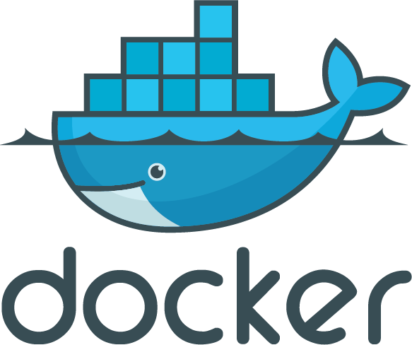
Enterprises are looking to Docker for critical transformations
3 out 4
Top initiatives revolve around applications
App Modernization
80%
Docker is central to cloud strategy
44%
Looking to adopt DevOps
Cloud
DevOps
Docker Survey: State of App development : Q1 - 2016
State of App development Survey: Q1 2016
Notes:
So why do companies look at Docker?
Software is the lifeblood of your organization, whether automating internal processes or creating unique and engaging ways for you to service your customer, every company considers themselves a “digital” or “tech” company to some extent. To that end, many organizations like yours are looking at strategies to…
- Modernize their apps (refactor or build cloud native apps)
- Adopt microservces / distributed app architectures
- migrate to containers
- Cloud adoption, migration or multi cloud approaches
But getting tthere isn’t always easy becuase you have legacy applications and envrionment to take care while you try to do new innovatinv things. Your organizational processes might not be ready to go all in and how do you avoid the worries of just getting locked into a cloud from your datacenter?

Slide 23
Docker delivers speed, flexibility and savings
+
+
Agility
Portability
Control
13X
More software releases
41%
Move workloads across private/public clouds
62%
Report reduction in MTTR
65%
Reduction in developer onboarding time
10X
Cost reduction in maintaining existing applications
Eliminate
“works on my machine” issues
State of App development Survey: Q1 2016, Cornell University case study
Notes:
The Docker CaaS platform delivers these benefits for organizations and is already proven by the thousands of organizations who embarked on the Docker journey starting in 2013
Agility – The speed and simplicity of Docker is what originally drew developers to Docker. They were fundamentally able to ship more software faster. This fundamentally changed the way in which companies could innovate
- ING went from shipping once every 9 months to shipping over 1,500 times a year by adoption Docker and DevOps
- CapitalOne was able to use Docker to transform how they use data to empower their data scientists and business decisions.
Portability – Just by the nature of the Docker technology, these developers realized they could easily move that containerized app from dev to test and ultimately to prod without any issue. No more finger pointing about why the app that worked fine in dev doesn’t work in prod. Having the app and dependencies packaged together made the container a self contained and independent unit. And beyond that, teams realized they could also move these apps across data centers and clouds – giving them a level of freedom and leverage not possible before. No more lock-in.
The combination of agility and portability led to the #1 most popular use case for Docker – Continuous Integration. But that’s only half the value. To realize the full value of Docker, these apps need to move to production and new requirements around manageability, security and monitoring are required to enforce SLAs.
Control – The Docker platform is the only solution that provides Agility AND Portability AND Control.
Docker standardizes your application environment, with native tooling to manage the infrastructure and applications. And we provide you the levers so YOU can decide how much control and freedom is appropriate for YOUR business. We don’t prescribe that for you. Our tools help unify your heterogeneous infrastructure, languages and systems.

Slide 24
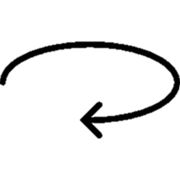
One platform delivers one journey for all applications
1
Containerize Legacy Applications
Lift and shift for portability and efficiency
2
Transform Legacy to Microservices
Look for shared services to transform
3
Accelerate New Applications
Greenfield innovation
Notes:
It used to be that you couldn’t talk about containers without talking about Microservices, but over the past year or so people have been looking at different ways to use containers along an application delivery continuum.
In some cases customers are taking existing legacy applications and moving them directly from VMs into containers. This allows these applications to be migrated easily across different infrastructures. Additionally, in the case of Linux, you can run your application container based on an older version of Linux (Say RHEL6) while the Docker host is running the latest version.
Customers have two choices at this point. They can leave their legacy app as is running in a container, or they can begin to deconstruct it into various micro services.
Organizations often find that if they look across all their applications they will see an number of common services: Logging, authentication, etc. What we see customers doing is removing those services from their monolithic apps and moving them into their own containers. Then those containers can talk to the older applications. In some cases applications can be fuilly deconstructed, and in other cases much of the original application remains in tact, and only one or two components are moved to containers.
Finally, in the case of green field applications it often makes sense to simply start with containers for all the reasons previously mentioned.

Slide 25

Containers in production with Docker Datacenter
CI/CD
Images
Networking
Volumes
Config Mgt
Monitoring
Logging
..more..
Enterprise container orchestration, management and security for dev and ops
Available today for Linux environments
Q4 2016 beta for Windows environments
Integrated Security
Docker Universal Control Plane
Docker Trusted Registry
Docker Engine
Physical
Virtual
Public Cloud
Notes:
Docker Datacenter is a COMMERCIAL product that delivers an integrated platform for developers and IT operations to collaborate in the enterprise software supply chain. Bringing security, policy and controls to the application lifecycle without sacrificing any agility or application portability. Docker Datacenter integrates to your business – from on premises and VPC deployment models, open APIs and interfaces, to flexibility to support a wide variety of workflows.
SUPPORT FOR DOCKER ENGINESUPPORT FROM THE SOURCE
Enterprises receive hot fixes, patches and support for older versions of Docker engine as well as support for embedded orchestration (Swarm).
DOCKER TRUSTED REGISTRYSECURE IMAGES REPOS
Trusted Registry allows enterprise IT users to store and secure their images on-premises or within their virtual private cloud.
UNIVERSAL CONTROL PLANEDEPLOY & MANAGE APPS
Universal Control Plane enables teams to manage and deploy dockerized applications, and can be run on any private infrastructure or public cloud.
FASTEST TIME TO VALUE
Easy to set up and use, Docker Datacenter provides a simple installation and upgrade process for the system. System configurations like storage, certificates and managing users and images are available in an intuitive web interface.
ORCHESTRATION AND MANAGEMENT AT SCALE
Easily orchestrate containers and clustered Engine nodes at enterprise scale with Docker native tools like Compose, Swarm. The point and click UI makes actions like start, stop and scale quick and easy.
BUILT IN HIGH AVAILABILITY
From the Datacenter components to cluster to application, Docker Datacenter provides high availability (HA) for the complete stack. Docker Datacenter controllers and replicas can be configured in a one, three or five node set up for failover and state preservation. Application HA is provided through container rescheduling to healthy nodes in the case of node failures in a running cluster.
END TO END SECURITY
Secure the enterprise software supply chain from development to production. Integrated Docker Content Trust allows for image signing and verification to ensure the freshness guarantees of images and to prevent old or malicious content from being inserted into the pipeline.
ROLE BASED ACCESS CONTROL
Integration to enterprise systems like LDAP/AD make it easy to manage user and group access to Docker Datacenter managed repositories and Engines. Granular role based access control (RBAC) combined with labels allow IT administrators to ensure the right level of access and permissions for a project and team.
FLEXIBILITY AND CHOICE
Docker Datacenter is designed to easily integrate to your existing systems and processes. As a platform agnostic solution, Docker Datacenter runs on any infrastructure (physical, cloud, virtual) with any operating system with support from a broad ecosystem of partners. From networking and volume plugins to storage and log drivers and open APIs, Docker Datacenter provides a robust platform with the flexibility to customize the platform to your applications and business.

Slide 26
Getting started!

Slide 27
Docker on Linux
Create a Linux VM (or use physical), and install Docker
Requires kernel 3.10
Stable builds
curl –sSL https://get.docker.com/ | sh
Test and experimental builds
curl –sSL https://test.docker.com/ | sh
curl –sSL https://experimental.docker.com/ | sh
Can also manually install (see docs)
Notes:
Installing Docker on Linux is as simple as curling an installation script to the shell.
get.docker.com has the lastest stable build, whereas test.docker.com has beta builds, and experimental.docker.com is the cutting edge distribution
If you would rather install manually, there are detailed installation instructions for several different distributions up on the website

Slide 28
Docker for Windows / Mac
Currently in public beta
Easy to install: Get up and running on Docker in minutes
Leverages Hyper-V (Windows) or xhyv (Mac)
Docker for Windows requires Windows Pro 10, Enterprise, or Education
Full API / CLI compatibility
OS integration for increased stability and speed
Notes:
DOCKER FOR MAC
An integrated, easy-to-deploy environment for building, assembling, and shipping applications from a Mac, Docker for Mac is a native Mac application architected from scratch, with a native user interface and auto-update capability, deeply integrated with OS X native virtualization (xhyv), Hypervisor Framework, networking and file system, making it faster and more reliable than previous ways of getting Docker on a Mac. With Docker for Mac, volume data access works correctly, including file change notifications enabling edit/test cycles for “in container” development. It includes a DNS server for containers, and is integrated with the Mac OS X networking system so that Docker can be used even when connected to a very restrictive corporate VPN.
DOCKER FOR WINDOWS
An integrated, easy-to-deploy environment for building, assembling, and shipping applications from a Windows PC, Docker for Windows is a native Windows application with a native user interface and auto-update capability, deeply integrated with Windows native virtualization, Hyper-V, networking and file system, making it faster and more reliable than previous ways of getting Docker on a Windows PC.

Slide 29
Docker for Azure / AWS
Currently in private beta
https://beta.docker.com/
Easily deploy Docker 1.12 Swarm clusters (Linux)
Scale up and down easily
Integrate with underlying platform (i.e. load balancers)
Notes:
DOCKER FOR AWS
An integrated, easy-to-deploy environment for building, assembling, and shipping applications on AWS, Docker for AWS is a native AWS application optimized to take optimal advantage of the underlying AWS IaaS services while giving you a modern Docker platform that you can use to deploy portable apps. Docker for AWS does not require any software installed. You just need a browser and an AWS account, and can provision Docker in a few clicks. Docker for AWS installs a Swarm of Docker Engines secured end to end with TLS by default, and is integrated with AWS Autoscaling, Elastic Load balancer and Elastic Block Store.
DOCKER FOR AZURE
An integrated, easy-to-deploy environment for building, assembling, and shipping applications on Microsoft Azure, Docker for Azure is a native Azure application optimized to take optimal advantage of the underlying Azure IaaS services while giving you a modern Docker platform that you can use to deploy portable apps. Docker for Azure does not require any software installed. You just need a browser and an Azure account, and can provision Docker in a few clicks. Docker for Azure installs a Swarm of Docker Engines secured end to end with TLS by default, and is integrated with Azure VM Scale Sets for autoscaling, Azure Load Balancer and Azure Storage

Slide 30
Docker + Windows Server = Windows Containers
Native Windows containers powered by Docker Engine
Windows kernel engineered with new primitives to support containers
Deep integration with 2+ years of engineering collaboration in Docker Engine and Windows Server
Microsoft is top 5 Docker open source project contributor and a Docker maintainer
App
App
App
Bins/Libs
Bins/Libs
Bins/Libs
Docker Engine
Windows Server 2016
Infrastructure
Notes:
DOCKER FOR WINDOWS SERVER
Docker and Microsoft have partnered to enable the containerization of native Windows containers in Windows Server 2016, supported by Microsoft and backed by Docker. Windows Server 2016 brings Docker containers to the Windows ecosystem and expands the toolset for traditional Docker Linux developers. Powered by Docker CS Engine, Windows Server Containers 2016 offers enterprise class business day or business critical support for Docker Engine with available SLAs and hotfixes and full support for Docker APIs. Support is available for: Windows Server 2016 Essentials, Standard, and Datacenter Editions.

Slide 31
Walk, Jog, Run
Walk:
Setup your preferred Docker environment
Fire up some prebuilt images (nginx, hello-world, mikegcoleman/catweb)
Jog:
Pick a well documented solution (Wordpress, Jenkins, etc)
Build it for yourself (blogs are your friend)
Run:
Extend one your Walk solution or Dockerize an existing project
Build your own Dockerfiles
Experiment with Docker Compose and Swarm Mode

Slide 32
Thank You.
Questions?

Slide 33
Hands-on Labs
http://github.com/docker/labs/tree/master/beginner
Notes:
For workshops, you can have your attendees follow the labs in the attached GitHub repo.
They are designed to work for Docker for Mac / Windows as well as Docker Machine.

