Slide 1

Coding Dojo
Object Calisthenics

Slide 2


Slide 3
Coding Dojo
Working in pairs
TDD (Red, Green, Refactor)
Doing something you can’t comfortably do (yet)
Slowly ☺

Slide 4
Format
45 minute session
Lunch
45 minute session
Retrospective

Slide 5
The Problem

Slide 6
The Rules…

Slide 7
One level of indentation per method
class Board {
...
String board() {
StringBuffer buf = new StringBuffer();
for (int i = 0; i < 10; i++) {
for (int j = 0; j < 10; j++)
buf.append(data[i][j]);
buf.append(“\n”);
}
return buf.toString();
}
}

Slide 8
One level of indentation per method
class Board {
...
String board() {
StringBuffer buf = new StringBuffer();
collectRows(buf);
return buf.toString();
}
}

Slide 9
Don’t use the ELSE keyword
if (status == DONE) {
doSomething();
} else {
…
Think of polymorphism,
Null objects

Slide 10
Wrap all primitives and Strings
public void addHours(int hours);
public void add(HourDuration hours);
currentTime.addHours(2);
vs.
HourDuration twoHours = new HourDuration (2);
currentTime.add(twoHours);

Slide 11
First class collections
Any class that contains a collection should contain no other member variables.

Slide 12
One dot per line
Law of Demeter
game.getRow(1).countCrosses();
vs
game.crossesForRow(1);

Slide 13
Don’t abbreviate
Why do we abbreviate in the first place?
Repetition?
Names too long?
Duplication of context?

Slide 14
Keep all entities small
No classes over 50 lines
No packages over 10 files (should be easy)

Slide 15
No classes with more than two instance variables
class Name {
String first;
String middle;
String last;
}
would be decomposed into two classes thus=>
class Name {
Surname family;
GivenNames given;
}
class Surname {
String family;
}
class GivenNames {
List<String> names;
}

Slide 16
No classes with more than two instance variables
class Name {
String first;
String middle;
String last;
}
would be decomposed into two classes thus=>
class Name {
Surname family;
GivenNames given;
}
class Surname {
String family;
}
class GivenNames {
List<String> names;
}

Slide 17
No getters/setters/properties

Slide 18
The Rules!
One level of indentation per method
2. Don’t use the ELSE keyword
Wrap all primitives and Strings
First class collections
5. One dot per line
6. Don’t abbreviate
7. Keep all entities small
8. No classes with more than two instance variables
9. No getters/setters/properties

Slide 19
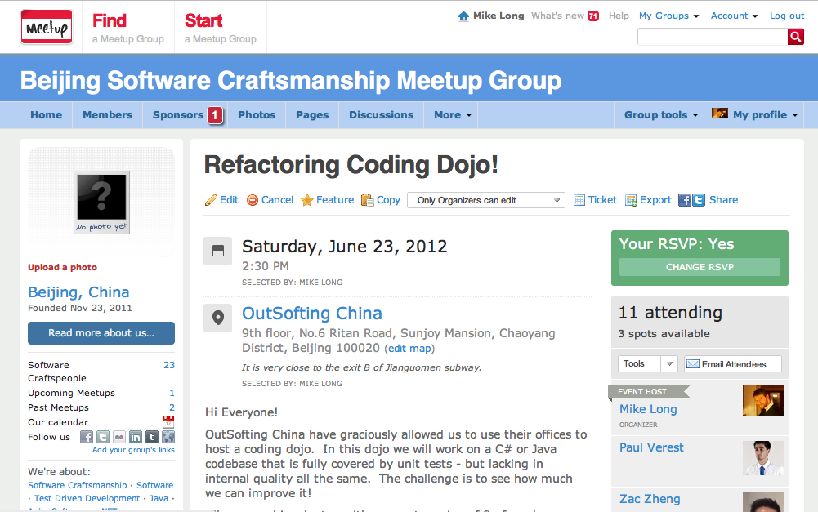

Slide 20
Credits
Cat
http://www.funnyjunk.com/funny_pictures/189828/Calisthenics/
Kid
http://www.kidsguideperth.com.au/byford-calisthenics/

