Slide 1

HACK ORBIT
🛸
AI Mission Intelligence
Platform
One Platform. Every Signal. Zero Missed Alerts.
NOAA Feed: LIVE
Orbit Feed: ACTIVE
AI Copilot: ONLINE
THE ACES · Space-Tech Hackathon 2025
Notes:
Welcome. Hack Orbit is an AI Mission Intelligence Platform for satellite operators. Built by The Aces. In the next few minutes you'll see a fully working system that unifies satellite health, space weather, collision risks, and AI recommendations into one operational cockpit.

Slide 2




THE PROBLEM
Satellite Operations Are Getting Harder
Orbital Congestion
Space Weather
11,000+ active satellites. Space is crowded and getting worse.
237 geomagnetic storms per year. Kp ≥5 events wreak havoc.
Fragmented Tools
Time Pressure
Operators juggle telemetry, weather, collision tools simultaneously.
Only ~16 hours notice for collision avoidance decisions.
By the time information is correlated across disconnected tools, valuable decision time is lost.
Notes:
Satellite operations today are fragmented. Operators switch between telemetry dashboards, space weather portals, collision warning systems, and email alerts. By the time data is correlated across tools, critical decision time is lost. Hack Orbit solves this.

Slide 3
THE SCALE OF THE CHALLENGE
The Numbers Don't Lie
11,000+
70,000
45,000
Active Satellites
Planned by 2030
Tracked Debris Objects
By end of 2024
LEO mega-constellations
Larger than 10 cm
15,600
41%
237
Conjunction Alerts / Year
SmallSat Failure Rate
Geomagnetic Storms / Year
For a 50-satellite fleet
Historical 2000–2016
Kp ≥ 5 events
Hours to Decide. Millions at Stake. Zero Room for Error.
Notes:
These are the real numbers operators face every day. Nearly 11,000 satellites active, 70,000 planned. 15,600 collision warnings per year — that's 300 per week for a 50-satellite fleet. 41% of small satellites still fail. And operators have only 16 hours to execute a collision avoidance maneuver. Hack Orbit was built for this reality.

Slide 4



INTRODUCING
Hack Orbit
A mission co-pilot for the age of crowded orbit.
Satellite Health
Space Weather
Collision Detection
Real-time telemetry. Anomaly detection. Health scoring.
NOAA Kp Index tracking. Storm warnings. Impact forecasts.
CelesTrak TLE data. Close approach alerts. Risk scoring.
AI Copilot
What-If Simulator
Mission Forecasts
Claude-powered recommendations. Incident analysis. Reports.
Simulate decisions. Assess mission impact in real time.
XGBoost failure prediction. Predictive maintenance.
Notes:
Hack Orbit unifies six mission-critical modules: satellite health monitoring, space weather tracking, collision detection, AI-powered recommendations, what-if simulation, and failure prediction. Every signal in one platform. The AI copilot synthesizes all of them into a single actionable recommendation.

Slide 5
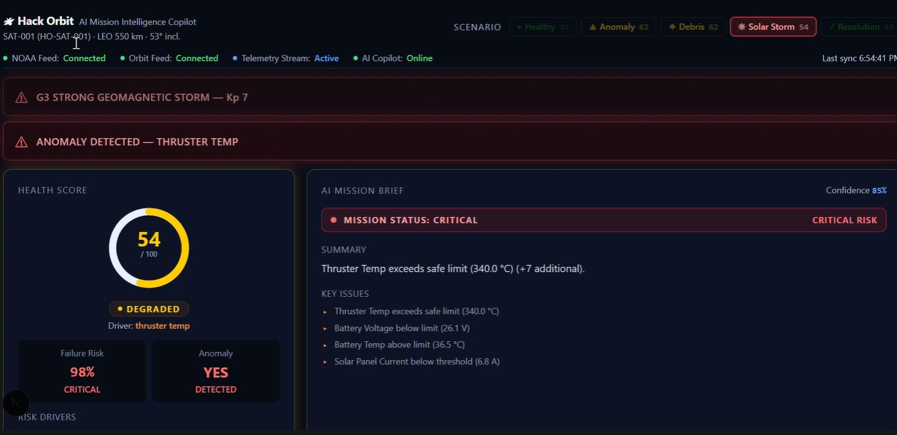
LIVE DASHBOARD
NOAA: LIVE
ORBIT: ACTIVE
AI: ONLINE
This is the actual Hack Orbit interface — built and running.
Critical Alerts
Health Score
AI Mission Brief
Failure Risk: 98%
Notes:
This is the actual Hack Orbit dashboard — not a mockup. Every widget you see is live-connected to NOAA, CelesTrak, and our AI engine. The health score, the mission brief, the alert banners — all generated in real time.

Slide 6
MODULE 01 — SATELLITE HEALTH & FAILURE PREDICTION
Health Score Widget
54 / 100
Health Score
Degraded — Thruster anomaly
Failure Risk
98%
CRITICAL — XGBoost prediction
Anomaly Status
DETECTED
Thruster temp, Battery, Solar
Monitored Params
8+
Temp, Power, Battery, Telemetry
Powered by Isolation Forest anomaly detection + XGBoost failure prediction
Notes:
The health module continuously monitors telemetry: temperature, power, battery, solar panels. Isolation Forest detects anomalies, XGBoost predicts failure probability. In the SAT-7 scenario the thruster temperature spike pushed failure risk to 98% — Hack Orbit caught it instantly.

Slide 7
MODULE 02 & 03 — SPACE WEATHER & COLLISION RISK
Space Weather
Collision Risk
Kp Index
7
Object ID
TBA-4821
G3 — Strong Geomagnetic Storm
Tracked debris object
Storm Class
G3
Distance
4.2 km
Significant satellite drag
Critical close approach
Storms/yr
237
Time to CA
3.5h
Average Kp≥5 events annually
Conjunction in 3.5 hours
Warning Lead
18h–3d
Decision Lead
~16h
CME arrival forecast window
Standard avoidance notice
⚠ G3 STRONG GEOMAGNETIC STORM — Kp 7
⚠ CONJUNCTION ALERT — TBA-4821 at 4.2 km in 3.5h
Notes:
Two simultaneous threats: a G3 geomagnetic storm with Kp=7, and debris object TBA-4821 approaching at 4.2 km in just 3.5 hours. Hack Orbit detects both in real time using NOAA space weather APIs and CelesTrak TLE data with SGP4 orbital propagation.

Slide 8
MODULE 04 — AI COPILOT MISSION INTELLIGENCE
Operator asks:
"What should I do right now?"
AI Copilot Response
CRITICAL RISK
Confidence: 85%
• Thruster anomaly likely caused by solar particle interference.
AI Mission Brief widget — live
• Debris conjunction expected in 3.5 hours (TBA-4821 at 4.2 km).
• Recommend DELAYING maneuver by 6 hours until storm conditions improve.
• Monitor thruster temperature every 15 minutes.
• Issue standby notification to ground operations team.
Notes:
The operator types one question: What should I do right now? The AI Copilot — powered by Claude — synthesizes the thruster anomaly, the debris conjunction, and the storm conditions, and delivers a prioritized action plan in seconds. This is the mission co-pilot concept: one question, complete situational awareness.

Slide 9
SAT-7 LIVE MISSION SCENARIO — END-TO-END WORKFLOW
01
NOMINAL
06
PREDICTION
Health: 92 / 100 · All systems green
XGBoost: 73% → 98% failure probability
02
ANOMALY
07
AI RESPONSE
Thruster temp spikes to 340°C
Co-pilot: Delay maneuver 6h · Monitor temp
03
ALERT
08
REPORT
Health drops · Anomaly detected
Incident report auto-generated
04
DEBRIS
09
SIMULATION
TBA-4821 at 4.2 km · 3.5h to conjunction
What-If: Reduce thruster load → Health: 81
05
STORM
10
RESOLUTION
Kp = 7 · G3 geomagnetic storm warning
Mission continues · Threat window cleared
Notes:
Walk judges through the complete SAT-7 scenario: from a healthy satellite to a simultaneous thruster anomaly, debris conjunction, and geomagnetic storm — and how Hack Orbit's AI resolves all three threats in real time. This is not a demo scenario we created for the pitch — it ran live on our platform.

Slide 10


ENGINEERING — ARCHITECTURE & TECH STACK
NOAA API
CelesTrak
FastAPI
Backend
AI Engine
(Claude + XGBoost)
Mission
Insights
ESA Data
Next.js 14 Dashboard
Frontend
Backend
AI & ML
Space Intelligence
· Next.js 14 · React
· FastAPI · Python
· Claude AI · OpenAI API
· NOAA Space Weather API
· Tailwind CSS · Recharts
· PostgreSQL · SQLAlchemy
· XGBoost · Isolation Forest
· CelesTrak · SGP4 · Skyfield
· Zustand · Axios
· Uvicorn
· AI Copilot · Report Gen
· Poliastro · TLE Data
Notes:
Hack Orbit's architecture: data flows from NOAA, CelesTrak, and ESA into our FastAPI backend, through the AI engine running Claude and XGBoost, and surfaces as mission insights in the Next.js dashboard. The full stack is deployed on Vercel and Railway with Supabase for data persistence.

Slide 11


IMPACT & FUTURE VISION
What We Proved. Where We Go.
< 1s
98%
Real-time
6 modules
AI response time
Failure risk detected
Live data integration
Unified platform
ROADMAP
Fleet Intelligence
Predictive Maintenance
Autonomous Maneuvers
Space Traffic Integration
Monitor hundreds of satellites simultaneously with cross-fleet anomaly correlation.
Proactively schedule maintenance before failures occur — reduce 41% failure rate.
AI-planned collision avoidance burns — from alert to execution, automated.
Full space traffic awareness with ESA, SpaceX, and OneWeb coordination layers.
Notes:
In 48 hours we built a working system that detects real threats in real orbit. The roadmap takes Hack Orbit to fleet scale — hundreds of satellites, autonomous maneuver planning, and integration with space traffic management systems. This isn't a prototype concept. It's a foundation.

Slide 12

THE ACES
Built by
The Aces
Working System
Ritu Patil
Tejas Patil
Darshan Sonar
Dipak Saindane
Anjali Wagh
"Because in space, every second counts."
🛸 HACK ORBIT · AI Mission Intelligence Platform
Notes:
Thank you. We are The Aces — five engineers who spent 48 hours building a real mission intelligence system. Hack Orbit isn't just a hackathon project. It's a blueprint for how the next generation of satellite operators will run their missions. Because in space, every second counts.

