Slide 1
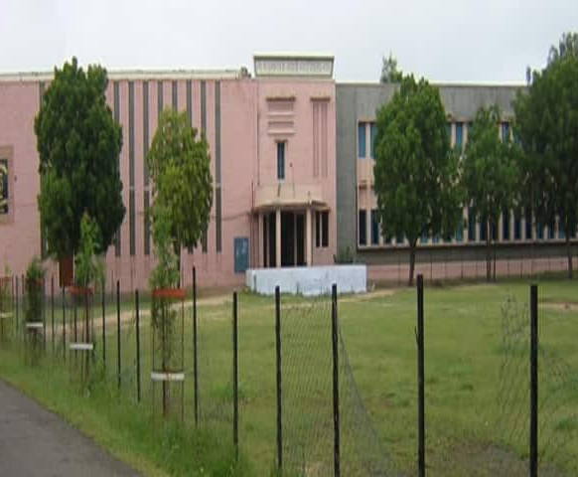
Introduction
I am Sanjay, a passionate Full Stack Developer with expertise in MERN stack technologies. I specialize in building dynamic, user-friendly websites and web applications, focusing on both front-end and back-end development. With hands-on experience in React, Node.js, Express, and MongoDB, I strive to create innovative and scalable solutions. Constantly learning and adapting to new technologies, I aim to deliver high-quality work that solves real-world problems and enhances user experience.

Slide 2
Project Structure
Description: Visual Studio Code (VS Code) is a lightweight and powerful source-code editor developed by Microsoft. It supports multiple programming languages and is highly customizable with extensions.
Key Features:
Syntax highlighting and IntelliSense for faster coding.
Integrated terminal for running commands directly.
Extensions for added functionality, like Prettier, ESLint, and Git integration.
Usage in Portfolio: I used VS Code as my primary code editor to develop the portfolio, leveraging its
features like auto-completion, debugging tools, and Git integration for efficient coding.

Slide 3

Project Structure
Project Structure
Vite React:
Vite is a fast and optimized bundler for modern web development. It allows instant hot-reloading during development, which makes it a great choice for React projects. Vite improves the overall developer experience by reducing build times and providing instant feedback.
Tailwind CSS:
Tailwind CSS is a utility-first CSS framework that helps in creating custom and responsive designs quickly. Instead of writing custom CSS, Tailwind allows you to use predefined utility classes, making it faster to build UI components and responsive.
Node.js:
Node.js is used for handling the backend logic of the project. In this portfolio, Node.js powers the server-side API, handles requests from the front-end, and integrates services like Nodemailer to handle email functionalities.

Slide 4
PROJECT OVERVIEW
Home Page:
The Home Page serves as the welcoming section of your portfolio. It provides a brief introduction to who you are, along with a navigation menu to explore other sections like About Me, Projects, and Contact.
About Me Page:
The About Me page introduces you in detail, highlighting your skills, experience, and professional background. Here, visitors can learn about your journey, your expertise in web development, and your key skills like React, Node.js, Tailwind CSS, etc.
Project Page:
The Projects Page showcases your development work. Each project is displayed with a brief description, technology stack used, and visual representations (like images).
Contact Page:
The Contact Page offers an easy way for visitors to get in touch with you. It contains a contact form where users can submit their name, email, and message, which is sent directly to your email using Nodemailer.

Slide 5
Project Features and Functionality
Dark/Light Mode Toggle: This feature allows users to switch between dark and light themes, providing a personalized and comfortable viewing experience according to their preferences.
Smooth Animations: GSAP animations enhance user interaction by adding smooth transitions and effects, making the portfolio more engaging and visually appealing.
Responsive Design: Tailwind CSS ensures the portfolio is fully responsive, adapting seamlessly to different screen sizes, from desktops to mobile devices, ensuring a consistent user experience.
Contact Form With Nodemailer: The contact form allows users to directly send messages through the website. Nodemailer handles form submissions by sending emails to your inbox, making communication seamless and efficient. This feature helps potential clients or collaborators easily reach out to you.

Slide 6
useState and useContext in React
useState:
Description: useState is a React hook that allows you to add state to functional components. It returns an array with two elements: the current state value and a function to update it. It's useful when you need to store and update the state of a specific variable in your component.
2. useContext:
Description: I used useContext to manage the global theme setting (light/dark mode). By wrapping the theme state in a context provider, I can easily access and update the theme value from any component withou prop drilling.

Slide 7
React Router DOM
Description: React Router DOM is a library that allows you to handle navigation and routing in a React application. It enables you to create single-page applications (SPAs) where you can navigate between different views or components without reloading the page.
Key Features:
Declarative Routing: Routes are defined using JSX, making it easier to manage and organize the application's navigation.
Nested Routes: You can create routes within other routes for better organization of views and layouts.
Usage in Portfolio: In my portfolio, I used React Router DOM to manage the navigation between different pages, such as the Home, About, Projects, and Contact pages, ensuring a seamless user experience.
Dynamic Routing: Routes can change based on application state, making it highly interactive and customizable.

Slide 8
Git and GitHub Integration
Description: I have integrated Git for version control, which helps in tracking changes, managing code history, and collaborating efficiently. The project code is hosted on GitHub, providing a centralized repository for easy access and collaboration.
Version Control: Git helps in maintaining version history, making it easy to track changes and roll back if necessary.
Collaboration: GitHub makes it simple to collaborate with others by allowing pull requests, issues, and discussions on the code.
Deployment: The repository also serves as the base for deploying the portfolio on platforms like Render.
GitHub Repository: You can access the complete project source code on GitHub, ensuring transparency and enabling others to contribute or view the development process.

Slide 9
Deployment on Render
Description: Render is a modern cloud platform that simplifies the deployment of web applications, APIs, and static sites. It offers automatic builds and free hosting for hobby projects.
Key Features:
  Easy integration with Git repositories like GitHub.
  Automatic deployment on every code push.
  Free plan for deploying static sites and web apps.
Usage in Portfolio: I deployed my portfolio on Render to make it accessible online, ensuring fast and reliable hosting.

Slide 10
Conclusion
My portfolio reflects a seamless integration of modern web technologies like Vite React, Tailwind CSS, and Node.js. It showcases essential features, including smooth animations, a responsive design, and a fully functional contact form. Hosted on Render with a well-structured folder hierarchy, the portfolio is designed to provide an engaging user experience. With tools like Visual Studio Code and GitHub for efficient development and deployment, this project highlights my skills in creating dynamic and interactive web applications.
GitHub Account: https://github.com/codecraft-sanju
Portfolio Project Link: My Portfolio

