Slide 1
IBM University Engagement Project Submission
“Exploring the Power of Agentic AI with IBM Granite and LangFlow”

Slide 2

MindGuard AI – Agentic AI for Mental Health Awareness & Suicide Prevention
Domain of Project – Healthcare – Mental Health & Suicide Prevention
Student Name | Recent Passport Photo | Email ID | Mobile number [WhatsApp]
Saksham Gupta |  | sakshamgupta12312030@gmail.com | 9389770509

Slide 3
Problem Statement -
Problem Statement : Agentic AI for Mental Health Awareness & Suicide Prevention
The Challenge
Mental health issues such as stress, anxiety, depression, loneliness, and suicidal thoughts are increasing worldwide. Many people hesitate to seek professional help due to stigma, lack of awareness, limited access to mental health resources, and delayed intervention. Existing solutions are often reactive and fail to provide continuous emotional support, early risk detection, personalized self-care guidance, and secure journaling.
The Objective
Build an AI-powered Agentic Mental Health Assistant (MindGuard AI) that provides empathetic conversations, emotional wellness support, early distress detection, and personalized self-care guidance for users. The solution should include:
AI Mental Health Chatbot – Provide empathetic conversations using IBM watsonx.ai while maintaining user safety.
Mood Tracking & Analytics – Allow users to record daily moods and visualize emotional trends over time.
Personal Journal – Enable secure journaling with Cloudant storage for emotional reflection and progress tracking.
Self-Care Exercises – Recommend breathing exercises, meditation, stretching, gratitude practice, and mindfulness sessions.
Mental Health Resource Center (RAG) – Retrieve trusted mental health information and wellness guidance using Retrieval-Augmented Generation.
Emergency SOS Support – Provide immediate access to emergency contacts, crisis helplines, and safety guidance during high-risk situations.
Safety Classification Agent – Detect potentially harmful or suicidal conversations and provide safe, responsible responses with escalation guidance.
Visualization Dashboard – Display mood history, journaling activity, wellness progress, and self-care engagement through interactive analytics.

Slide 4
Proposed Solution -
Proposed Solution: MindGuard AI – Agentic Mental Health Assistant
MindGuard AI is an AI-powered mental health assistant built using IBM watsonx.ai, IBM Granite Models, IBM Cloudant, RAG, React, and Node.js. It provides empathetic conversations, mood tracking, secure journaling, personalized self-care guidance, and emergency support.
At its core, the solution uses a Retrieval-Augmented Generation (RAG) pipeline to retrieve trusted mental health resources and generate safe, context-aware, and empathetic responses using IBM Granite models.
The system consists of the following key modules:
AI Mental Health Chatbot – Provides empathetic conversations and emotional support.
Mental Health RAG Agent – Retrieves trusted mental health knowledge and coping strategies.
Mood Tracking Agent – Records moods and visualizes emotional trends.
Personal Journal Agent – Stores journals securely using IBM Cloudant.
Self-Care Agent – Recommends breathing, meditation, mindfulness, and wellness exercises.
Safety Classification Agent – Detects high-risk conversations and generates responsible responses.
Emergency SOS Agent – Provides quick access to crisis helplines and emergency contacts.
The solution includes a user-friendly dashboard that visualizes mood history, journaling activity, and overall wellness progress.
IBM watsonx.ai powers conversational intelligence, IBM Granite Models handle reasoning, IBM Cloudant stores user data securely, and RAG enhances responses with trusted mental health knowledge.
Overall, this solution delivers an intelligent, secure, and privacy-focused mental health assistant that promotes mental health awareness, early risk detection, emotional well-being, and timely support.

Slide 5
Technology Used
IBM Granite Model – Used for natural language understanding, empathetic conversations, reasoning, and response generation.
IBM watsonx.ai – Powers AI model inference, prompt execution, and conversational intelligence.
IBM Cloud – Provides a secure and scalable cloud environment for deploying the application and AI services.
IBM Cloudant – NoSQL database used to securely store user journals, mood history, conversations, and application data.
Retrieval-Augmented Generation (RAG) – Retrieves trusted mental health resources to generate accurate and context-aware responses.
React.js + Node.js + Express.js – Used to build the interactive frontend and backend APIs for the application.

Slide 6
AI Components Used-
Chat Input – Accepts user messages, mood updates, and journal entries.
2) IBM watsonx.ai Agent – Processes user input and generates safe, empathetic responses.
3) IBM Granite Model – Granite-3-3-8B-Instruct for reasoning, conversation, and mental health guidance.
4) Chat Output – Displays AI-generated responses, self-care suggestions, and wellness guidance.
5) RAG Component – Retrieves trusted mental health resources and coping strategies before generating responses.
6) Cloudant Storage Component – Securely stores user journals, mood history, conversations, and application data.

Slide 7
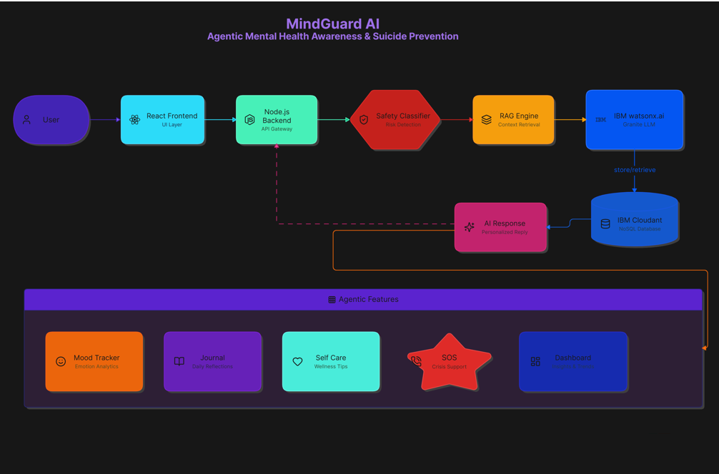

System Workflow-

Slide 8
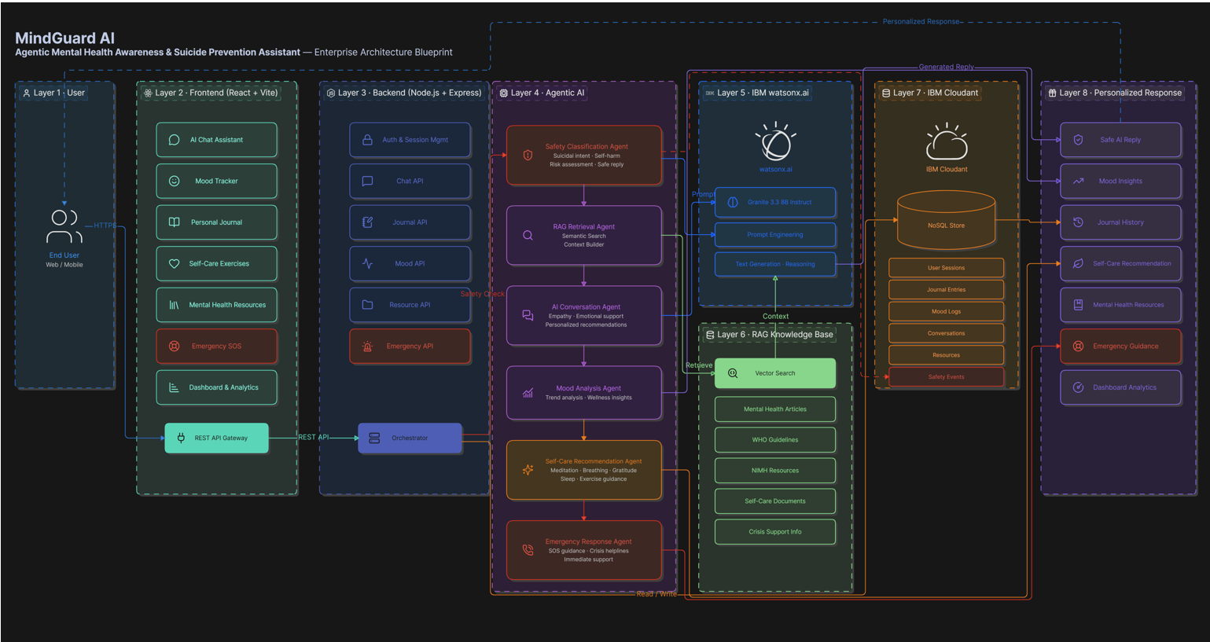
Architecture blueprint

Slide 9

Role of Agentic AI in the solution
Role of Agentic AI in MindGuard AI
Agentic AI enables MindGuard AI to function as an intelligent, proactive mental health assistant rather than a simple chatbot. Using IBM watsonx.ai and IBM Granite models, it coordinates multiple specialized AI agents to provide empathetic conversations, emotional support, and personalized self-care guidance.
Each agent performs a specific role—such as safety classification, mood analysis, RAG-based knowledge retrieval, journaling support, and self-care recommendations—while working collaboratively. This multi-agent architecture ensures accurate, context-aware, and reliable responses.
Agentic AI also provides context awareness, understanding users' mood history, journal entries, and conversation context to generate personalized recommendations. It supports real-time adaptation, continuously adjusting responses based on the user's emotional state and interactions.
Additionally, the agents communicate with each other to improve decision-making, detect high-risk situations, and provide timely crisis support when required.
Overall, Agentic AI makes MindGuard AI proactive, empathetic, personalized, and safety-focused, helping users improve their mental well-being through intelligent assistance and early intervention.

Slide 10
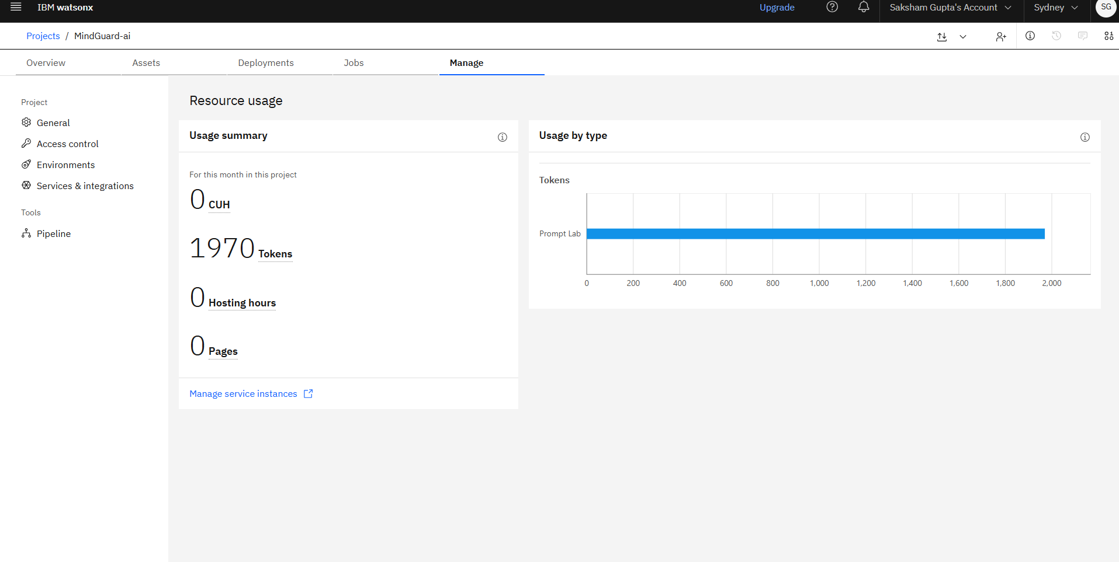
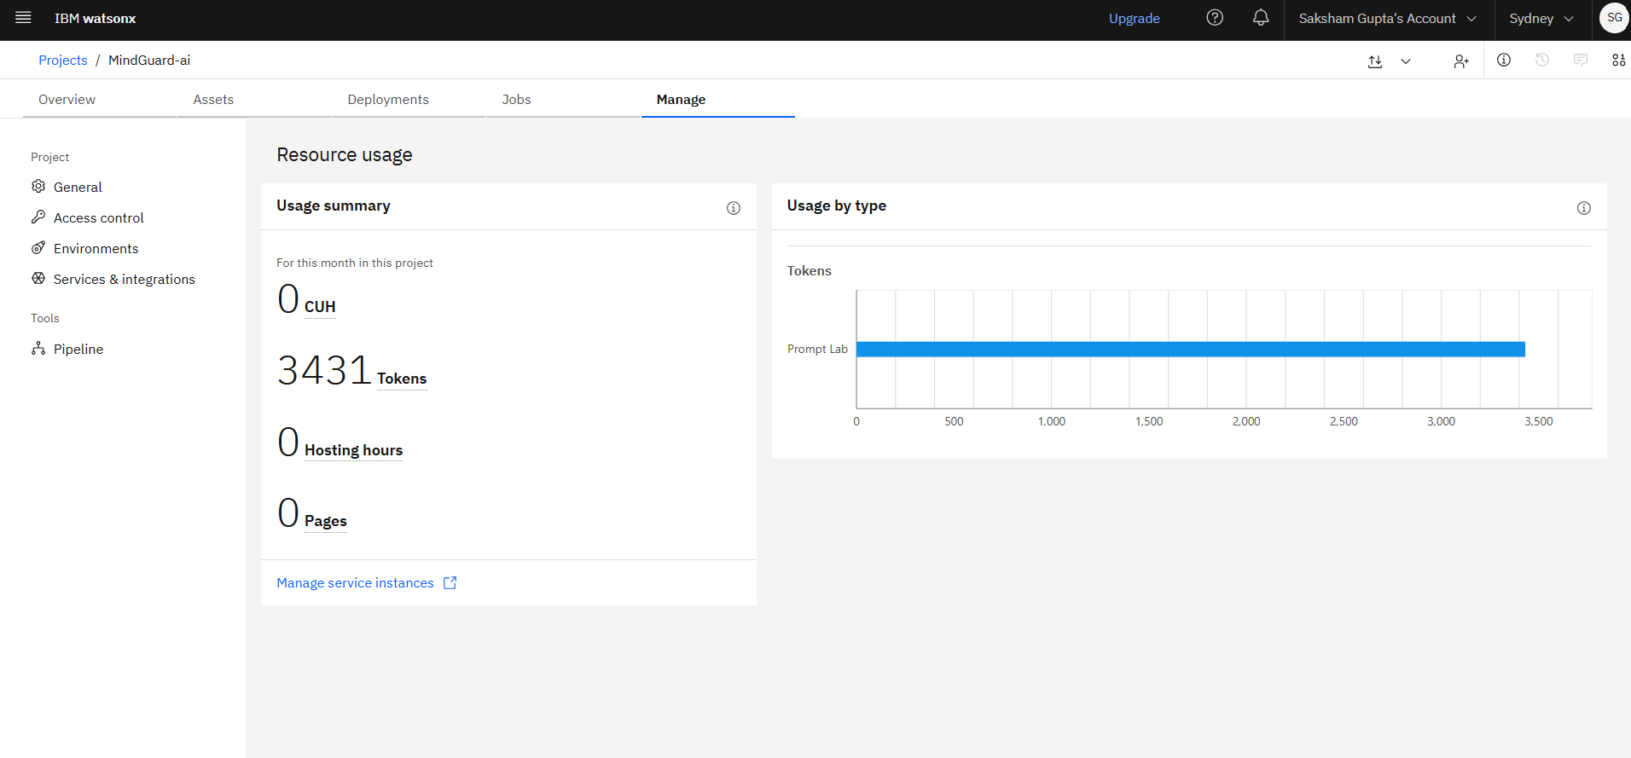
Token Usage
11,761 token are used
Before Prompt
After the Prompt
·
·
·

Slide 11
Novelty and Uniqueness
Key Features / Unique Selling Points (USP) of MindGuard AI
The proposed MindGuard AI stands out by combining Agentic AI, RAG, and personalized mental health support into one intelligent system.
Multi-Agent Intelligence – Multiple AI agents collaborate to provide safe, empathetic, and context-aware mental health assistance.
RAG-Based Knowledge Retrieval – Retrieves trusted mental health information to reduce misinformation and improve response quality.
Personalized Emotional Support – Delivers recommendations based on mood history, journal entries, and conversation context.
Real-Time Risk Detection – Continuously analyzes user interactions to detect emotional distress or high-risk situations.
Integrated Wellness Features – Combines AI Chat, Mood Tracking, Journaling, Self-Care Exercises, and Emergency SOS in one platform.
Safety-First Design – Uses AI safety classification to provide responsible responses and crisis guidance.
Scalable & Enterprise-Ready – Built using IBM watsonx.ai, Granite Models, Cloudant, and RAG for secure and reliable deployment.
This makes MindGuard AI a proactive, empathetic, and intelligent mental health companion rather than just a simple chatbot.

Slide 12
Git Hub Link
https://github.com/codecrafter34/MindGuard.git
·
·
·

Slide 13
Future Scope
1. Wearable & Health Device Integration –
Integrate with smartwatches and fitness bands to monitor heart rate, sleep, stress levels, and activity. This will enable real-time mental wellness insights and personalized self-care recommendations.
2. Voice Assistant & Multilingual Support –
Add voice-based interaction and support multiple regional languages to make the platform more accessible and user-friendly for people from diverse backgrounds.
3. Professional Counselor Integration –
Enable secure connections with licensed psychologists, therapists, and emergency helplines for timely intervention and continuous mental health support.
4. Mobile App & Smart Notifications –
Develop Android/iOS applications with personalized reminders for mood tracking, journaling, breathing exercises, and medication or therapy schedules.
·
·
·

Slide 14
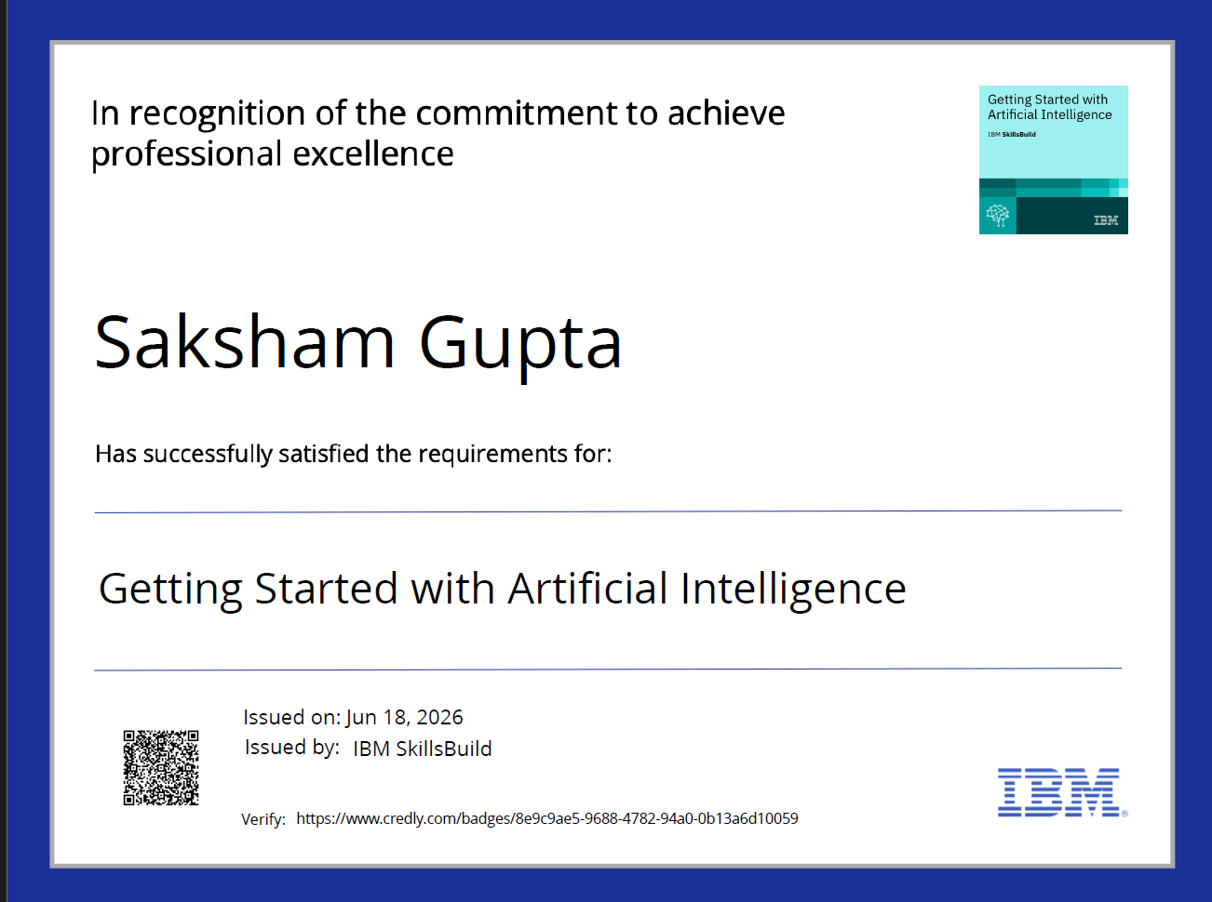
Certificates Earned:
Please add your credly certificate

Slide 15
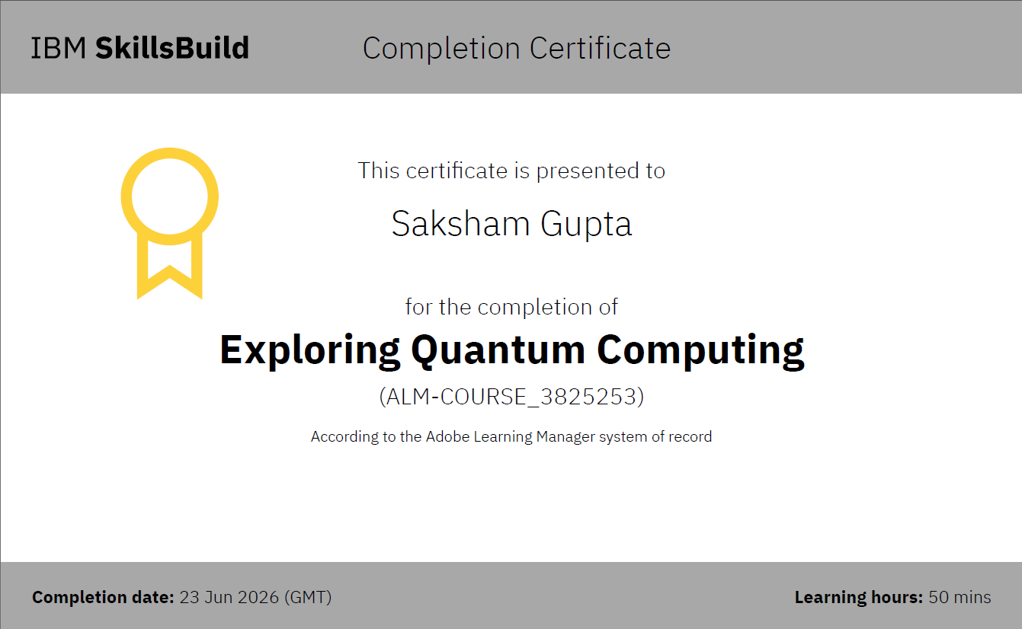

Slide 16
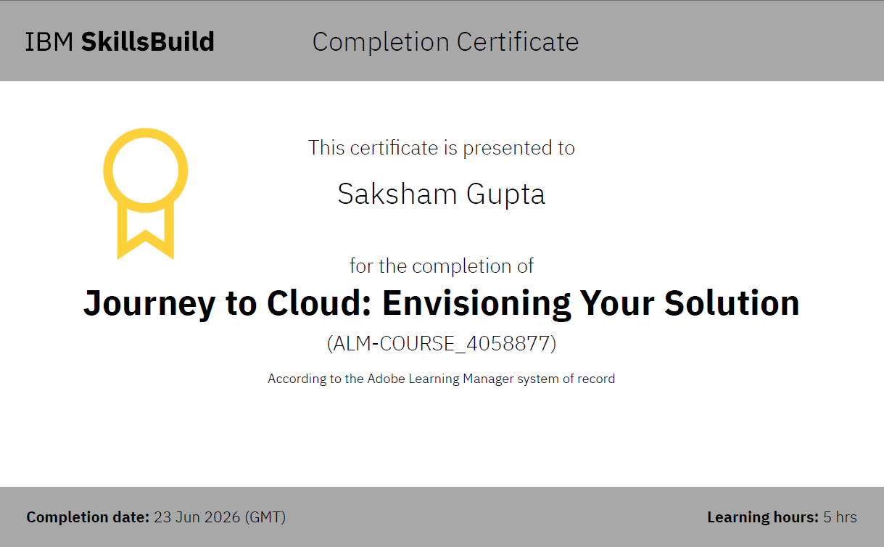

Slide 17
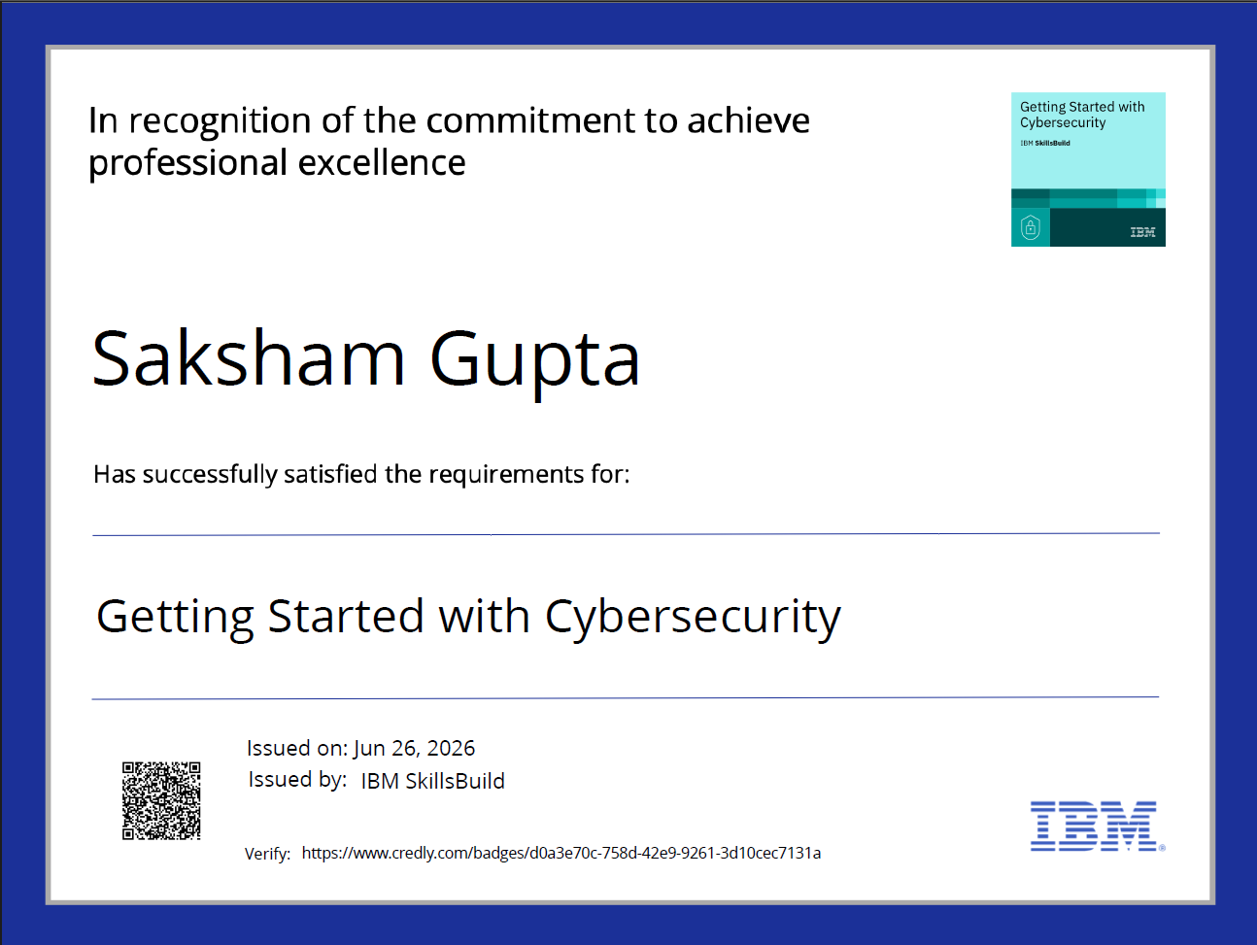

Slide 18
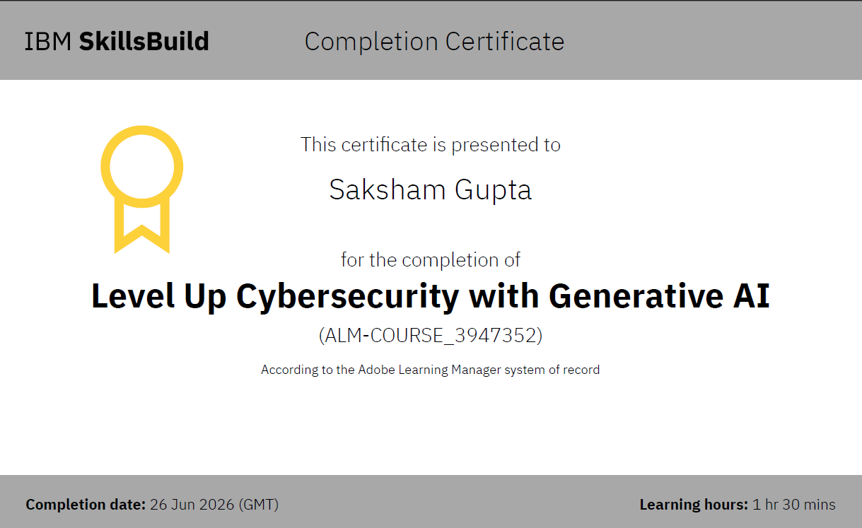

Slide 19
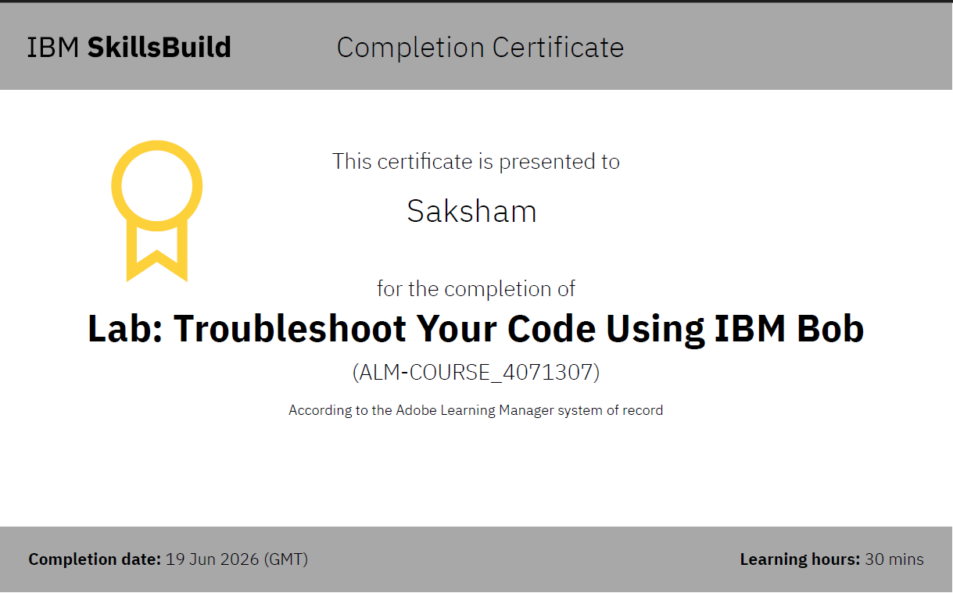
Certificates Earned:​

Slide 20


