Slide 1
IBM University Engagement Project Submission
“Exploring the Power of Agentic AI with IBM Granite and LangFlow”

Slide 2

Project Tile – College Admission Agent ( RAG Based )
Domain of Project – Education
Student Name | Recent Passport Photo | Email ID | Mobile number [WhatsApp]
Vijay kumar |  | kumarvijaykvn9@gmail.com | 9315818659

Slide 3
Problem Statement -
Problem Statement : College Admission Agent
The Challenge
Choosing the right college is difficult because students must compare institute brochures, counselling rules, cutoff trends, fee structures, and eligibility criteria across many sources. This information is often scattered, inconsistent, and difficult to interpret. Without personalized, data-backed guidance, students may miss suitable colleges, misunderstand admission chances, or make decisions without knowing the actual fee and cutoff details.
The Objective
Build an AI-powered College Admission Agent that provides personalized admission insights and guidance for students, parents, and counsellors. The solution should:
• Personalized College Shortlisting – Recommend colleges based on rank, marks, category, stream, location, budget, and preferences. • Admission Data RAG Retrieval – Fetch and summarize cutoff, fee, eligibility, and counselling details from trusted brochures and documents. • College Comparison & Guidance – Compare institutes across branch availability, fees, placements, and admission chances. • Counselling Support – Assist with round-wise cutoff trends, seat availability, and admission strategy. • Institute Knowledge Agent (retrieves brochure and admission data) • College Recommendation Agent (shortlists suitable institutes) • Admission Advisory Agent (explains eligibility and counselling options) • Document Query Agent (answers brochure-based questions) • Visualization Dashboard – Show shortlist, cutoff comparison, fee comparison, and admission probability insights.

Slide 4
Technology Used
Technology Used
Tech Stack
IBM watsonx Orchestrate
IBM watsonx.ai
IBM Granite Models
RAG (Retrieval-Augmented Generation)
PDF Knowledge Base
Knowledge Sources
JoSAA Bulletin
CSAB Bulletin
JAC Delhi
JAC Chandigarh
UPTAC 2026 Bulletin
Other official Counselling PDFs
Why This Stack?
watsonx Orchestrate → To manage and automate the agent workflow
watsonx.ai → To power AI reasoning and response generation
Granite Models → For summarization, analysis, and intelligent answers
RAG → To retrieve accurate information from official admission PDFs
Vector Database → To store and search document embeddings efficiently

Slide 5
Proposed Solution -
Proposed Solution: AI-Powered College Admission Agent
The proposed solution is a multi-agent AI-powered College Admission Agent built using IBM Orchestrate, IBM watsonx.ai, and IBM Granite models to provide personalized, reliable admission guidance. The system addresses the challenge of college selection, cutoff analysis, and fee comparison through an intelligent modular architecture. At its core, the solution uses a Retrieval-Augmented Generation (RAG) pipeline to fetch accurate admission data from trusted sources such as college brochures, counselling PDFs, cutoff lists, and fee documents. This data is embedded and stored in a vector database, enabling the system to retrieve and summarize college details, admission criteria, and fee structures using Granite models.
The system consists of four key agents: Institute Knowledge Agent retrieves and summarizes brochure-based admission information using RAG. College Recommendation Agent generates personalized college shortlists based on rank, category, budget, branch, and location. Admission Advisory Agent provides counselling guidance, cutoff interpretation, and eligibility support. Document Query Agent allows users to ask questions from uploaded brochures and admission documents and delivers instant answers. IBM Orchestrate is used to coordinate agent workflows, while watsonx.ai ensures scalable model deployment, embeddings, and AI governance. Granite models power reasoning, summarization, and personalized admission recommendations. Overall, this solution delivers an end-to-end intelligent admission assistant that helps students make better college choices through personalized insights, document-grounded answers, and counselling support.

Slide 6
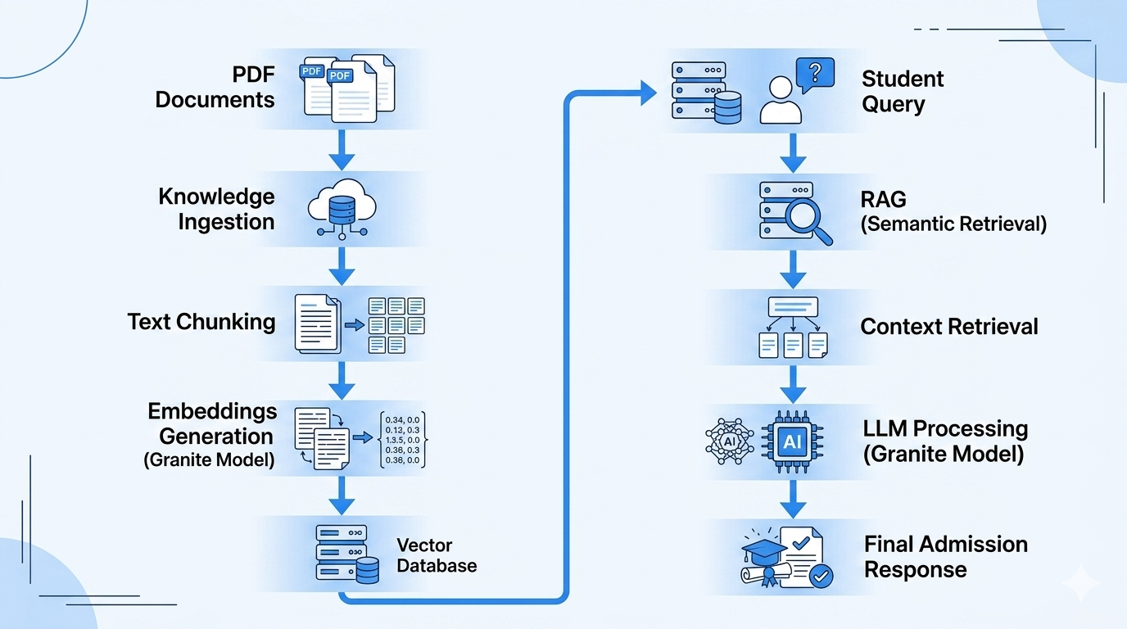
IBM Orchestrate workflow -

Slide 7
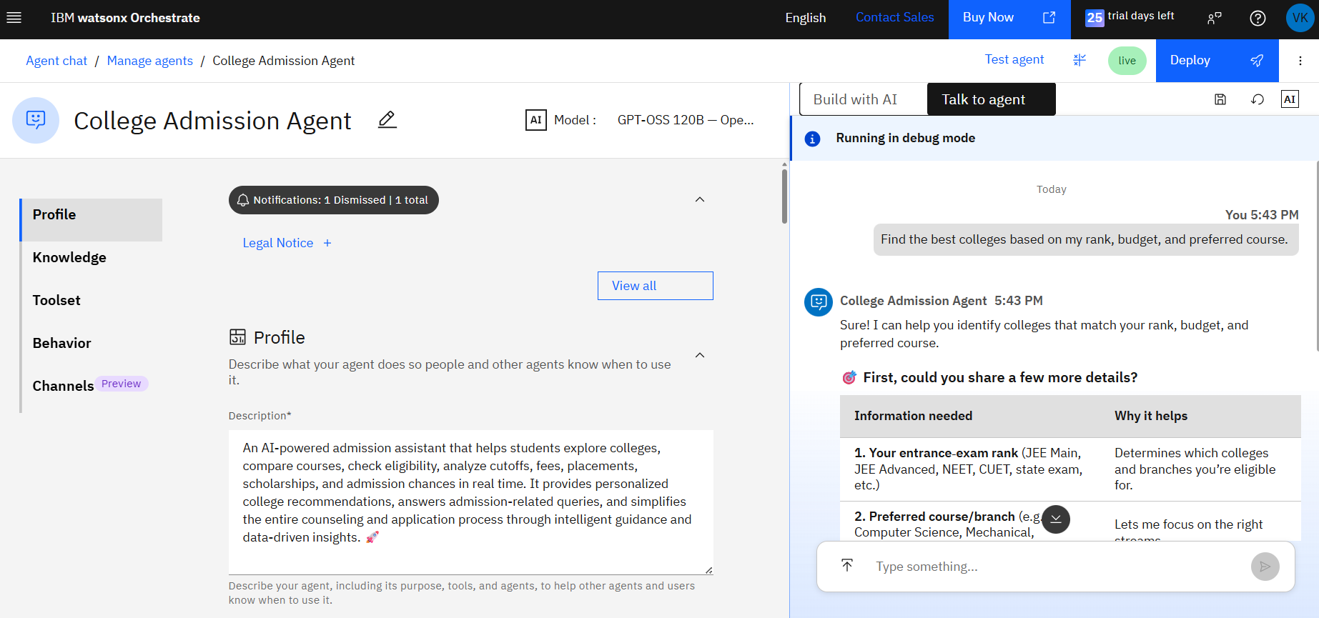
Project image

Slide 8
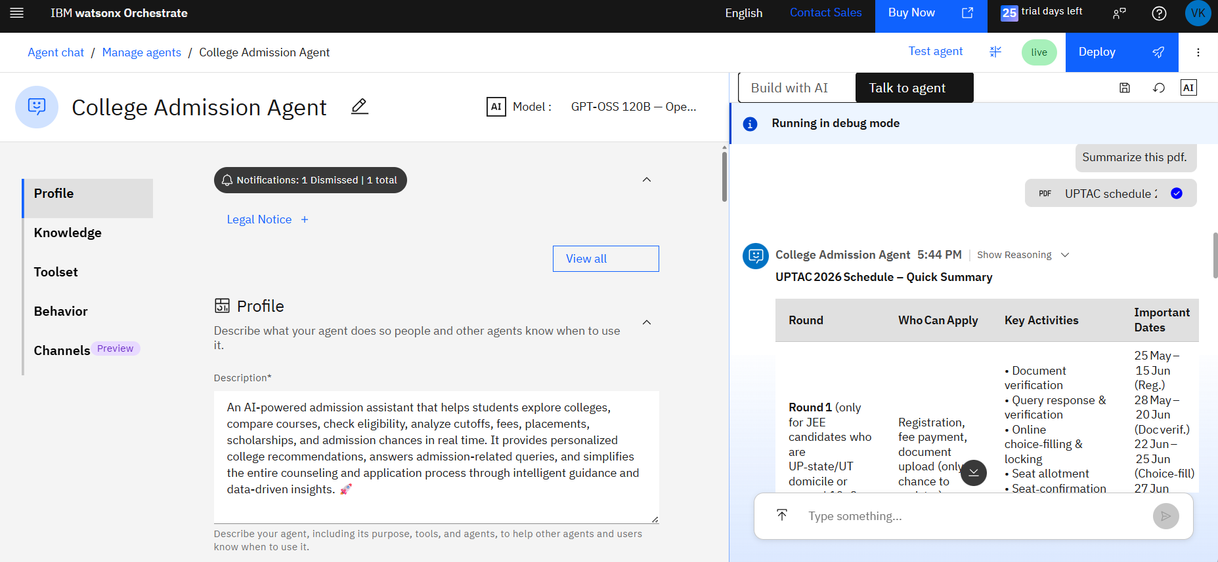
Project image

Slide 9

Role of Agentic AI in the solution
Role of Agentic AI in College Admission Agent
Agentic AI enables the College Admission Agent to function as an intelligent, autonomous system rather than a simple chatbot. Using IBM watsonx.ai, IBM Orchestrate, and IBM Granite models, it coordinates multiple specialized agents to deliver personalized admission guidance. Each agent performs a specific role—such as retrieving brochure data, analyzing cutoff trends, comparing fees, and recommending colleges—while working collaboratively. This multi-agent approach ensures accurate shortlist generation and better admission decisions. Agentic AI also brings context awareness, understanding user details like rank, category, preferred branch, budget, and location to generate tailored recommendations. It supports real-time adaptation, continuously updating suggestions based on new counselling rounds, uploaded brochures, and user inputs. Additionally, agents communicate with each other, enabling better comparison, reasoning, and decision-making. Overall, Agentic AI makes the system proactive, personalized, and admission-focused, acting like a smart digital admission counsellor that helps users choose the right college with confidence.

Slide 10
Novelty and Uniqueness
The proposed College Admission Agent stands out by combining Agentic AI, RAG, and personalization into a single intelligent admission system.
Multi-Agent Intelligence – Instead of a single chatbot, multiple specialized agents collaborate to deliver accurate and context-aware admission guidance. RAG-Based Accuracy – Integrates brochure and admission document retrieval with AI generation, reducing misinformation and ensuring data-backed answers. Hyper-Personalization – Tailors college recommendations based on rank, category, branch, budget, location, and counselling preferences. Admission Comparison Loop – Continuously adapts shortlists based on cutoff trends, fee data, and user feedback. Document-Centric Input – Supports brochure, PDF, and text-based admission data for reliable question answering. Counselling Support Focus – Goes beyond basic search to provide branch-wise cutoff insights and admission strategy guidance. Scalable & Enterprise-Ready – Built on IBM Orchestrate with IBM Granite models, ensuring reliability, governance, and modular workflow management.
This makes the solution a smart, adaptive, and data-grounded admission assistant, not just a static college search tool.

Slide 11
Git Hub Link
Repository Details
A public GitHub repository has been created to host all project resources, source files, and documentation related to the College Admission Agent (RAG Based) project.
Repository Contents
✅ Problem Statement PDF
✅ Project Presentation (PPTX)
✅ Knowledge Base Documents (JoSAA, CSAB, JAC Delhi, JAC Chandigarh, UPTAC, etc.)
✅ Additional Project Files and Resources
GitHub Repository URL
🔗 https://github.com/codecraftpython-dev/College-Admission-Agent

Slide 12
Future Scope
1. Integration with Counselling Portals & Seat Matrix
The system can be integrated with counselling portals, seat matrix updates, and deadline alerts to collect real-time admission information such as round-wise cutoffs, vacant seats, and reporting schedules. This will enable the College Admission Agent to provide more accurate and dynamic recommendations based on actual counselling progress and institute-wise changes.
2. AI-Powered Voice Assistant & Multilingual Support
Enhancing the system with a voice-enabled assistant and support for multiple languages will improve accessibility. Students can interact naturally in their preferred language, making the solution more inclusive and suitable for diverse users, especially during admission seasons where quick guidance is needed.
·

Slide 13


