Slide 1
Impact of Implementing Basic Computer Programming Skills into a Senior Level Algebra 3-4 Class
By Charlie Cuddy
In partial fulfillment for
masters of education degree,
Leadership in teaching and learning
From Midland University

Slide 2
Purpose of the Study:
To determine if students turned in more homework, and earned better grades by studying computer programming
To determine if there was an increase in students problem solving ability and creativity
To determine if students demonstrated a more positive attitude about math in general by studying computer programming
To determine if students exposed to computer programming had a heightened interest in pursuing math related degrees and/or jobs
Notes:
Explain why you selected it.

Slide 3
Research Question:
Does implementing basic computer programming skills into the senior level Algebra 3-4 curriculum increase creativity and problem solving ability while also improving participation and performance of the students in the class?
Notes:
Share expectations and assumptions prior to implementing the study.

Slide 4
“Many people in the United States and around the world lack the education and skills required to participate in the great new companies coming out of the software revolution”
Relevancy of Study:
-Why Software is eating the world.
The wall street journal

Slide 5
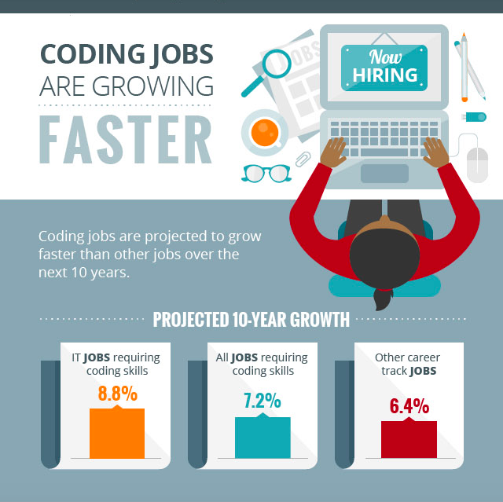
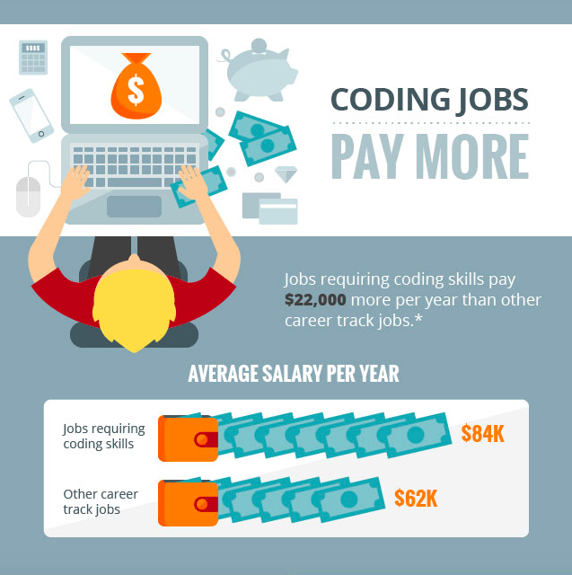
Computer Programming Prepares Students for the Future
-Burning Glass Careers in Focus. 2016
Notes:
* Comparing those jobs that pay $15+ per hour (living wage according to MIT)

Slide 6
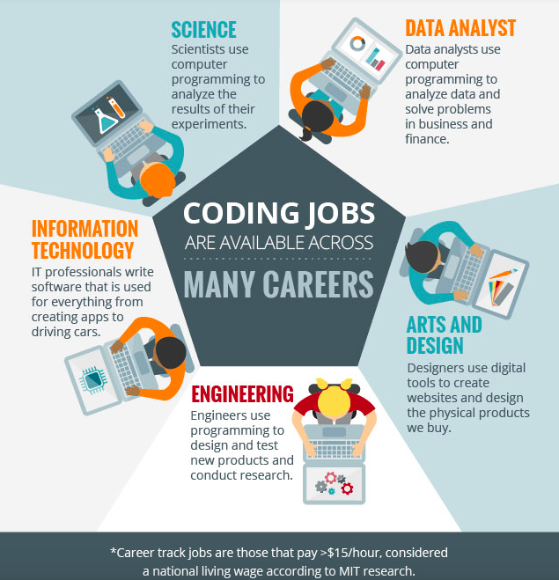
Careers are Available in Different Fields
-Burning Glass Careers in Focus. 2016

Slide 7
“Computer science [programming] teaches kids to be problem solvers and innovators.”
Relevancy of Study:
-computer science is the key to America’s skill crisis
Linda moore
[President & CEO of TechNet, the nation’s preeminent, bipartisan network of technology CEOs and senior executives]

Slide 8
Level 4 Questions Attempted by Students
Problem Solving Growth in Senior Students

Slide 9
“… the positive effects (better learning and better scores) of Information Computer Technology are not limited to students’ scores. The students perceived their classroom more positively when their classroom was enhanced with technology… such perceptions can keep them highly motivated and satisfied”
Relevancy of Study:
-effects of computer and multimedia software on Iranian high school students’ learning and perception

Slide 10
Coding Scores Relative to Other Sections on Final Exam
Retention of Computer Programming Compared to Other Units

Slide 11
Survey Question: “I look forward to coming to this math class”

Slide 12
Research Design
Preparation
Designed Curriculum
Tested Technology
Vocab Notes
Pre-Data Collection
Pre-Survey
Learn to log in and save on Codecademy
Discuss uses of math in daily life
Introduction
December-January
January
End of January – Begin February
Notes:
Prep: Letters Home, Vocab Notes, Tested Ipads for Surveys (created on surveymonkey), Signed up for Codecademy

Slide 13
Data Collection
Tracking
Track Codecademy Completion
Attendance
Post Survey
Begin Data Analysis
Analyze Data
Discuss best and worst of the unit
Post-Data Collection
February – March
Beginning of April
April – May

Slide 14
Implementation
Class began with an open discussion about what students expected to learn that day and how they were going to get there
Students checked out a computer and formed small groups or worked individually on Codecademy lessons
Instructor floated from group to group as an active member, asking questions and contributing their own thoughts when appropriate
When confused, students were to work within the group, if the group remained puzzled, they looked it up online, and/or they were to ask a group close to them and finally ask the instructor directly
The instructor would guide these discussions, but not directly give answers

Slide 15
Data Analysis and Interpretation
There was a 420% increase in homework completion
Students were requesting more than was assigned
Students were excited about what they were learning and opening talked about it outside of class
Students began to feel that the things they learn in math are relevant to their lives outside the classroom
Attendance remained an issue, but students stayed more caught up when working in the computer programming unit

Slide 16
Participation via Homework Completion

Slide 17
Survey Question: “I talk to my family and/or friends about what I learn in math.”

Slide 18
Survey Question: “I feel like the things I learn in math are relevant to my life, and I will use math in my daily life after high school .”

Slide 19
Absences: 1st Semester Compared to 2nd Semester

Slide 20
Interpretation
The amount of homework turned in going from less than one-forth to over 100% is significant, and this drastic of growth was unexpected
Students excitement about the topic and the relevance to their lives is believed to be a factor in the improvement which was expected
Students were more willing to take chances on the level 4 questions on non-coding units which showed a growth in problem solving skills and creativity
Students grades increased
Student attendance remained unchanged

Slide 21
Action Plan
Continue to implement basic computer programming skills into the curriculum when appropriate
Allow opportunity for students to collaborate and research how to solve problems through discussion and structured guidance
Include projects that relate the curriculum to relevant topics in the students lives
Make lessons and assignments readily available online so students who are absent can remain caught up
Introduce the idea of a computer programming elective or club to administration

Slide 22
Limitations of the Study
Generalizations can not be made for all students because of the following:
Only seniors were involved in the study
All involved come from a similar, below grade level, mathematics background
Study took place over one quarter of the school year

Slide 23
Questions for Discussion.
What areas of the presentation would you like to know more about?
Do you think this program should be expanded at Bryan HS? If so, how might this be done in your curricular area?
Do you have any additional questions or comments that would help me to expand this presentation?

