Slide 1

Math Analysis
Emily GATES

Slide 2
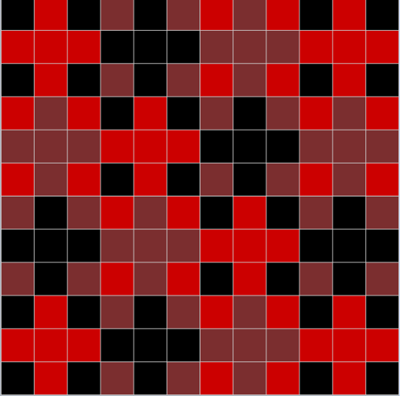
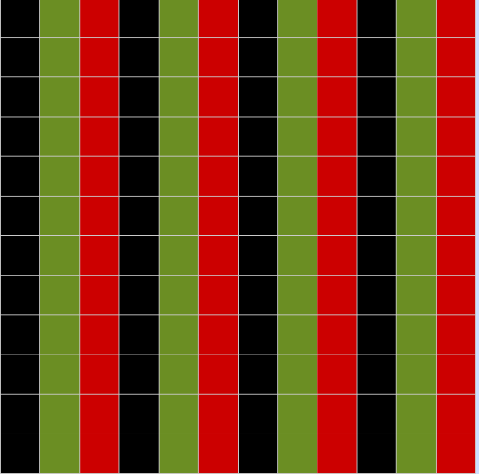
01_pATTERNS
-Used the grid in bricklayer

Slide 3
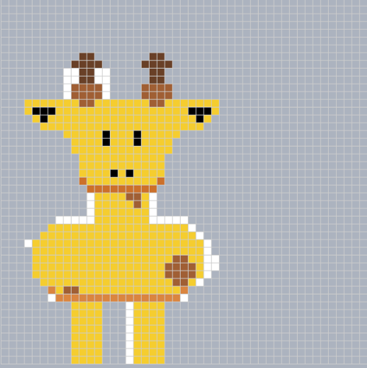
02_Pixel Art
-Used the bricklayer grid and copied an image from the internet

Slide 4
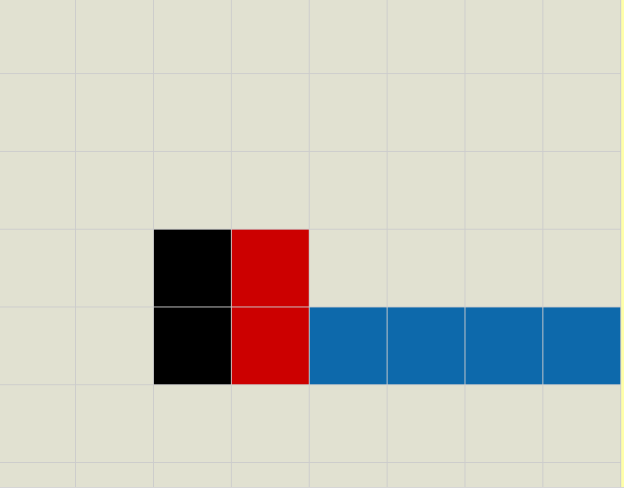
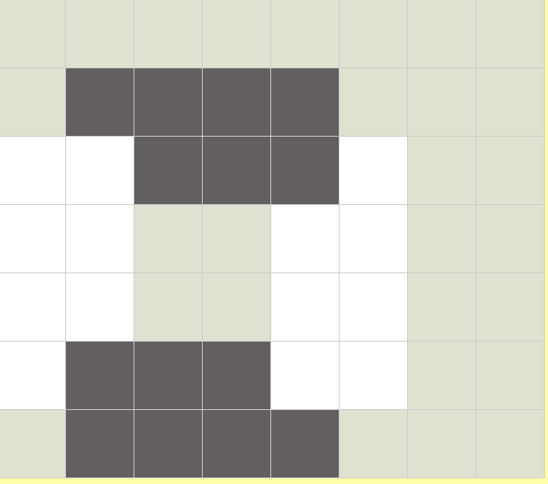
03_Saving/04_Objects in Bricklayer-lite

Slide 5
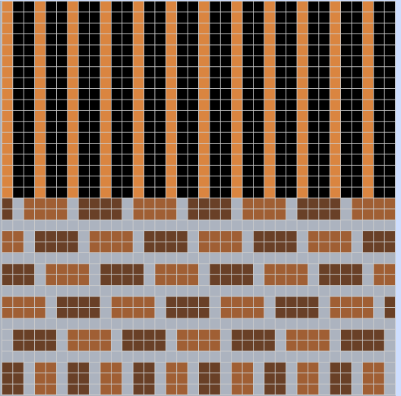
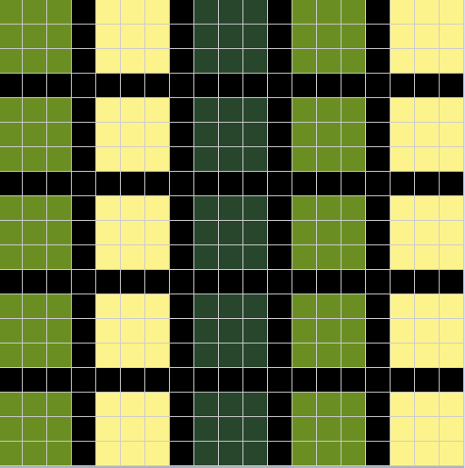
05_Objects Around Bryan
-Used the grid in bricklayer, copied images.

Slide 6

06_Name_Project
-Used bricklayer lite level 1, could’ve used level 3 to make it easier. Accidentally used internet explorer.

Slide 7
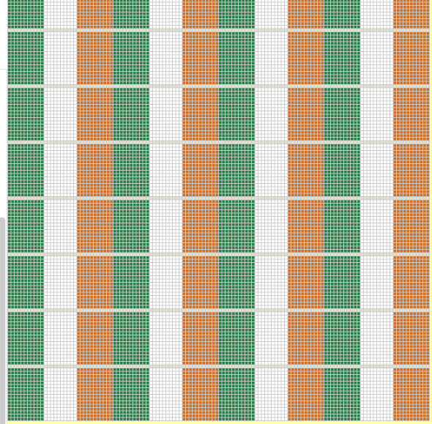

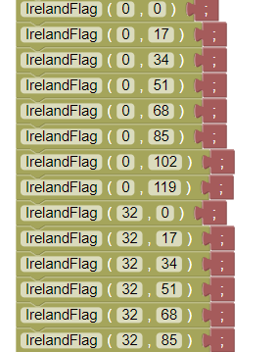
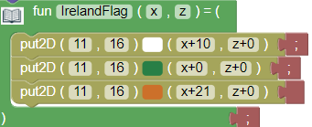
07_Flag_project
-Used bricklayer level 3. Copied the IrelandFlag code and pasted it in different spots on the grid. I could’ve put the flags into columns and called the column function.

Slide 8


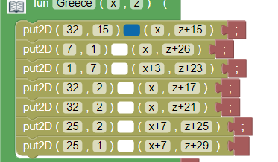
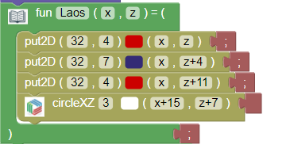
07_Flag project
-Created the two flags

Slide 9
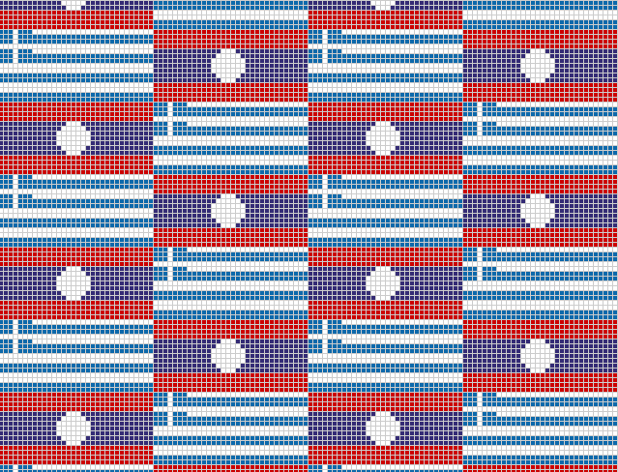
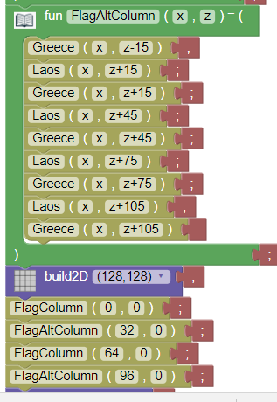
07_Flag_Project
-Put the flags in order in two columns, then I called the columns as their own functions.

Slide 10

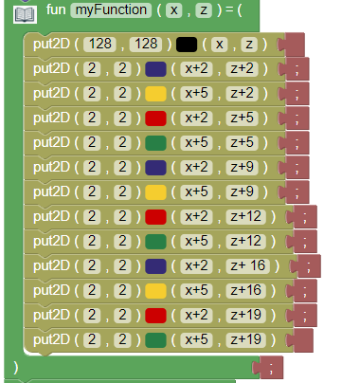
08_More_patterns
-Created a column of the pattern

Slide 11
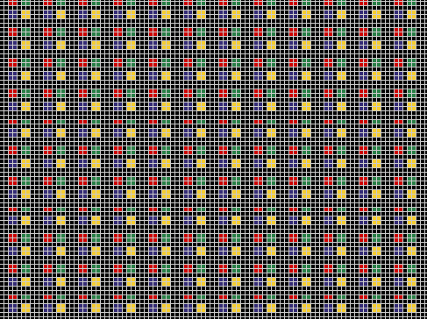
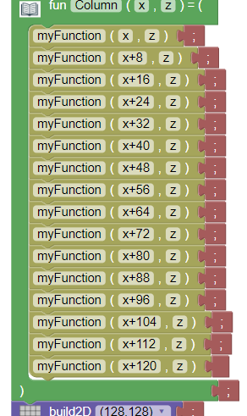
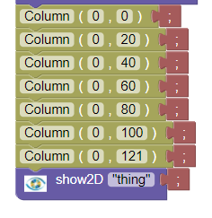
08_More_patterns
-Called the function and put it in a column function. Then I called the column function in different spots in the grid.

Slide 12
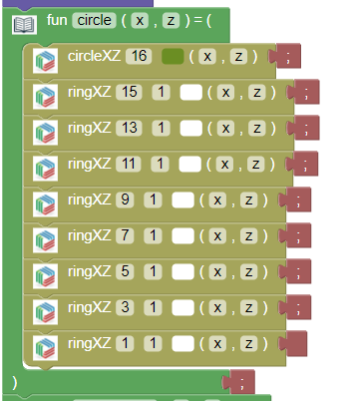
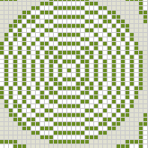
10_Ring_circle

Slide 13
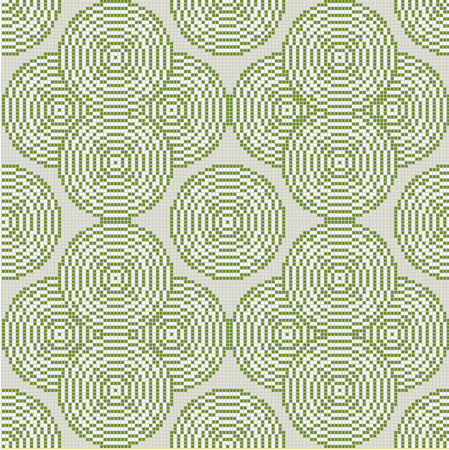
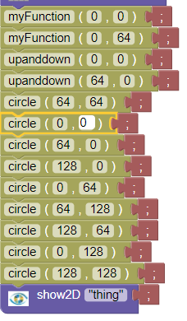
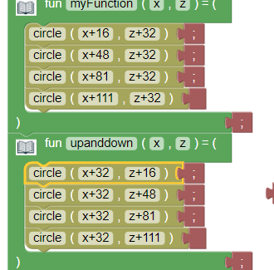
10_Ring_circle
-Created rows of the circles and copied them into functions and called them. Then put individual circles in empty spaces. I could’ve created the four piece circle shapes.

Slide 14
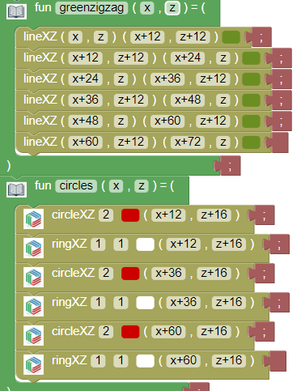
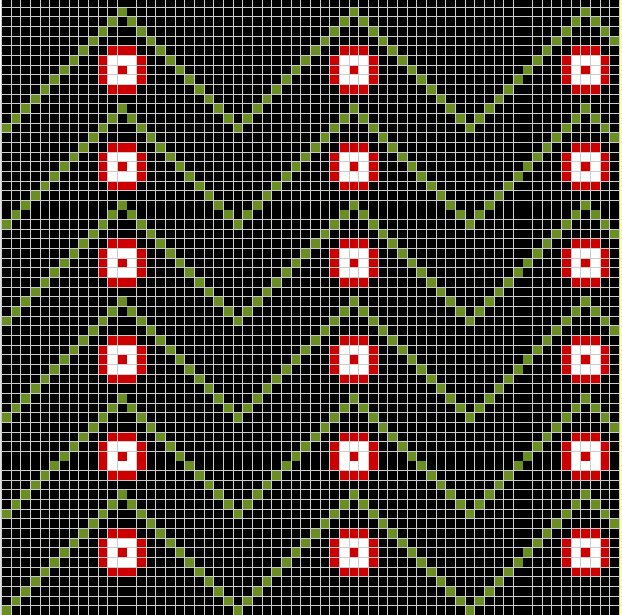
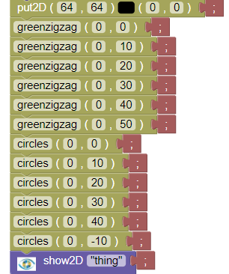
11_all_functions
-Called the green zig zag function and then the circles, but I could’ve made rows of the zig zag and circles to use less code.

Slide 15
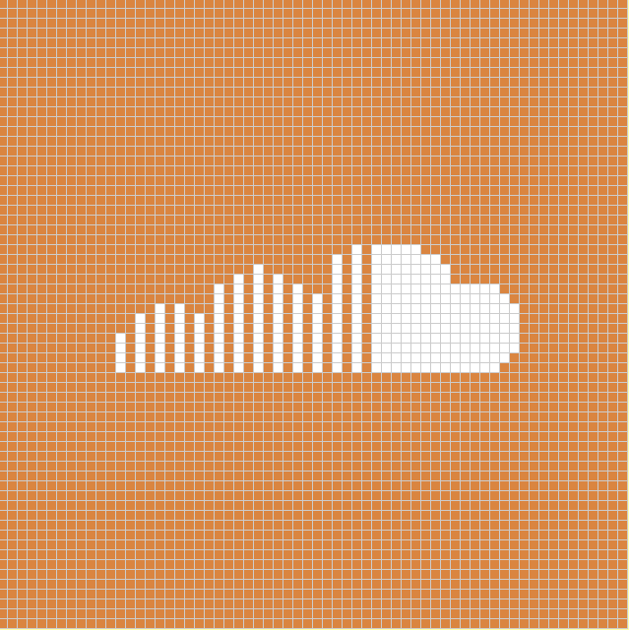
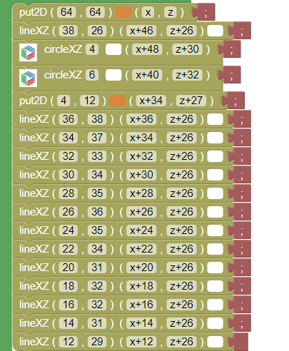

12_real_image
-Created the Soundcloud logo. Used two circle functions to make the cloud shape and used different line lengths for the rest.

Slide 16
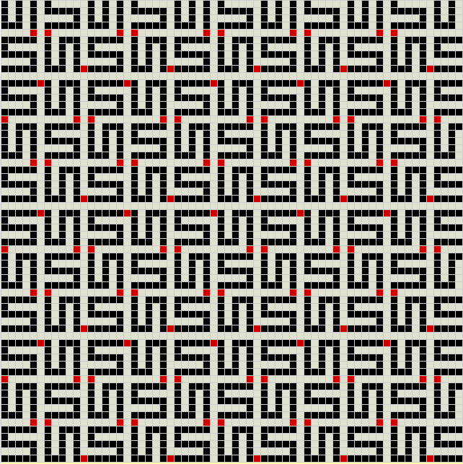
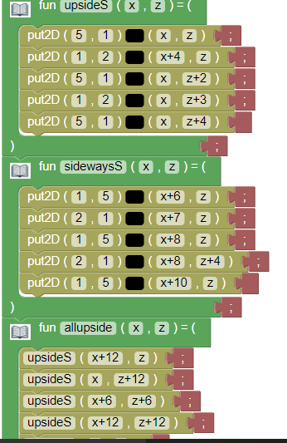
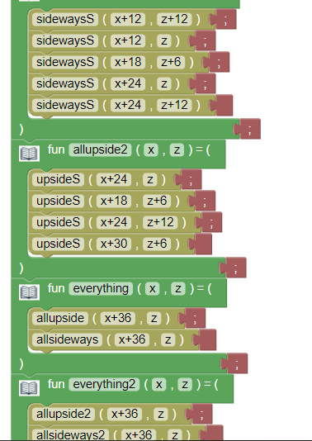
13_Space_filling_curve
-I created the sideways and upside S’s in separate codes, then I put them into 3x3 squares as a function.

Slide 17
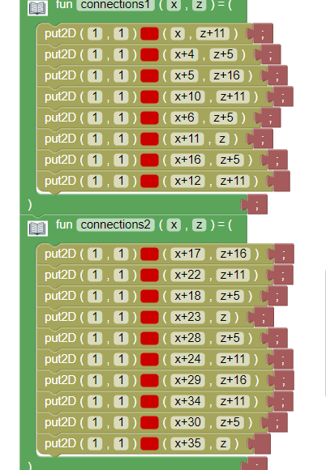
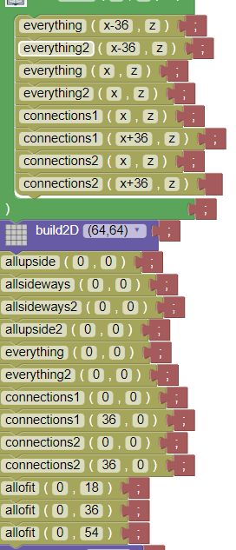
13_space_filling_curve
-I then created red dots as connecters for the curve. I put them in two different functions for two different combinations. Then I called everything into a function and called it. I probably could’ve done this more efficiently but I barelt figured it out.

