Slide 1
MATH ANALYSIS: FINAL PRESENTATION
By Jakob Tague
B4

Slide 2
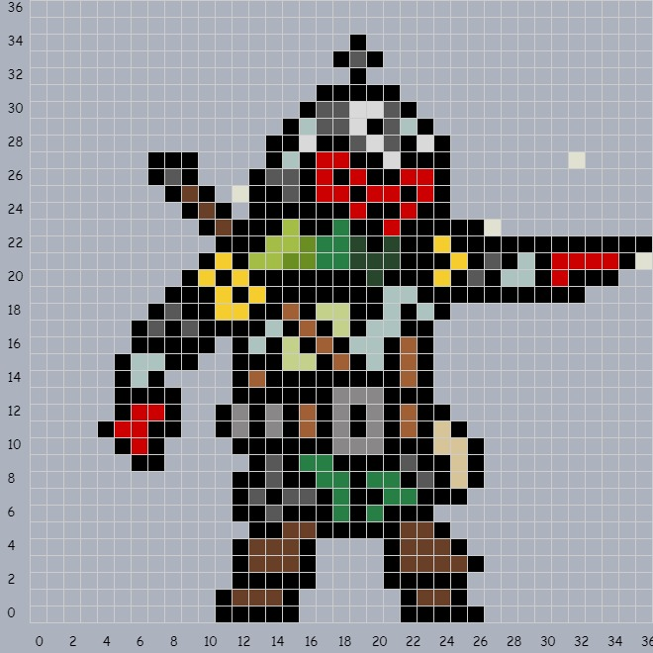
PIXEL ART
Program used to create: Grid
Too complex to recreate in bricklayer within the time allotted for a normal project
Displays one of the many possibilities with this technology
Based off of video game character “Bounty Hunter”, from “Darkest Dungeon (2016)”

Slide 3
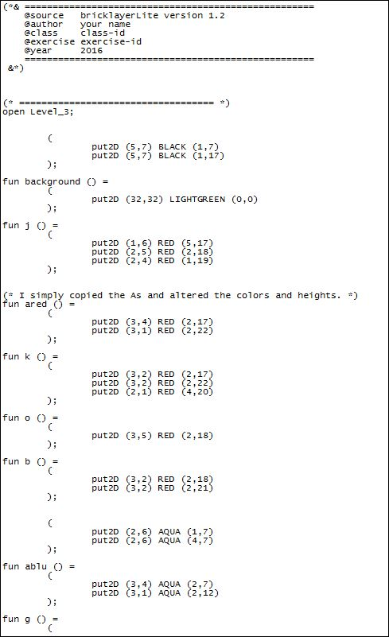
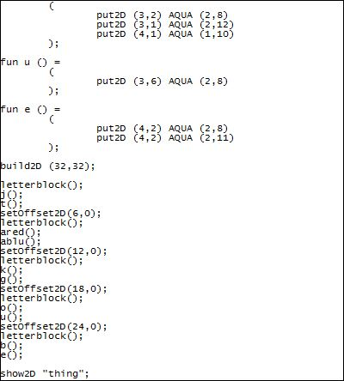
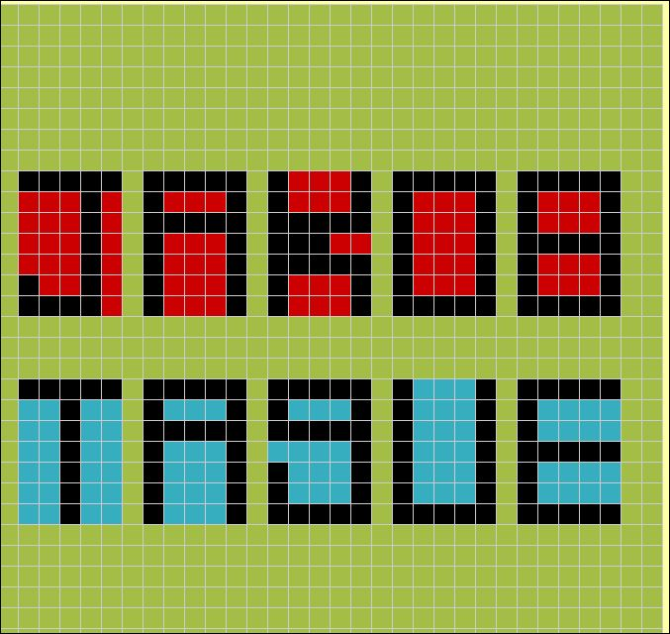
NAME PROJECT

Slide 4
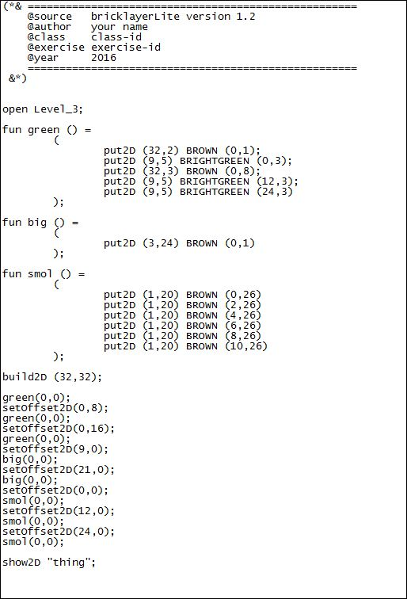
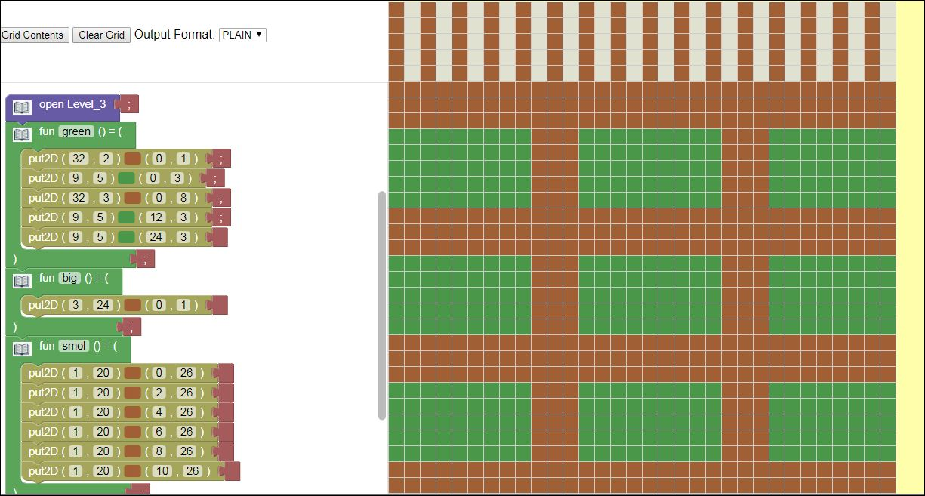
OBJECTS AROUND BRYAN HIGH: CAFETERIA BARS

Slide 5
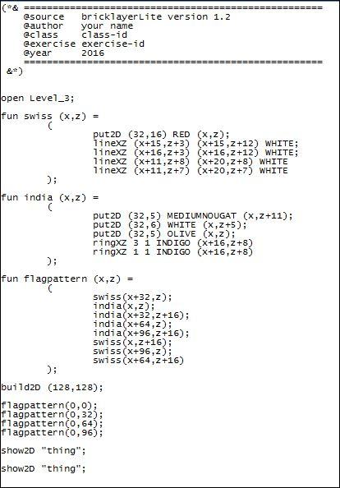
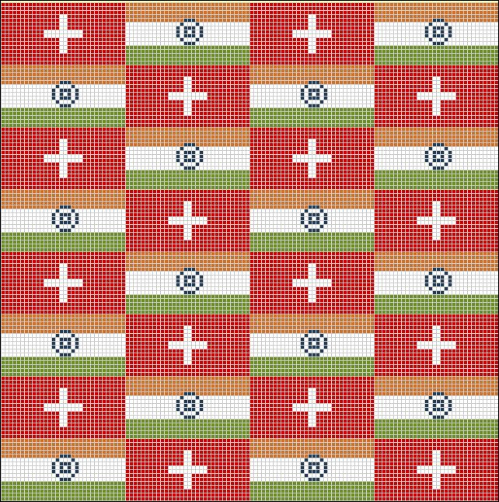
FLAG PROJECT: SWIZTERLAND AND INDIA

Slide 6
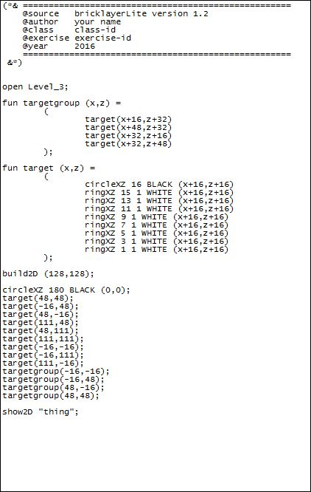
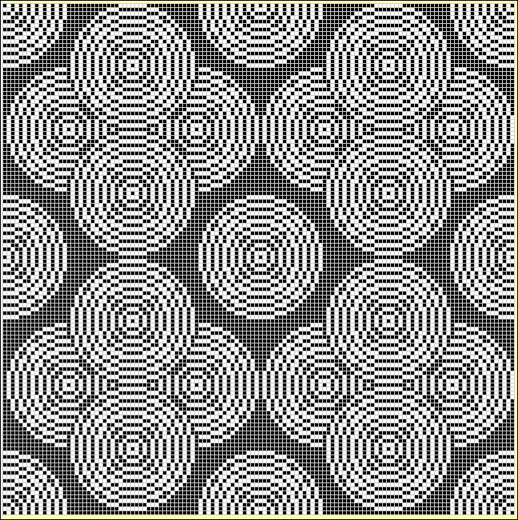
CIRCLE PATTERN PROJECT

Slide 7
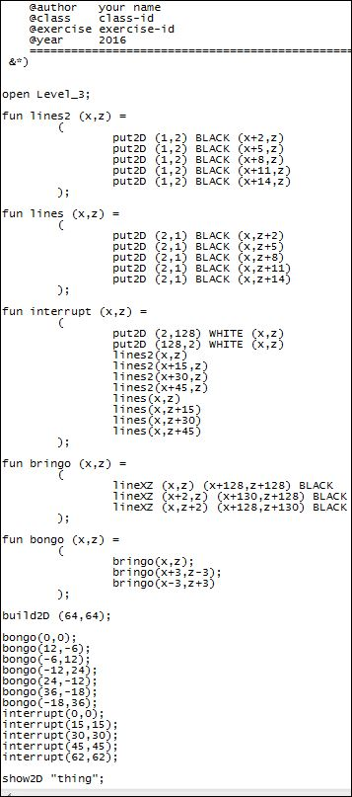
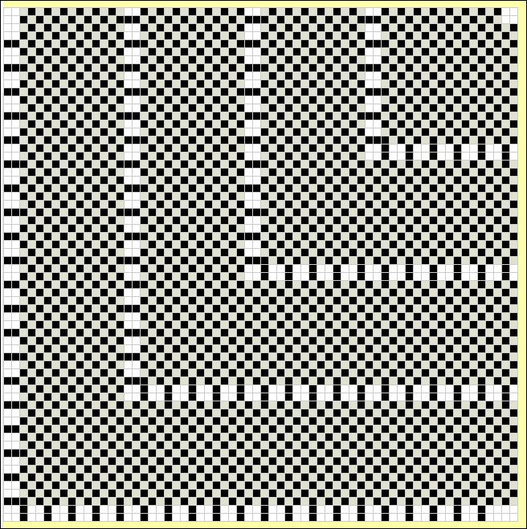
GRIDLOCK PATTERN PROJECT

Slide 8
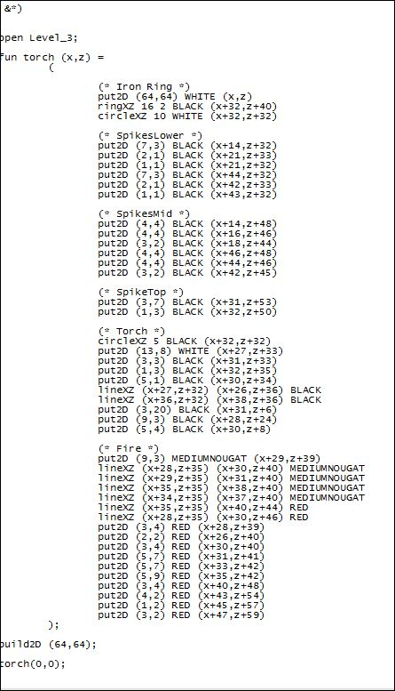
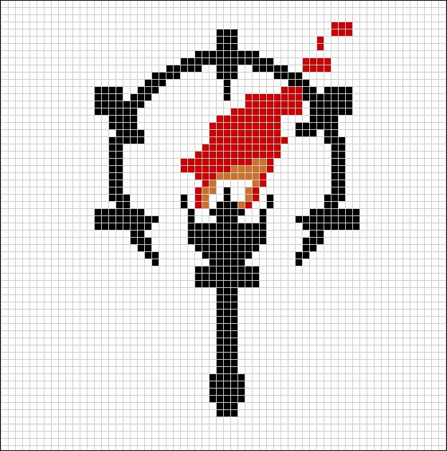
DESIGN PROJECT: REAL LIFE IMAGE “Darkest Dungeon Logo”

Slide 9
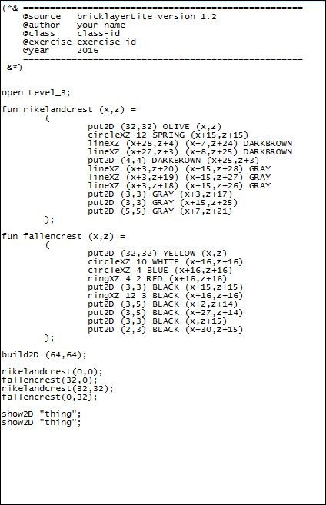
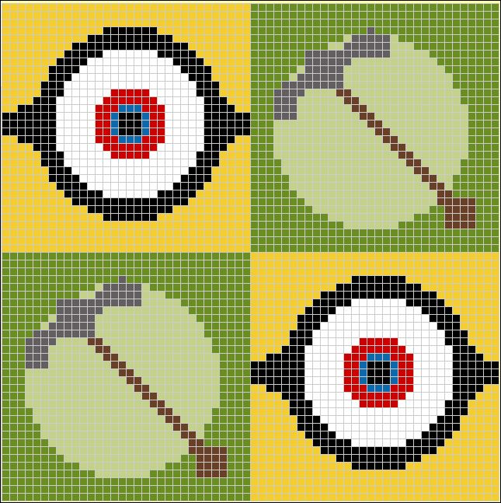
“PLACE, LINE, RADIUS, CIRCLE” PATTERN PROJECT

