Slide 1






A GRADUATE THESIS DEFENCE
PRESENTER:
JOHAYBER C. SARIP
II-MS CHEMISTRY

Slide 2

Characterization In Haustorium, Endosperm, Roots, Shoots, and Leaves of a 3 months and 6 months Germinating (Cocus Nucifera) Coconut seed
Presenter :
JOHAYBER C. SARIP
Prof. Ellen dl. V. Inutan, Ph.D
Thesis Adviser
Prof. Aldrine A. Cagang , Ph.D
Panel Member
Prof. Mark Tristan J. Quimque Ph.D
Panel Member

Slide 3
CONTENTS
Introduction
Methodology
01
03
1.1 Background of the Study
1.2 Statement of the Problem and Objective of the Study
1.3 Significance of the Study
1.4 Scope and Limitation of the Study
Review of Literature
02
3.1 Experimental Design
3.2 Sample
3.3 Chemicals and Materials
3.4 Chemical Profiling
3.4.1 GC-MS
3.4.2 LC-MS
3.6 Phytochemical Analysis
3.6.1 Total Phenolic Content
3.6.2 Total Flavonoid Content
3.6.3 Antioxidant Activity : DPPH Assay
3.6.4 Antioxidant Activity: FRAP Assay
3.7 Column Chromatography
3.8 Untargeted Bioassay
3.8.1 Glucose Concentration
3.8.2 Alpha-amylase Inhibition
3.9 Principal Component Analysis
2.1 The Coconut
2.2 Coconut Seed Germination
2.3 Coconut Oil
2.4 Chemical Profiling
2.4.1 GC-MS
2.4.2 LC-MS
2.5 Phytochemical Analysis
2.51 Total Phenolic Content
2.5.2 Total Flavonoid Content
2.5.3 Antioxidant Activity: DPPH Assay
2.5.4 Antioxidant Activity: FRAP Assay
2.6 Microplate Reader
2.6.1 The Induced-Fit Theory
2.6.2 The Conformation Ensemble Theory
2.7 Column Chromatography
2.8 Untargeted Assay
2.9 Chemometrics
2.10 Principal Component Analysis
Budgetary Requirement
Ghant Chart
References

Slide 4

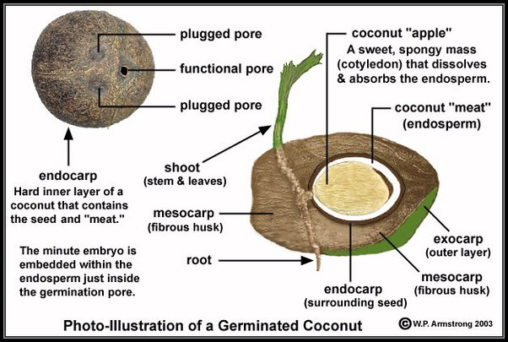

Background of the Study
Coconut (Cocus nucifera)
01
Coconut (Cocos nucifera Linn.) is widely known as the tree of life due to its significant contribution to human life from all of its meat, water, husk, shell, wood, leaves, spikelet, etc.^{1,2,3}
Every part of the coconut is utilized for the benefit of the human race, and its fruit particularly provides an important constituent of food, which is indispensable in every household. ⁴
Coconut is grown in nearly 90 countries spread along the tropical belt; about 10 million families rely on coconuts as their main source of food and income. ⁴
. Folklore medicine claims its uses in diabetes, diarrhea, cancer, etc. Coconut and its by-products have been used for centuries as culinary, cosmetic, and medicinal agents. ⁵
02
03
04
https://www.pinterest.ph/pin/264797653067114642/

Slide 5
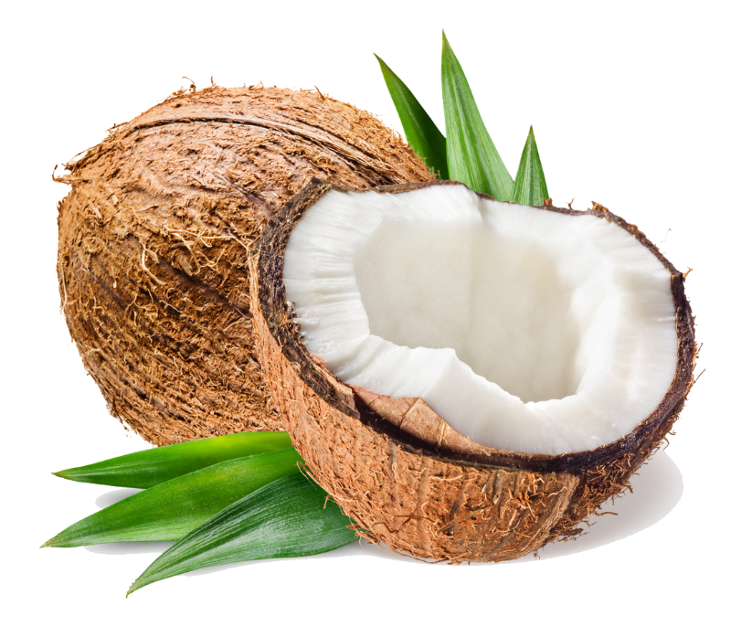

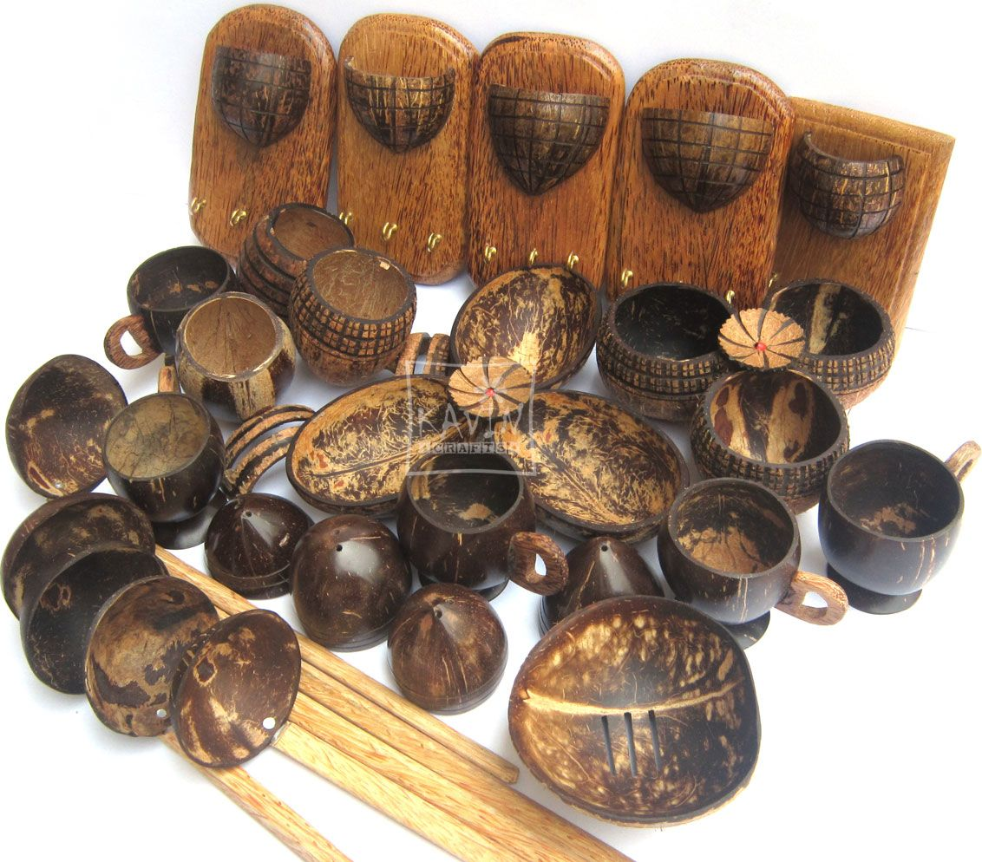

Background of the Study
Coconut shell
Used for decor
Activated charcoal
To create bowls, utensils
Coconut trunk
Used to make furniture
walls and pillar
Door frames and floor
Coconut meat
Coconut oil
Coconut milk
copra
Coconut water
Refreshing drink
Coconut wine
Coconut vinegar
Nata de coco

Slide 6

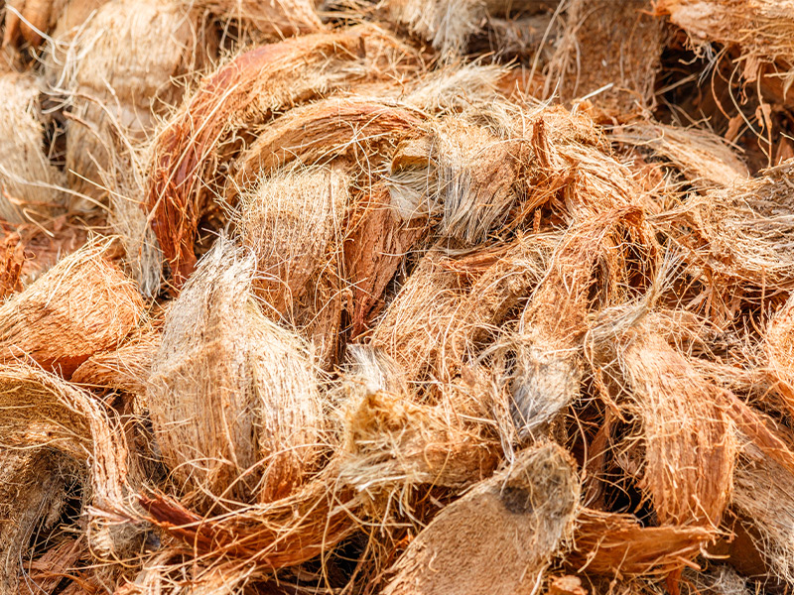
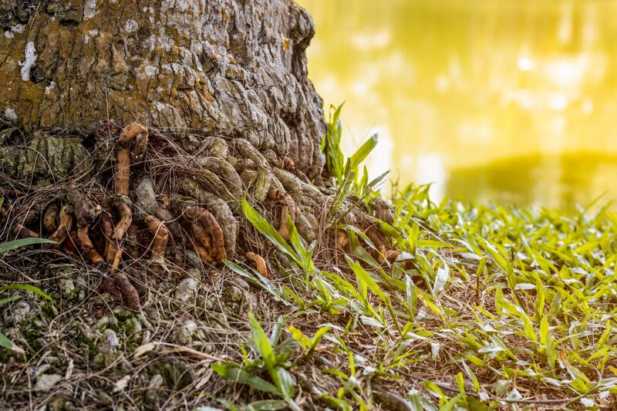
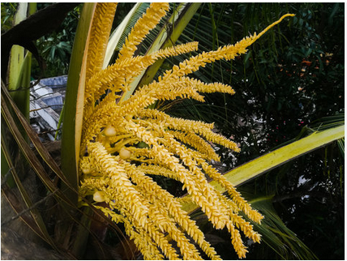
Background of the Study
Coconut roots
Used as dyes
Used as mouthwash
Medicine as a treatment for dysentry
Coconut nectar
Coconut sugar are made from the sap of flower buds.
Low glycemic index
Coconut husk
The fiber can be used to make rope, matting and coarse cloth
Coconut leaves
Brooms
Basket and mats
Cooking skewers

Slide 7
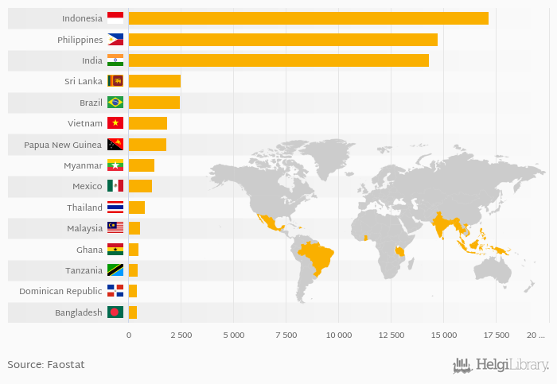
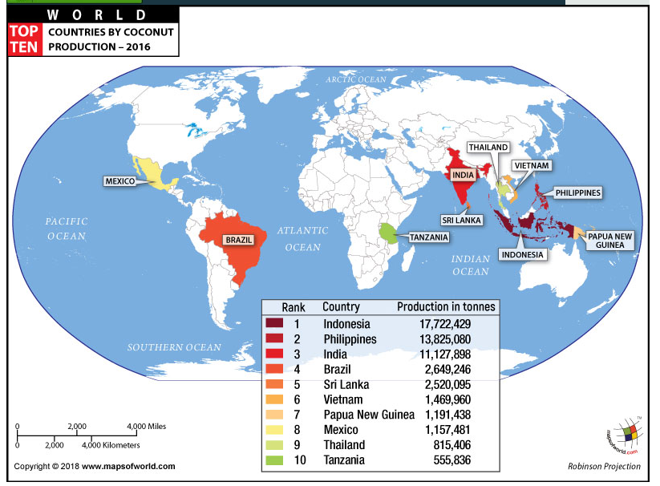
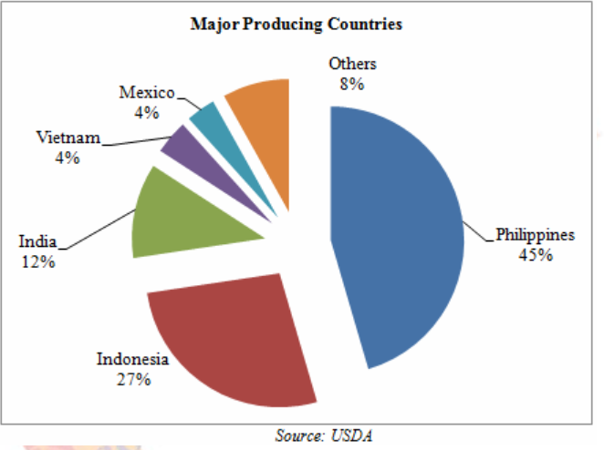
Background of the Study
https://www.helgilibrary.com/charts/which-country-produces-the-most-coconuts/
https://www.mapsofworld.com/world-top-ten/world-map-coconut-production-countries.html
http://www.commoditiescontrol.com/eagritrader/commodityknowledge/copra/copra.htm

Slide 8
Statement of the Problem
During the six-month germination of coconut seed, the haustorium of the coconut embryo in the nut enlarges and grows towards the cavity of the nut. This organ digests and absorbs nutrients which it supplies to the growing shoot and root. The mechanism suggests an explanation for the observed correlation between fatty acid composition and development during the germination period. In addition, the nutrients like carbohydrates, fat, proteins, fiber, and minerals present in the matured kernel are utilized during the germination and early development of the embryo. Thus, characterization of the different parts of a germinating coconut seed is essential to determine its composition and identify metabolites responsible for the medicinal claims.

Slide 9
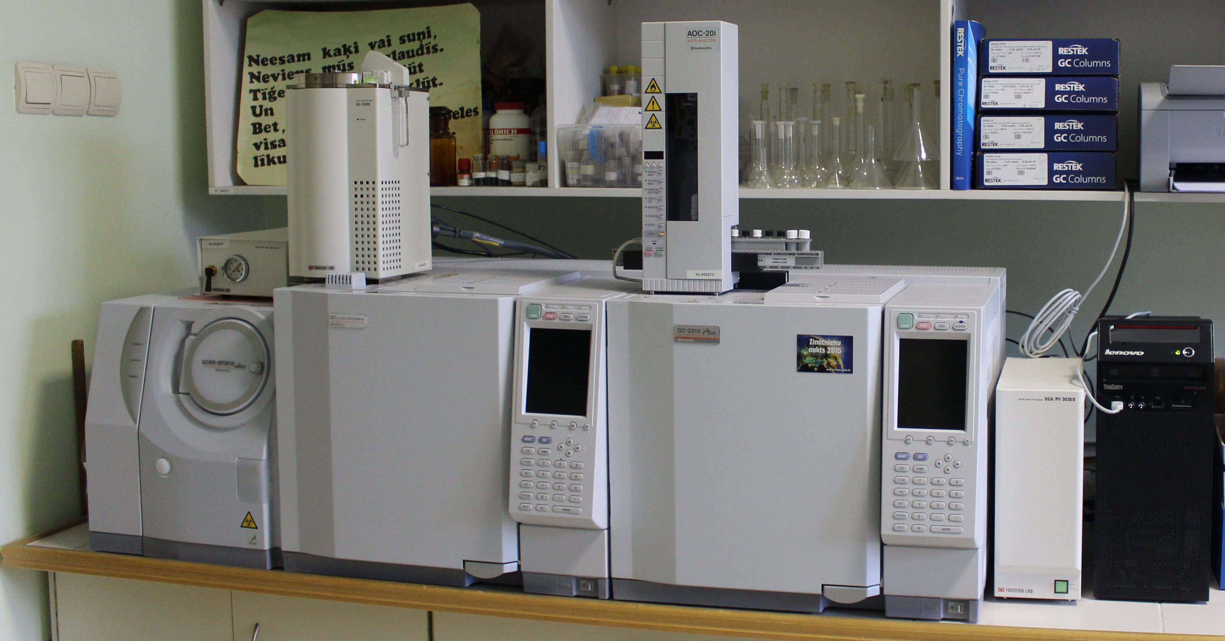
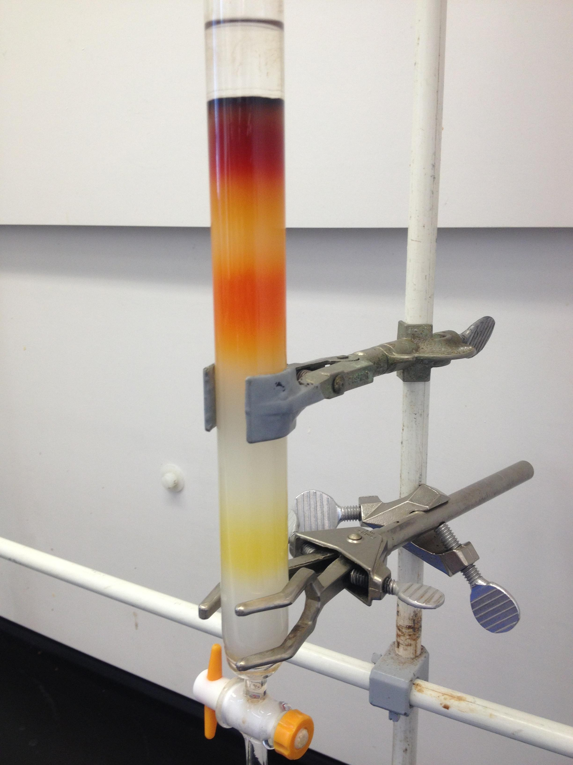
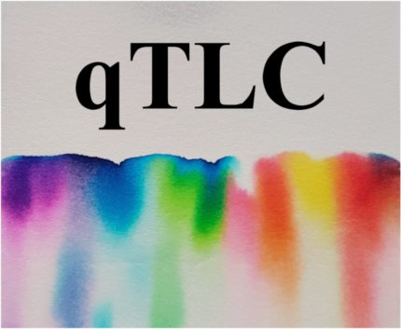
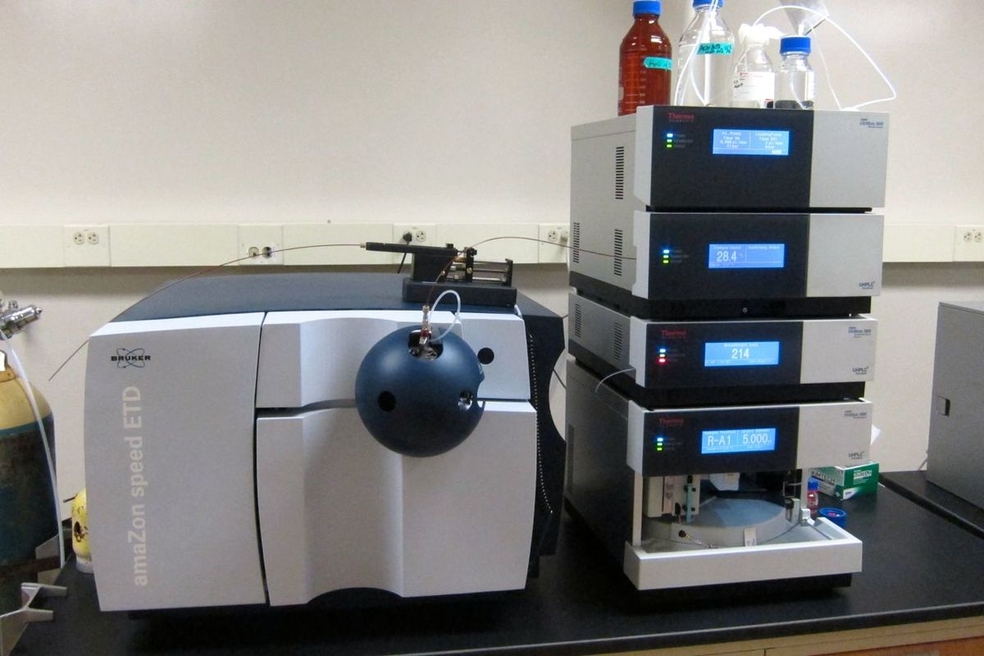
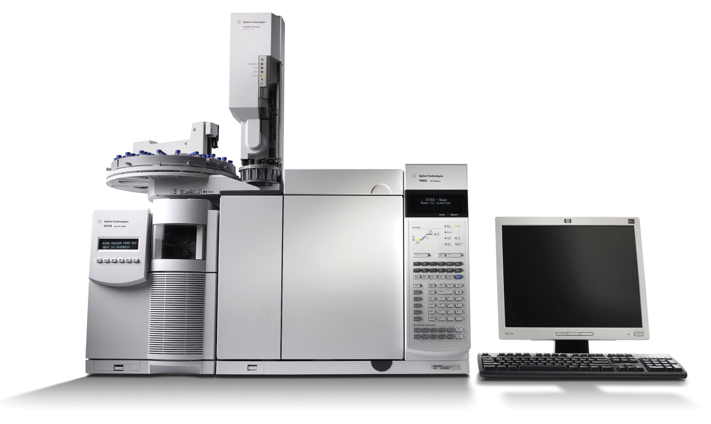
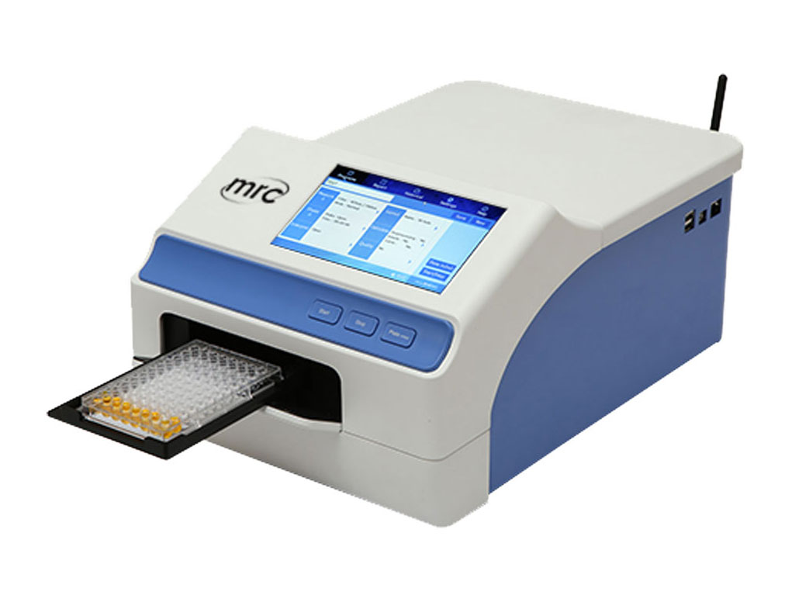
Objectives of the Study
Thus, this study aims to characterize the crude methanolic extracts of haustorium, endosperm, roots, shoots, and leaves of a six-month old germinating coconut seed.
SPECIFICALLY, THIS STUDY AIMED TO :
QTLC
Chemical profiling
LC-MS
i. in vitro glucose diffusion retardation assay
ii. alpha-amylase inhibition assay
Column Chromatography
Chemical profiling
GC-MS
Phytochemical Analysis
TPC and TFC

Slide 10
Objectives of the Study
continuation …..
SPECIFICALLY, THIS STUDY AIMED TO :
PCA
    apply Principal Component Analysis to correlate the
phenolics and flavonoids content between coconut parts and germination period and
lipids and mass detection of six-month-old germinating coconut seed.

Slide 11
Significance of the Study
3
Coconut is an important subsistence plant in the tropics, and almost every part of the plant is explored for application in different fields.
Germinating coconut seeds have been studied previously and shown to have exceptionally high lipolytic activity, probably to meet the energy requirements. Studies conducted for haustorium and endosperm show that haustorium development and seedling growth mainly depend on the nutrients stored in the endosperm at early stages.
In succeeding stages, its fatty acids degrade rapidly to sugar to provide enough energy for the coconut seed's growing shoots, roots, and leaves. These findings could be used to extend the correlation to other parts of a germinating coconut.
Although many studies are available on the application, use, and importance of different parts of the coconut, no correlation study using PCA has been conducted on the different parts of coconut (haustorium, endosperm, roots, shoots, and leaves) germinating coconut seed on its chemical profile, phytochemical analysis and untargeted bioassay.
4

Slide 12
Scope and Limitations
3
The samples to be used in this study are already in crude methanolic extracts prepared by the previous researchers (Ms. Kathleen Aligaya and Ms. Asia Catherine Mahayag) of this project under OVCRE, MSU-IIT. The source of the germinating coconut seed was from Katipunan, Ramon Magsaysay, Zamboanga del Sur, Philippines.
This study will be limited to a single variety of coconut, the common variety, Local Tall and will use only the six-month-old germinating coconut seeds.
Extraction method is limited only to methanol extraction. Characterization of the crude methanolic extracts will be limited to chemical profiling (GC-MS and LC-MS) and phytochemical analysis (Total Phenolic and Flavanoid content, Antioxidant activity using DPPH and FRAP assays).
GC-MS and LC-MS analysis will be conducted in De La Salle University Manila. Phytochemical analysis will use the Microplate Reader in the Department of Chemistry, MSU-IIT.
Column chromatography and thin layer chromatography will be used for further purification of the extracts for further untargeted bioassay.
4

Slide 13
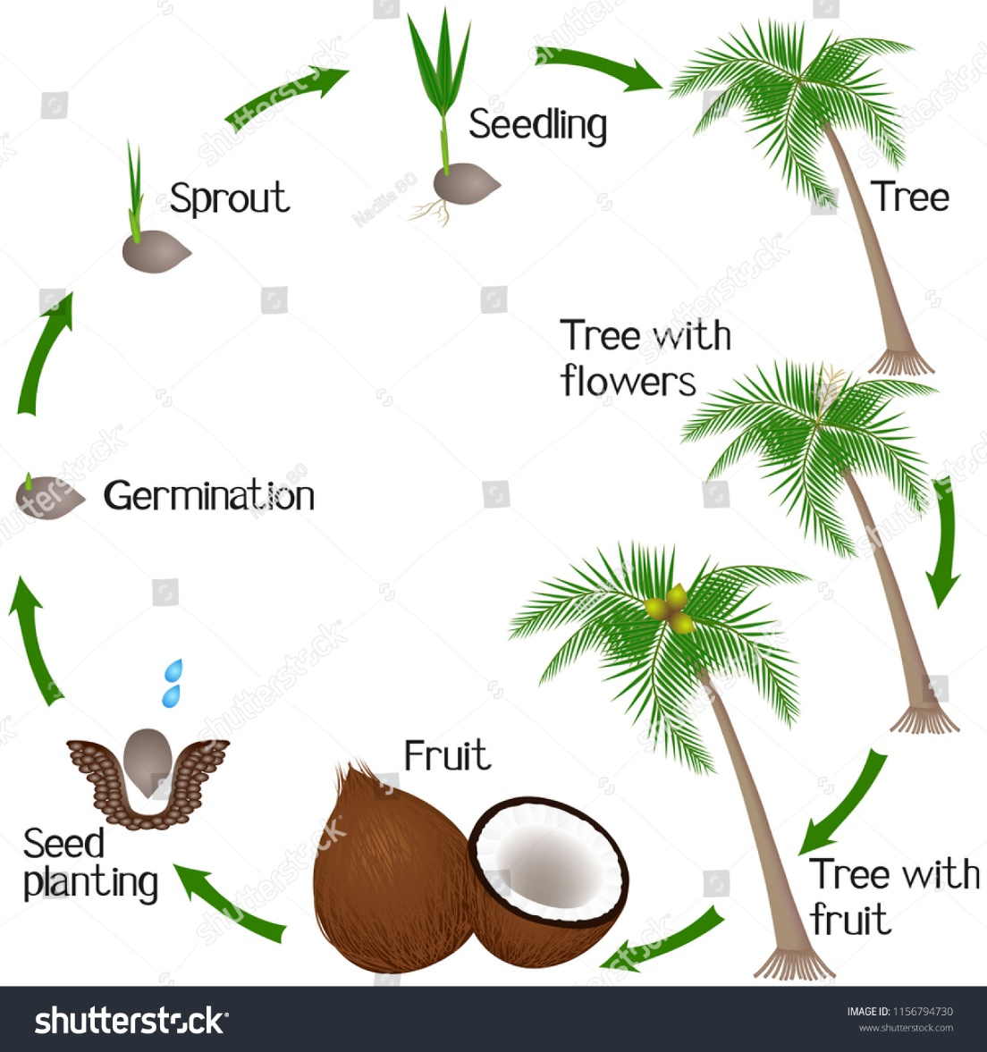
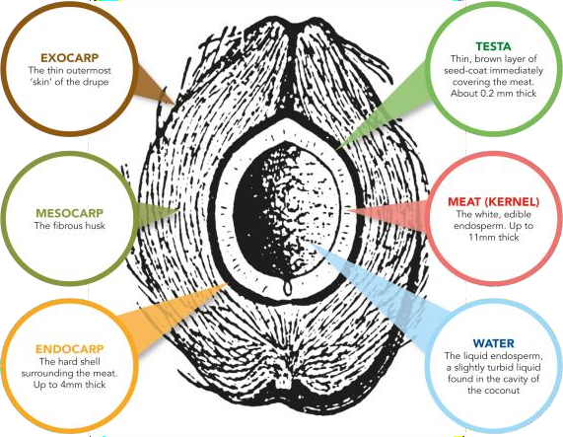
2.Review of Literature
2.1 The Coconut
3
Cocos nucifera (Linn) is an important member of the family Arecaceae (palm family) popularly known as coconut, coco, coco-da-Bahia, or coconut-of the-beach. ^{11,16}
Figure 3. Different parts of a single coconut fruit
https://www.shutterstock.com/search/germinating-coconut
https://coconuthandbook.tetrapak.com/chapter/composition

Slide 14
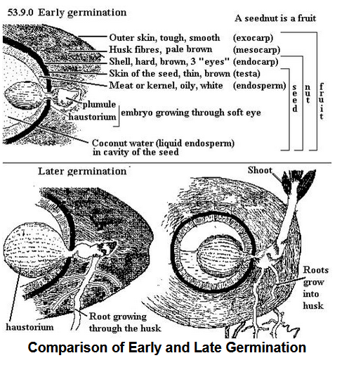
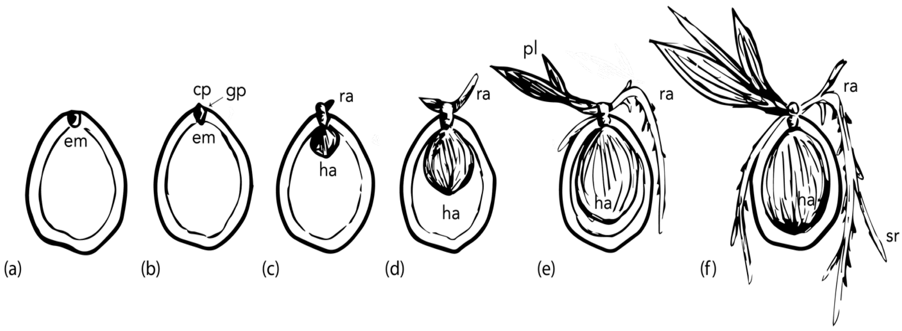
Figure 4. Comparison of Early and Late Germination³
Review of Literature
2.2 Coconut Seed Germination
Figure 4. Coconut germination stages: (a) Ungerminated coconut fruit. Embryo (em) consists of a short plumular-radicular axis. The plumule consists of a central meristematic zone enclosed by scaly-leaf primordia, which are then surrounded by the cotyledonary petiole. (b) In the proximal end of the embryo, the cotyledonary petiole (cp) extends through the germination pore (gp). (c) Germinative button formation and radicle emergence (ra) from the cotyledonary petiole. The cotyledonary blade (distal end of the embryo) starts expanding to form a haustorium (ha). (d) Radicle elongation, plumule emergence and continuous haustorium growth. (e) Secondary roots forming, plumule elongation and first leaves, extensive haustorium growth. (f) Secondary root (sr) growth, leaf growth, haustorium completely fills the inner cavity (endosperm).
4
Figure 4. Comparison of Early and Late Germination³
https://www.mdpi.com/2223-7747/11/23/3293

Slide 15
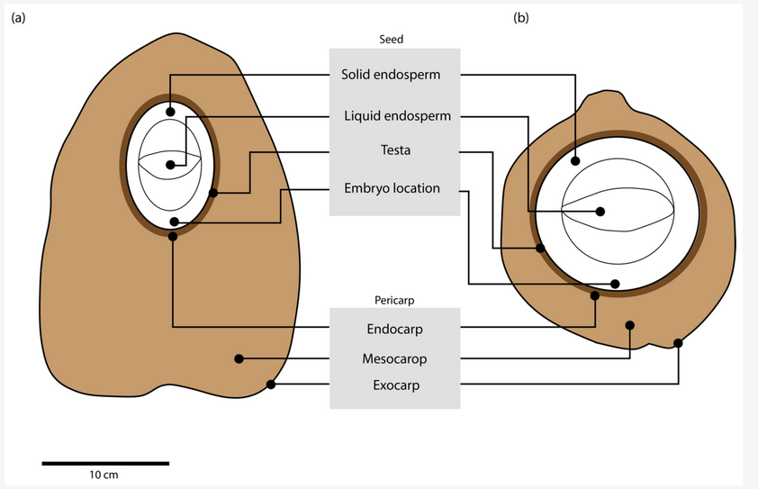
Review of Literature
Coconut seed Germination
3
Figure 3. Differences in morphology of (a) wild and (b) domesticated coconut fruit. Domesticated varieties show a smaller pericarp region, having significantly less mesocarp as compared to wild types. They also have a rounder shape which allows a higher volume of water to be held inside the seed
https://agritech.tnau.ac.in/horticulture/horti_pcrops_coconut_botany.html
https://www.mdpi.com/2223-7747/11/23/3293

Slide 16
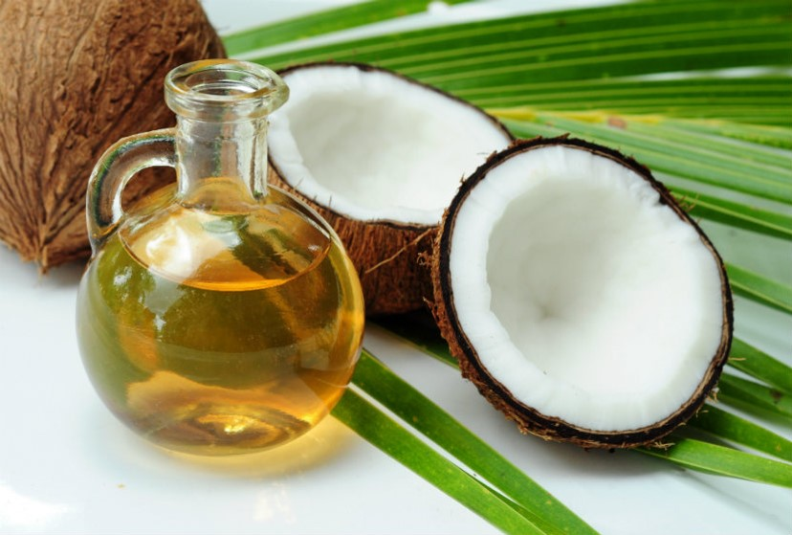
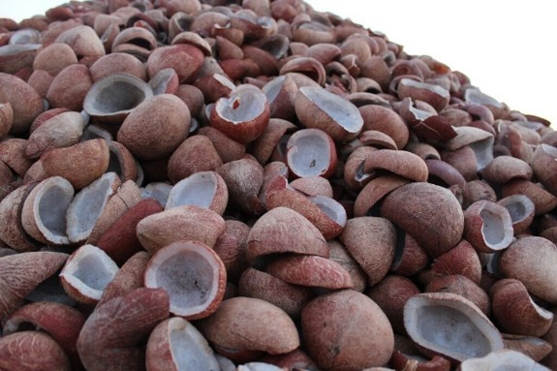
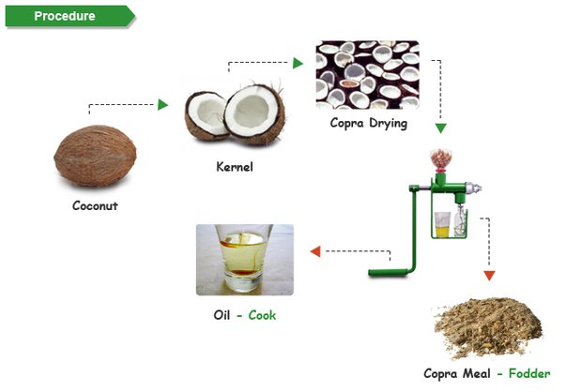
Review of Literature
2.3 The Coconut oil
3
Coconut oil is a vegetable oil obtained from the nut of the tropical palm tree, Cocos nucifera L. Refined coconut oil (RCO) is produced by extraction of the oil from dried copra, followed by chemical refinement, bleaching, and deodorization (1). On the other hand, Virgin coconut oil (VCO) is produced from fresh mature coconut meat and processed by mechanical and natural processes . [1]
[1]
[2]
[3]
[1] https://www.justdial.com/jdmart/Kangayam/Organic-Coconut-Copra/pid-2016907259/9999P4258-4258-180205184811-U6T4
[2] https://www.quora.com/What-are-the-by-products-of-coconut-tree
[3] https://www.unlockfood.ca/en/Articles/Fat/Coconut-Oil-Facts-and-Myths

Slide 17
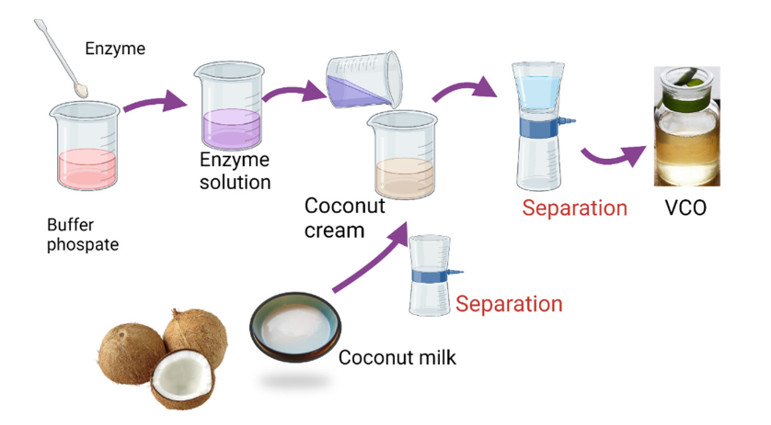
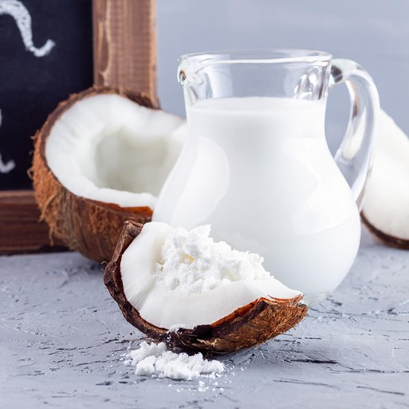
Review of Literature
The Virgin Coconut oil ( VCO )
3
[4]
[5]
[6]
[4] https://www.jmitra.com.my/product/vegan-coconut-milk-powder/
[5] https://www.mdpi.com/2227-9717/10/2/315
[6] https://www.unlockfood.ca/en/Articles/Fat/Coconut-Oil-Facts-and-Myths

Slide 18

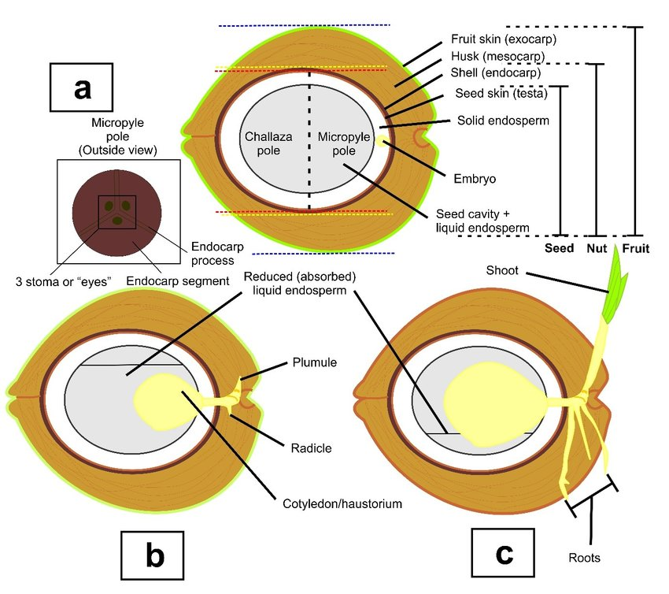
Review of Literature
[1]
[2]
[3]
Cocos nucifera (L.) is an important member of the family Arecaceae (palm family) popularly known as coconut, coco, coco-da-Bahia, or coconut-of the-beach (Aragao WM. (2002), as cited in E.B.C, 2015)⁷ the plant is originally from Southeast Asia (Malaysia, Indonesia, and the Philippines) and the islands between the Indian and Pacific Oceans.
[1] https://www.khaosok.com/national-park/coconut-palm/
[2] https://agritech.tnau.ac.in/horticulture/horti_pcrops_coconut_botany.html
[3] https://www.researchgate.net/figure/Anatomy-a-and-development-of-normal-coconut-a-c-Note-the-reduced-level-of-liquid_fig5_354913466

Slide 19
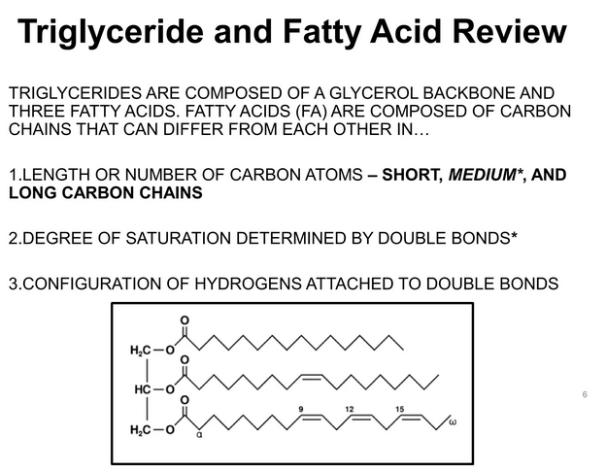
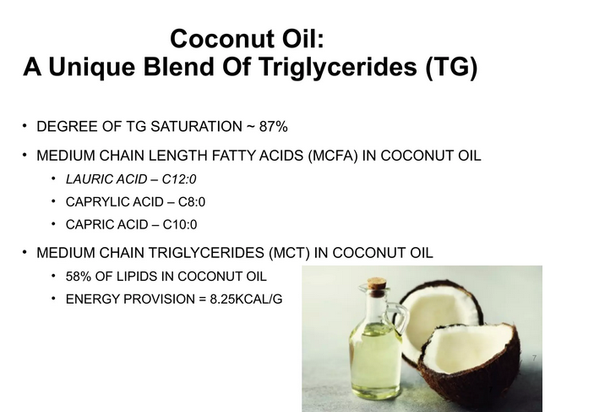
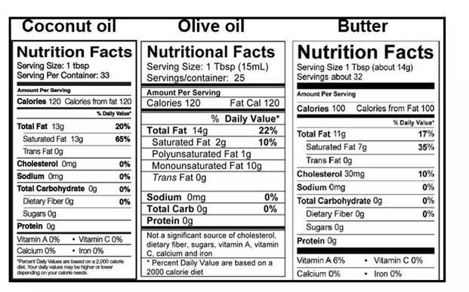
Review of Literature
Coconut oil is a vegetable oil obtained from the nut of the tropical palm tree, Cocos nucifera L. Refined coconut oil (RCO) is produced by extraction of the oil from dried copra, followed by chemical refinement, bleaching, and deodorization (1). On the other hand, Virgin coconut oil (VCO) is produced from fresh mature coconut meat and processed by mechanical and natural processes (2). Several methods are used to produce VCO, such as natural separation, expeller, and centrifugation (3).

Slide 20
Review of Literature
2.4 Chemical Profiling
Chemical profiling of a plant extract refers to the chromatographic and/or spectroscopic or spectroscopic analysis of plant extracts to establish their identity and quality. This method assumes that the phytochemical composition of each plant species is unique and that this reflects the quality of the plant sample. ²⁵
Chemical profiling has become a tool for the standardization of medicinal plants, from farm production, manufacturing, and determination of shelf life. ^{23,26}
The analytical methods that have been used for chemical profiling include chromatographic technique (TLC, GC, HPLC) and their hyphenated MS techniques (GC-MS and LC-MS), and spectroscopic technique (FTIR, NMR). ²⁵
Quality assurance can be based on the targeted analysis of one or few compounds (univariate) or on the chemical profile of the plant extract (multivariate). ²⁷

Slide 21
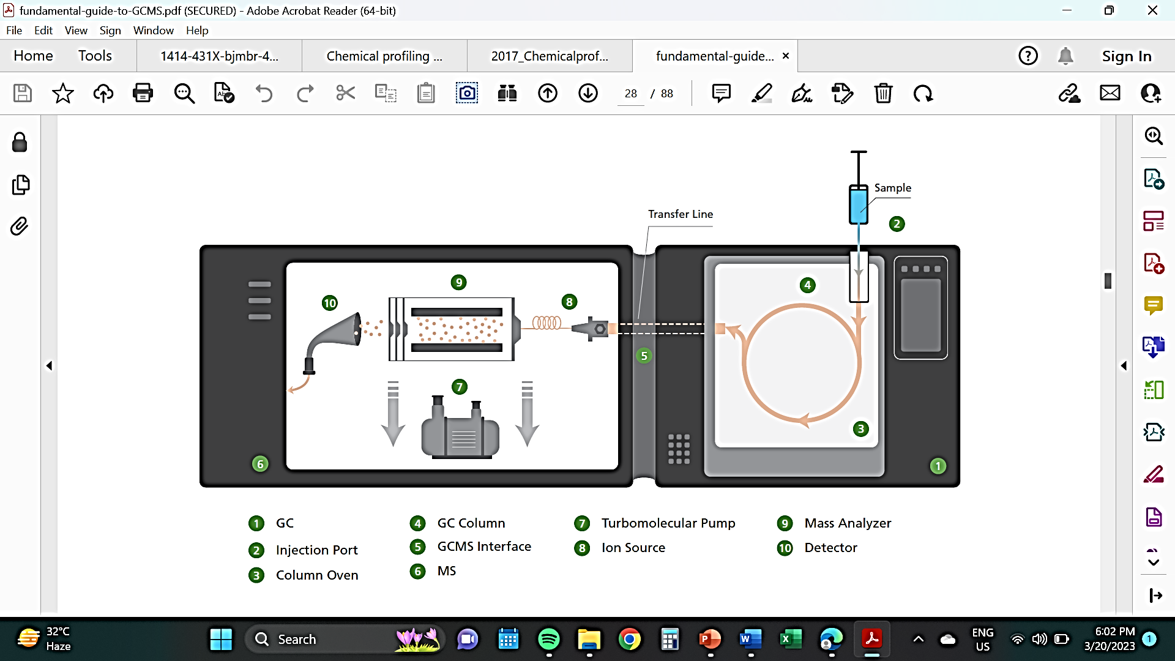
Review of Literature
2.4.1 GC-MS
Gas Chromatography-Mass spectrometry (GC-MS) provides added specificity, sensitivity, and simultaneous multi-component analysis convenience. This applies to many industries and applications today, for example, environmental, forensic, food and beverage, clinical, pharmaceutical, and chemical industries. It is commonly used for the direct separation and analysis of air samples and is often labeled as the accepted technique or gold standard for separation and analysis. ³⁰
Figure 5. Gas Chromatography-MS Instrumentation³⁰

Slide 22
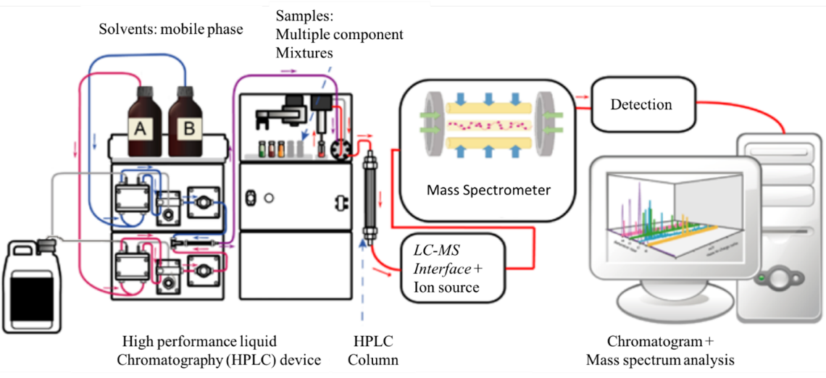
Review of Literature
2.4.2 LC-MS
Liquid Chromatography-Mass Spectrometry (LC-MS) is fast becoming the preferred tool of liquid chromatography. It is a powerful analytical technique that combines the resolving power of liquid chromatography with the detection specificity of mass spectrometry.
Liquid chromatography (LC) separates the sample components and introduces them to the mass spectrometer (MS). The MS creates and detects charged ions. The LC/MS data may provide information about the molecular weight, structure, identity, and quantity of specific sample components. ³²
Figure 6. Schematic diagram of an LC-MS setup³³

Slide 23
Review of Literature
2.5 Phytochemical Analysis
Phytochemicals are chemical compounds naturally present in plants attributing to positive or negative health effects Medicinal plants used in different diseases and ailments are the richest bio reservoirs of various phytochemicals. ²⁹
Phenolic compounds are important phytochemicals that exhibit several bioactive properties including antioxidant activity. Quantification and identification of phenolic compounds in different kinds of fruits and vegetables and their processed products have been reported in many studies. ⁴²
For coconut meat, fat components are of interest for food scientists and industries. It is well-known that triacylglycerols present in coconut contain mainly lauric and other medium chain fatty acids. These medium chain triacylglycerols show a potential use as a functional food ingredient. ⁵⁰
The total flavonoid content (TFC) in plants is usually determined colorimetrically after solvent extraction. One of the widely followed methods for the determination of TFC in plant extracts is the aluminum chloride colorimetric assay, where Al(III) is utilized as a complexing agent. ⁵¹

Slide 24
Review of Literature
2.5.3 Antioxidant Activity
DPPH Assay
Antioxidants are considered important nutraceuticals on account of many health benefits.^{54,55,56}
In 2009, Sharma and Bhaton revisited DPPH antioxidant assay. The authors concluded that the antioxidant assay scavenging of DPPH radical at a DPPH concentration of 50 μM in methanol or buffered methanol, depending upon the solubility of the compound under investigation, is recommended. All operations must be done in dark or dim light. ⁶²
The extent of inhibition is influenced by the solvent. This is evident from the data for DPPH radical scavenging by BHT in methanolic or buffered methanolic solution. The comparative reaction of ascorbic acid, BHT and propyl gallate indicates that the time course of inhibition also has to be determined. ⁶¹

Slide 25
Review of Literature
2.5.4 Antioxidant Activity: FRAP Assay
FRAP Assay
The ferric reducing antioxidant power (FRAP) assay^{63,64} monitors the reaction of Fe²⁺ with 2, 4, 6-Tripyridyl-s-Triazine (TPTZ) to form a violet-blue color with an absorbance maximum at 593 nm. ⁶⁵
Microplate-based FRAP (mFRAP) assays were introduced recently leading to improved sample throughput compared to the manual FRAP assay (Jimenez-Alvarez et al., 2008; Firuzi, Lacanna, Petrucci, Marrosu & Saso, 2005; Tsao, Yang & Young, 2003).
The methodology detailed in the current could be useful in evaluating antioxidant assays on a variety of different platforms. ⁶⁹

Slide 26
Review of Literature
2.6 Microplate Reader
The microplate reader, also known as “Photometric microplate reader or ELISA reader,” is a specialized spectrophotometer designed to read the results of the ELISA test, a technique used to determine the presence of antibodies or specific antigens in samples. The technique is based on the detection of an antigen or antibodies captured on a solid surface using direct or secondary, Labeled antibodies produce a reaction whose product can be read by the spectrophotometer. The word ELISA is the acronym for “Enzyme-Linked Immunosorbent Assay. ⁷⁰
A microplate reader is useful for high-throughput measurements due to its non-contracted optical measurement without containment towards a photoelectric detector or biochemical samples. ^{71,72}

Slide 27
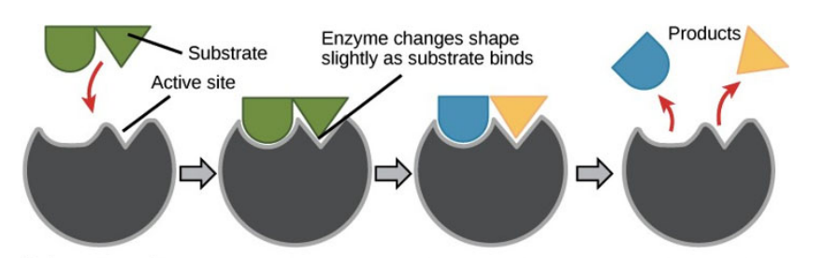
Review of Literature
2.6.1 The Induced-Fit Theory
Daniel Koshland proposed the "induced fit theory" in 1958. The fundamental concept is that throughout the character recognition, both the ligand and target, as seen in Figure 10, adapt to one another by modest conformational changes until an ideal match is reached. ⁷⁴
Figure 10. Induced-Fit Model⁷⁴

Slide 28
Review of Literature
2.6.2 The conformation ensemble model
Apart from minor induced-fit modifications, proteins have been discovered to undergo significantly greater conformational changes. According to a new concept, proteins are composed of a pre-existing ensemble of conformational states. The protein’s flexibility enables it to transition between states. ⁷⁴
An untargeted bioassay strategy using natural product databases provides an efficient way of profiling and dereplicating medicinal plants before proceeding to bioassay-guided fractionation to look for novel compounds. In this work, we illustrate the strategy of untargeted bioassay for the study of medicinal plants. Briefly, the untargeted bioassay strategy that is used in this work involves the preparation of several non-identical extracts and fractions which are bio assayed. ⁷⁵
2.7 Untargeted BioAssay

Slide 29
Review of Literature
2.6.2 Chemometrics
Chemometrics is a family of techniques that applies statistics to voluminous chemical data, such as spectroscopic signals from a collection of samples, with the objective of gaining insights into the characteristics of the sample through graphical representation or pattern recognition (World, 1995). ⁷⁵
Chemometrics analysis is an ideal tool for the classification of spectroscopic data from whole plant extracts to differentiate plants according to species, orgins, processing treatment, age, and other quality parameters (Kim et al.,2010) ⁷⁵
2.10 Principal Component Analysis
The Principal Component Analysis (PCA) is a widely used statistical technique for unsupervised dimension reduction. ⁷⁹

Slide 30
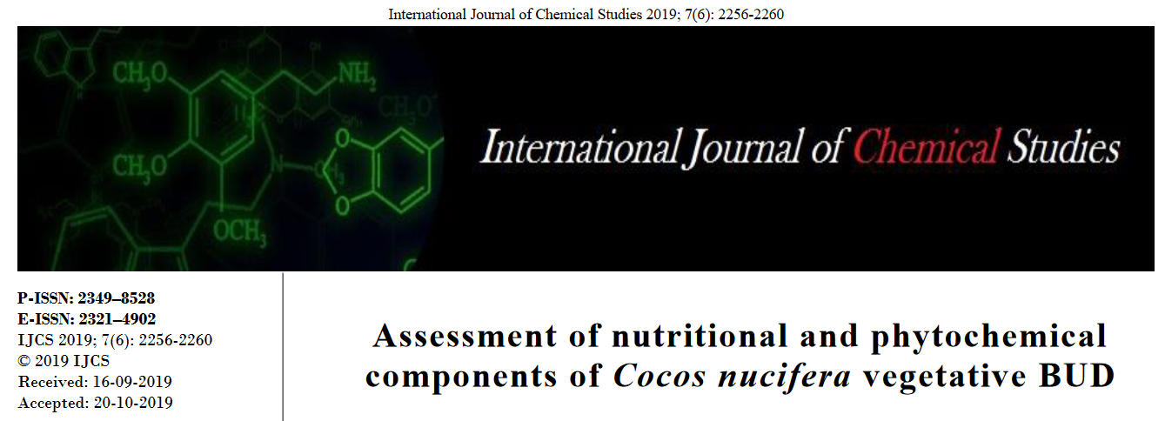
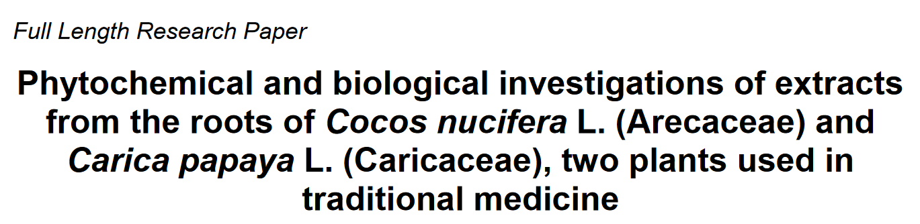
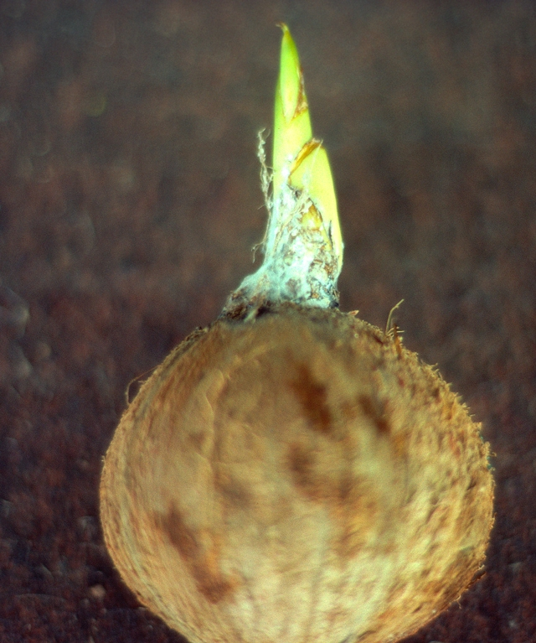
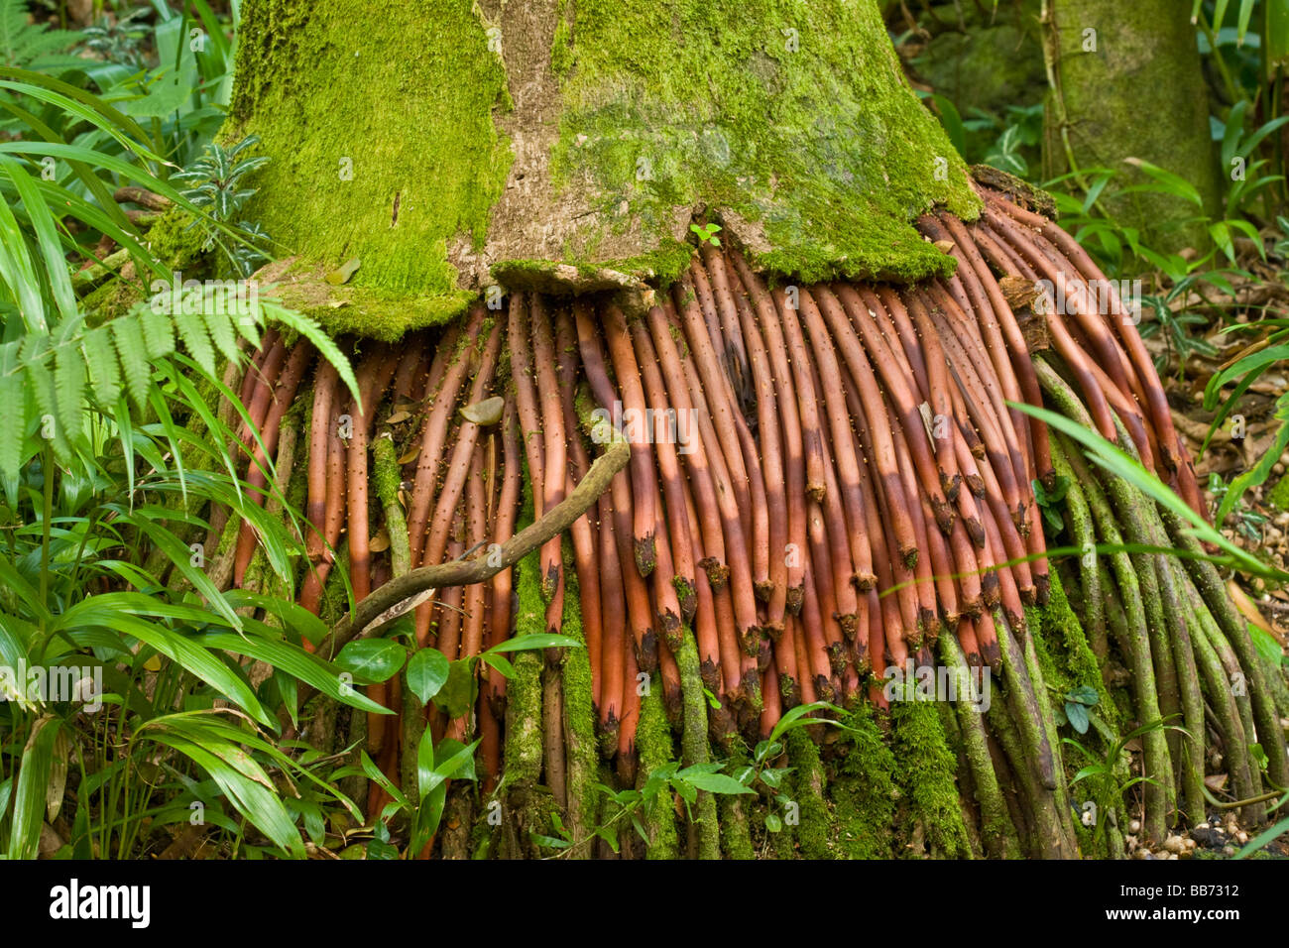
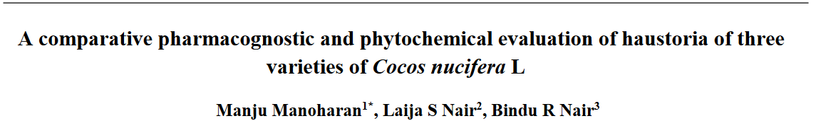
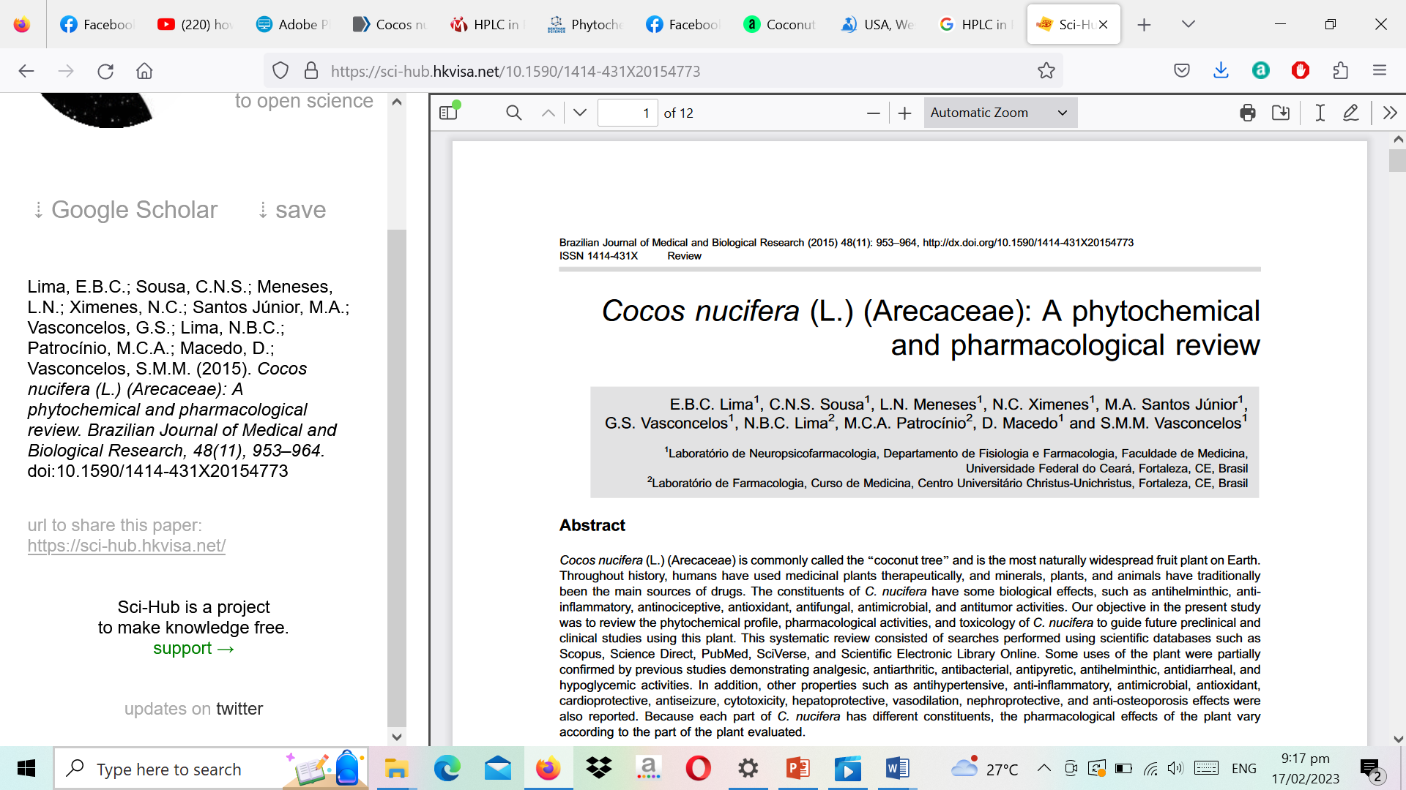
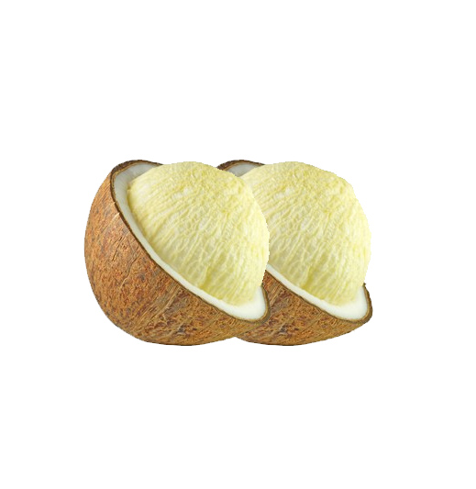
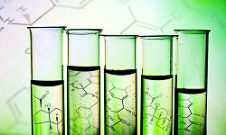

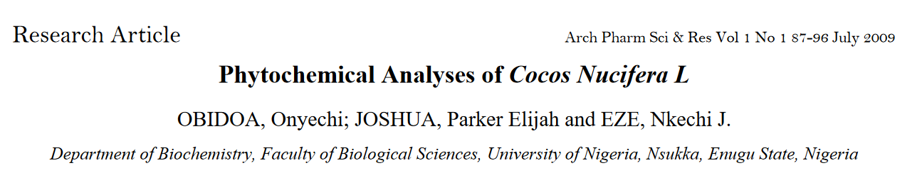
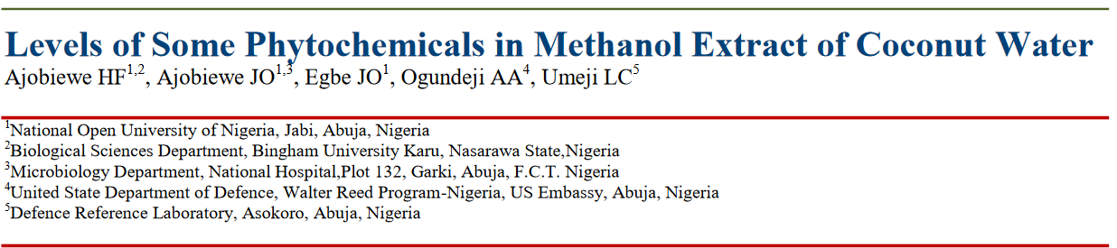
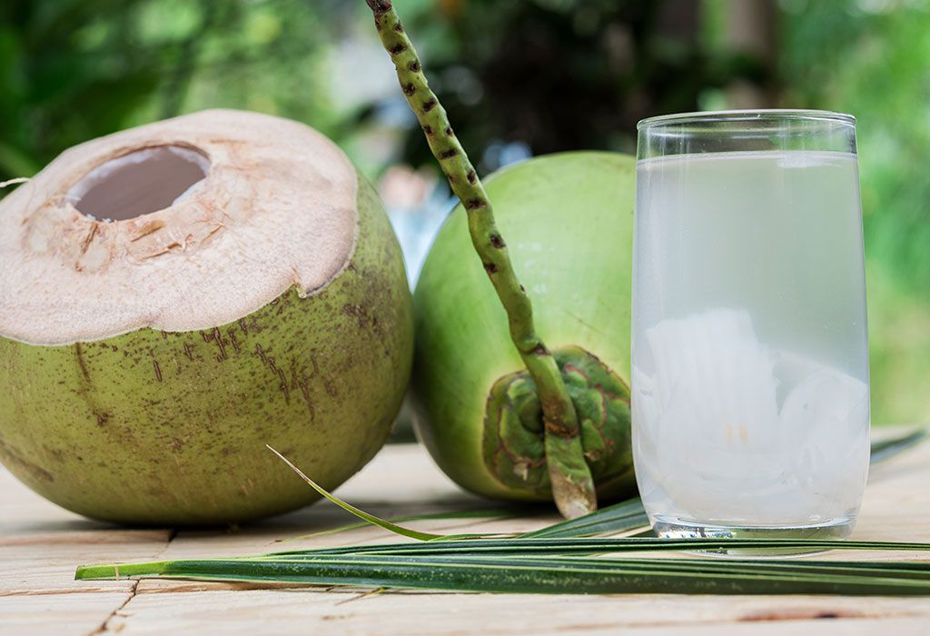
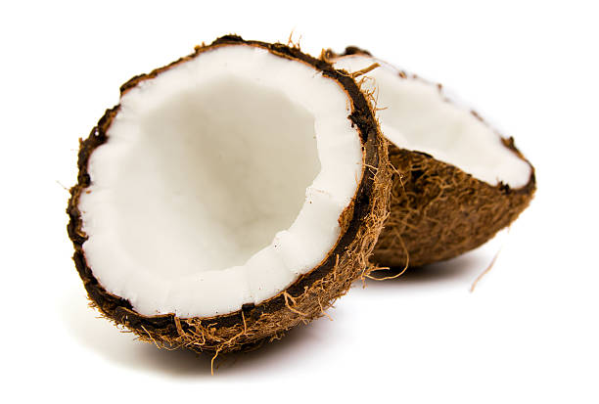
Review of Literature

Slide 31
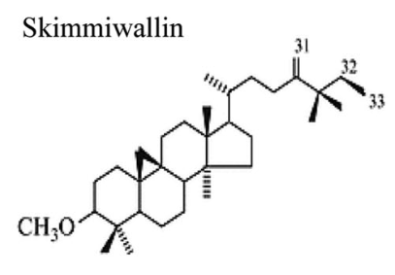
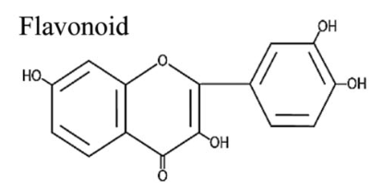
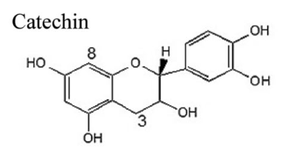
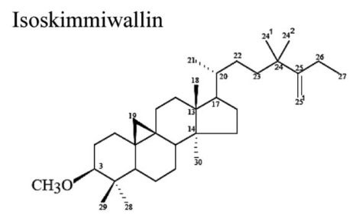
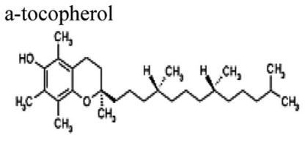
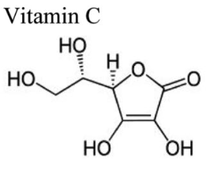




Review of Literature

Slide 32



Review of Literature
UV-VIS
FTIR
1
3
UV-Vis spectroscopy is an analytical technique that measures the amount of discrete wavelengths of UV or visible light that are absorbed by or transmitted through a sample in comparison to a reference or blank sample. This property is influenced by the sample composition, potentially providing information on what is in the sample and at what concentration. Since this spectroscopy technique relies on the use of light, let’s first consider the properties of light.[1]
Fourier Transform Infrared (FTIR) has been developed to simultaneously determine organic components, including chemical bonds and organic content (e.g., protein, carbohydrate, and lipid). However, until now, further documents have yet to describe the detailed information in the FTIR peaks. [16]
SPECTROSCOPY
4
2
HPLC
GC-MS
High-performance liquid chromatography (HPLC) is an important qualitative, and quantitative technique generally used to estimate pharmaceutical and biological samples. It is the most versatile, safest, dependable, and fastest chromatographic technique for the quality control of drug components. [31]
GCMS provides added specificity, sensitivity, and simultaneous multi-component analysis convenience. This applies to many industries and applications today, for example, environmental, forensic, food and beverage, clinical, pharmaceutical, and chemical industries.[18]
[1] https://www.technologynetworks.com/analysis/articles/
[31] Malviya, R., Bansal, V., Pal, O., & Sharma, P. (2009).
[16] Nandiyanto, A. B., Oktiani, R., & Ragadhita, R. (2019).
[18] Shimadzu Corporation. (2020)

Slide 33



Review of Literature
Microplate Reader
6
5
Microwave Digestion
The microplate reader, also known as “Photometric microplate reader or ELISA reader,” is a specialized spectrophotometer designed to read the results of the ELISA test, a technique used to determine the presence of antibodies or specific antigens in samples. The technique is based on the detection of an antigen or antibodies captured on a solid surface using direct or secondary,[ 32]
Microwave digestion is a well-established preparation technique for converting solid samples into solutions suitable for analysis by ICP-AES, ICP-MS, atomic absorption spectrophotometry, or polarography. [21,22]
Thin Layer Chromatography
Molecular Docking
Thin layer chromatography (TLC) is a quick, sensitive, and inexpensive technique used to determine the number of components in a mixture, verify the identity and purity of a compound, monitor the progress of a reaction, determine the solvent composition for preparative separations, and analyze the fractions obtained from column chromatography. [25]
The objective of docking studies is to anticipate the desired three-dimensional structures. Docking, in and of itself, generates only suitable incentive structures.^{[38]}
7
8
[21] Hassan, N. M., Rasmussen, P. E., & Zlotorzynska, E. D. (2007)
[38] Laldinfeli, R., Laldinliana, K., Nurpen, T. M., Awadhesh, K., & Y., T. S. (2022).
[22] Helmeczi, E., Wang, Y., & Brindle, I. D. (2016).
[25] Cai, L. (2004). Thin Layer Chromatography. Current Protocols Essential Laboratory Technique, 6.3.1-6.3-18.
[32] World Health Organization. (2008).

Slide 34
Methodology
3.1 Experimental Design
Figure 11. Workflow schematic diagram of the study.

Slide 35

Methodology
3.2 Sample
The sample that will be used in this study are crude methanolic extracts prepared already from previous researcher of this research project under OVCRE of MSU-IIT. The Cocos Nucifera seeds were obtained from the previous researcher's residence in Katipunan, Ramon Magsaysay, Zamboanga del Sur, Philippines (8.0495° N, 123.4524° E) (Figure 12).
Figure 12. Map of the sample collection location.

Slide 36
Methodology
3.3 Chemicals and Materials
In preparing the coconut samples, the following chemicals will be uses:
Isopropanol
1M Sodium Acetate
Chloroform
Ammonium Ferro thiocyanate
Methanol
Folin-Ciocalteu reagent
Butylated hydroxytoluene (BHT)
Quercetin
Potassium Chloride (KCL)
Distilled water
lauric acid
20 % Sodium Carbonate
Methyl ester
10 % Aluminum Chloride
phospholipid Capsule
1 M NaOH

Slide 37
Methodology
3.3 Chemicals and Materials
In preparing the coconut samples, the following instruments/ equipements will be uses:
Analytical balance (Kern, ABS 220-4)
Centrifuge (LC-04C),
Vortex mixer (LMS Mixer Uzosio VTX-3000L),
Magnetic stirrer
water bath shaker
Freeze dryer
UV-Vis spectrophotometer double beam (Peak Instruments)
FTIR spectrometer
LCMS-2020 instrument (Shimadzu).

Slide 38

Methodology
3.4 Chemical Profiling
3.4.1 GC-MS
The crude methanolic extracts of haustorium, endosperm, roots, shoots and leaves from six-month old germinating coconut will be sent to the Central Instrumentation Facility of De La Salle University (DLSU) Manila for GC-MS analysis. Expected data to be obtained will be the mass spectra of the sample extracts with Heatmaps and PCA for data analysis.
https://www.dlsu.edu.ph/research/central-instrumentation-facility/gcms/#1549434877177-866c4daf-c0cc

Slide 39

Methodology
3.4 Chemical Profiling
3.4.2 LC-MS
The crude methanolic extracts of haustorium, endosperm, roots, shoots and leaves from six-month old germinating coconut will be sent to the Central Instrumentation Facility of De La Salle University (DLSU) Manila for LC-MS analysis. Expected data to be obtained will be the mass spectra of the sample extracts with Heatmaps and PCA for data analysis.
https://www.gfz-potsdam.de/en/section/organic-geochemistry/infrastructure/liquid-chromatography-mass-spectrometry-lc-ms

Slide 40







Methodology
3.6.1 Total Phenolic Content
Add 10 µL of FC reagent ,
9 mL of Distilled Water and 80 μL 7.5% Na₂CO₃ solution into each well
Leaves
stay in the dark at room temperature
for 30 mins
Roots
absorbance will then be measured at 765 nm with a Microplate Reader.
Methanolic
Extraction
Shoots
Standard Sol’n
Cocus Nucifera
Plant Extract
Endosperm
The TPC will be expressed as milligrams of gallic acid equivalents per gram of extract (mg GAE/g)
Haustorium

Slide 41

Methodology
3.6.2 Total Flavonoid Content
Add 20 µL of 10 % AlCl₃,
20 µL of 1 M potassium acetate and 140 µL of deionized water
Shake for 60 seconds
20 µL of Standard Solution
20 µL of plant extract
Leaves
Incubated at room temperature
for 30 mins
Roots
absorbance will then be measured at 765 nm with a Microplate Reader.
Methanolic
Extraction
Shoots
Standard Sol’n
Cocus Nucifera
Plant Extract
Endosperm
TFC will be expressed as milligram of quercetin equivalent (QE) per gram of extract
Haustorium

Slide 42

Methodology
3.6.3 DPPH Assay
The 2,2-diphenyl-1-picrylhydrazyl (DPPH) assay described by Brand-Williams et al. will be used in this study with some modifications.
Ascorbic acid and trolox will be used as positive controls, methanol plus DPPH as negative control, and sample without DPPH as blank.
Briefly, 40 μL of the positive/negative controls, blank and sample extracts will be loaded into the 96-well plate separately in triplicates followed by the addition of the DPPH solution (160 μL) prepared at 25 μg/mL.
The resulting reaction mixture will be incubated at room temperature in the dark for 30 min and the absorbance will be measured at 517 nm using a microplate reader
All determinations will be carried out in triplicate

Slide 43
Methodology
3.6.4 FRAP Assay
The microplate Ferric Reducing Antioxidant Power (FRAP) assay will be based on the method described by Bolanos De La Torre (2014) and Shinta Marlin (2017) with some modifications. The FRAP reagent solution contains 10:1:1 of acetate buffer (300 mM, pH 3.6), TPTZ (40 mM dissolved with 40 mM HCL) and ferric chloride (20mM in water).
The absorbance will be measured at λ 595 nm using a microplate reader. The percentage of reducing power capacity can be calculated using the equation:
where T_{s} = Transmittance from the measured absorbance A_{s}
A_{s} = - log T_{s}
A_{s} = A_{s} positive control – A_{s} blank FRAP solution
The result will be expressed as EC₅₀ (µg/ml) using the equation of nonlinear regression. The analysis will be done in triplicate
$$\% Capacity=\left(1−Ts\right) x 100\%$$

Slide 44

Methodology
3.7 Purification of Crude Extracts
Fractions with bioactivity will then be further subjected to purification and isolation of bioactive compounds using spectroscopic methods
CC
The plates will be recorded using a digital camera under UV-254 nm light and will be processed using QuantiScan v3.0 software (Biosoft, UK). The correlation coefficient, R², for the marker compound in all TLC plates will be > 0.99

Slide 45
Methodology
3.8 Untargeted Bioassay
3.8.1 Determination of glucose concentration
The 3,5-dinitrosalicyclic acid (DNS) reagent will be used to quantify glucose in the external solution of the dialysate (Wang, 2015). Glucose will be used as a standard to estimate the reducing sugars present in the samples using a 96-well microplate reader at 540 nm. A standard curve will be established using the following glucose concentrations: 0.25, 0.50, 1, 2, 3, 5, 7, 10 and 15 mM.

Slide 46
Methodology
3.8 Untargeted Bioassay
3.7.2 Inhibition of alpha-amylase by plant extract
5 mL (50 U/mL ) alpha-amylase and 0.1% (w/v) of V.negundo plant extract in DMSO were mixed.
Twenty mililiters of the above starch solution will be then added and dialyzed against 200 mL of deionized water at 37 degree Celsius.
The glucose concentration at the external solution was measured at time (1, 2, 3, 4 and 5 hours) using the DNS method.
The negative control will be prepared using 300 µL DMSO in place of the plant extract. Glucose was used for the calibration curve.
Corrections will be made by subtracting the results of the negative control runs from those of the test runs.
It should be noted that upon generation of the glucose from starch hydrolysis, this may be further related by intermolecular binding with compounds from the plant extract.

Slide 47


Methodology
3.9 Principal Component Analysis
To make the study results more conclusive, the data obtained from all experimental analyses will be subjected to a correlation study using the Principal Component Analysis (PCA) in XLSTAT software embedded in excel. PCA will be conducted on the following data:
GC-MS and LC-MS
Phytochemical Analysis
Untargeted Bioassay
Untargeted BioAssay

Slide 48



End of presentation,
THANK YOU.

