Slide 1
Enrollment no : 25010101240
Name : SHREENA SOLIA department : BTECH CSE semester : 3 subject : OAT

Slide 2

About Darshan University
Darshan University (DU) is a prominent institution offering a broad slate of academic programs and professional courses at the undergraduate, graduate, and postgraduate levels in Engineering & Technology, Science, Management, and Yoga. The University is located in peaceful and sylvan surroundings with a distinctive collegiate structure, about 19 km from Rajkot, Gujarat, India. It was established as an Engineering Institute in 2009 by Shree G. N. Patel Education & Charitable Trust with the objective of imparting quality education and training in various fields of Engineering and Technology. It has since been transformed into Darshan University through an Act by the Government of Gujarat under the Gujarat State Private Universities (Amendment) Act, 2021 (Act No. 15).
Since its inception, the institution has grown steadily and created a unique identity in the field of Engineering & Technology by implementing a skill- and training-based foundation for education. The academic environment on campus fosters creativity and encourages the exploration of technical skills. Darshan University is committed to the generation of knowledge, fostering innovation, and contributing to the development of the Nation.
Our Motto
This verse advises us to perform our allocated duty excellently. Kaushalam signifies doing work with devotion and without attachment. Such detached attitude enhances its values and improves the concentration and skill of the worker. If we work with elegance, fortitude, and skill our Body-Mind-Soul will co-operate with our hands. Any work becomes valuable if carried out with full concentration, dedication, and abilities and also helps us to become valuable to others as well as to society.

Slide 3
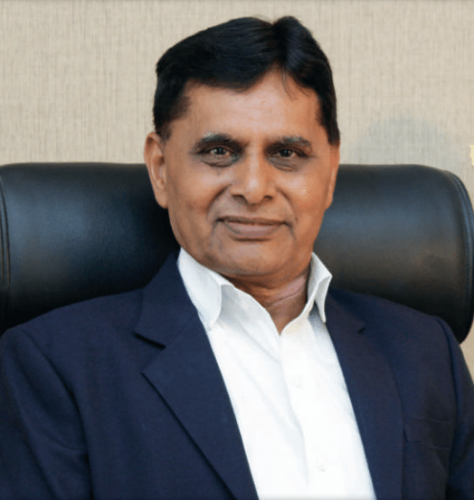
Dr. Ramnik G. Dhamsaniya
President
Dr. Ramnik G. Dhamsaniya, the vibrant and visionary President of Darshan University and prominently recognized as a pivotal pillar and an outstanding administrator in the field of education. Upon completing his Bachelor of Civil Engineering from Lukhdhirji Engineering College, Morbi, Master of Engineering in Structural Engineering & Ph.D. in Concrete Technology from Birla Vishvakarma Mahavidyalaya (BVM), Sardar Patel University.
He has started his career as a lecturer at L. E. College Morbi and worked for 10 years. In 1996, he has moved to V. V. P. engineering college where he has played vital role in the infrastructural & academic development of the institute. He has also worked as a Principal in Atmiya Institute of Technology and Science for Diploma Studies for 2 years.
During 40 years of his career, He has notably contributed to the development of a quality-focused educational system and institutional governance. Being a powerful blend of distinguished academician and profound visionary, he has successfully contributed to bridging the gap between academics and industries. With the notion of skill-based education, he has established Darshan University, which is committed to developing a conducive learning environment, strengthening student progression and promoting value-based education.

Slide 4
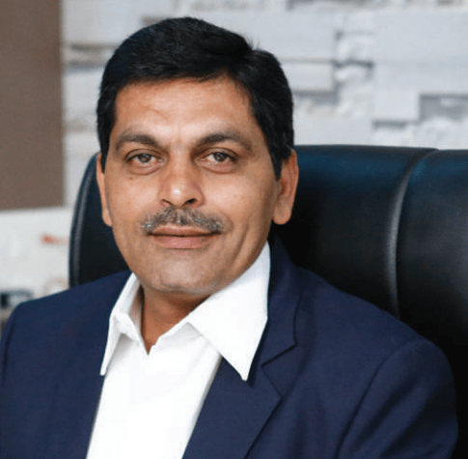
Prof. Manish V. Sanghani
Provost
Prof. Manish V. Sanghani, an academician with an in-depth knowledge and profound skill set in teaching pedagogy, education and administration. He has completed his Bachelor of Civil Engineering from Lukhdhirji Engineering College, Morbi, and his Master of Engineering in Structural Engineering from The Maharaja Sayajirao University, Baroda.
He has started his career as a lecturer at Dr. Jivraj Mehta Government Polytechnic for 10 years. In 1997, he has moved to V. V. P. engineering college where he has worked as an Assistant Professor for 11 years.
He plays a vital role in integrating academics with industries. His career experience spans around 37 years and, presently he is the founder and Provost of the University. He has contributed towards the development and effective implementation of numerous education initiatives. He has been a key person to enhance the educational framework at the University and streamline it with the expectations of industries & corporate sectors. He is committed to creating an effective skill and training-based foundation for education where students are empowered to concrete their experience of learning and gain an edge in an increasingly competitive workforce.

Slide 5
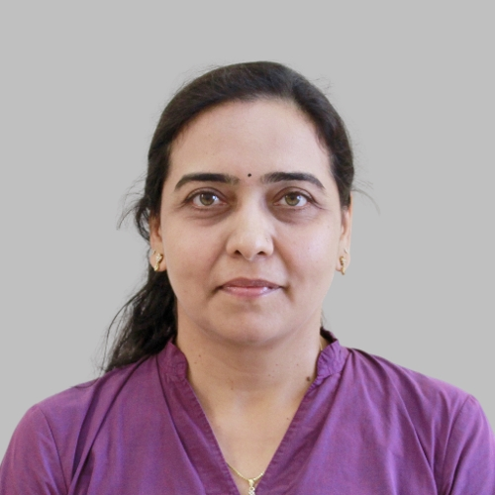
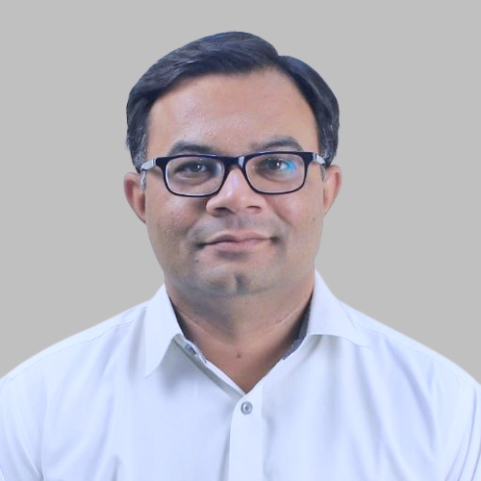
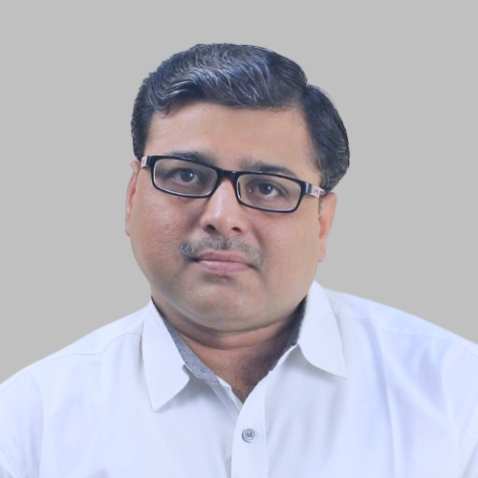
University Authority
BoS – (Computer Science & Engineering)
Chairperson
Member
Member
Dr. Gopi B. Sanghani
Dean, DICA
Dr. Nilesh M. Gambhava
Vice Provost, DU
Dr. Pradyumansinh U. Jadeja
CSE Department, DIET

Slide 6
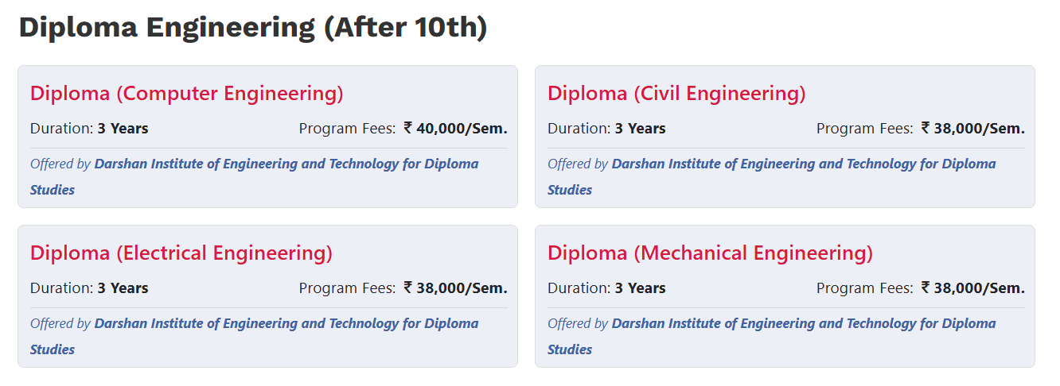
Programs Offered
Admission 2026
Direct Admission for all programs has already started. Kindly apply online on DU Direct Admission Portal.
For admission regarding query:
+91-7096979952, +91-7096979962

Slide 7
Why Darshan University ?
Academic Staff : Well-Qualified, Experienced, Industry Linked and Dedicated Academic Staff.
Project-based Learning : Extensive student-corporate interaction through internships and projects.
Seminars/Workshops : Exposure to cutting-edge technologies through seminars and workshops.
State-of-the-art Laboratories : Continuous upgradation of laboratories to meet the dynamic industry demands.
Academics Monitoring : Continuous assessment of each & every student’s progress.
Placement : Well networked with 1000+ industries and excellent placement track record.
And Many More …

Slide 8
Government Scholarships
[1] MYSY (Mukhyamantri Yuva Swalamban Yojana)
Eligibility: Student must have secured 80 or more Percentile in 10th / 12th exam and family income must be less than Rs. 6 lakh/annum.
Amount of Scholarship:
  For Degree Engineering: Rs. 50,000/- or 50% of tuition fees whichever is less.
  For Diploma Engineering: Rs. 25,000/- or 50% of tuition fees whichever is less.
  For B.Com./BBA/BCA/B.Sc.: Up to Rs. 10,000/- or 50% of tuition fees whichever is less.
[2] Scholarships for SC/ST Students
Eligibility: Student must belong to SC or ST category and family income must be less than Rs. 2,50,000/annum.
Amount of Scholarship: Approximately 100% of tuition fees as per Government norms.

Slide 11
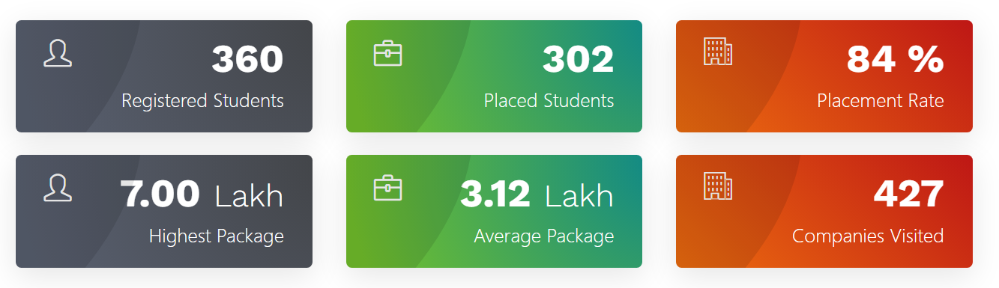
Placement Summary (2025)
Branch wise Summary
# | Program | Registered Students | Placed Students | Placed % | Companies Visited | Highest Package | Average Package
1 | B.Tech. (CSE) | 172 | 161 | 93.60 % | 81 | 7.00 LPA | 3.78 LPA
2 | B.Tech. (Civil) | 12 | 12 | 100.00 % | 17 | 4.50 LPA | 2.36 LPA
3 | MBA | 50 | 24 | 48.00 % | 129 | 6.00 LPA | 2.78 LPA
4 | B.Tech. (Mechanical) | 5 | 5 | 100.00 % | 22 | 3.00 LPA | 2.32 LPA
5 | MCA | 48 | 42 | 87.50 % | 45 | 4.00 LPA | 2.23 LPA

Slide 12
THANK YOU !

