Slide 3
What is the national bird of india ?
1. Penguin
2. Peacock
3. Sparrow
4. Owl
ANSWER

Slide 4
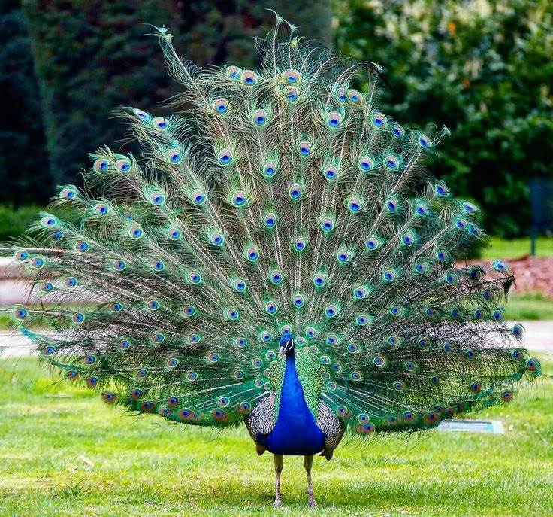

Slide 5
