Slide 1
Enacting ethos online
Enacting ethos online: Using classical rhetoric to analyse visual Web design – Breanna Lee Byers
A rhetorical analysis of: SHAZAM Inc. and Flyway
-Kristian Os

Slide 2
The sites in question
SHAZAM Inc.
  Big corporation
  An electronic funds transfer(EFT) network that serves financial institutions.
  Provide information to interested customers.
Flyway: A journal of Writing and Environment
  Non profit
  Provide information about environmental actions.

Slide 3
The terms
Weight on ethos over pathos and logos
Considering the usage of ethos in its classical meaning
Welcome- and about-pages
Based on the works and definitions of Aristotle, Cicero and Quintilian

Slide 4
What should the pages accomplish
Ethos should
  Establish the rhetors trustworthiness and goodwill
  Inspire a positive, persuasive emotional reaction…
  Assist in overcoming prior perceptions
Ethos combined with Kostelnick and Roberts interpretation of tone
  Very similar in definition and usage

Slide 5
Ethos as a tool (See handouts)
Establish what you are looking for
What is conveyed and how
From whom? To whom?
More than one Ethos...(Know the audience and learn)
Select appropriate visual elements
  Green for nature
  Patterns for design
  Picture of people to convey trust

Slide 6
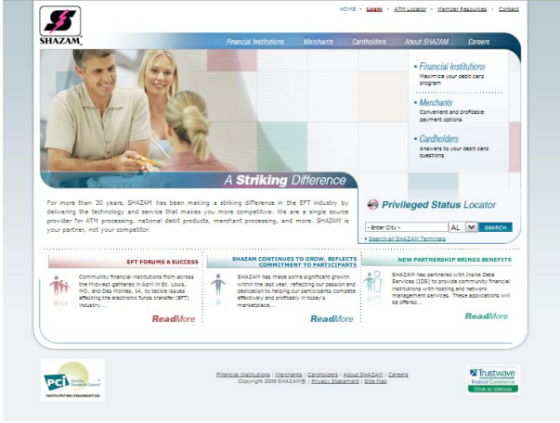
SHAZAM Welcome

Slide 7
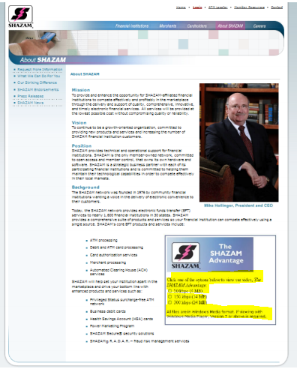
SHAZAM about

Slide 8
Requirement for ethos on SHAZAM
Banking need professionalism
Elements of stability
Goal
  Trust
  Goodwill
  Credibility

Slide 9
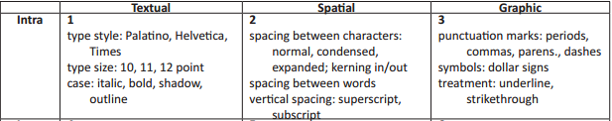
Intra
No nonsense font! (Serif)
  Font, continuity, subtle hints
  Show, but don’t scream!
  Clever boldness
  Missing continuity
  Ethos is lost and gained

Slide 10
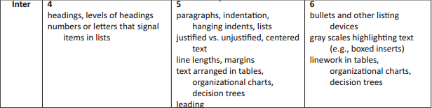
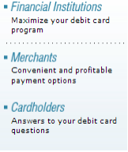
Inter
Clear headings (Open, directions = goodwill)
Square bullets on square background
Random structure
  Which one was h1 again?
Structure over all else
Lessen again..

Slide 11
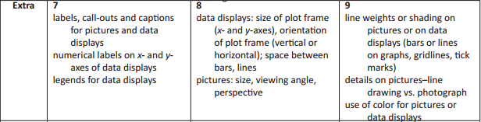

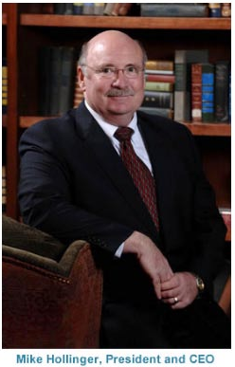
Extra
Pictures (Faces, people, attitudes, actions)
Who will relate.
  Ethnicity
  Gender
Thrust and goodwill
Logos
Placing of logos

Slide 12
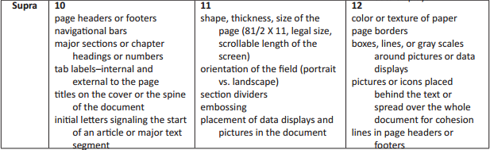
Supra
Navigation
  17 links welcome
    Two external (Credibility)
    15 internal
  Links to endorsement on about
Logo and site together
  Colour and variations

Slide 13
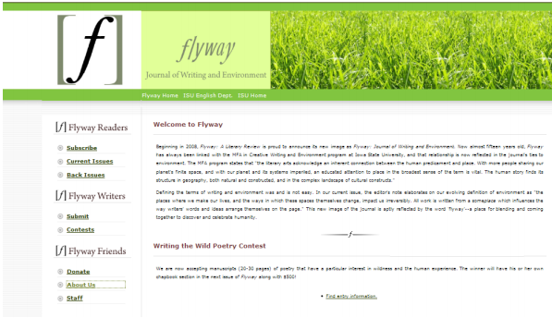
Flyway

Slide 14
Requirement for ethos on FLYWAY
Still need for conveying professionalism
Also need for elements of environmentalism
Goal
  Engaging readers
  Trustworthiness and goodwill
  Positive feelings
  Identity for the page.

Slide 15
Intra
Serif fonts and serif typefaces
  Academic
  Literature
  “Less technical and more humane” - Kostelnick and Roberts
Sans Serif for text
  Easier to read (goodwill)
  Credibility and trustworthiness

Slide 16
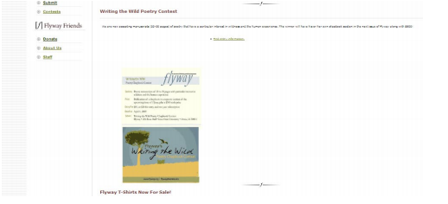
Inter
Identifiers
  Flyway Readers, Flyway Writers, Flyway Friends.
Creates organizational structure
  Headings
  Too much
Bullets
  Ruins in the text
  Helps on the left

Slide 17


Extra
Use nature
  Too obvious, but logical
It’s already saved
  Go urban
The logo
  Box and yet open
  Confirmed ugly

Slide 18
Supra
Links
  Two external links
    Iowa State University English Department
    Hard to discover the connections
Lacking in credibility
No animations here either
Strong colour and identity

Slide 19
Lets apply it
Amazon

