Slide 1
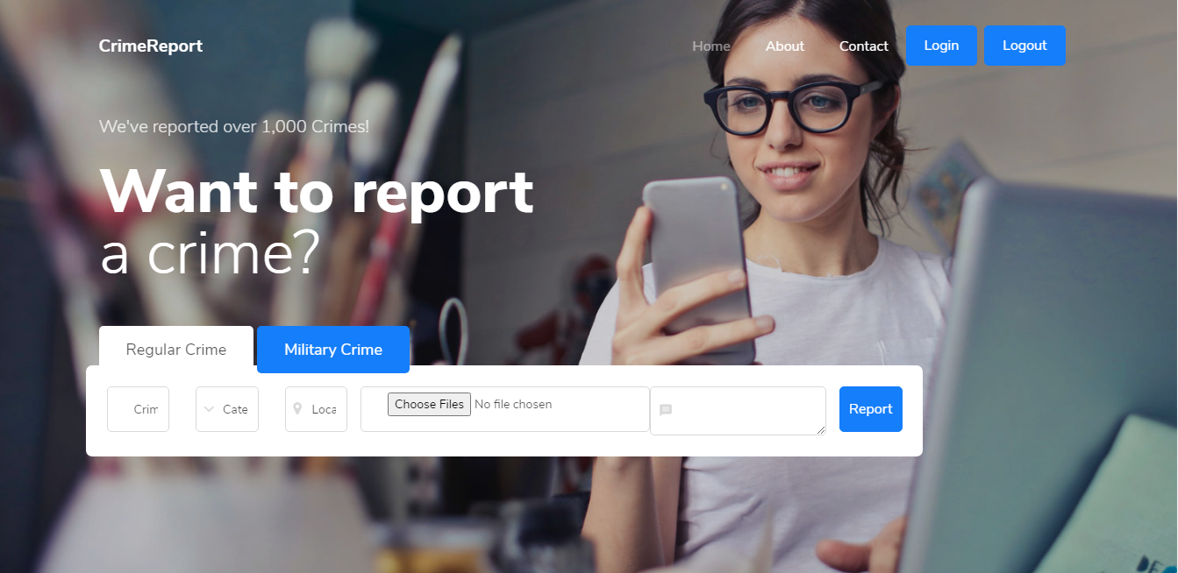
A web based crime report system with the implementation of Cryptowerk Blockchain Technology
By Team CLITECH

Slide 2
contents
Introduction
Background of study
Statement of Problem
Objectives of Study
Proposed Solution
Executive Summary
Competitors
Technology/Expertise
Financial Analysis
Why Us
Our Team
Acknowledgement

Slide 3
introduction
A good leader is the leader that forms a nation that does not need a leader. Nothing destroys a nation more than bad leaders, abuse of power and corruption, so the Crime Report System comes to mind as a corruption control measure:
This is a software program with the implementation of cryptowerk blockchain technology that helps a nation to fight corruption and maintain a democratic system of government for peace and unity to reign.

Slide 4
Background of study
Our background of study is the country Nigeria. As we all know Nigeria is one of the most corrupt countries in West Africa and we happen to be citizens of that country and we know that something has to be done not just because we are citizens but because we want to save lives, people are dying on a daily basis because of bad governance and we want to help.
Right now in Nigeria, police and anti robbery squad kill people for no good reason maybe because you are dressed in a type of way that they may find offensive, then they will kill you and the government is doing nothing about it which has made everyone to start a protest against such action, in some situations, no one dares to speak or act because your life is at risk.
In other to stop these type of problems to arise again the future we have to do something today, we have to create a really democratic system of government which allows the citizens of the country to speak up freely without fear of being killed or sanction for no reason

Slide 5
Statement of problem
Lack of communication between the people and the government
Government lack knowledge of the problems of citizens nor even how to solve them
No freedom to express maltreatment or abuse especially from the authorities
Lack of Action taken even after complaints

Slide 6
Objectives of the study
The objectives of this project are outlined below:
To enable the citizens of a country to confidently express any form of maltreatment from any of the authorities or from anyone for immediate investigation and sanction.
To create a platform that enables the government and citizens to communicate.
To enable the government to directly hear, see and attend to the needs of the citizens
This project makes data available for future predictions and helps to ascertain necessary method to tackle similar issues

Slide 7
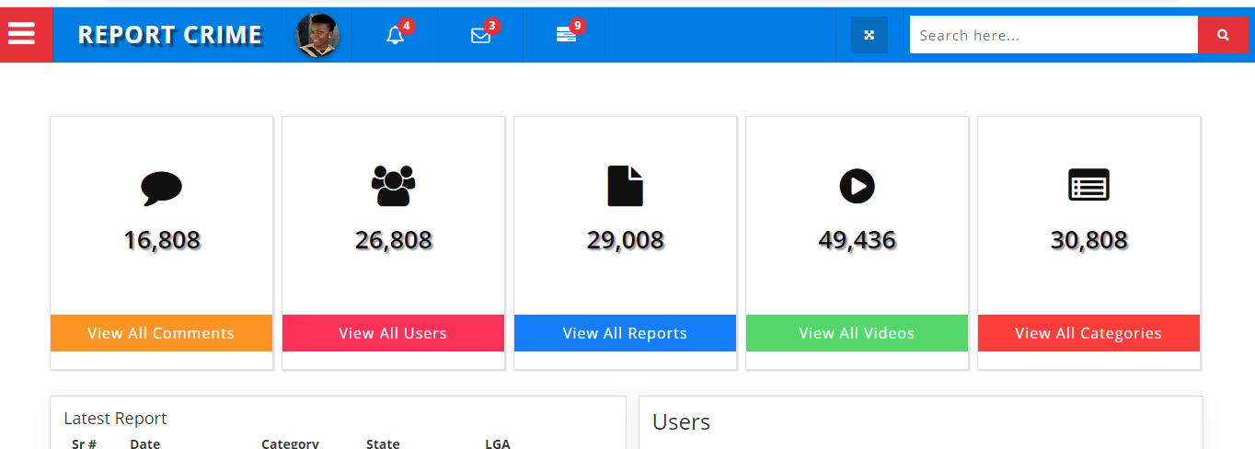
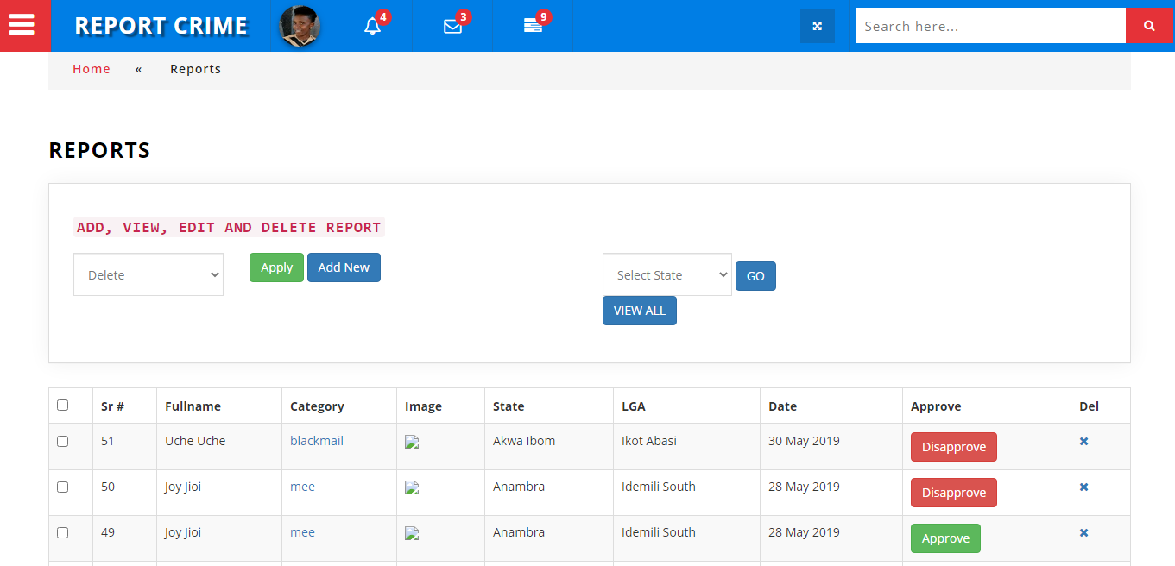
Proposed solution
A web platform where users can freely and confidently express maltreatments and abuse for the necessary officials to sanction offenders. It is referred to as the CRIME REPORT SYSTEM as a Corruption Control measure to help the nation to live in peace and unity

Slide 8
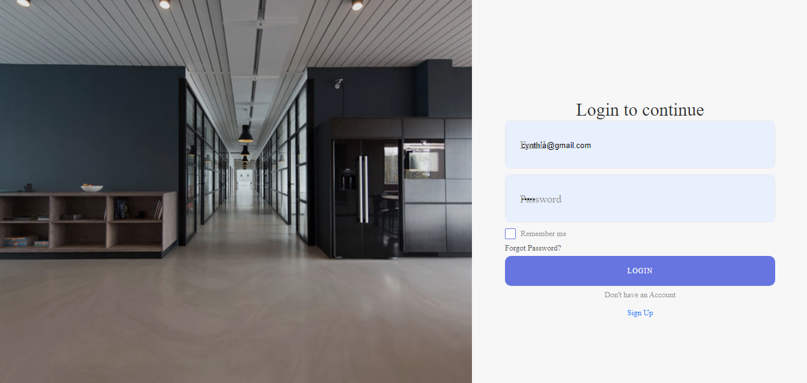
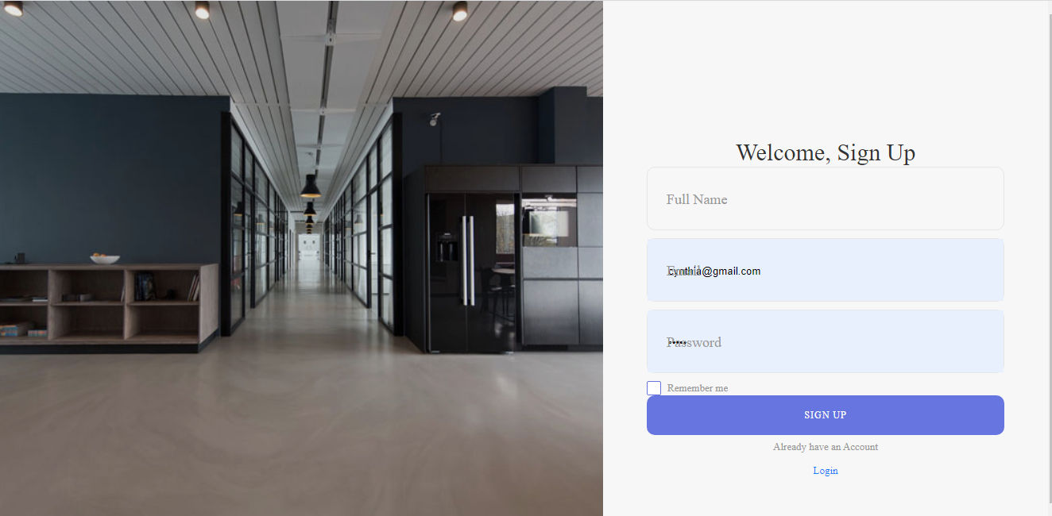
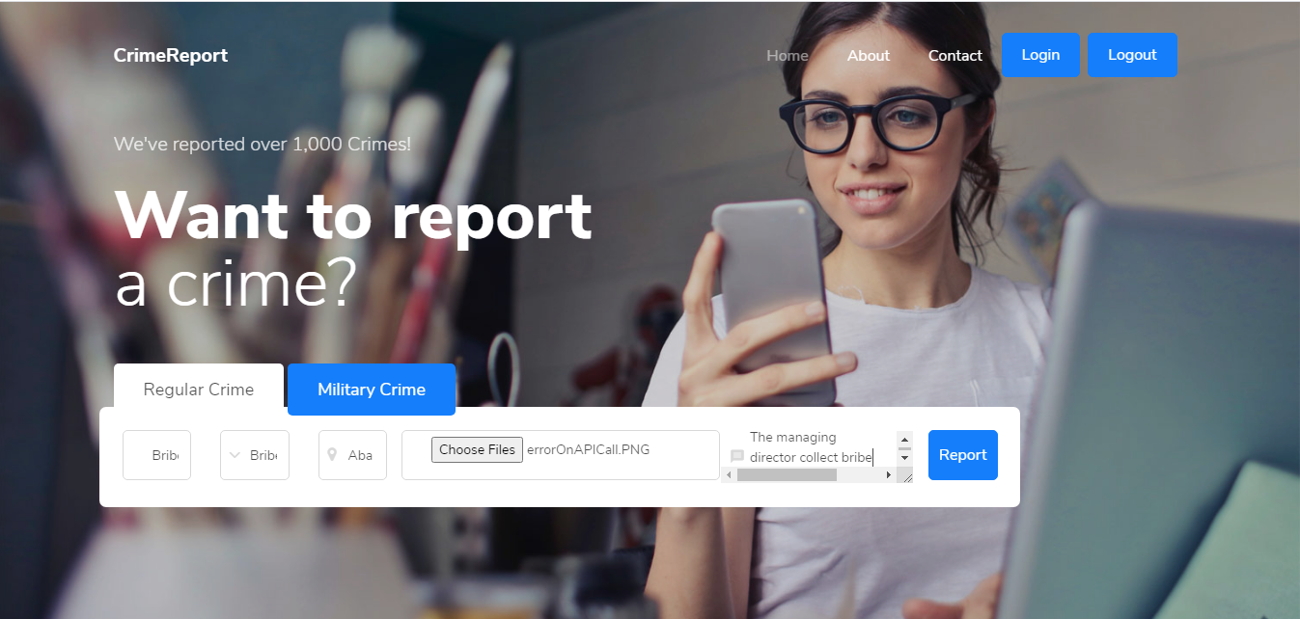
Proposed solution

Slide 9
Executive summary
This project is for a web application called the Crime Report System which offers a platform that enables the people the freely and confidently express themselves and any form of maltreatment from any authority or from anyone without fear of the authorities. To avail these services, users need to register as an anonymous or with personal detail. If a user posts a compliant, it first waits for approval and thorough investigation before it is made public, offenders are punished by the appropriate authorities and sent to the block chain technology to avoid data manipulation or change. Users can also posts evidence on the website to enable a better and smooth investigation

Slide 10
Competitors
Manual system of government
(The Current System)
The Automated System of government (The Proposed System)

Slide 11
Technology/ expertise
HTML/HTML5,
CSS
Bootstrap
JAVASCRIPT,
MySQL,
PHP
Data Science
Cryptowerk Technology (Work in progress)

Slide 12
Finacial analysis
From 2020 to 2025 the financial estimate will have been 10times multiplied because a major challenge is being solved

Slide 13
Marketing Plan
In other to sell this idea and automate the manual method currently in use we have made some marketing plan:
Social media advertisement
Televised advertisement
Both online and offline advertisement will be put up for all eyes to see

Slide 14
Why us?
We solve the most pressing need of the citizens of a country by:
Making it easy for the government to hear the complaints of the people
Your voice can be heard from anywhere even with your smart phone
It does not require heavy payment and too much protocols like the mauual method currently in use

Slide 15
Our team
Team Lead: Amadikwa Joy N.
Project Manager / Entrepreneur: Ezeh Cynthia Ifeoma
Data Scientist: Emeto Winner
Graphics Designer: Dominic

Slide 16
Thank you

