Slide 1

MINI PROJECT
AUTO CLIMATE MONITORING SYSTEM
Group Members:-
1) Mr. Keshav Rathod 2) Mr. Tejas Khode 3) Mr. Shantanu Wankhade
Project Guide:-
Dr. P. N. CHATUR
Department of Computer Science and Engineering
Government College of Engineering , Nagpur

Slide 2
INTRODUCTION
The temperature and humidity monitoring system is a valuable asset for warehouse companies with logistics quality control processes.
Installation of the temperature and humidity sensors demonstrates their commitment to the quality of stock and adding value for the customer
Central Warehousing Corporation (CWC) is into scientific storage and handling services for more than 400 commodities including Agricultural produce, Industrial raw-materials, finished goods and variety of hygroscopic and perishable items.
The climate condition of field can be monitored from distant place and won’t required them to physically present. Time to time updating the real time situation of warehouse on web page.

Slide 3
LITERATURE REVIEW
M. Rahaman Laskar et al. presented a paper on weather forecasting using Arduino and Cube-Sat. This proposed system uses temperature and humidity sensor (DHT11), pressure and altitude sensor (BMP180).
Vinayak Aappasaheb Pujari et al. have proposed a system that uses the solar power panel. This system is used to monitor temperature, wind speed, wind direction, humidity, and rain.
Prof. Satyashil Nagrale et al. have proposed the weather monitoring system using real-time data transmission. The proposed system uses VAISALA weather transmitter sensor WXT520 to transmit the data to the control room.
Prof. C. H. Chavan et al. have proposed their system to develop a wireless sensor network for an agricultural environment.

Slide 4
OBJECTIVES
Make current system obsolete.
Reduce human intervention.
Make it centralized for the whole warehouse.
Analysing data based on previous readings.
Real time display of data

Slide 5
PROBLEMS OF EXISTING SYSTEM
It takes comparatively more time to process.
It requires additional devices for operation.
It requires an external clock.
Programming for microcontroller 8051 is difficult.
For programming, it requires a development system.
The circuit size becomes large.
PCB making becomes complex, difficult, and tedious.

Slide 6
PROPOSED SYSTEM
We are using the DHT11 sensor for monitoring the atmospheric conditions that are temperature and humidity so that we get the accurate results and we can take efficient measures.
Our system will be faster and less power consuming.
Our system collects the data from the sensor and sends it to the ThingSpeak web server to maintain the atmospheric conditions of a particular place (warehouse). We can access the data of the atmospheric conditions of the warehouse from anywhere in the world.
Our system updates the data from time to time so the user can observe the real-time conditions in the warehouse.

Slide 7
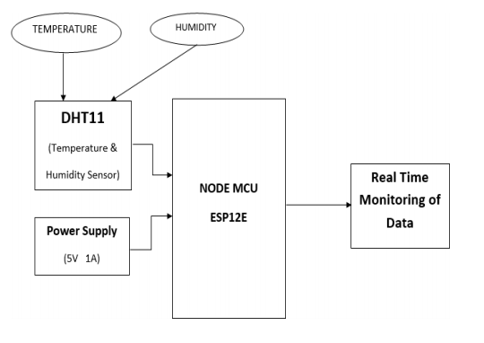
BLOCK DIAGRAM OF SYSTEM

Slide 8
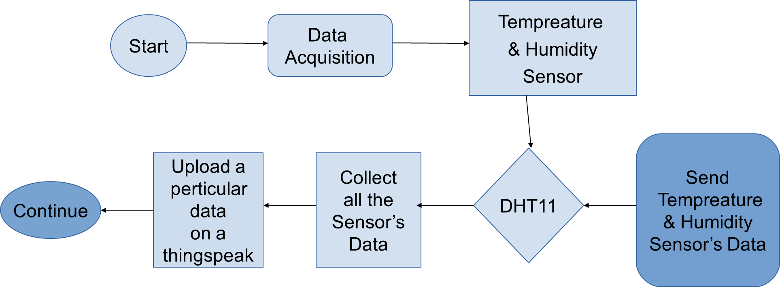
ACTIVITY DIAGRAM OF SYSTEM

Slide 9
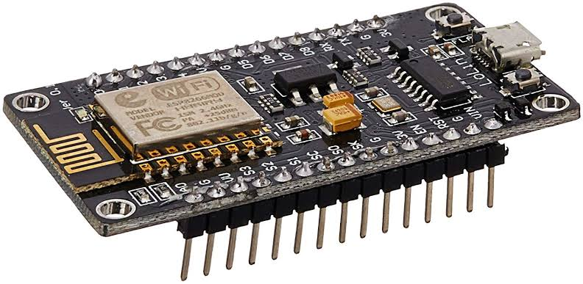
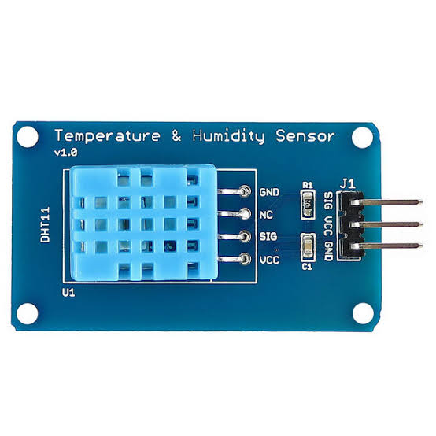
SYSTEM REQUIREMENTS
Hardware :-
Node MCU
2) DHT11 Sensor

Slide 10
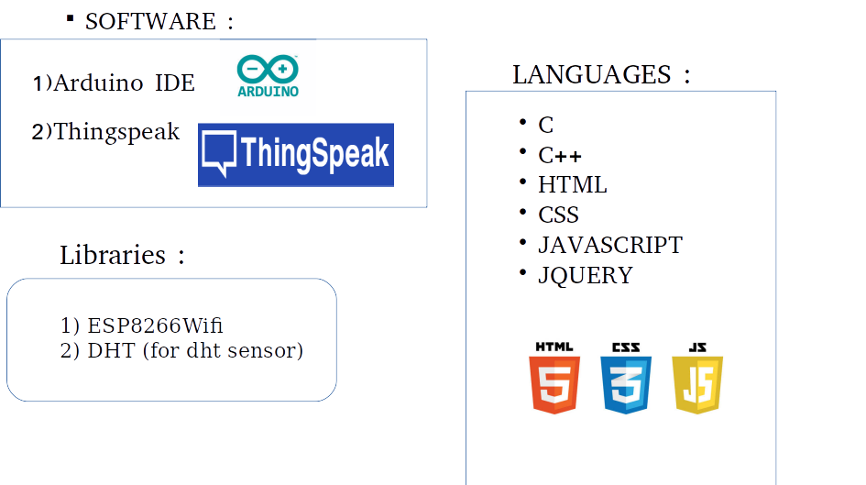

Slide 11
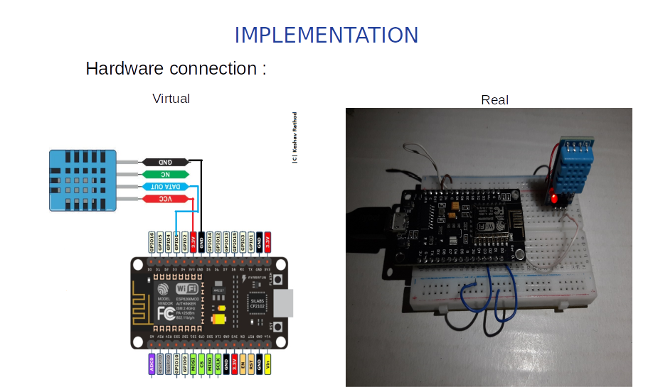

Slide 12
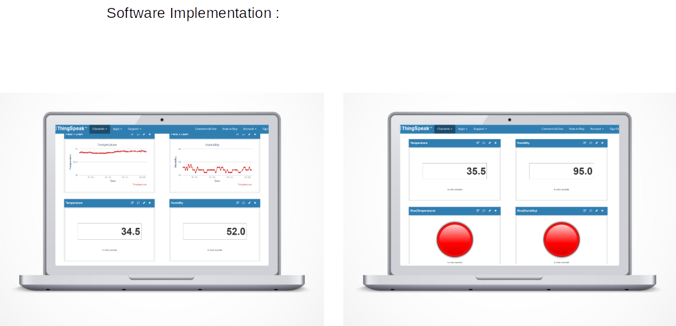

Slide 13
SOFTWARE TESTING
Features to be Tested :-
DHT11 should detect temperature and humidity properly.
Node MCU should give the required outputs on the output port.
Alarm lamp glows if temperature and humidity are not equal to set point.
The system should be stable and work properly in the given range of temperatures.
Real-time Temperature and Humidity are displayed on the webpage

Slide 14
APPLICATIONS
This project can be used in Industry as well as in Home.
To monitor the environments that are not comfortable, or possible, for humans to monitor, especially for extended periods.
Prevents waste of energy when it’s not hot enough for a fan to be needed.
To assist people who are disabled to switch on or off the cooling device automatically.
The system is used to monitor warehouses containing agricultural goods , dairy products etc.

Slide 15
CONCLUSION
We developed web application for auto climate monitoring system which fulfill following needs
low cost solution for auto climate monitoring system so, user can install as much as possible devices
Accurate real time data generation and showing appropriate data visualization
User friendly features like alert lamp

Slide 16
REFERENCES
Jeremy Blum, 2013, Exploring Arduino: Tools and Techniques for Engineering Wizardry, Wiley PUB.
Sharam, M.C., 1986, Relay and Their Application, Delhi, BPB PUB.
Chaudhary, D. Roy, 2003, Linear Integrated Circuit, Second Edition, New Delhi, New Age International PUB.
Massimo Banzi, 2011, Getting Started with Arduino, 2nd Edition, UK, Maker Media, Inc. Catalogs
S. Pasha, “ThingSpeak based sensing and monitoring system”, International Journal of New Technology and Research, Vol. 2, No. 6, pp. 19- 23, 2016.
Arduino, Arduino Uno Rev 3 Overview, available at: https://store.arduino.cc/arduino-uno-rev3 https://thingspeak.com

Slide 17
THANK YOU

