Slide 1
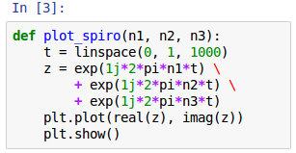
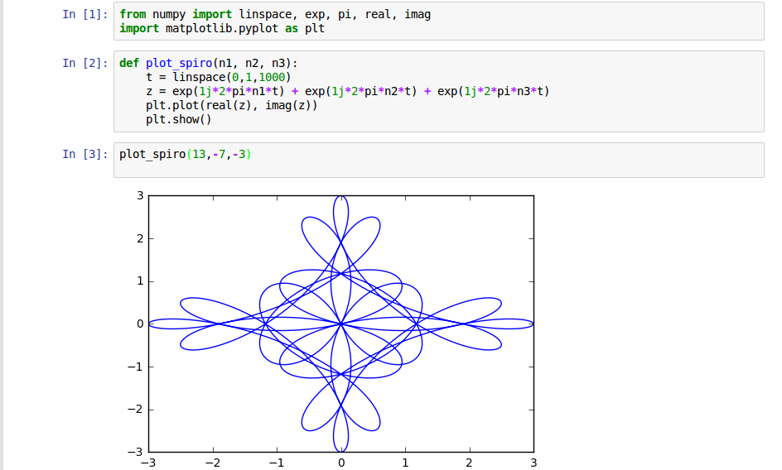
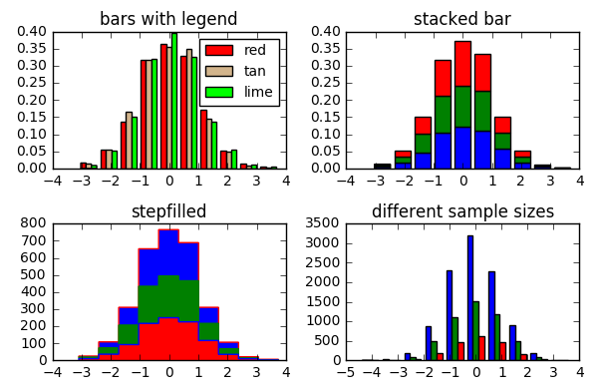
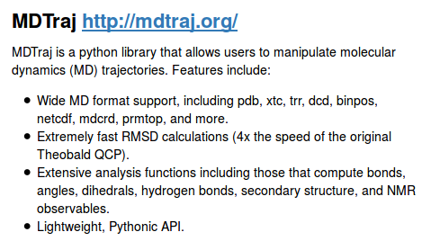
Telling Your Science Story
Derrick Kearney
HUBzero® Platform for Scientific Collaboration
Purdue University
This work licensed under
Creative Commons
See license online:
by-nc-sa/3.0

Slide 2


Your scientific life

Slide 3
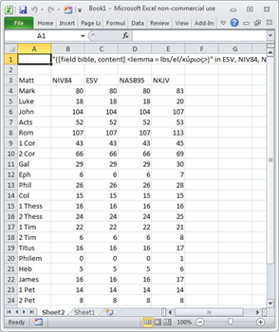
Your scientific life

Slide 4
Your scientific life
I need a plot of your analysis!

Slide 5
Your scientific life
.csv

Slide 6

Your scientific life
.csv
MATLAB

Slide 7
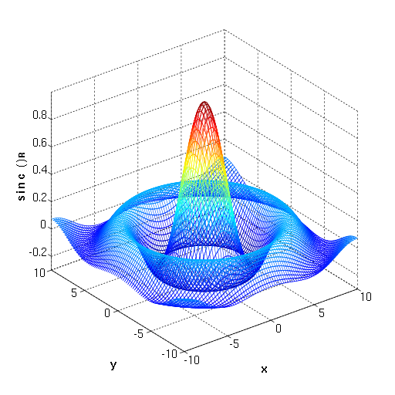
Your scientific life
.csv
MATLAB
v1 = 3.125
v2 = 9.987
x2 output
CPU: 420s

Slide 8

No good deed goes unpunished...
.csv
MATLAB
2 weeks
later
v1 = 3.125
v2 = 9.987
x2 output
CPU: 420s

Slide 9
Your scientific life
.csv
MATLAB
2 weeks
later
v1 = 3.125
v2 = 9.987
x2 output
CPU: 420s

Slide 10
Your scientific life
Proposal Due in 3 Days !
2 weeks
later
6 months
later
v1 = 3.125
v2 = 9.987
x2 output
CPU: 420s

Slide 11

Your scientific life
Proposal Due in 3 Days !
2 weeks
later
6 months
later
v1 = 3.125
v2 = 9.987
x2 output
CPU: 420s

Slide 12
Your scientific life
Over the next 2.5 days...
Proposal Due in 3 Days !
.csv
MATLAB
6 months
later
v1 = 3.12498
v2 = 9.9901
x3.1a output
CPU: 340s

Slide 13
Your scientific life
Over the next 2.5 days...
Proposal Due in 3 Days !
Science !
.csv
MATLAB
6 months
later
v1 = 3.125
v2 = 9.987
v1 = 3.12498
v2 = 9.9901
x2 output
x3.1a output
?
CPU: 420s
CPU: 340s

Slide 14



Towards Reproducible Research
1.
Source Code Repository
Interactive
Scientific
Notebooks
2.

Slide 15
Top 5: Why use a repository
It’s easy to learn
4 main commands:
clone, add, commit, push

Slide 16
Top 5: Why use a repository
It’s easy to learn
4 main commands:
clone, add, commit, push
Collaborate with others
No longer have to email new versions

Slide 17






Top 5: Why use a repository
It’s easy to learn
4 main commands:
clone, add, commit, push
Collaborate with others
No longer have to email new versions
Where did I put that…
It’s always in the repository
SSL
Repository
NCSA
carter

Slide 18
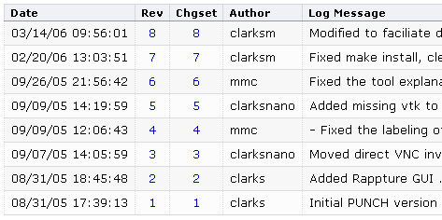
Top 5: Why use a repository
It’s easy to learn
4 main commands:
clone, add, commit, push
Collaborate with others
No longer have to email new versions
Where did I put that…
It’s always in the repository
Who broke the build?
Look at the revision history
SSL
Repository
NCSA
carter

Slide 19
Top 5: Why use a repository
It’s easy to learn
4 main commands:
clone, add, commit, push
Collaborate with others
No longer have to email new versions
Where did I put that…
It’s always in the repository
Who broke the build?
Look at the revision history
Your hard drive just died
No problem, your code is in the repository
SSL
Repository
NCSA
carter

Slide 20
Towards Reproducible Research
1.
Source Code Repository
Jupyter
Notebook
Interactive
Scientific
Notebooks
2.
RStudio

Slide 21
What are Interactive Notebooks?
Executable Code
& Calculations
Jupyter Notebook
calculations.ipynb

Slide 22
What are Interactive Notebooks?
Executable Code
& Calculations
Data Visualizations
Jupyter Notebook
calculations.ipynb

Slide 23
What are Interactive Notebooks?
Executable Code
& Calculations
Data Visualizations
Jupyter Notebook
calculations.ipynb
Narrative

Slide 24

Sharing Notebooks
Sharing Made Easy
- Text based file format
- Outputs stored with
document

Slide 25
Sharing Notebooks
Sharing Made Easy
- Text based file format
- Outputs stored with
document
Export Document to:
PDF, Word, HTML,
LaTeX, Slides,
Markdown, Wiki, EPub

Slide 26
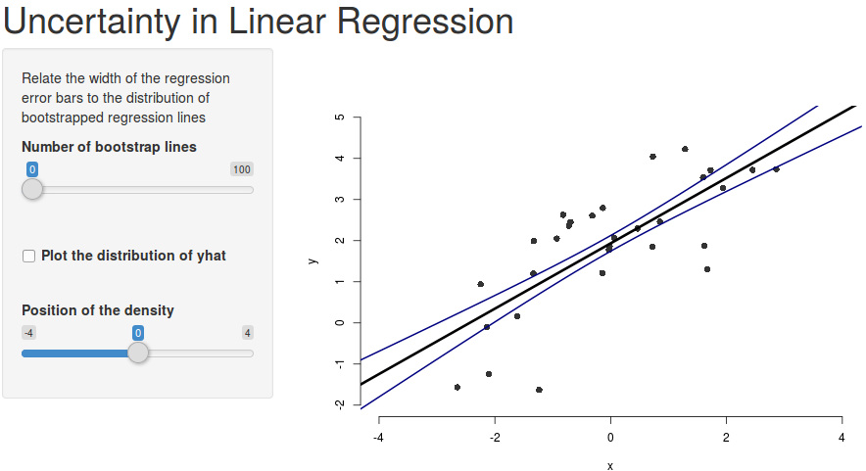
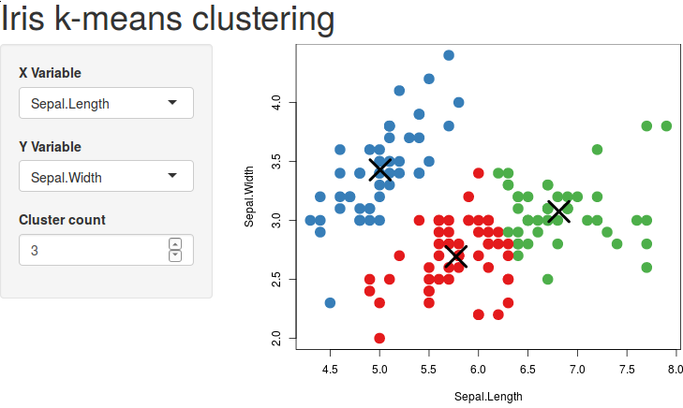
Sharing Notebooks
Sharing Made Easy
- Text based file format
- Outputs stored with
document
Export Document to:
PDF, Word, HTML,
LaTeX, Slides,
Markdown, Wiki, EPub
Embed Interactive
Web Applications

Slide 27
Let's see some examples...

