Slide 1

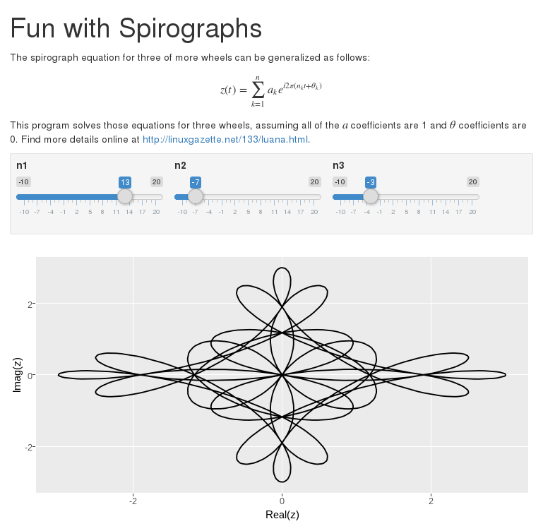
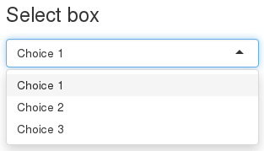
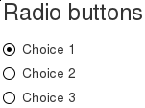
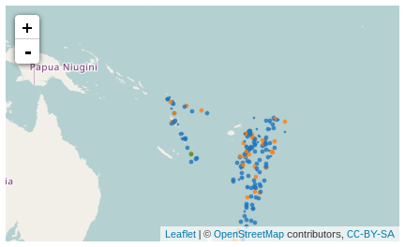
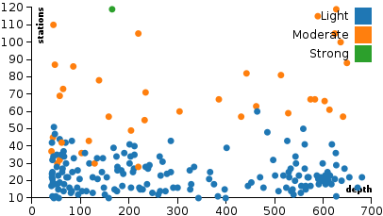
Using Rmarkdown to show Research
Derrick Kearney
HUBzero® Platform for Scientific Collaboration
Purdue University
This work licensed under
Creative Commons
See license online:
by-nc-sa/3.0
Notes:
Literate computing has a long history with contributions to the idea reaching from its creator Donald Knuth, to Mathematica, and Matlab. More recently we’ve seen the introduction of Jupyter Notebooks.
Rstudio Inc, a small company focused on the R programming language has built an ecosystem of tools that bring Literate Programming capabilities to the R programming language, while nicely incorporating the reporting and analysis tools that have been a halmark of the R programming language.
Today we’ll get a brief introduction to a few of these tools and see how they can be deployed as resources on the HUB.

Slide 2
Some people write programs like this...
spiro <- function(n1,n2,n3) {
t <- seq(0,1,length.out=1000)
z <- exp(1i*2*pi*n1*t) \
+ exp(1i*2*pi*n2*t) \
+ exp(1i*2*pi*n3*t) \
result <- data.frame(x=Re(z),y=Im(z))
return (result)
}
Notes:
You’ll notice this doesn’t launch the normal vnc viewer. Instead, the user is served a javascript based user interface.
This is the Rstudio IDE. There are 4 main parts to the IDE

Slide 3
Some people write programs like this...
# Comments Suck
spiro <- function(n1,n2,n3) {
t <- seq(0,1,length.out=1000)
z <- exp(1i*2*pi*n1*t) \
+ exp(1i*2*pi*n2*t) \
+ exp(1i*2*pi*n3*t) \
# Learn to read code!
result <- data.frame(x=Re(z),y=Im(z))
return (result)
}
Notes:
You’ll notice this doesn’t launch the normal vnc viewer. Instead, the user is served a javascript based user interface.
This is the Rstudio IDE. There are 4 main parts to the IDE

Slide 4
Other people write programs like this...
# Function to produce a spirograph
# Accepts 3 parameters describing the size of our wheels
spiro <- function(n1,n2,n3) {
t <- seq(0,1,length.out=1000)
# Spirographs can be approximated with this formula
z <- exp(1i*2*pi*n1*t) \
+ exp(1i*2*pi*n2*t) \
+ exp(1i*2*pi*n3*t) \
# store the results for the user
result <- data.frame(x=Re(z),y=Im(z))
return (result)
}
Notes:
You’ll notice this doesn’t launch the normal vnc viewer. Instead, the user is served a javascript based user interface.
This is the Rstudio IDE. There are 4 main parts to the IDE

Slide 5
And a few people write programs like this...
The spirograph equation for three of more wheels
can be generalized as follows:
$$z(t) = sum_{k=1}^n a_k e^{i2pi(n_kt+theta_k)}$$
This program solves those equations for three wheels,
assuming all of the $a$ coefficients are 1 and $theta$
coefficients are 0. Find more details online at
<http://linuxgazette.net/133/luana.html>.
```{r echo=TRUE}
spiro <- function(n1,n2,n3) {
t <- seq(0,1,length.out=1000)
z <- exp(1i*2*pi*n1*t) + exp(1i*2*pi*n2*t) + exp(1i*2*pi*n3*t)
result <- data.frame(x=Re(z),y=Im(z))
return (result)
}
ggplot(data=spiro(13,-7,-3),aes(x=x,y=y)) + geom_path()
```
Notes:
You’ll notice this doesn’t launch the normal vnc viewer. Instead, the user is served a javascript based user interface.
This is the Rstudio IDE. There are 4 main parts to the IDE

Slide 6
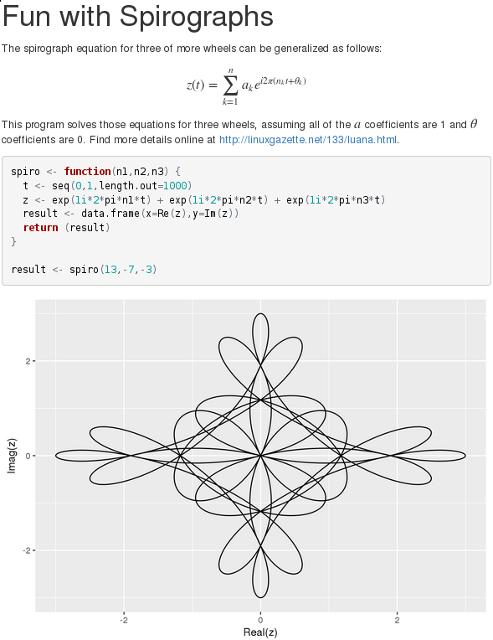
When they share their programs, it looks like this:
Notes:
You’ll notice this doesn’t launch the normal vnc viewer. Instead, the user is served a javascript based user interface.
This is the Rstudio IDE. There are 4 main parts to the IDE

Slide 7
Literate Programming
Donald Knuth. "Literate Programming (1984)" in Literate Programming. CSLI, 1992, pg. 99.
I believe that the time is ripe for significantly better documentation of programs, and that we can best achieve this by considering programs to be works of literature. Hence, my title: "Literate Programming."
Let us change our traditional attitude to the construction of programs: Instead of imagining that our main task is to instruct a computer what to do, let us concentrate rather on explaining to human beings what we want a computer to do.
The practitioner of literate programming can be regarded as an essayist, whose main concern is with exposition and excellence of style. Such an author, with thesaurus in hand, chooses the names of variables carefully and explains what each variable means. He or she strives for a program that is comprehensible because its concepts have been introduced in an order that is best for human understanding, using a mixture of formal and informal methods that reinforce each other.
literateprogramming.com (retrieved Apr 29, 2017)
Notes:
There are a number of applications working in this space.
Mathematica
Jupyter Notebooks
Sweave for R
Apache Zepplin
Rstudio with RMarkdown

Slide 8
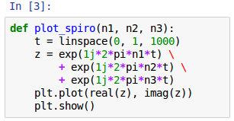
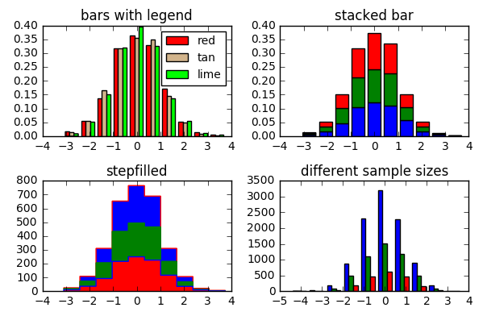
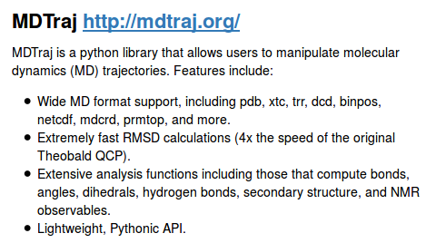
What are Interactive Notebooks?
Executable Code
& Calculations
Jupyter Notebook
calculations.ipynb
Notes:
The most recent interpretations of this include Interactive Notebooks

Slide 9
What are Interactive Notebooks?
Executable Code
& Calculations
Data Visualizations
Jupyter Notebook
calculations.ipynb

Slide 10
What are Interactive Notebooks?
Executable Code
& Calculations
Data Visualizations
Jupyter Notebook
calculations.ipynb
Narrative

Slide 11

Sharing Notebooks
Sharing Made Easy
- Text based file format
- Outputs stored with
document

Slide 12
Sharing Notebooks
Sharing Made Easy
- Text based file format
- Outputs stored with
document
Export Document to:
PDF, Word, HTML,
LaTeX, Slides,
Markdown, Wiki, EPub

Slide 13
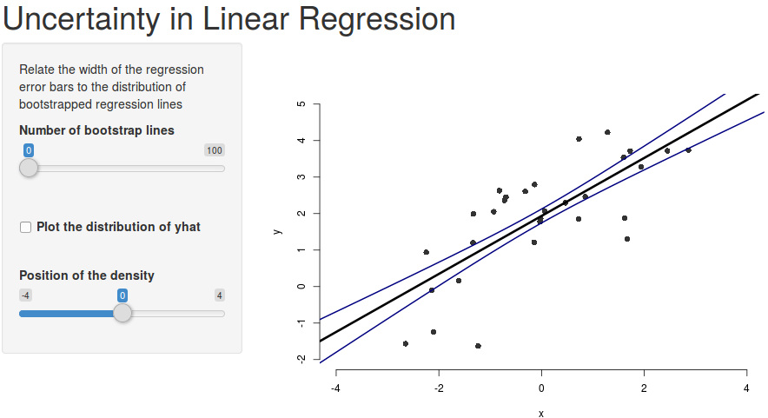
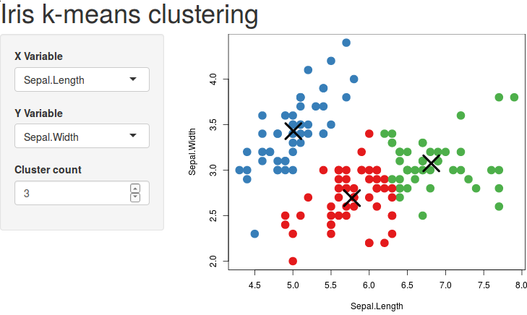
Sharing Notebooks
Sharing Made Easy
- Text based file format
- Outputs stored with
document
Export Document to:
PDF, Word, HTML,
LaTeX, Slides,
Markdown, Wiki, EPub
Embed Interactive
Web Applications

Slide 14
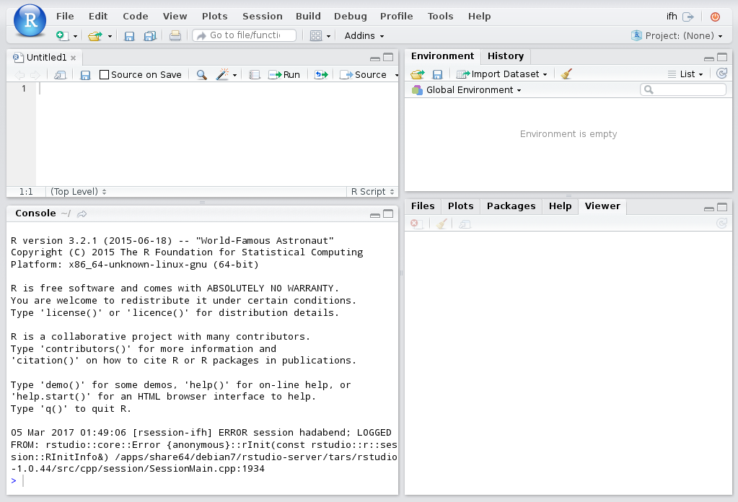
Launching RStudio IDE
Notes:
You’ll notice this doesn’t launch the normal vnc viewer. Instead, the user is served a javascript based user interface.
This is the Rstudio IDE. There are 4 main parts to the IDE

Slide 15
RStudio Interface Tour – Source Pane
Notes:
The Code Pane is where users manipulate source code

Slide 16
RStudio Interface Tour – Console Pane
Notes:
The console is where R commands are executed

Slide 17
RStudio Interface Tour – Environment Pane
Notes:
The Environment / History pane shows variables and files that have been loaded into the ide environment.

Slide 18
RStudio Interface Tour – Viewer Pane
Notes:
And the viewer pane shows output that can be visualized

Slide 19
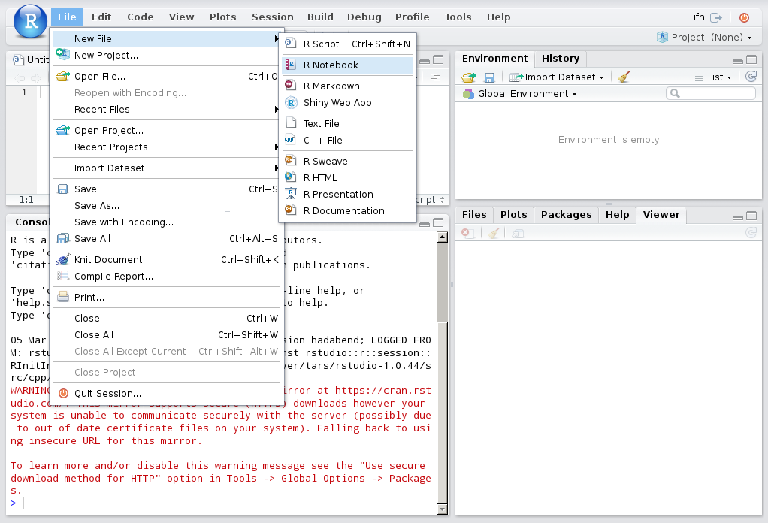
Writing R Code
Notes:
To write code, use the File → New menu item to open a new file.
Notice there are a number of different types of files you can open.
You would probably expect to be able to open an R file to write a regular program in R, but there are three other types of files I’d like to highlight today.

Slide 20
Writing R Code
Notes:
Shiny Web Apps, RMarkdown, and the closely related R Notebooks

Slide 21


Building Applications and Interactive Reports
RStudio and Shiny are trademarks of RStudio, Inc.
Notes:
The R language has a history of allowing people to easily generate reports. People have been using Sweave to combine R code and plots with LaTeX for years.
RStudio, the company behind the graphical user interface, has been focusing on building ways for people to more easily disseminate their research results and analysis, particularly on the web.
Two packages they developed to make this happen include Shiny and RMarkdown.
Shiny is a toolkit that allows users to put together web apps.

Slide 22
Building Applications and Interactive Reports
RStudio and Shiny are trademarks of RStudio, Inc.
Notes:
It includes things like the normal input widgets you would expect, sliders, radio buttons, dropdown menus.

Slide 23
Building Applications and Interactive Reports
RStudio and Shiny are trademarks of RStudio, Inc.
Notes:
And output widgets like text boxes and static plots.
It also includes a number of interactive output widgets backed by JavaScript libraries like leaflet for mapping, Plotly for plots, and data tables.

Slide 24
Building Applications and Interactive Reports
RStudio and Shiny are trademarks of RStudio, Inc.
Notes:
And it allows users to either fully describe their layout using a grid system or one of their predefined templates.
Shiny applications are backed by a shiny server, which produces the HTML, CSS, and JavaScript that the user renders in their web browser.
Let’s check out a couple of examples.

Slide 25
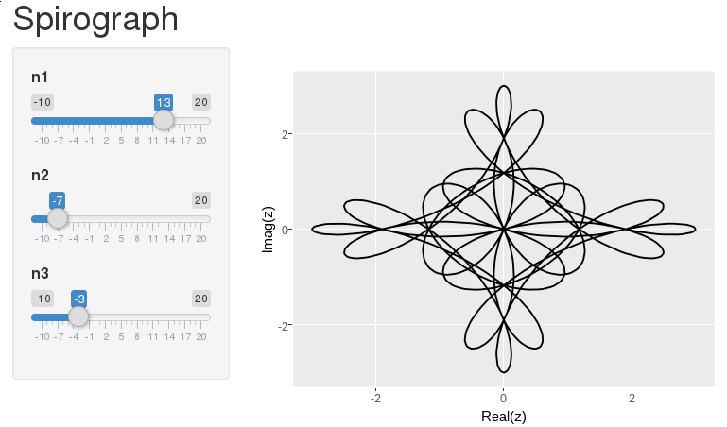
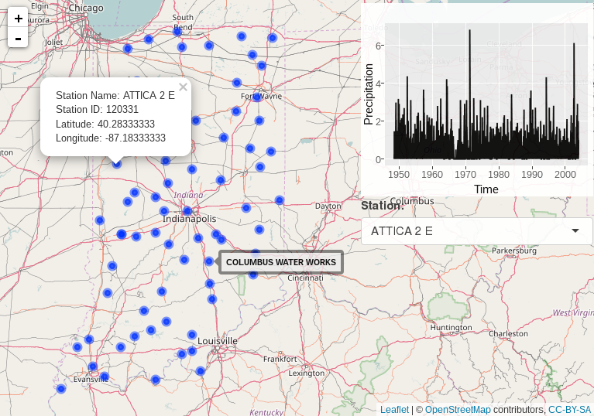
Shiny Example 1 - Spirograph
Spirograph Example
Indiana Precip Example
https://github.com/codedsk/hubzero-tool-spiro-shiny-1
https://github.com/codedsk/rplay/mapping/indiana-precip-shiny
RStudio and Shiny are trademarks of RStudio, Inc.
Notes:
https://github.com/codedsk/hubzero-tool-spiro-shiny-1

Slide 26
Shiny Example 2 – Indiana Precipitation
Spirograph Example
Indiana Precip Example
https://github.com/codedsk/hubzero-tool-spiro-shiny-1
https://github.com/codedsk/rplay/mapping/indiana-precip-shiny
RStudio and Shiny are trademarks of RStudio, Inc.
Notes:
https://github.com/codedsk/rplay/mapping/indiana-precip-shiny

Slide 27
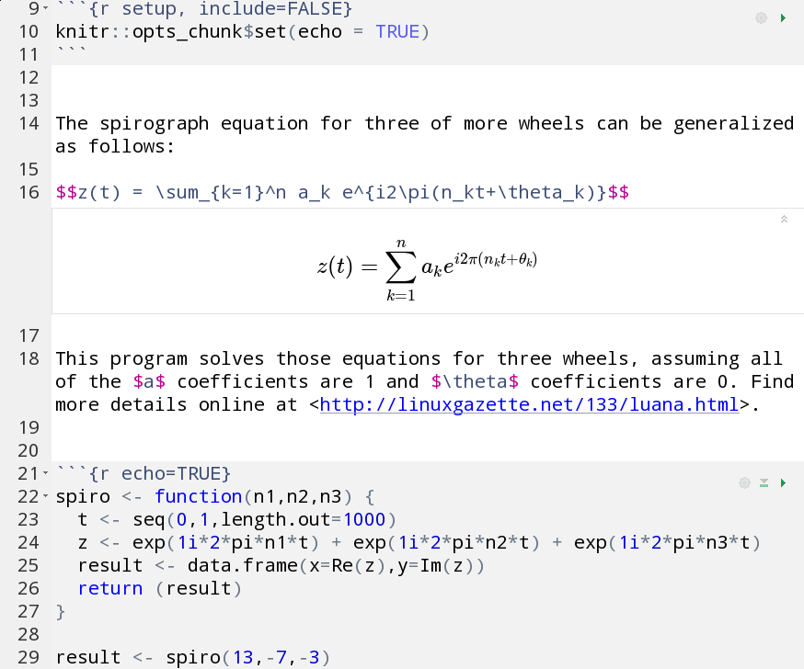
Building Applications and Interactive Reports
RStudio and Shiny are trademarks of RStudio, Inc.
Notes:
RMarkdown is a type of markup language, based on the markdown syntax that holds a few additional features including being able to hold R code.

Slide 28
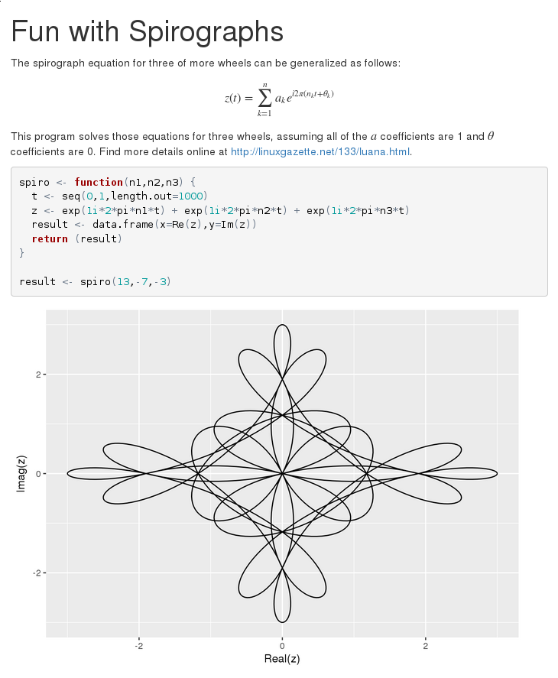
Building Applications and Interactive Reports
RStudio and Shiny are trademarks of RStudio, Inc.
Notes:
RMarkdown files can be converted to HTML files for distribution on the web or PDF files. Additionally they can be converted to Word document, LaTeX documents and a handful of other formats.
Thats one of the strengths of the system.

Slide 29
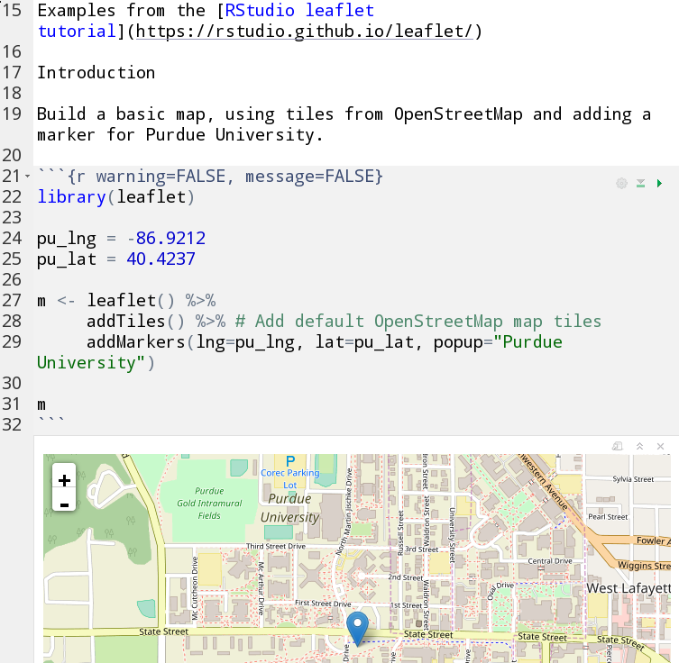
Rmd Example 1 – Markup
Markup Example
Notebook w/
HTML Widgets
RMarkdown w/
Shiny Widgets
https://github.com/codedsk/rplay
RStudio and Shiny are trademarks of RStudio, Inc.
Notes:
Let’s check out some examples
http://github.com/codedsk/rplay/rmarkdown/plain_markup.Rmd

Slide 30
Rmd Example 2 – Notebook w/ HTML Widgets
Markup Example
Notebook w/
HTML Widgets
RMarkdown w/
Shiny Widgets
https://github.com/codedsk/rplay
RStudio and Shiny are trademarks of RStudio, Inc.
Notes:
http://github.com/codedsk/rplay/mapping/notebook_htmlwidgets_example.Rmd

Slide 31
Rmd Example 3 – Rmd w/ Shiny Widgets
Markup Example
Notebook w/
HTML Widgets
RMarkdown w/
Shiny Widgets
https://github.com/codedsk/rplay
RStudio and Shiny are trademarks of RStudio, Inc.
Notes:
http://github.com/codedsk/hubzero-tool-spiro-rmd-html-rshiny-widgets/src/spirograph_with_shiny_widgets.Rmd.

Slide 32
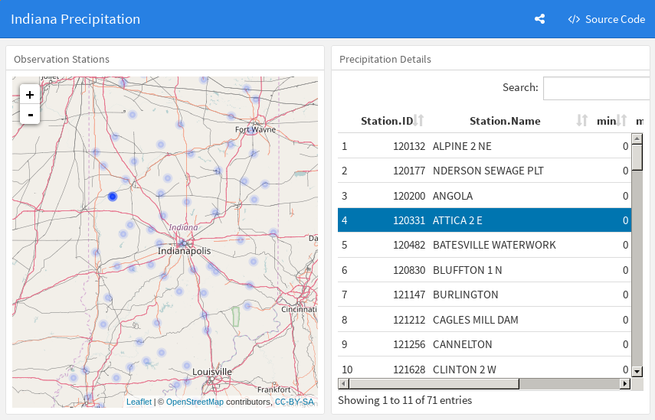
Layout and widget communication w/o Shiny
Notes:
https://github.com/codedsk/rplay/mapping/indiana_precip_dashboard_1.Rmd
Shiny apps require a server and provide great flexibility to control how widgets react to changes to each other.
The flexdashboard module allows users to layout a dashboard using html widgets.
The crosstalk module allows you to coordinate communication between the widgets so as you filter with say a map widget, an xy plot also sees the changes and reacts accordingly.

