Slide 1

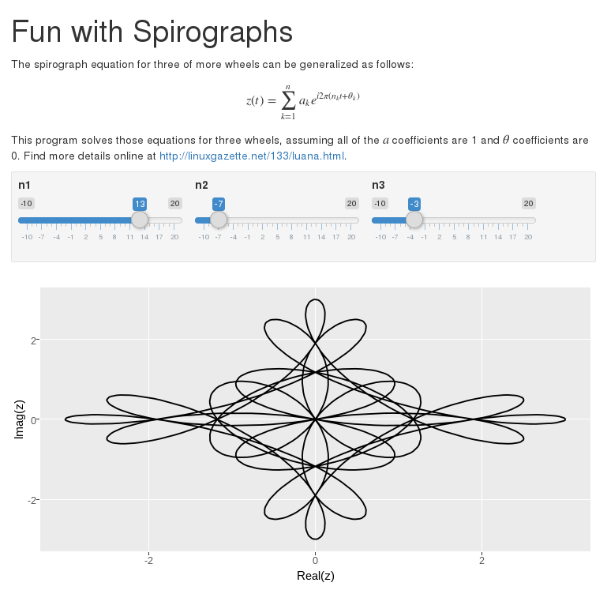
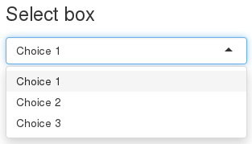
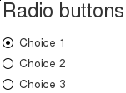
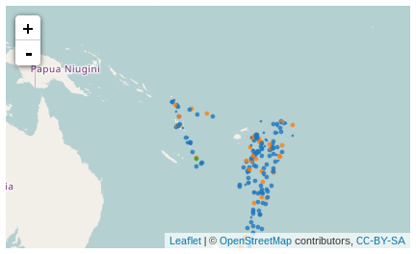
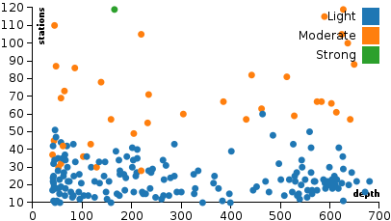
Developing with R on HUBzero
Derrick Kearney
HUBzero® Platform for Scientific Collaboration
Purdue University
This work licensed under
Creative Commons
See license online:
by-nc-sa/3.0
Notes:
Literate computing has a long history with contributions to the idea reaching from its creator Donal Knuth, to Mathematica, and Matlab. More recently we’ve seen the introduction of Jupyter Notebooks.
Rstudio Inc, a small company focused on the R programming language has built an ecosystem of tools that bring Literate Programming capabilities to the R programming language, while nicely incorporating the reporting and analysis tools that have been a halmark of the R programming language.
Today we’ll get a brief introduction to a few of these tools and see how they can be deployed as resources on the HUB.

Slide 2
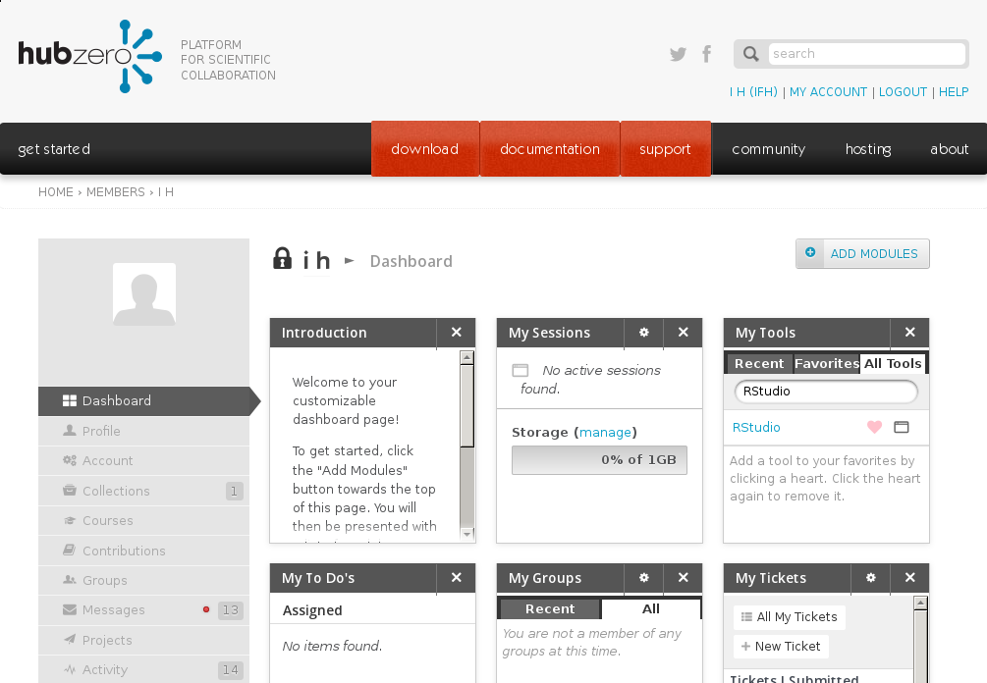
Launching RStudio From HUBzero
Notes:
The RstudioIDE is available on the HUB

Slide 3
Launching RStudio From HUBzero
Notes:
You can search for it under the My Tools module
When you click the launch tool button,

Slide 4
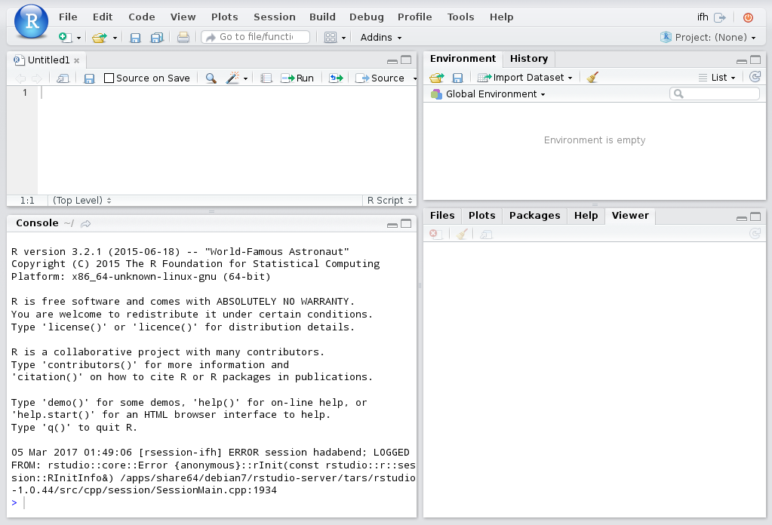
Launching RStudio From HUBzero
Notes:
You’ll notice this doesn’t launch the normal vnc viewer. Instead, the user is served a javascript based user interface.
This is the Rstudio IDE. There are 4 main parts to the IDE

Slide 5
RStudio Interface Tour – Source Pane
Notes:
The Code Pane is where users manipulate source code

Slide 6
RStudio Interface Tour – Console Pane
Notes:
The console is where R commands are executed

Slide 7
RStudio Interface Tour – Environment Pane
Notes:
The Environment / History pane shows variables and files that have been loaded into the ide environment.

Slide 8
RStudio Interface Tour – Viewer Pane
Notes:
And the viewer pane shows output that can be visualized

Slide 9
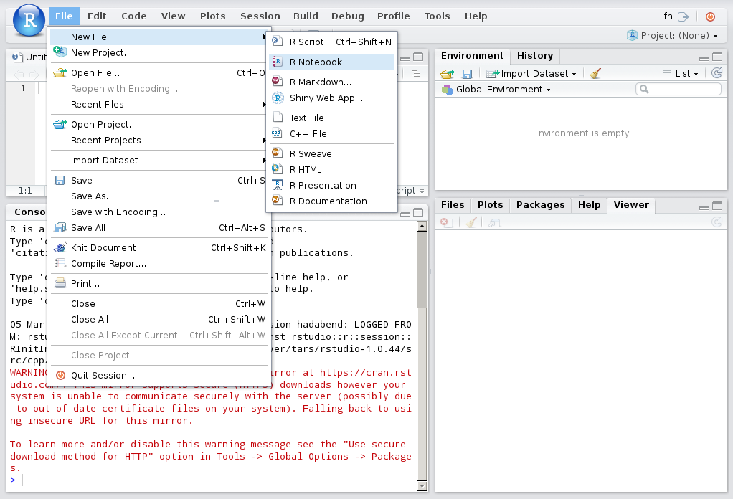
Writing R Code
Notes:
To write code, use the File → New menu item to open a new file.
Notice there are a number of different types of files you can open.
You would probably expect to be able to open an R file to write a regular program in R, but there are three other types of files I’d like to highlight today.

Slide 10
Writing R Code
Notes:
Shiny Web Apps
Rmarkdown, and the closely related R Notebooks

Slide 11


Building Applications and Interactive Reports
RStudio and Shiny are trademarks of RStudio, Inc.
Notes:
The R language has a history of allowing people to easily generate reports. People have been using Sweave to combine R code and plots with LaTeX for years.
Rstudio, the company behind the graphical user interface, has been focusing on building ways for people to more easily disseminate their research results and analysis, particularly on the web.
Two packages they developed to make this happen include Shiny and Rmarkdown.
Shiny is a toolkit that allows users to put together web apps.

Slide 12
Building Applications and Interactive Reports
RStudio and Shiny are trademarks of RStudio, Inc.
Notes:
It includes things like the normal input widgets you would expect, sliders, radio buttons, dropdown menus.

Slide 13
Building Applications and Interactive Reports
RStudio and Shiny are trademarks of RStudio, Inc.
Notes:
And output widgets like text boxes and static plots.
It also includes a number of interactive output widgets backed by javascript libraries like leaflet for mapping, plotly for plots, and data tables.

Slide 14
Building Applications and Interactive Reports
RStudio and Shiny are trademarks of RStudio, Inc.
Notes:
And it allows users to either fully describe their layout using a grid system or one of their predefined templates.
Shiny applications are backed by a shiny server, which produces the html, css, and javascript that the user renders in their web browser.
Let’s check out a couple of examples.

Slide 15
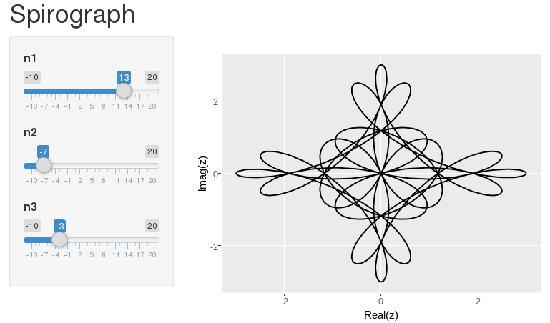
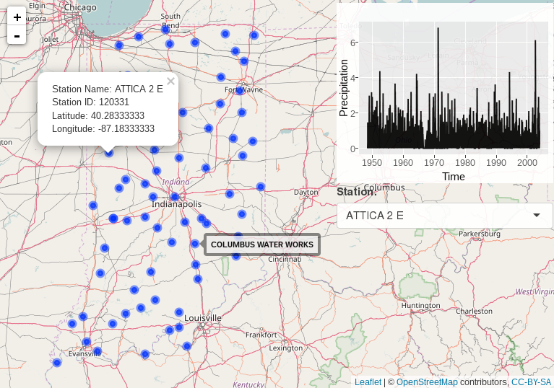
Shiny Example 1 - Spirograph
Spirograph Example
Indiana Precip Example
https://github.com/codedsk/hubzero-tool-spiro-shiny-1
https://github.com/codedsk/rplay/mapping/indiana-precip-shiny
RStudio and Shiny are trademarks of RStudio, Inc.
Notes:
https://github.com/codedsk/hubzero-tool-spiro-shiny-1

Slide 16
Shiny Example 2 – Indiana Precipitation
Spirograph Example
Indiana Precip Example
https://github.com/codedsk/hubzero-tool-spiro-shiny-1
https://github.com/codedsk/rplay/mapping/indiana-precip-shiny
RStudio and Shiny are trademarks of RStudio, Inc.
Notes:
https://github.com/codedsk/rplay/mapping/indiana-precip-shiny

Slide 17
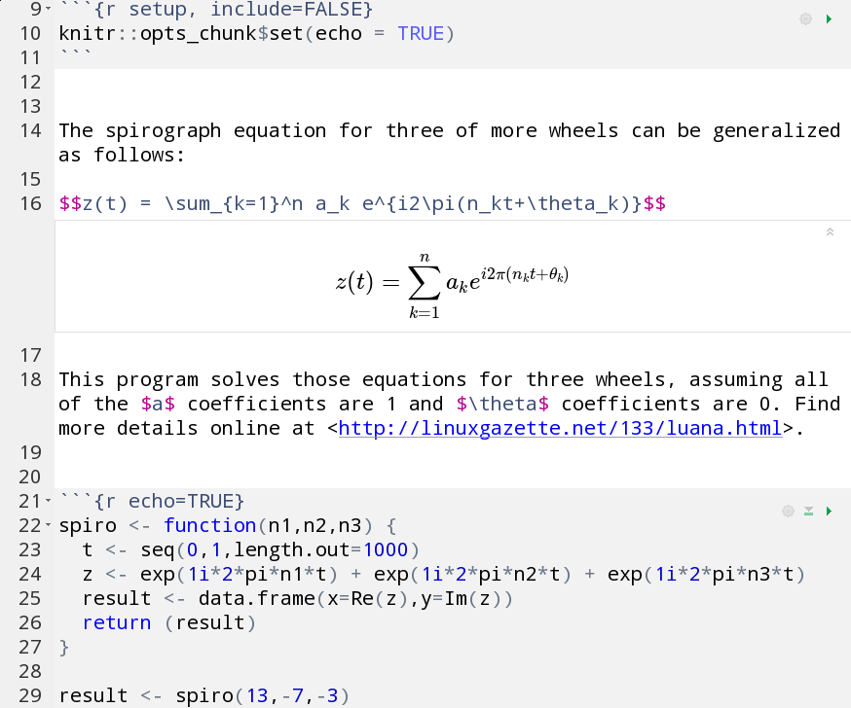
Building Applications and Interactive Reports
RStudio and Shiny are trademarks of RStudio, Inc.
Notes:
Rmarkdown is a type of markup language, based on the markdown syntax that holds a few additional features including being able to hold R code.

Slide 18
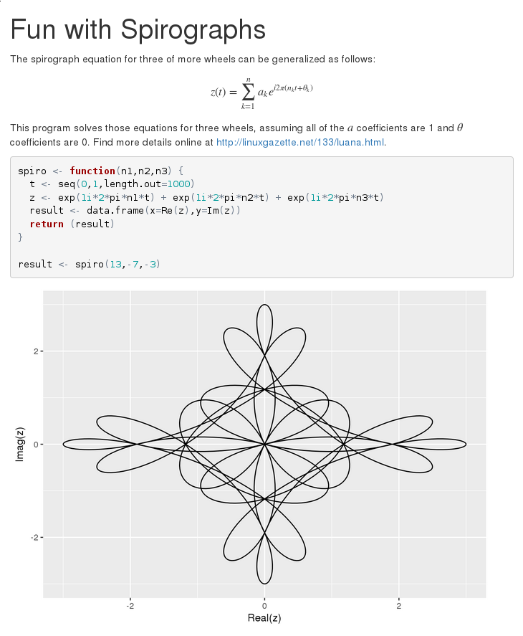
Building Applications and Interactive Reports
RStudio and Shiny are trademarks of RStudio, Inc.
Notes:
Rmarkdown files can be converted to HTML files for distribution on the web or PDF files. Additionally they can be converted to Word document, LaTeX documents and a handful of other formats.
Thats one of the strengths of the system.

Slide 19
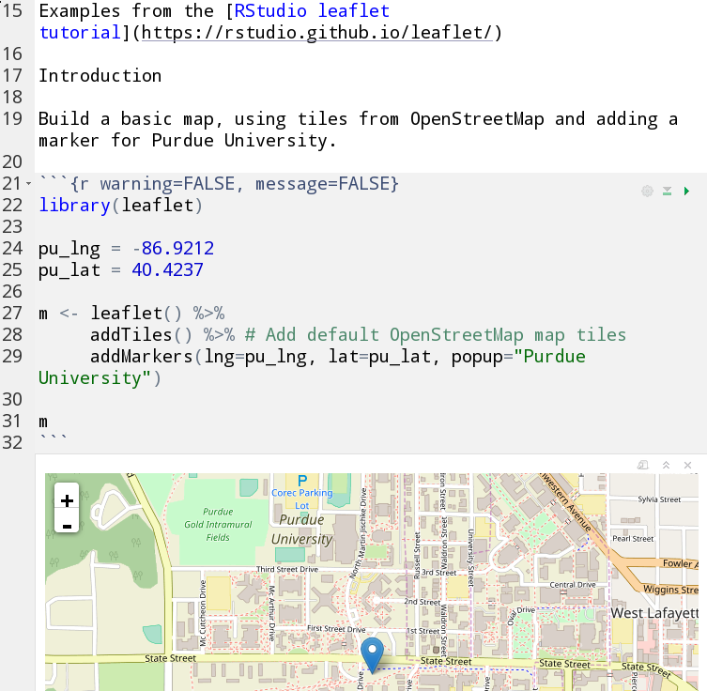
RMarkdown Example 1 – Markup
Markup Example
Notebook w/
HTML Widgets
RMarkdown w/
Shiny Widgets
https://github.com/codedsk/rplay
RStudio and Shiny are trademarks of RStudio, Inc.
Notes:
Let’s check out some examples
http://github.com/codedsk/rplay/rmarkdown/plain_markup.Rmd

Slide 20
RMarkdown Example 2 – Notebook w/ HTML Widgets
Markup Example
Notebook w/
HTML Widgets
RMarkdown w/
Shiny Widgets
https://github.com/codedsk/rplay
RStudio and Shiny are trademarks of RStudio, Inc.
Notes:
http://github.com/codedsk/rplay/mapping/leaflet_plotly_examples.Rmd

Slide 21
RMarkdown Example 3 – Rmd w/ Shiny Widgets
Markup Example
Notebook w/
HTML Widgets
RMarkdown w/
Shiny Widgets
https://github.com/codedsk/rplay
RStudio and Shiny are trademarks of RStudio, Inc.
Notes:
http://github.com/codedsk/hubzero-tool-spiro-rmd-html-rshiny-widgets/src/spirograph_with_shiny_widgets.Rmd.

Slide 22

Publishing on the HUB
Source Code
Graphical User
Interface
Makefile
Invoke
Script

Slide 23
Publishing on the HUB
Source Code
Graphical User
Interface
Makefile
Invoke
Script

Slide 24
Publishing on the HUB
Source Code
Graphical User
Interface
Makefile
Invoke
Script
</>
HTML
RStudio and Shiny are trademarks of RStudio, Inc.

Slide 25
Publishing on the HUB
Source Code
Graphical User
Interface
Makefile
Invoke
Script
all:
@. /etc/environ.sh; \
use -e -r R-3.2.1; \
use -e -r rstudio-server-1.0.44; \
Rscript -e "rmarkdown::render('${RMDFILE}')"
install:
install --mode 0444 -D ${HTMLFILE} ${WWWDIR}/${HTMLFILE}
ln -s ${HTMLFILE} ${WWWDIR}/index.html

Slide 26
Publishing on the HUB
Source Code
Graphical User
Interface
Makefile
Invoke
Script
/usr/bin/invoke_app "$@" -t spirormddoc \
-u R-3.2.1 \
-u rstudio-server-1.0.44 \
-u wrwroxy-0.1 \
-u wrapprun-0.1 \
-c "wrwroxy --listenPort 8000 --forwardPort 8001 --stream-log --logfile /dev/null" \
-C "wrapprun --host 0.0.0.0 --port 8001 @tool/www/index.html"

Slide 27
Publishing on the HUB
Source Code
Graphical User
Interface
Makefile
Invoke
Script
all:
install:
install --mode 0444 -D ${RMDFILE} ${BINDIR}/${RMDFILE}

Slide 28
Publishing on the HUB
Source Code
Graphical User
Interface
Makefile
Invoke
Script
/usr/bin/invoke_app "$@" -t spirormddoc \
-u R-3.2.1 \
-u rstudio-server-1.0.44 \
-u wrwroxy-0.1 \
-u wrapprun-0.1 \
-c "wrwroxy --listenPort 8000 --forwardPort 8001 --stream-log --logfile /dev/null" \
-C "wrapprun --host 0.0.0.0 --port 8001 @tool/bin/spirograph.Rmd"

Slide 29
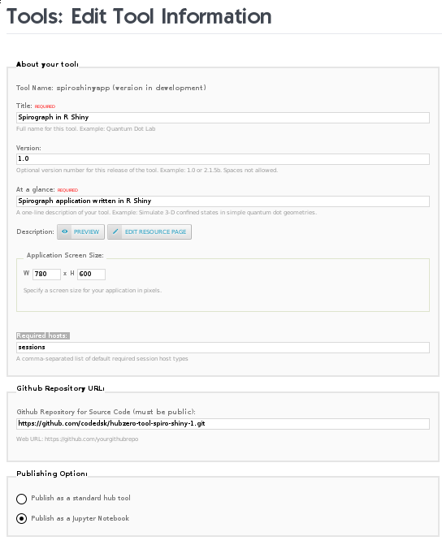
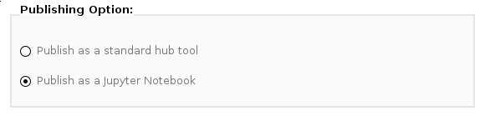
Contribtool: View as Notebook

Slide 31
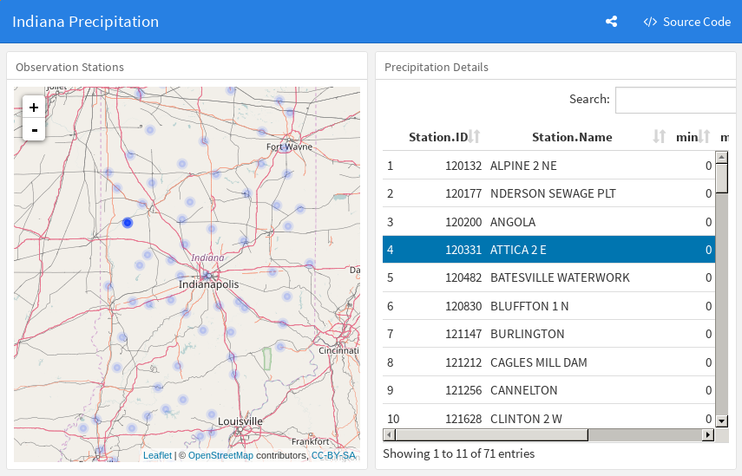
Layout and widget communication without Shiny
Notes:
https://github.com/codedsk/rplay/mapping/indiana_precip_dashboard_1.Rmd
Shiny apps require a server and provide great flexibility to control how widgets react to changes to each other.
The flexdashboard module allows users to layout a dashboard using html widgets.
The crosstalk module allows you to coordinate communication between the widgets so as you filter with say a map widget, an xy plot also sees the changes and reacts accordingly.

