Slide 1
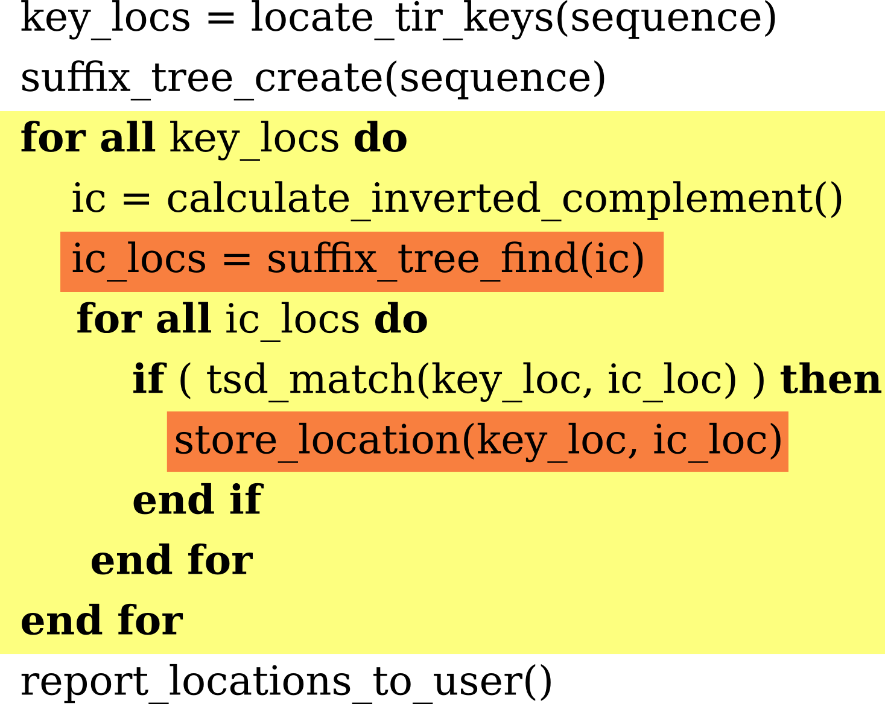
Trolling for Transposons
Derrick Kearney
dsk@purdue.edu
Purdue University
ECE 563
April 16, 2009

Slide 2

Identifying Transposons

Slide 3
Approach

Slide 4
Test Setup
Machine A:
2 x Dual-Core AMD Opteron
Processor Model 2222
(3GHz / 2 x 1MB – L2)‏
Machine B:
2 x Quad-Core Intel Xeon
Processor X5355
(2.66Ghz / 2 x 4MB - L2)‏

Slide 5
Future Work
Lower memory footprint
New ways to report uniques

