Slide 1
GABBs Simulation and Data Visualization Features
36 Month Review
Dec 7, 2016
Derrick Kearney hubzero.org

Slide 2
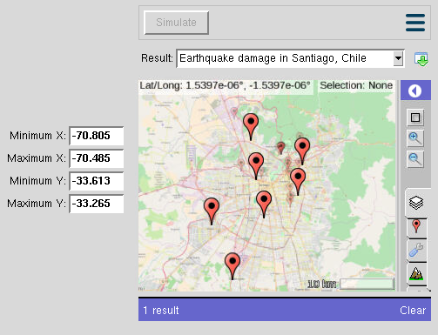
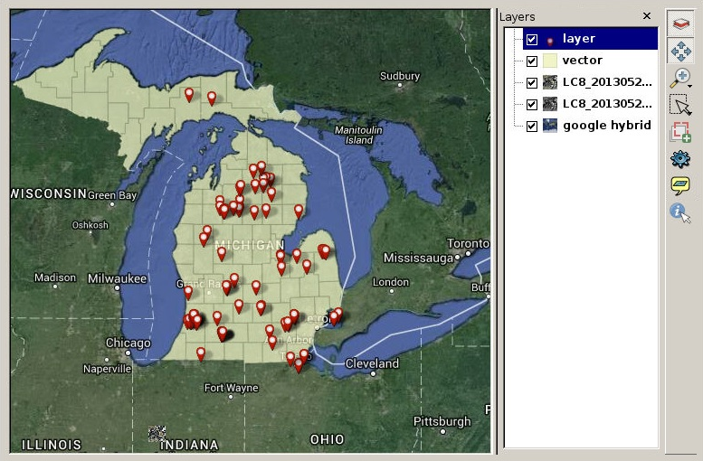
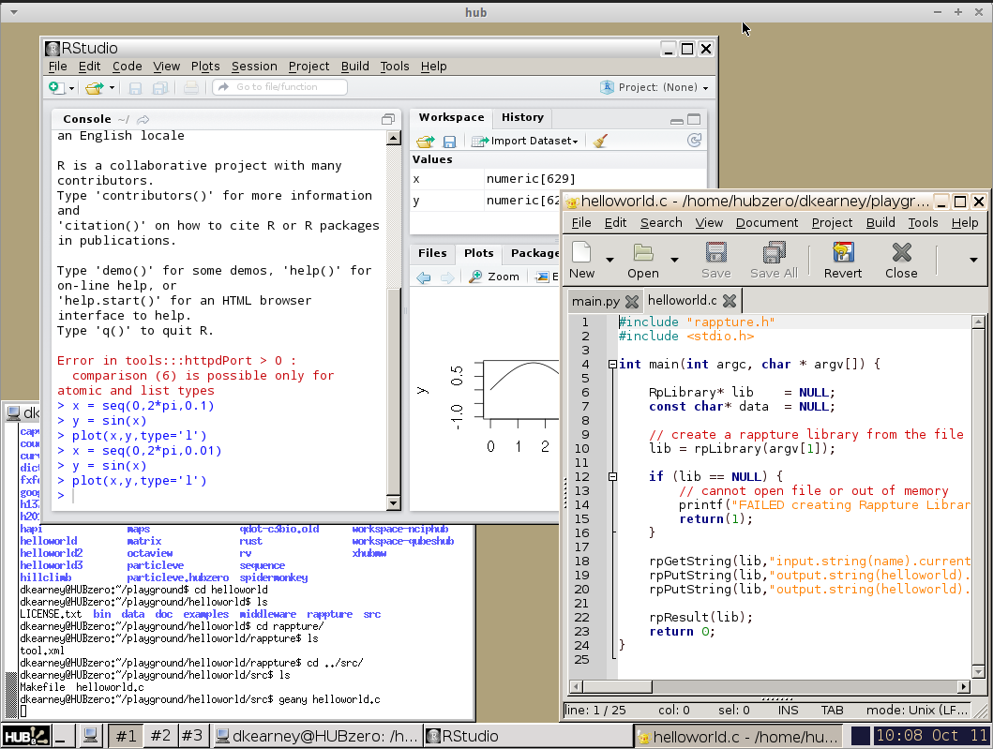
Agenda
Rappture Toolkit
PyMapLib
Geospatial Output Widget
Render servers support
Example applications
API origins
Example applications
Tool
Containers

Slide 3
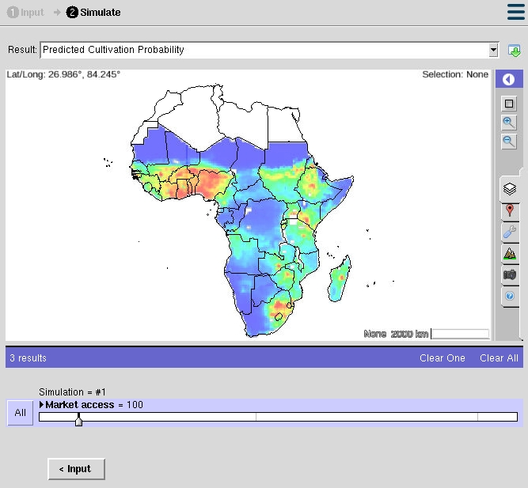
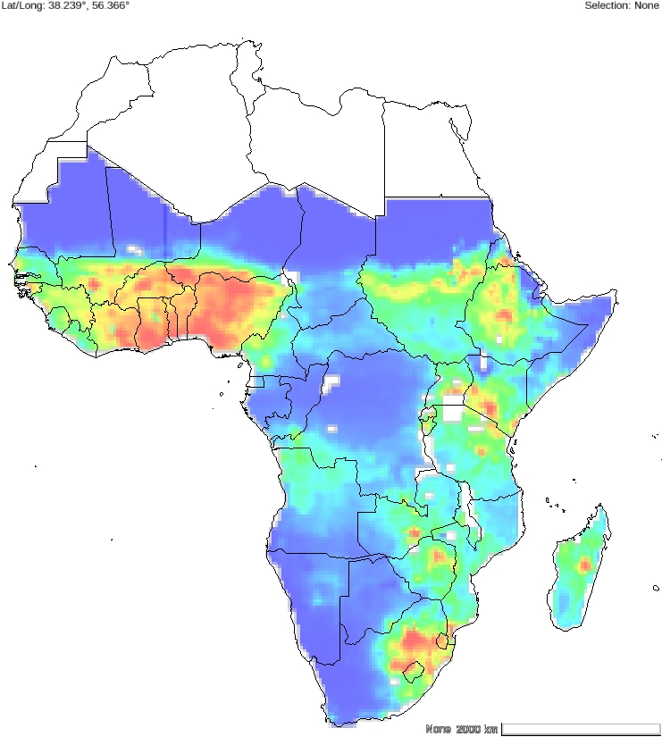


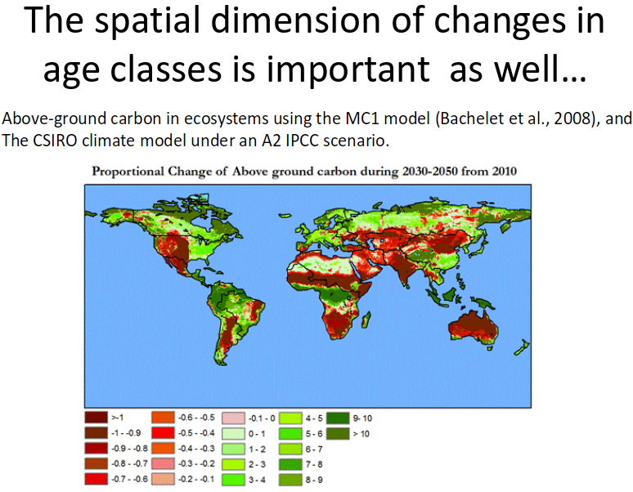

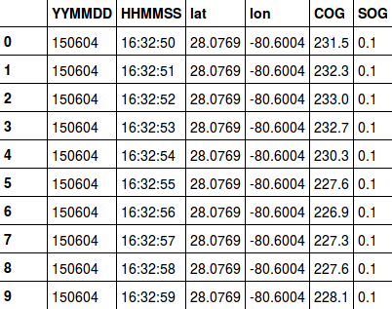
HUBzero Infrastructure
Simulation & Modeling
Q/A,
Wishlists,
Points
Online
Education
Seminars
Data
Management

Slide 4
HUBzero Infrastructure
Simulation & Modeling
Q/A,
Wishlists,
Points
Online
Education
Seminars
Data
Management

Slide 5
HUBzero Infrastructure
Simulation & Modeling
Q/A,
Wishlists,
Points
Online
Education
Seminars
Data
Management

Slide 6
HUBzero Infrastructure
Simulation & Modeling
Q/A,
Wishlists,
Points
Online
Education
Seminars
Data
Management

Slide 7
HUBzero Infrastructure
Simulation & Modeling
Q/A,
Wishlists,
Points
Online
Education
Seminars
Data
Management

Slide 8
HUBzero Infrastructure
Simulation & Modeling
Q/A,
Wishlists,
Points
Online
Education
Seminars
Data
Management

Slide 9
HUBzero Infrastructure
Simulation & Modeling
Q/A,
Wishlists,
Points
Online
Education
Seminars
Data
Management

Slide 10
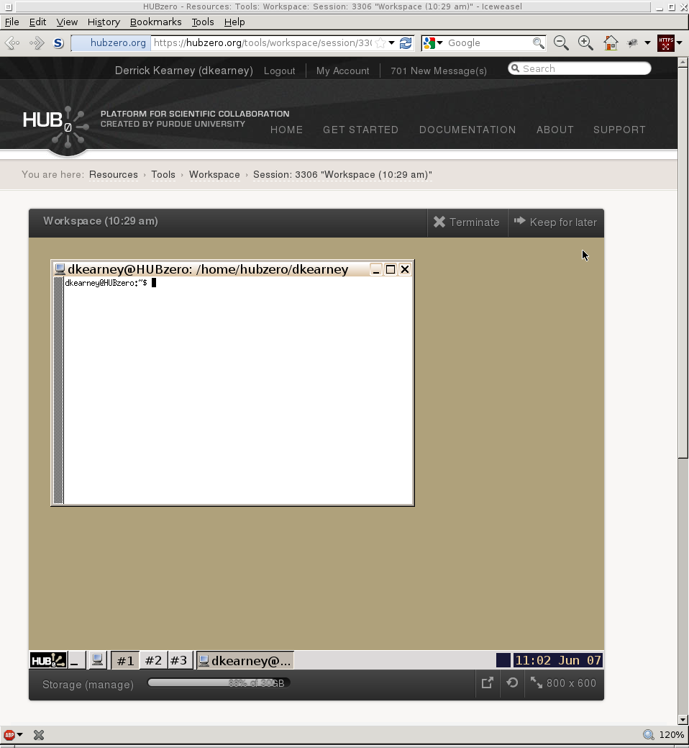
Tool Containers
User's Web Browser

Slide 11

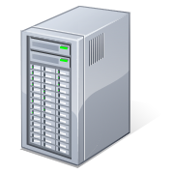
Tool Containers
User's Web Browser
HUBzero Infrastructure
Web Server
Middleware
Tool
Containers

Slide 12





Tool Containers
User's Web Browser
HUBzero Infrastructure
External Services
Web Server
Middleware
Grid
Submit
Proxy
Tool
Containers

Slide 13
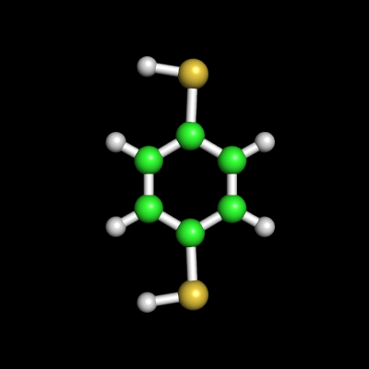


Tool Containers
User's Web Browser
HUBzero Infrastructure
External Services
Web Server
Middleware
Grid
Submit
Proxy
Tool
Containers
Visualization

Slide 14
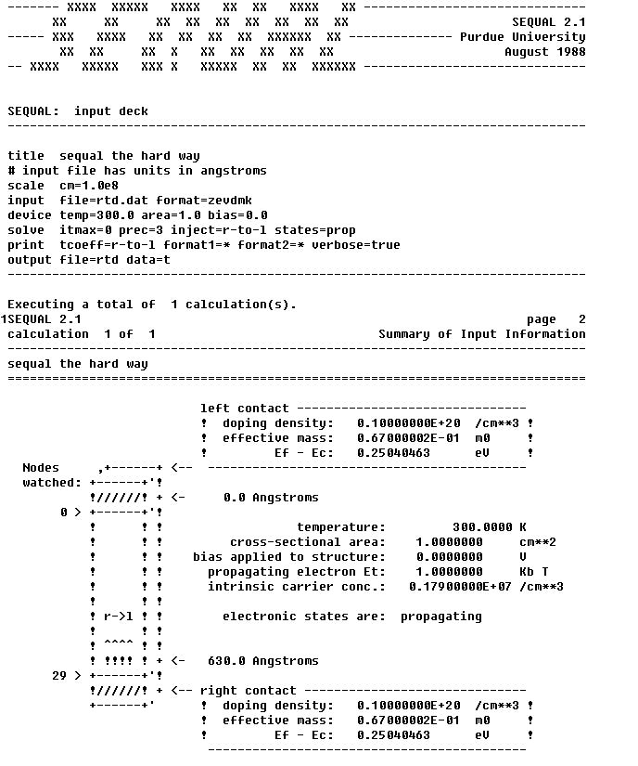
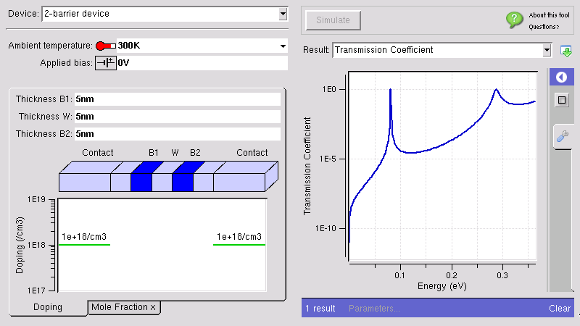



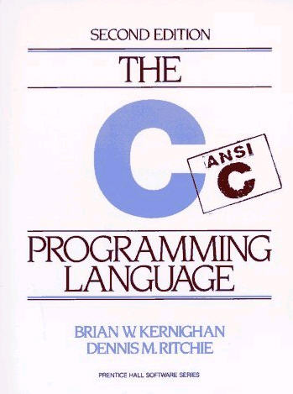

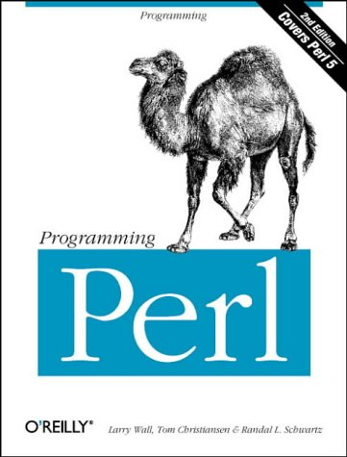



The Rappture Toolkit
inputs
outputs
Rappture
Rapid Application Infrastructure
Released in May 2005
Open Source (rappture.org)
Create standard desktop apps
Works with your favorite
programming language

Slide 15
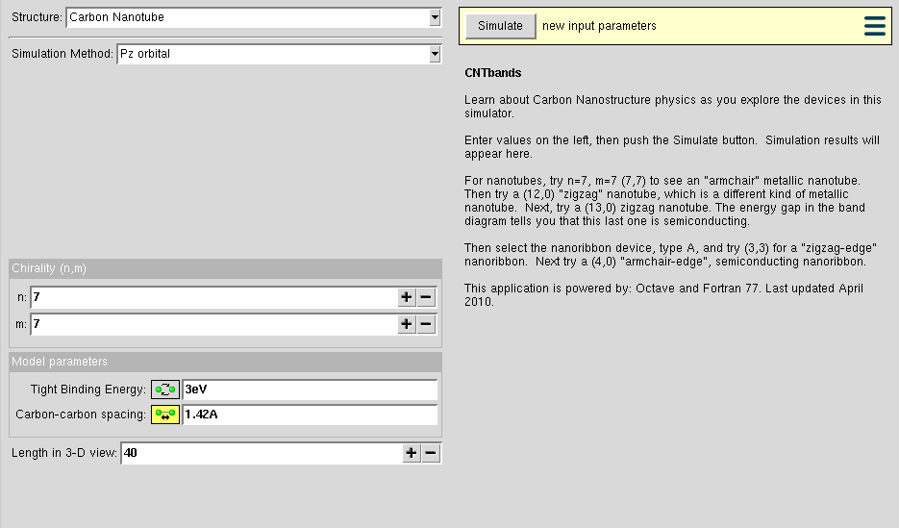
Tool Containers
HUBzero Infrastructure
External Services
Web Server
Middleware
Grid
Submit
Proxy
Tool
Containers
Visualization

Slide 16
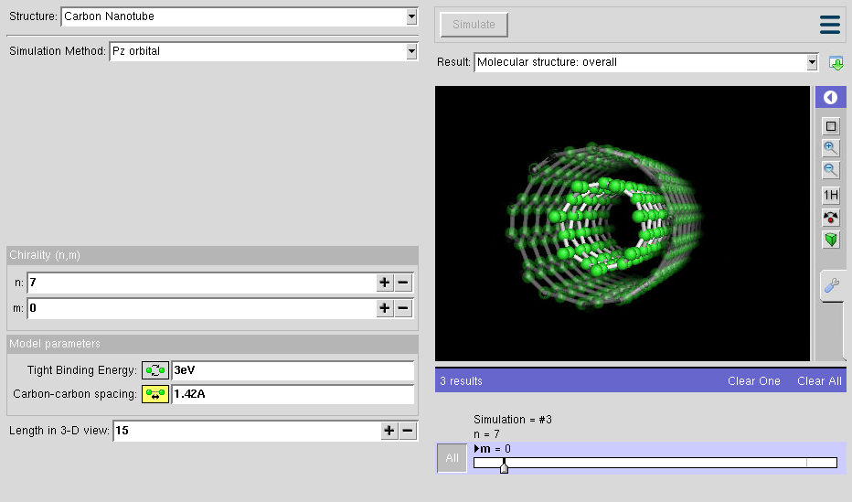
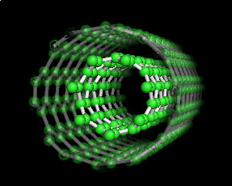
Tool Containers
HUBzero Infrastructure
External Services
Web Server
Middleware
Grid
Submit
Proxy
Tool
Containers
Visualization

Slide 17
Tool Containers
HUBzero Infrastructure
Visualization Type
Supported ?
Web Server
Molecules
☑
3D Structures
☑
Middleware
Geospacial Data

Submit
Proxy
Tool
Containers
Visualization

Slide 18
Tool Containers
HUBzero Infrastructure
Visualization Type
Supported ?
Web Server
Molecules
☑
3D Structures
☑
Middleware
Geospacial Data
☑
Supported Data Formats:
Raster: GeoTiff, netCDF,
PNG, jpeg, TMS,
WMS, XYZ
Vector: ESRI shapefile,
TFS, WFS,
PostGIS
Model: 3D model formats of
OpenSceneGraph
Submit
Proxy
Tool
Containers
Visualization

Slide 19



Tool Containers
HUBzero Infrastructure
Visualization Type
Supported ?
External Services
Web Server
Molecules
☑
3D Structures
☑
Middleware
Geospacial Data
Grid
☑
Supported Data Formats:
Raster: GeoTiff, netCDF,
PNG, jpeg, TMS,
WMS, XYZ
Vector: ESRI shapefile,
TFS, WFS,
PostGIS
Model: 3D model formats of
OpenSceneGraph
Submit
Proxy
Tool
Containers
OpenStreetMap
Visualization

Slide 20
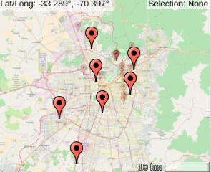
Building Block: Rappture Mapping Widget
Visualization

Slide 21
Building Block: Rappture Mapping Widget
Visualization

Slide 22
5 Step Widget Integration
1. Setup the MapViewer
2. Describe the Layers
3. Configure Attribute
Placard
4. Configure the Camera
5. Render Results

Slide 23
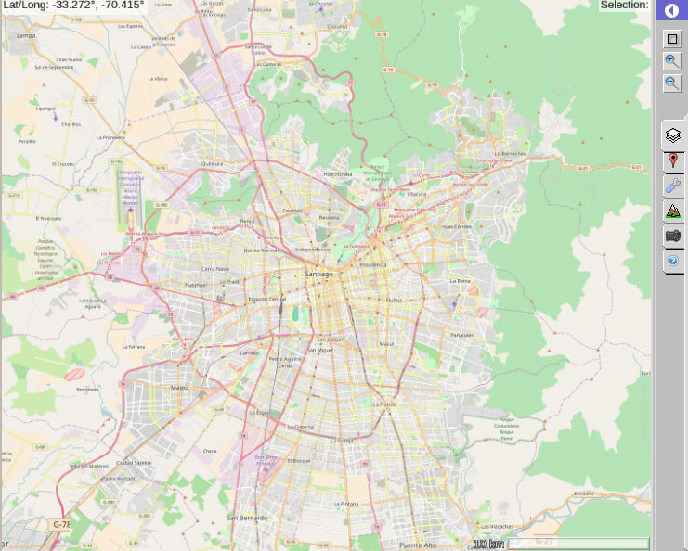
Step 1: Setup the MapViewer
set driver [Rappture::library [lindex $argv 0]]
…
$driver put $mapPath.about.label "Earthquake damage in Santiago, Chile"
$driver put $mapPath.type "projected"
$driver put $mapPath.projection "global-mercator"

Slide 24
Step 2: Describe the Layers
…
# Add a base layer from OpenStreetMap.org
set osmLayerPath “$layersPath.layer(osm)”
$driver put $osmLayerPath.label "OSM Map"
$driver put $osmLayerPath.description "OpenStreetMap Street base layer"
$driver put $osmLayerPath.type "image"
$driver put $osmLayerPath.xyz.url {http://[abc].tile.openstreetmap.org/{z}/{x}/{y}.png}

Slide 25
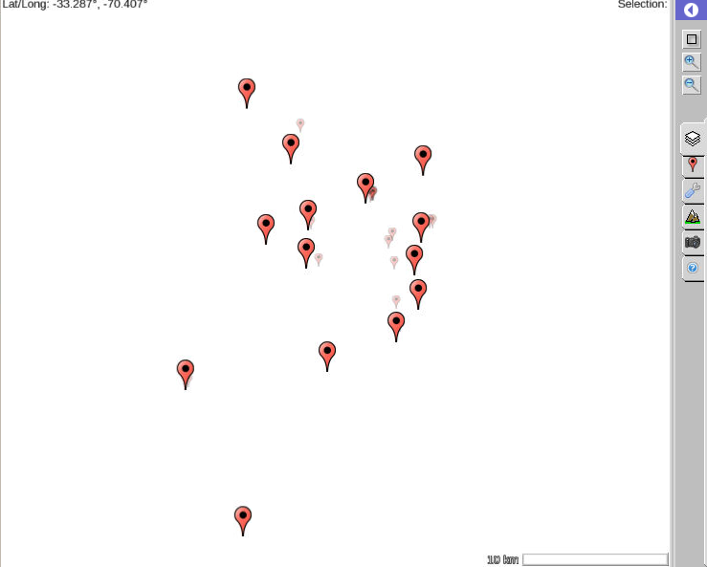
Step 2: Describe the Layers
…
$driver put $osmLayerPath.type "image"
$driver put $osmLayerPath.xyz.url {http://[abc].tile.openstreetmap.org/{z}/{x}/{y}.png}
# Now add a data layer from a CSV file using the OGR driver
set csvLayerPath “$layersPath.layer(csv)”
$driver put $csvLayerPath.label "Chile Stations"
$driver put $csvLayerPath.description "Locations of damage from the chile earthquake."
$driver put $csvLayerPath.type "icon"
$driver put $csvLayerPath.ogr.url "local://chile_station_latlon.csv"

Slide 26
Step 3: Configure the Placard
Lat: -33.43
Lon: -70.667
…
$driver put $csvLayerPath.placard.attributes \
“ latitude Lat
longitude Lon ”
# Additional optional placard styling
$driver put $csvLayerPath.placard.style \
" fill: #B6B6B688;
text-fill: #000000;
text-size: 12.0; "

Slide 27
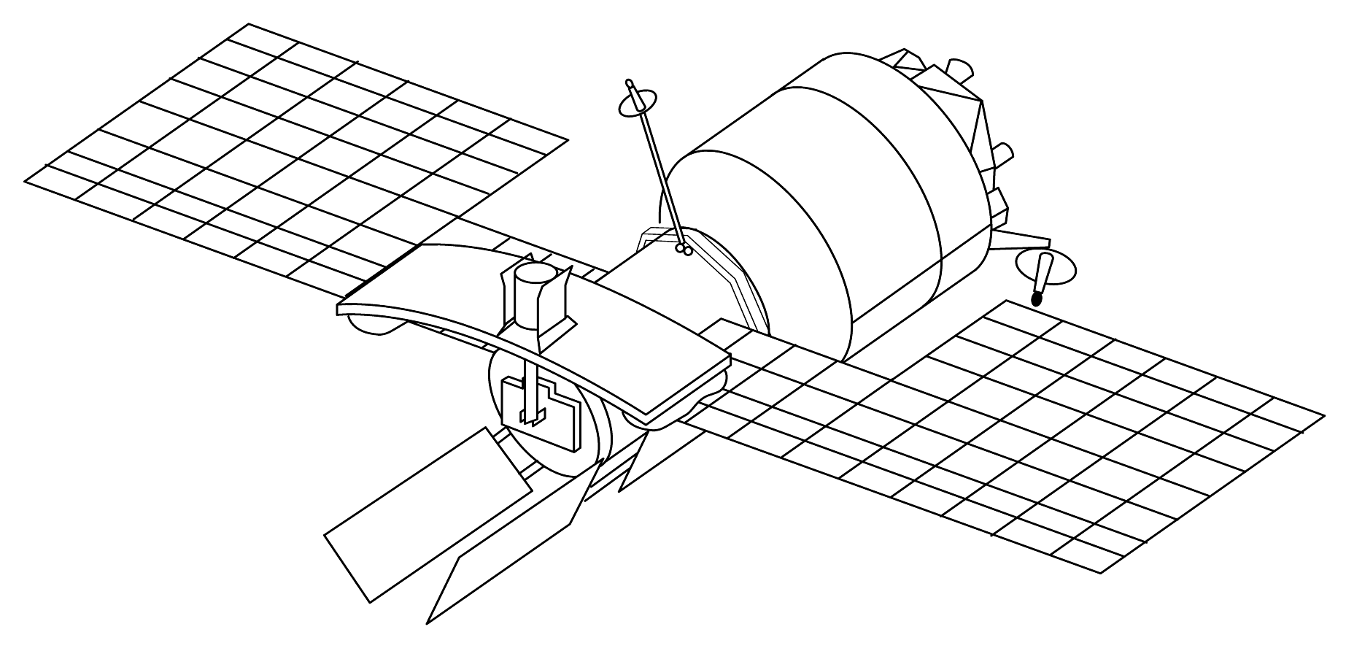
Step 4: Configure the Camera
…
$driver put $mapPath.camera \
" xmin -70.805
xmax -70.485
ymin -33.613
ymax -33.265
srs wgs84 "

Slide 28
Step 5: Render the Result
…
Rappture::result $driver

Slide 29
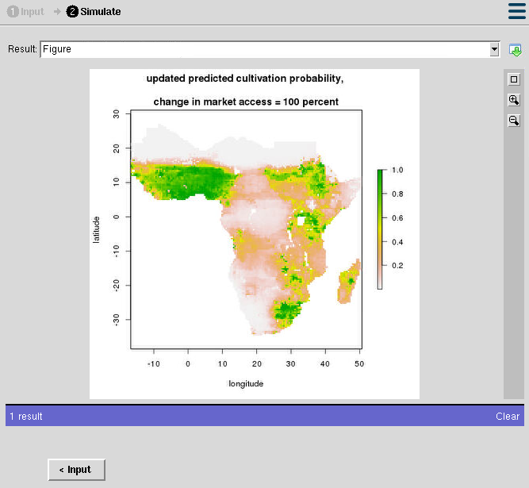
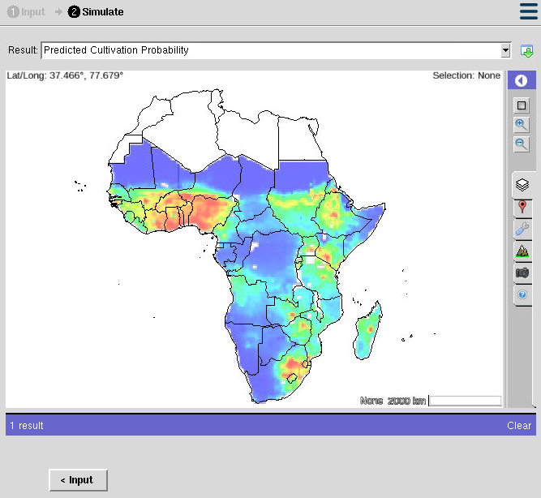
Example Application: LandParam
Before
After
R generated PNG of map
Interactive Rappture
Map Widget

Slide 30
Building Block: PyMapLib
Generic framework for geospacial
data visualization
Quickly build maps with little
geospacial experience
Handles common types of data:
  Vector
  Raster
  Delimited Text
Python based user interface widget
For doing simple data visualization and analysis

Slide 31



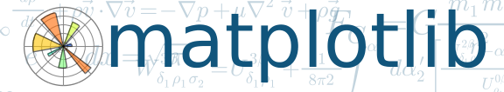

PyMapLib: Utilizes standard libraries
PyMapLib API
QGIS
PyQt

Slide 32
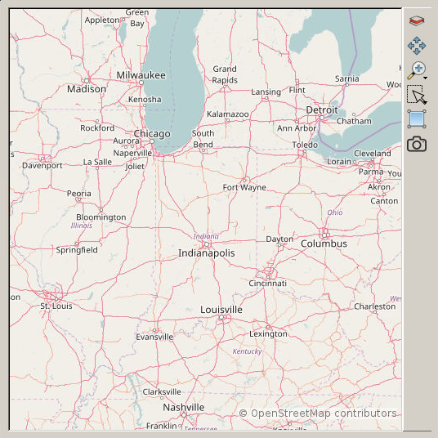
PyMapLib: Container Widget
# create a map container
c = gabbs.maps.MapContainer()
# configure the widget
c.setPaneControl(True)
c.setLayerControl(True)
c.setZoomControl(True)
…
# add container to application
layout.addWidget(c)
Python
PyMapLib API
QGIS
PyQt

Slide 33
PyMapLib: Adding Base Map
# create a base layer
m = gabbs.maps.Map(...)
# center the map on lat/lon
m.setCenter(-86,39)
# add the new
c.addLayer(m)
Python
PyMapLib API
QGIS
PyQt

Slide 34
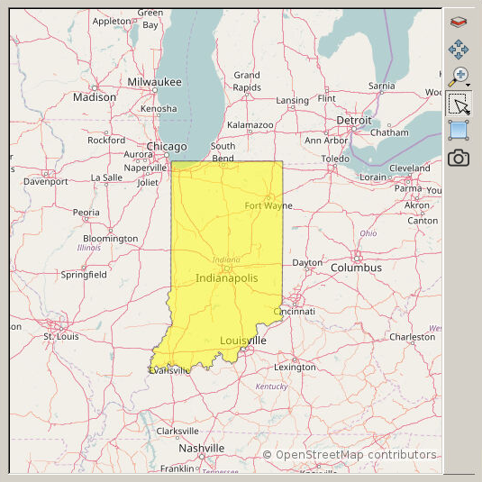
PyMapLib: Adding Shapefile
# create a vector layer
v = gabbs.maps.Vector(“state.shp”)
# set properties
vprops = {
“strokeColor” : “#00B6B6”
...
}
v.setLayerProperties(vprops)
c.addLayer(v)
Python
PyMapLib API
QGIS
PyQt

Slide 35
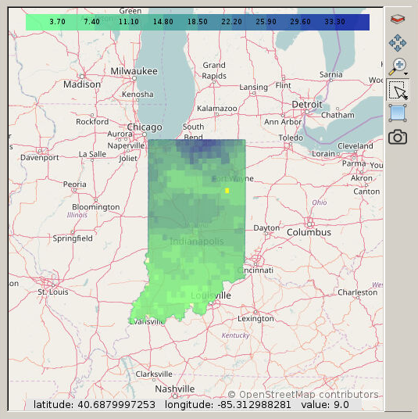
PyMapLib: Adding Data
# create a raster layer from tif
r = gabbs.maps.Raster(“LC8.tif”)
# set raster properties
r.setCustomStyle(“style.qml”)
r.setCustomScale([4,10])
c.addLayer(r)
Python
PyMapLib API
QGIS
PyQt

Slide 36
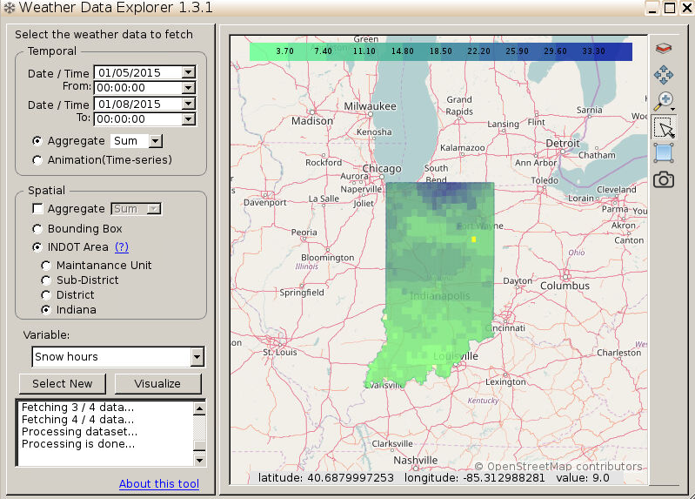
Example Application:
Weather Data Explorer

Slide 37
Example Application:
Weather Data Explorer
PyMapLib
Map
Widget

Slide 38
Geospacial Building Blocks
Rappture Toolkit
PyMapLib
Geospatial Output Widget
Render servers support
2D / 3D support
Rappture Applications
Tcl/Tk
Python Based
Generic Framework
2D Data support
Compatible with
C++ & Java user interfaces

Slide 40
Tool Containers
User's Web Browser
HUBzero Infrastructure
External Services
Web Server
Middleware
Grid
Submit
Proxy
Tool
Containers
OpenStreetMap
Visualization

