Slide 1

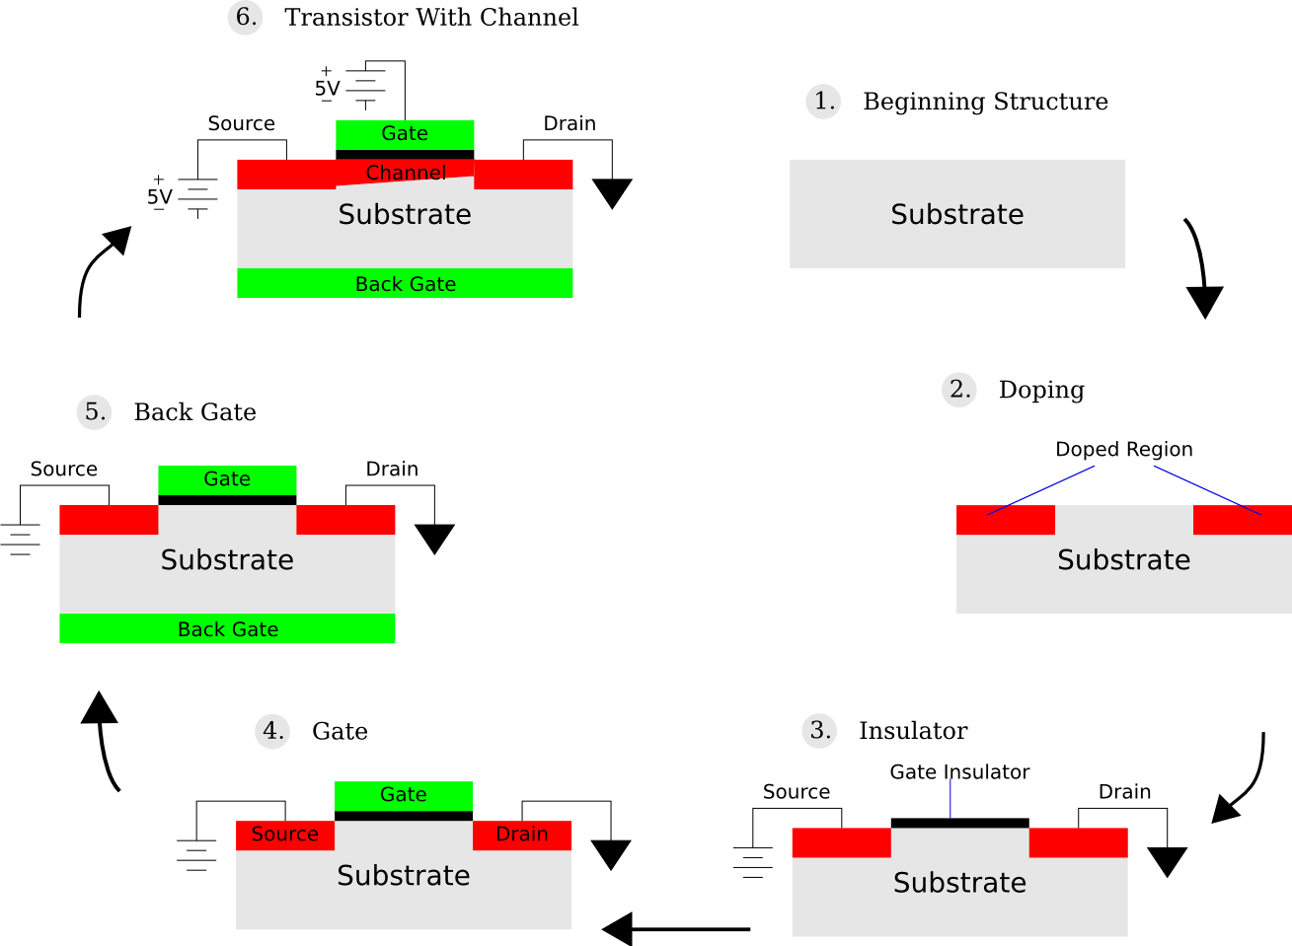

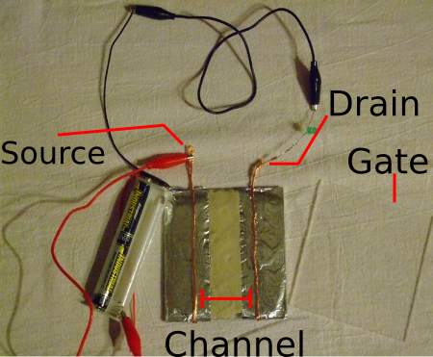
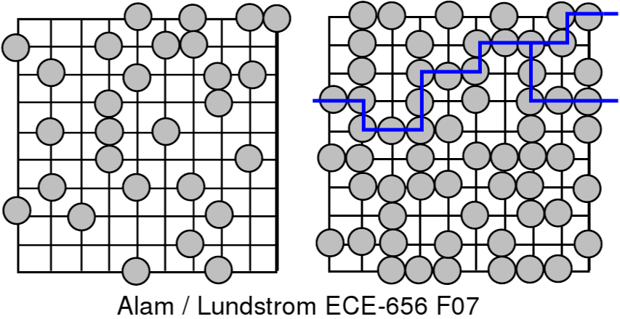
Transistor Basics
  Derrick Kearney
  Michael McLennan
  Abhijeet Paul
  Saumitra Mehrotra
  Network For Computational Nanotechnology
  Purdue University
  Hands On Future Tech
  Norfolk State University
  August 23, 2008

Slide 2
What is a Semiconductor?
  Electrical Conductor:
  Material which allows electrons to easily flow through it.

Slide 3
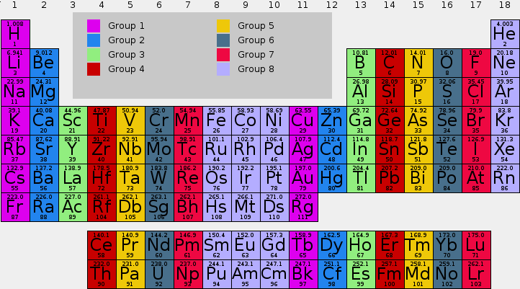
Semiconductors on the Periodic Table

Slide 4
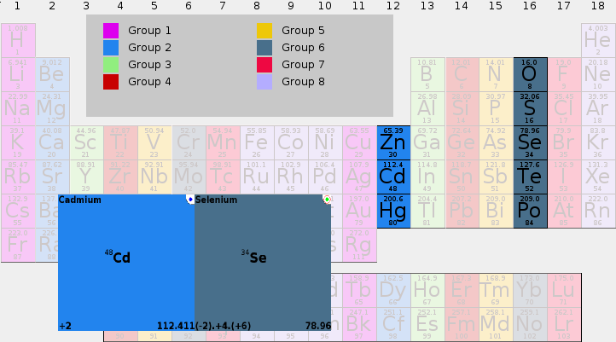
Groups II-VI Semiconductors
Cd
Se

Slide 5
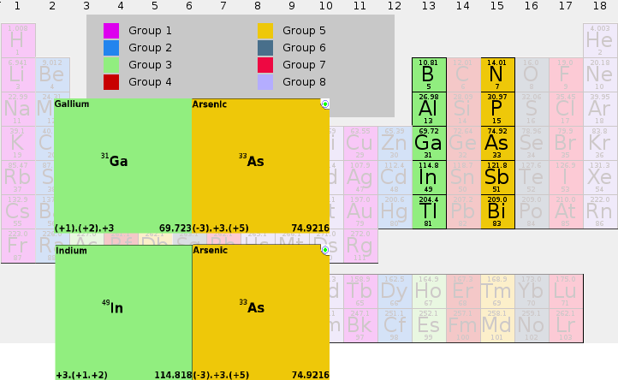
Groups III-V Semiconductors
Ga

Slide 6
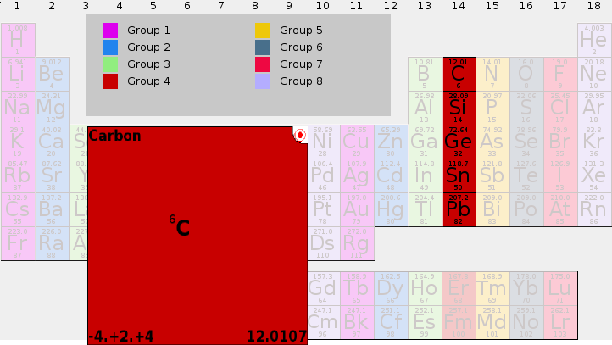
Group 4 Semiconductors

Slide 7
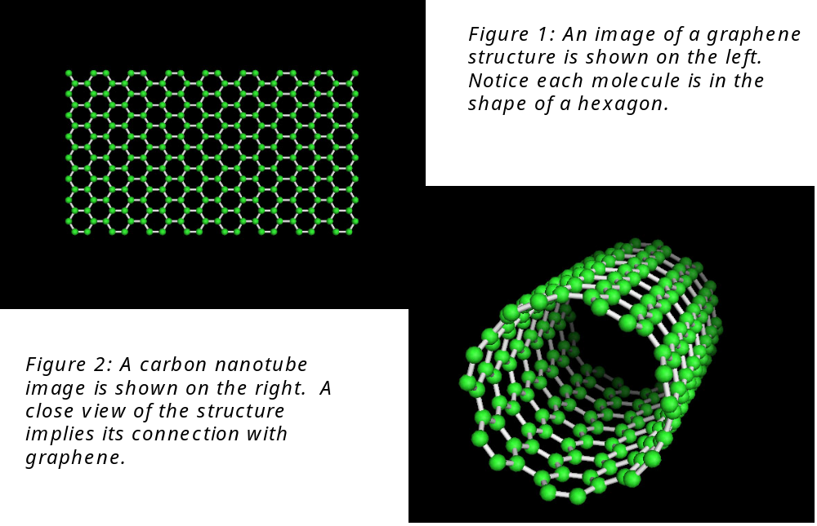
From Carbon to Carbon Nanotubes

Slide 8
Carbon Nanotubes on the Internet

Slide 9
Metallic vs. Semiconducting

Slide 10
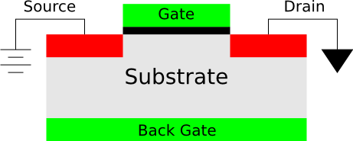
Basic Structure of Transistors
  Semiconducting CNT's can make good Transistors
  Transistors act as digital switches
  Transistors are basics of all Computers

Slide 11
Building a Transistor

Slide 12
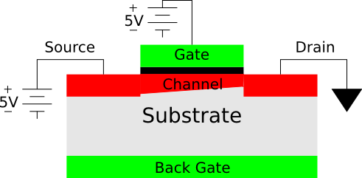
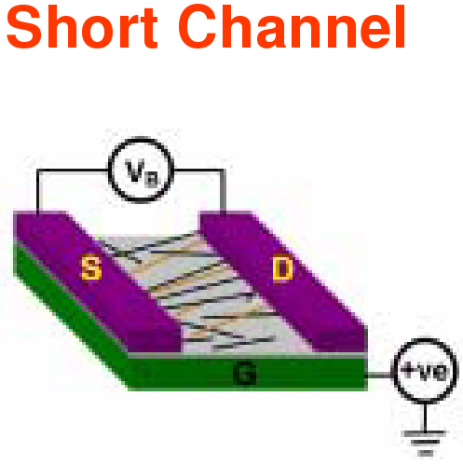
Building Pickup Stick
Thin-Film Transistors
Thin-Film Transistors (TFTs) Advantages
Lower Power, More Efficient Electronics
      Solar Cells
      Computer / TV Screens
Electronics on Plastics
      Light, Flexible E-Paper
      Biosensors

Slide 13
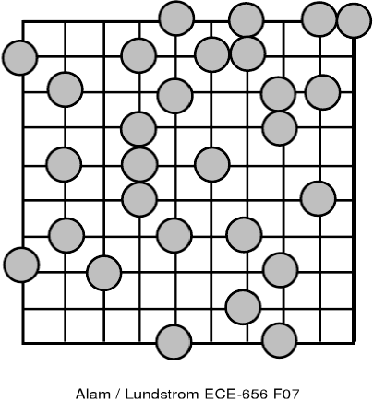
Percolation Theory makes
Nanowire TFTs work
Disk Percolation in Sparse System

Slide 14
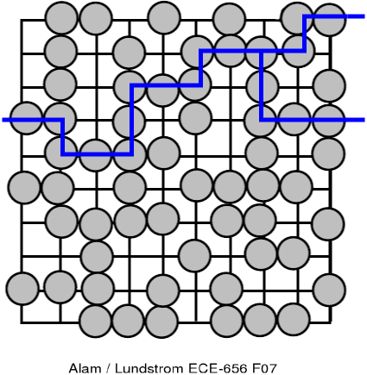
Percolation Theory makes
Nanowire TFTs work
Disk Percolation in Dense System

Slide 15
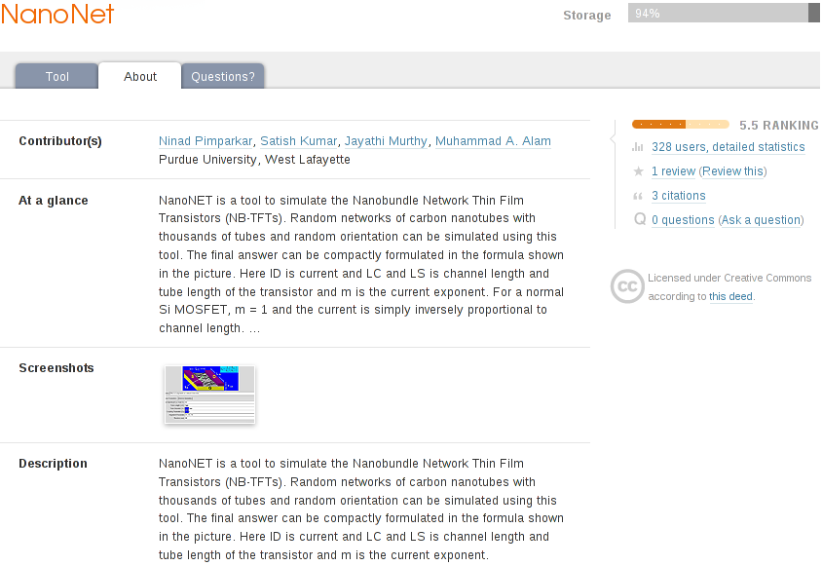
Carbon Nanotube Thin-Film Transistors on nanoHUB.org

Slide 16
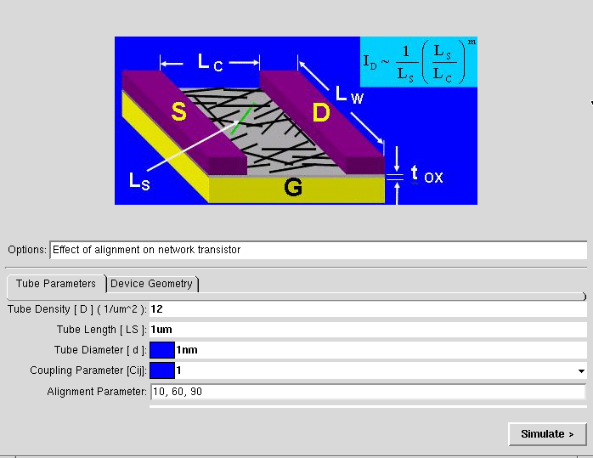
Carbon Nanotube Thin-Film Transistors on nanoHUB.org

Slide 17
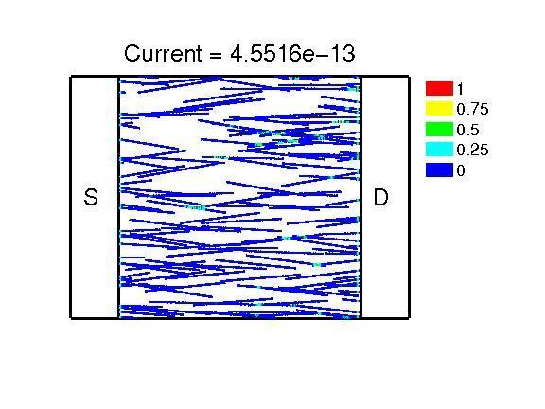
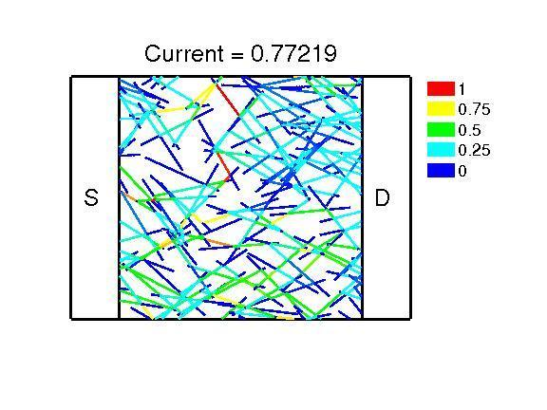
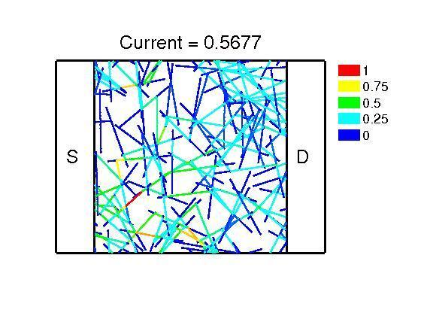
Carbon Nanotube Thin-Film Transistors on nanoHUB.org
Alignment = 10 Degrees 60 Degrees 90 Degrees

Slide 18
TFT Hands On Experiment
  Building a Thin-Film Transistor
  Components:
  2 x Acrylic Sheet (Gates)‏
  Putty (Substrate)‏
  Speaker Wire (Source/Drain)‏
  22 Ohm Resistor
  2 Volt Green LED
  2 AA Batteries
  Alligator Clips
  Pencil lead
    Goal: Use Percolation Theory to complete the transistor and the circuit.

Slide 19
Experiment Working
Experiment Setup
When the channel is just connecting the contacts (Source and Drain) the channel is not created & circuit is in OFF state and very small current will flow.
As we press on the pencil leads we create a channel and have a path for current to flow. This is ON state and can be observed by glowing LED.
This is the very basic concept of a working transistor in ON (closed circuit) and OFF (open circuit) state with a mechanical gate.

