Slide 1
HUBbub 2015
Tool Development Training
Sheraton Downtown, Indianapolis, In
Sept 15, 2015

Slide 2
Agenda
Tuesday, Sept 15
1:30pm - Using Simulation Workspaces
2:00pm - Introducing the Rappture Toolkit
2:30pm - What's Under the Hood?
3:00pm - Break
3:30pm - Simulations on the grid
with Submit and Pegasus
4:30pm - Uncertainty Quantification with Rappture
5:00pm - Questions / Wrap Up

Slide 3
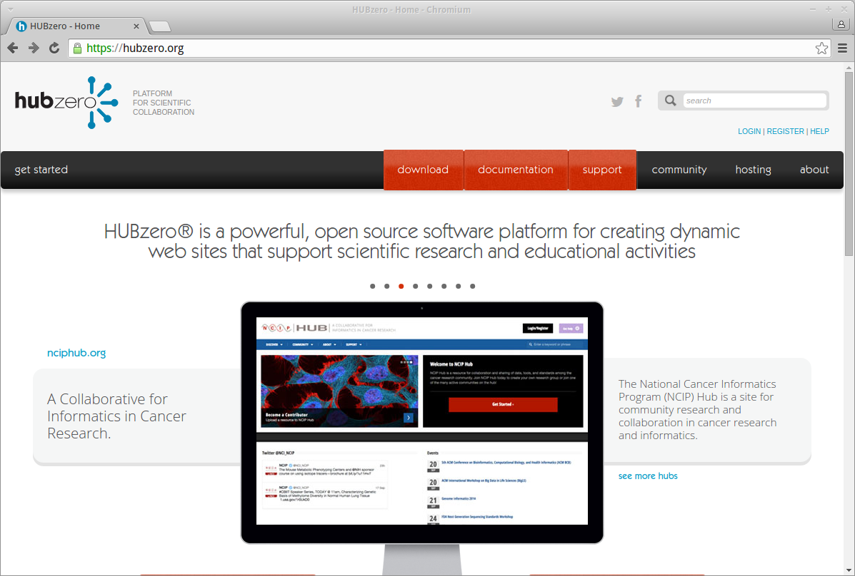
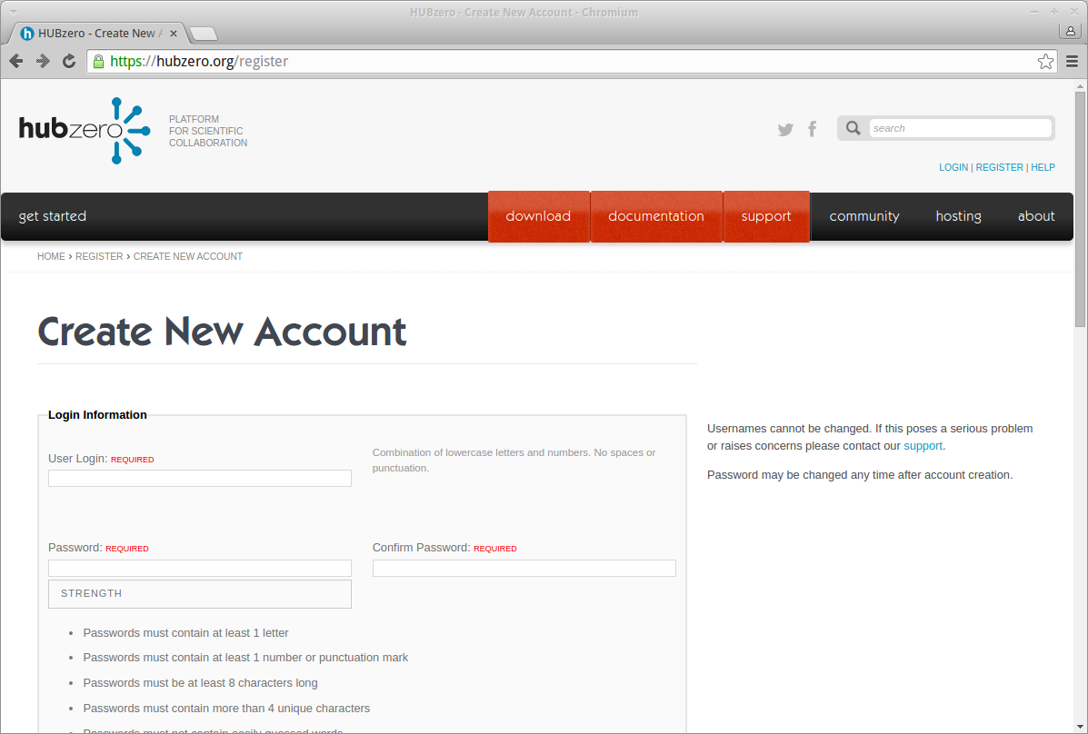
Warm-up: Register and Log In
Register
Create your hubzero.org
account and log in

