Slide 1
nanoHUB User's Conference 2015
Building and Publishing Simulation Tools
South Ballroom, Purdue Memorial Union, Purdue University
Sept 1, 2015

Slide 2
Agenda
Tuesday, Sept 1
1:30pm - nanoHUB Workspaces
2:00pm - Introducing the Rappture Toolkit
2:45pm - Break
3:15pm - Uploading and Publishing Tools
4:00pm - Using Subversion for Source Code Control
4:45pm – Questions / Wrap Up

Slide 3
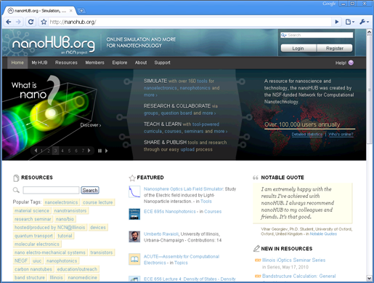
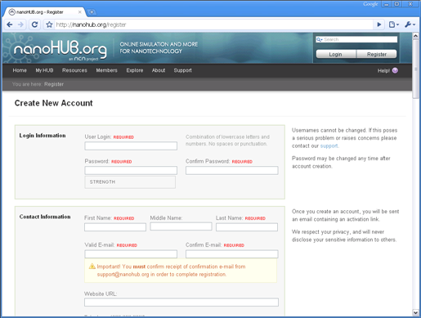
Warm-up: Register and Log In
Register
Create your nanoHUB.org
account and log in

