Slide 1
NCN Software Bootcamp

Slide 2
Agenda
Wednesday, May 31
9:00am - Using Simulation Workspaces
10:00am - Introducing the Rappture Toolkit
11:00am - What's Under the Hood?
12:00pm - Lunch
1:30pm – Intro to Jupyter Notebooks
2:30pm – Intro to MATLAB
3:30pm – Rappture and MATLAB

Slide 3
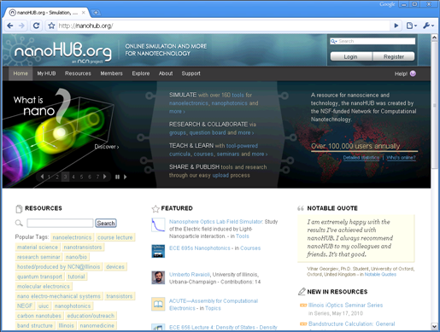
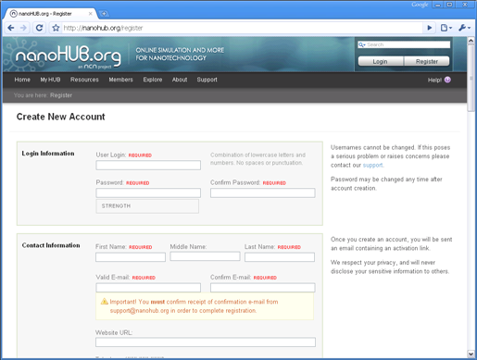
Warm-up: Register and Log In
https://nanohub.org/courses/tools/bootcamp2017
Register
Create your nanoHUB.org
account and log in

Slide 4
Agenda
Thursday, June 1
9:00am – More Rappture Objects
10:00am – Intro to Python
11:00am – Jupyter Tools
12:00pm - Lunch
1:30pm – Rappture and Python
2:30pm – Compiled Languages

Slide 5
Agenda
Friday, June 2
9:00am – Review of C
10:00am – Uploading Tools
11:00am – Subversion
12:00pm - Lunch
1:30pm – Submit
2:30pm – UQ

